Slide 1
Panel 1: “Legacy” Working Groups
Education
Health
Agriculture and Rural Development
Scaling in Fragile States
Monitoring & Evaluation
Nitika Tolani, MSI
Moderator: Laura Ghiron, ExpandNet
Lennart Woltering, CGIAR
Jonathan Papoulidis, World Vision
Larry Cooley, MSI

Slide 2
Education WG:
Accomplishments & Lessons Learned
2019 activities included 2 webinars
Supporting, learning, and documenting scaling efforts
  Center for Universal Education/Brookings, STIR, ExpandNet
Varying degrees of partnership and engagement with governments on journey to scale
  Room to Read, JPAL, TEP Center
  India, Zambia, Vietnam and Nigeria
For webinar recordings and resources contact: Ntolani@msi-inc.com and Natalie.Colangelo@msi-inc.com

Slide 3
Health Working Group
  Accomplishments:
  Expert presentations/discussion of “state of the field” thinking on adaptation, sustainability and country and government ownership
  Recognition of importance of looking beyond the fields of scale up and health, such as to implementation science and organization sciences
  Held four in-person meetings with some LMIC member participation
  CoP Resource Team provided safe venue to hash through thorny scale-up issues and reach conclusions

Slide 4

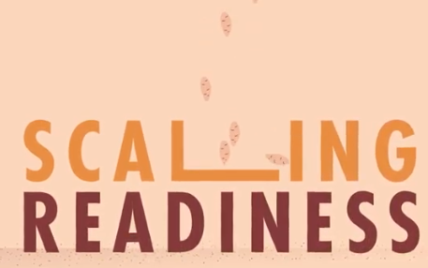
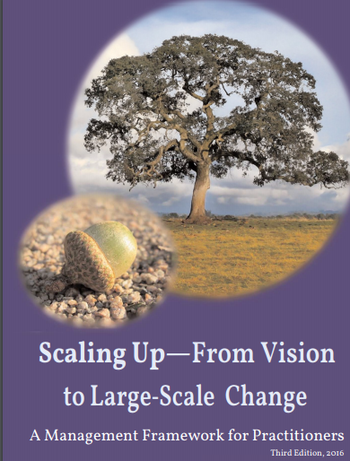
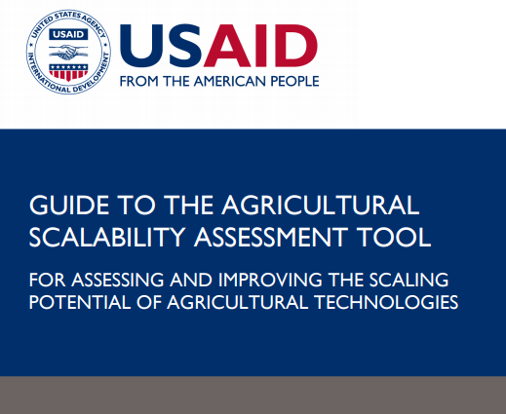
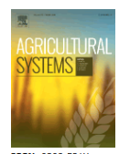


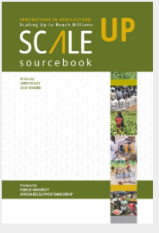
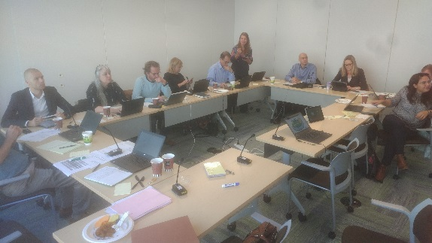
Agriculture and Rural Development
ARD WG meetings:
July ‘18,
Feb ’19
Sep ‘19
2018 CoP meeting about scaling frameworks
- Lots of interest, innovative uses, new frameworks coming up
Spin off_ CGIAR Scaling meeting

Slide 5
Scaling-Up in Fragile States Working Group
Lessons & Accomplishments
Group defined its scope of work/interests:
scaling-up to bridge humanitarian and development interventions
Identifying obstacles to scaling in fragile states and how they have been overcome, or when scaling should not have been attempted (possibly through case studies).
promoting adaptive, resilient and politically-smart methods for scaling
examining ways to strengthen country institutions and mobilize private sector finance for sustainable scaling in a range of fragile contexts.
Socialized paper (Tipping the Scales) on scaling up in fragile states
Webinar and upcoming learning event on scaling in South Sudan
Presentations at UN Global Solutions Summit African Development Bank Resilience Forum
Need to experiment with different forms of WG communication/feedback + angle group as a sounding board for WG member + dev community scaling initiatives
Notes:
Challenges
Contextual
Major disruptions to scaling from shocks and stress (conflict, social and political exclusion, disaster, pandemics, rapid urbanization, debt crisis)
major scaling pathways (governments, markets) often compromised
Aid ineffectiveness
Overemphasis on innovation and pilots as “things to scale”, not fostering a scaling ecosystem for development outcomes that can continually incorporate new innovations and tailor interventions to urban, rural, risk-prone contexts
Programming silos (humanitarian, development, resilience, peace)
ODA is project focused and uncoordinated, undermining joint financing, risk sharing and systems strengthening for scaling
Lessons
To address fragility
Scaling resilience to shocks and stress is critical in fragile states & also key for the humanitarian, peace, development “nexus”—requires political settlements analysis + political economic understanding of complex risks
Scaling requires social capital, and social capital requires scaling to achieve resilience and development outcomes
Scaling is often considered a static exercise of financing and replication, when it has the potential to be highly adaptive because it can generate variation, selection and niche development/coordination around what works in highly complex contexts.
Country platforms and portfolio approaches have potential to solve collective action problems in more adaptive/experimental ways than singular projects or even programs.

Slide 6
M&E Working Group – Accomplishments
Membership in working group more than doubled to over 100
Agreement on a 3-tier framework for M&E of scaling and budgeting guideline for M&E of pilot projects
3 virtual meetings, each with over 40 attendees, focused on dissemination of tools and examples of tier 2 and tier 3 M&E
Significant cross-over learning with other working groups, especially health and education

Slide 7
Education WG:
Challenges & Lessons Learned
Consistency of WG engagement is a challenge
Aligning WG interests with available resources
Online survey (July 2019) suggest several areas of interest:
  Meetups with peers at regional and national conferences (UKFIET, CIES, GYEOS, eLearning Africa)
  Collaborate on USAID Education and Youth learning agendas
  Produce + publish ‘call to scale’ in major education journal
  Opportunities to share on topics of interest (i.e. government ownership and role of education systems)

Slide 8
Health Working Group
  Lessons:
  Tremendous value in learning exchange with others engaged in scale-up work
  Increasing attention to scale up with many “talking the talk” now, but few “walking the walk”
  For some critical recurring scale-up issues - like adaptation, sustainability and country ownership – we are gaining consensus around how best to proceed
  Challenges:
  Primary focus of many participants is family planning & reproductive health
  Limited involvement of country participants/insufficient engagement with larger virtual CoP membership
  Need to transition leadership from the USAID-funded Evidence to Action (E2A) Project to another organization

Slide 9
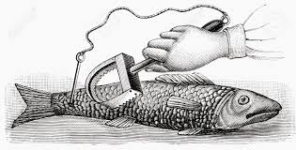
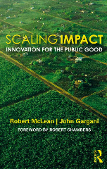
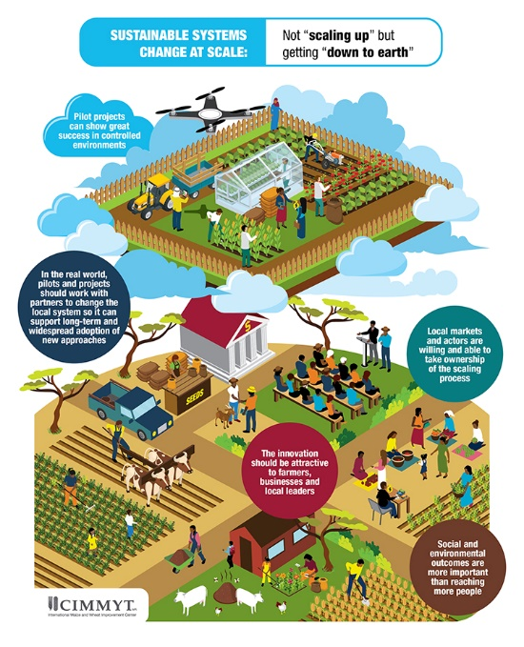


Agriculture and Rural Development
Shared understanding about what scaling means
Scaling paradigms: “more” vs “sustainable systems change”
Tension:
Scaling packages of innovations vs
Who scales?! Fit for scale?
Increase is use of “softer” methods- advocacy, “creating a movement”

Slide 10
Scaling-Up in Fragile States Working Group
Challenges & Failures:
Challenges to adaptive management
Social capital remains a difficult concept for donors
Coordination is easier to conceptualize than to manage
Frequent reversals; emergencies trump everything
Notes:
Challenges
Contextual
Major disruptions to scaling from shocks and stress (conflict, social and political exclusion, disaster, pandemics, rapid urbanization, debt crisis)
major scaling pathways (governments, markets) often compromised
Aid ineffectiveness
Overemphasis on innovation and pilots as “things to scale”, not fostering a scaling ecosystem for development outcomes that can continually incorporate new innovations and tailor interventions to urban, rural, risk-prone contexts
Programming silos (humanitarian, development, resilience, peace)
ODA is project focused and uncoordinated, undermining joint financing, risk sharing and systems strengthening for scaling
Lessons
To address fragility
Scaling resilience to shocks and stress is critical in fragile states & also key for the humanitarian, peace, development “nexus”—requires political settlements analysis + political economic understanding of complex risks
Scaling requires social capital, and social capital requires scaling to achieve resilience and development outcomes
Scaling is often considered a static exercise of financing and replication, when it has the potential to be highly adaptive because it can generate variation, selection and niche development/coordination around what works in highly complex contexts.
Country platforms and portfolio approaches have potential to solve collective action problems in more adaptive/experimental ways than singular projects or even programs.

Slide 11
M&E Working Group – Lessons/Challenges
Limitations on availability of real-time information and barriers to adaptive management limit current use of M&E for evidence-based decision-making
Need for more guidance or experience in negotiating the trade-off between fidelity and adaptation
More effective transfer of M&E to host governments and other “doers at scale”
Ways to track and report on systemic changes and indirect beneficiaries

Slide 12
Panel 1: “Legacy” Working Groups
Education
Health
Agriculture and Rural Development
Scaling in Fragile States
Monitoring & Evaluation
Nitika Tolani, MSI
Moderator: Laura Ghiron, ExpandNet
Lennart Woltering, CGIAR
Jonathan Papoulidis, World Vision
Larry Cooley, MSI

