Slide 1
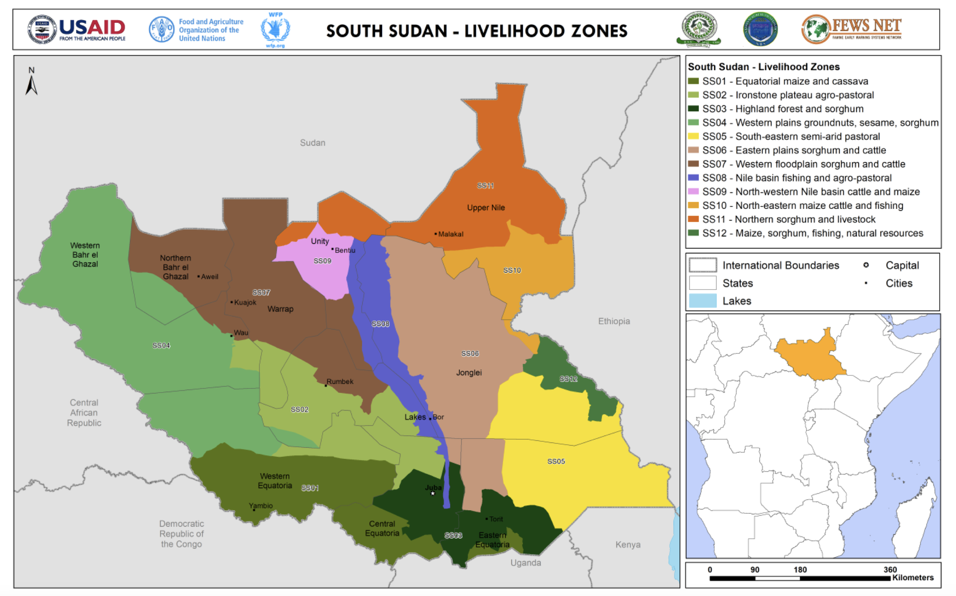

Slide 2
South Sudan climate resilience innovation: a ‘basket of opportunities’
Challenge: Single sources of income from agricultural practices are vulnerable to climate and security shocks
Opportunity: Diversify income sources at household level to be better able to withstand shocks and raise additional income
Vision: Create a range of additional agricultural income-generating opportunities that households can adopt.
Complete solution: All the parts needed for success, relevant to context
Lightweight: Easy to adopt, low-risk
Notes:
Already said it’s not about supplanting one element (the core product) with another in the same system. The innovation required consideration as the whole system that the innovation needed to be a success. It required seeing the complexity.
Complex Challenge: NFI & food aid demonstrating low impact and undignified, disempowering aid experience. Organisational and practitioner competencies, systems/processes, funding were firmly oriented around this model.
After a few successful pilots that proved the ‘case’ for the effectiveness of cash aid, the work has been enormous to then build out the complete solution which enables it to be successful at scale.

Slide 3
“A Basket of Opportunities” Building resilience through supporting households to select and adopt light-weight ways of generating additional income and foods, with a whole value-chain package
Okra
Honey
Smoked Fish
Smoked Fish
Value-Chain Integrated Package
Training & knowledge
Required equipment / inputs
Connection to others/peers
Branding support
Connection to market
Lightweight
Tested / Effective
Community-Led

Slide 4
“A Basket of Opportunities”: Building resilience through supporting households to select and adopt light-weight ways of generating additional income and foods, with a whole value-chain package
Okra
Honey
Smoked Fish
Common elements that are ‘building blocks’ and can be adapted and reused for each intervention
Market pricing information system
Transportation & storage service
Training service & resources
Branding support & advice

Slide 5
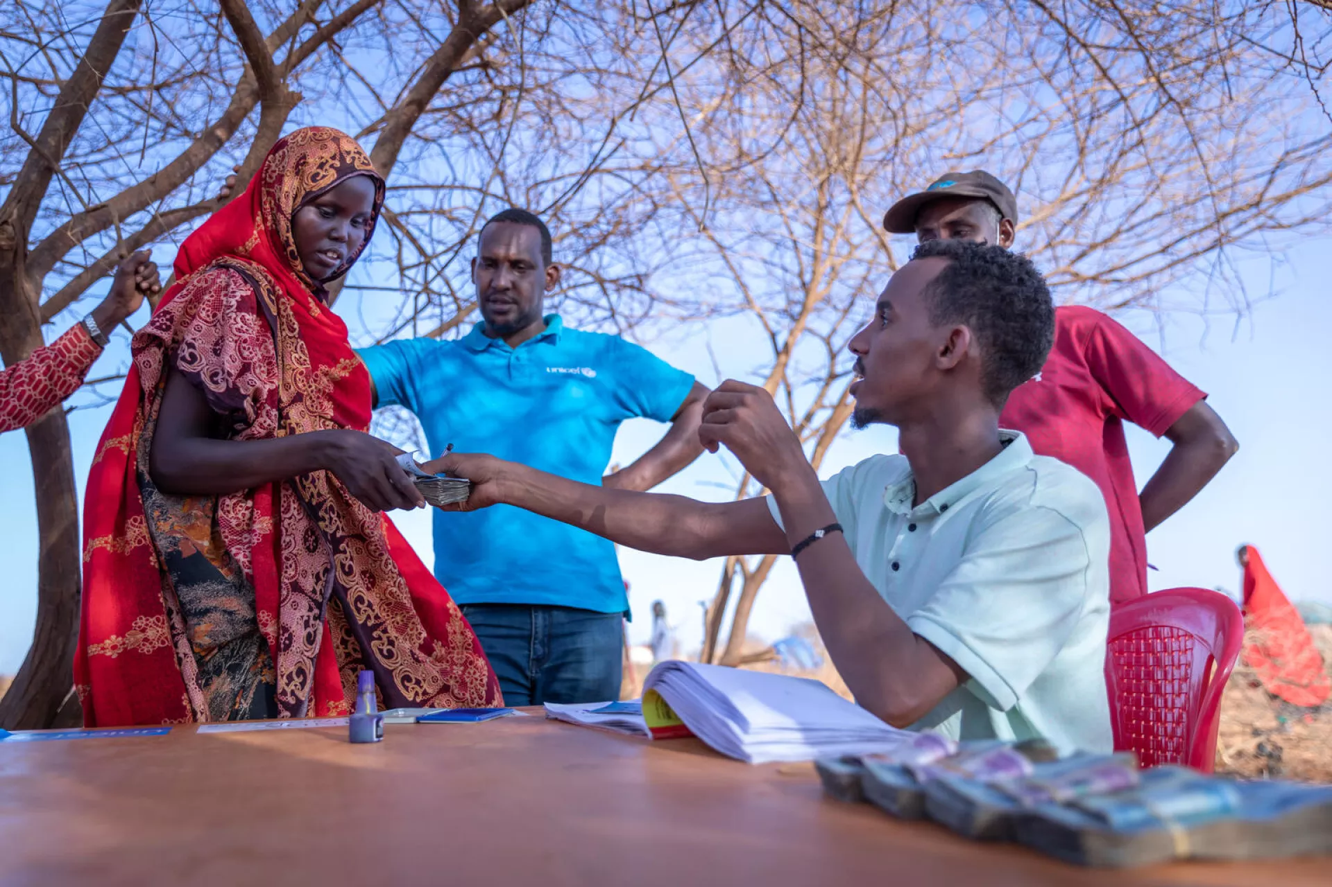
HUMANITARIAN CASH AID
Credit: UNICEF

Slide 6
Innovation across humanitarian aid supply chains only offers so much
PACKAGED FUNDING & STRATEGY
PLANNED LOGISTICS
DELIVER THE LAST MILE
Incrementally Improve a System
Meeting obvious needs
Efficient high-scale delivery
Easy to replicate roles
But Then We Hit a Wall ...
Low-impact (targeting, appropriateness)
Eroded dignity and agency
Undermine local markets
Limited impact of digital technology
Notes:
Thinking about one of most significant innovations in humanitarian space in recent years, is cash aid.
And if we thought about only as an innovation at in the old innovation journey, we would be swapping out the core product in the aid system. But, this has actually been about a new ecosystem.

Slide 7
Cash aid as an innovation presents a powerful impact
How to scale the impact of aid through cash aid for crisis-affected communities?
…. But also demands a different system
Notes:
Already said it’s not about supplanting one element (the core product) with another in the same system. The innovation required consideration as the whole system that the innovation needed to be a success. It required seeing the complexity.
Complex Challenge: NFI & food aid demonstrating low impact and undignified, disempowering aid experience. Organisational and practitioner competencies, systems/processes, funding were firmly oriented around this model.
After a few successful pilots that proved the ‘case’ for the effectiveness of cash aid, the work has been enormous to then build out the complete solution which enables it to be successful at scale.

Slide 8
A more powerful ‘Cash Aid’ system
(and more complex)
LOCAL MARKETS
EMPOWERED CHOICES
FUND MULTIPLE NEEDS
DIGITAL AND CASH LAST MILE
PRIVATE SECTOR + AID ACTORS
Not an Incremental Change
New actors (financial services)
New governance/coordination (Cash WGs)
New skills demand (Contracting with PS)
New capabilities
... Nor an Overnight Revolution
New barriers (digital inclusion, interoperability)
Systems/actors to integrate (social protection systems, local NGOs)
Formal ‘governance’ challenges (clusters, UN)
Notes:
We used to think about optimizing supply chains - Now we think about an entirely new ecosystem – cash aid
Complex Ecosystem Solution: Cash required a complete solution: Markets, new actors (local actors, financial services, mobile technology/network providers), new sets of processes (fewer warehouses and supply pipelines, more contracting with private sector), new models of coordination amongst actors (e.g. cash consortia for operations and cash working groups), different skills and practices / policies (birth of CashCap, CaLP etc.)...
The Power to Deliver Real Impact: A new narrative backed by evidence - cash as highly impactful and more dignified, less risky than perceived, a more dynamic and innovative aid model that could adapt to contexts more appropriately, include private sector more directly, utilise digital technological advancements.
Complex Innovations Are Not Overnight Revolutions: Ongoing challenging learning (e.g. how to address coordination in a system focused around sectors not modalities of aid? How to create interoperability between actors to increase collaboration and inclusivity of local actors?), building of new capabilities (to match varied and evolving ‘last mile’ innovations…. physical cash, bank cards, vouchers, direct support to markets, mobile phone cash transfers, biometrically enabled transfers….), ongoing barriers (connectedness of cash aid with social protection systems, legislative / political issues).
Changed the system

Slide 10
In every different context, the cash aid system needs to be adapted
Core elements of the cash aid system:
Funding (different sources)
Disbursement solution (mobile payment, smart cards, vouchers, cash, banks)
Technology (data management, analysis)
Community engagement (sensitization, feedback…)
Role of the state
Coordination (cash working groups, govt. led coordination)
Integration with existing systems (e.g. social protection)
Needs (targeting different priorities)

