Slide 1
Beyond the hopeless laundry list
Are there core underlying issues?
Lady Gaga singing “Bad Romance”
Dan McClure 2025
Notes:
https://commons.wikimedia.org/wiki/File:Lady_Gaga_Bad_Romance_JWT,_2017-11-03.jpg

Slide 2
Let’s go back to 2010
(and the mass adoption of Silicon Valley Fail Fast Pilots)
Lady Gaga singing “Bad Romance”
Notes:
https://commons.wikimedia.org/wiki/File:Lady_Gaga_Bad_Romance_JWT,_2017-11-03.jpg

Slide 3
Single User
A Focused “Silicon Valley” Pilot

Slide 4
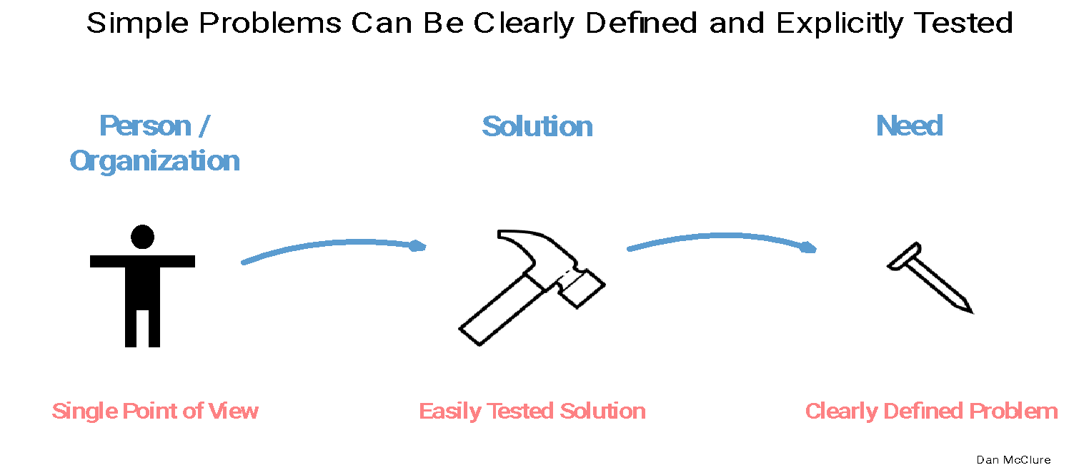
Single User – Well Defined Problem
A Focused “Silicon Valley” Pilot

Slide 5
Single User – Well Defined Problem – Bounded Solution
A Focused “Silicon Valley” Pilot

Slide 6
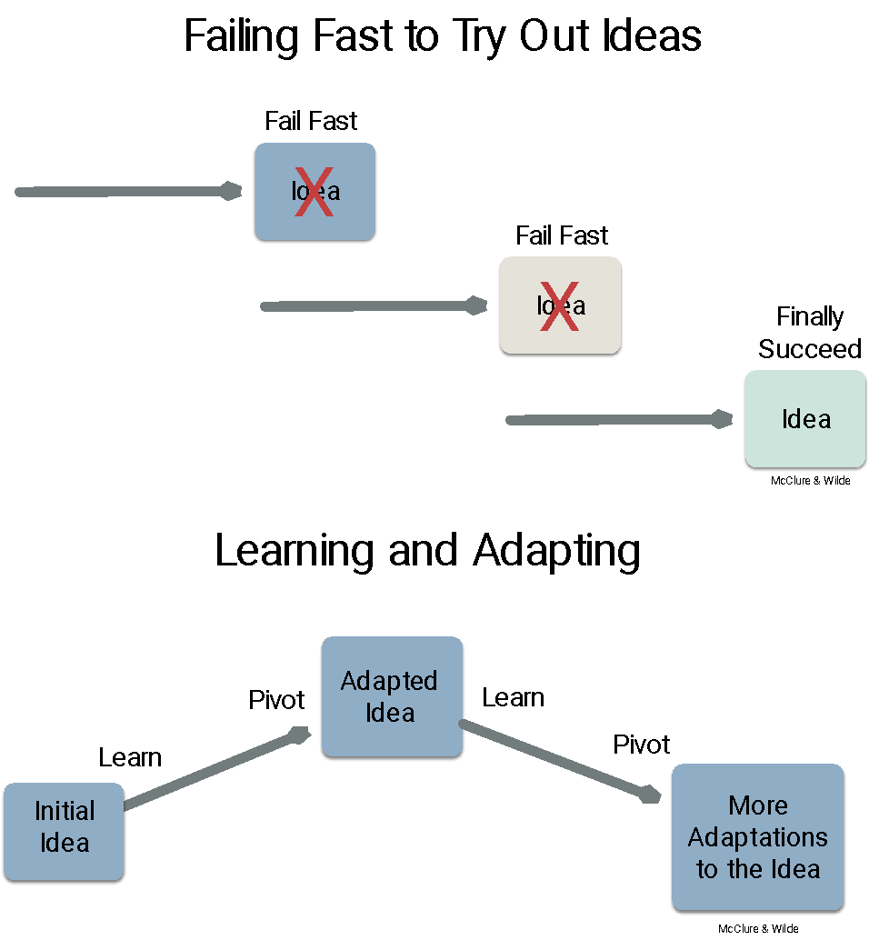
Bounded Pilots Have Advantages
Rapid Learning
Opportunity to Adapt
Small Budgets
Short Time Frames
Easily Measured Results

Slide 7
Can’t
Silicon Valley style pilots didn’t work
X
Low resource communities – development
Areas hit by crisis or conflict – humanitarian action
Brand new systems - new markets / big problems
Lady Gaga singing “Bad Romance”
Notes:
https://commons.wikimedia.org/wiki/File:Lady_Gaga_Bad_Romance_JWT,_2017-11-03.jpg

Slide 8
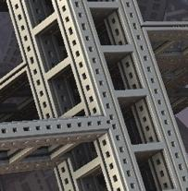
Arbitrary Simplicity
‹#›
Notes:
Pixabay - complexity

Slide 9
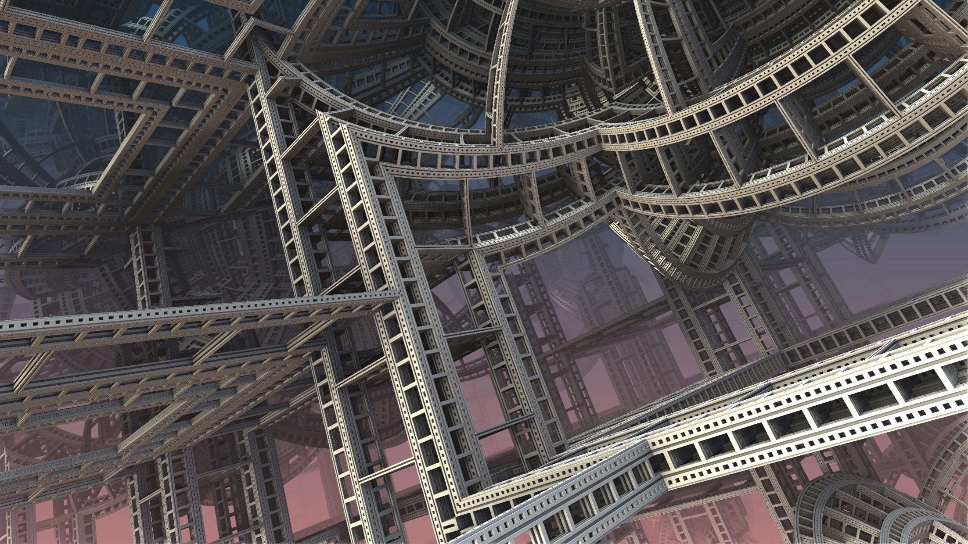
Doesn’t Erase Complexity
‹#›
Notes:
Pixabay - complexity

Slide 10
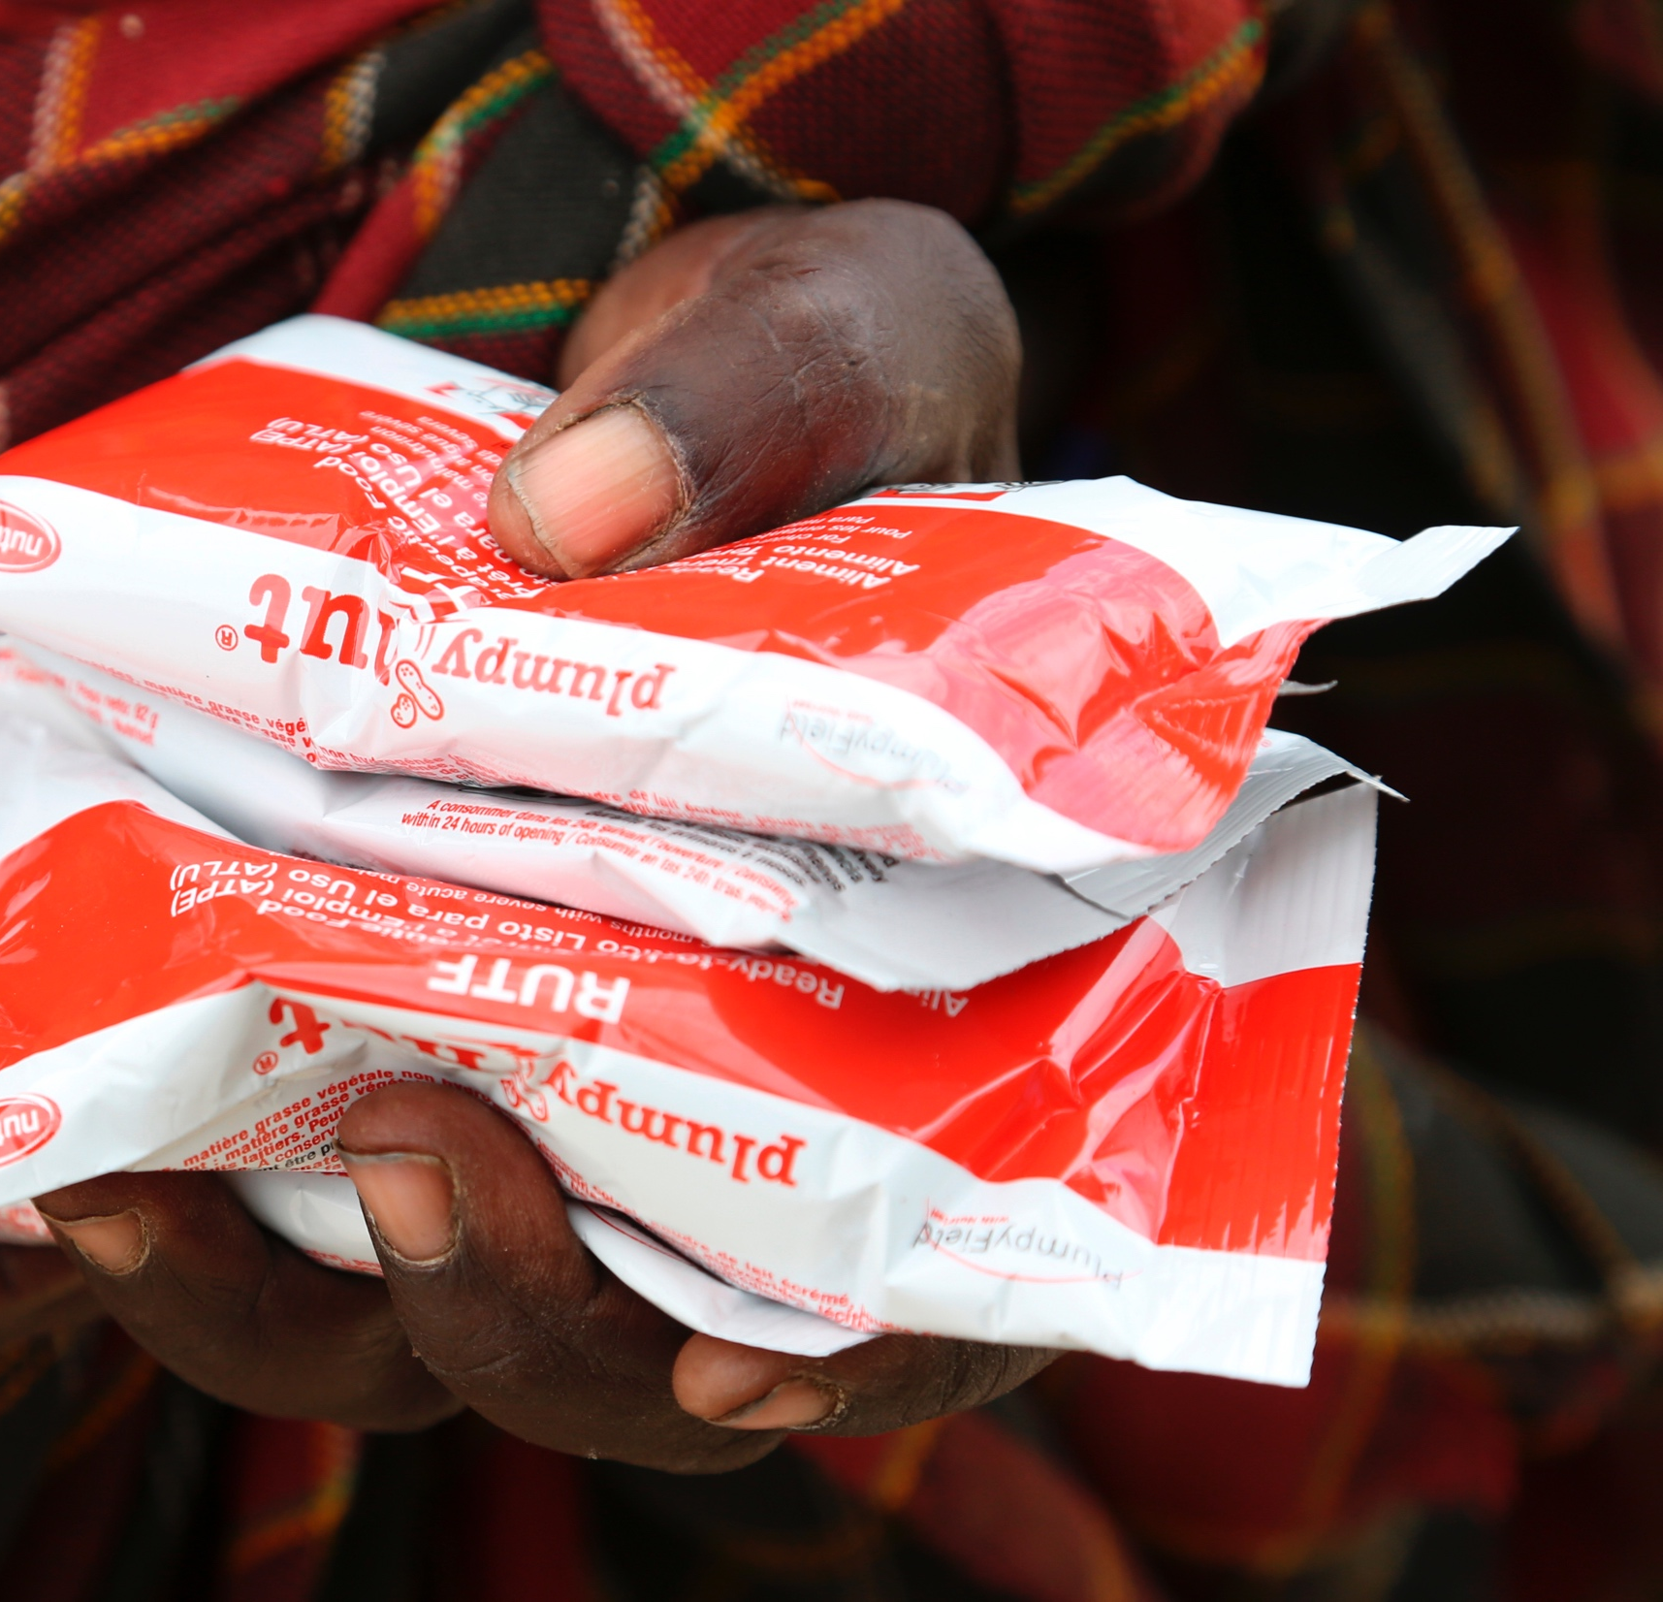
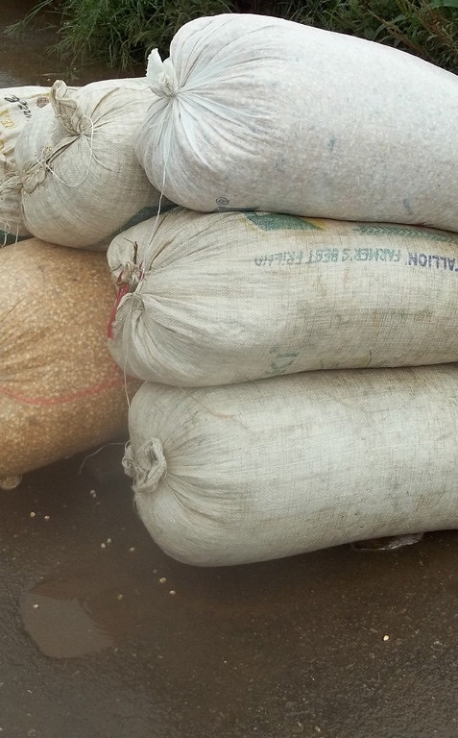
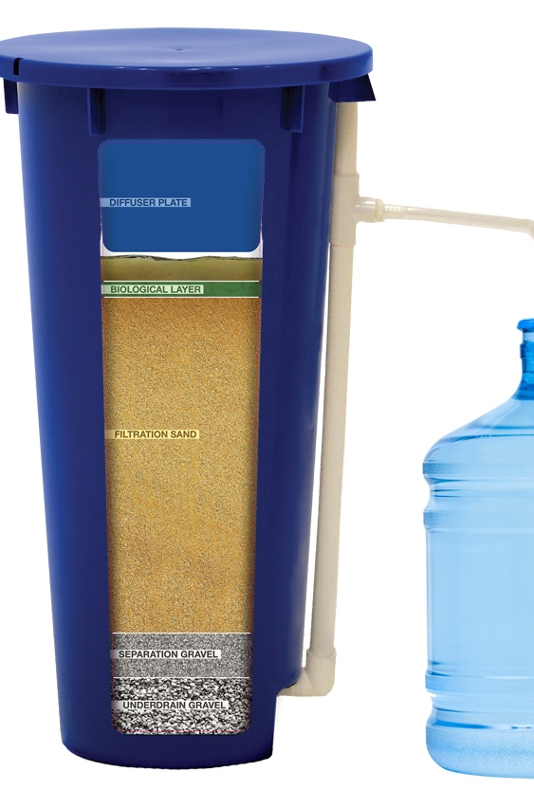
1
They don’t work - In complex low resource / pioneering environments even simple innovations need supporting systems
Commodity Products
Technology
Products
Low Tech
Notes:
https://www.flickr.com/photos/iita-media-library/10066384395

Slide 11
2
They don’t matter - Something simple enough to work
Is too small to deliver impact

Slide 12
3
We Expect More – Innovation design is increasingly held to higher standards
Localization – Community leadership and engagement
Shared Rewards – Everyone gets a pony
Equitable / Accessible – Everyone participates
Avoid Harm – Address risks (e.g. data privacy)
Integration – Woven into local systems

Slide 13
What are innovative organizations doing?

Slide 14
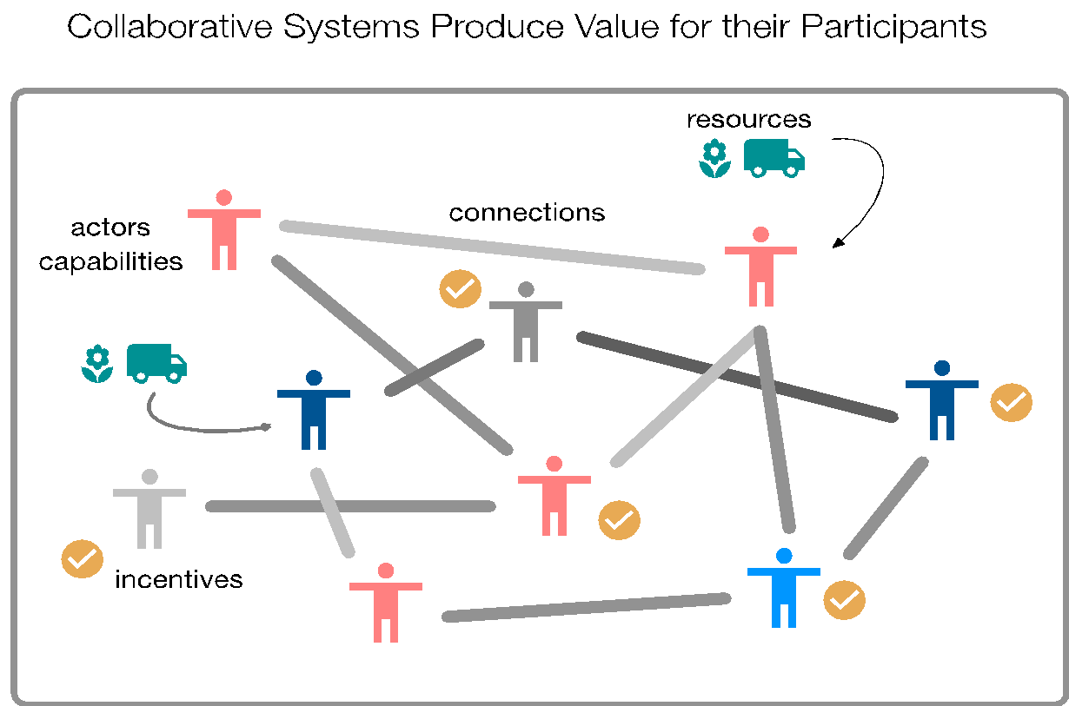
“The Innovation is a System”
Lots of “moving parts”
People, tech, resources
Everything works together
Sum bigger than its parts
Incomplete knowledge
Ongoing change
Notes:
Will there be sustained support from the people who are needed?

Slide 15
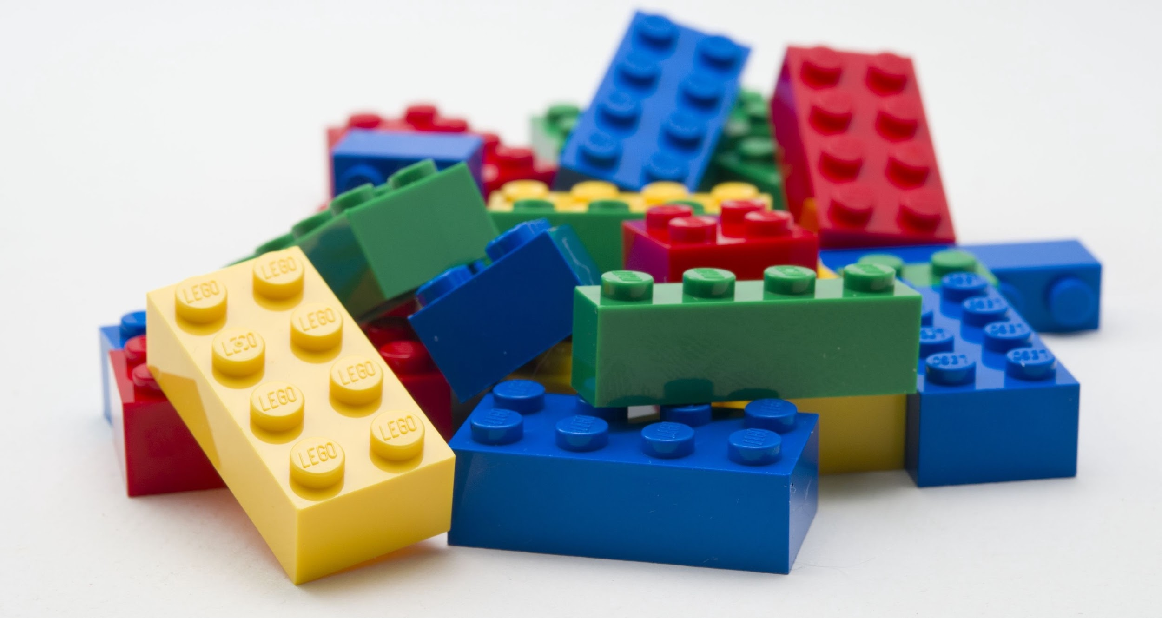
Creatively Assemble Real World “Lego” Blocks
People
Organizations
Technology
Resources
Data
Notes:
Will there be sustained support from the people who are needed?

Slide 16
Multiple actors participate
Notes:
Collaboration is key to all CE solutions – multiple parts in play, often undertaken by different stakeholders. Let’s look at an example

Slide 17
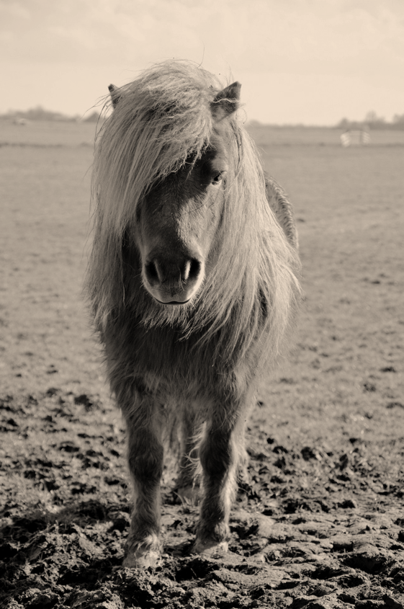
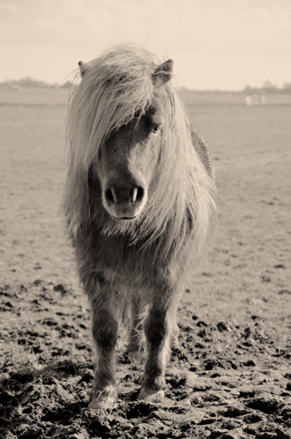
Everyone gets a pony
Notes:
http://www.publicdomainpictures.net/pictures/80000/velka/a-pony-1393433833jWp.jpg
It’s not only about connecting things is is about motivating all the people in the system to do what the solution needs them to do…
You need to know what they want – its not just what you think they want, its what they actually want. You can be testing this… person level…. Organisational level…

Slide 18
Haiti WFP Cook Bags from Recycled Materials
Haiti

Slide 19
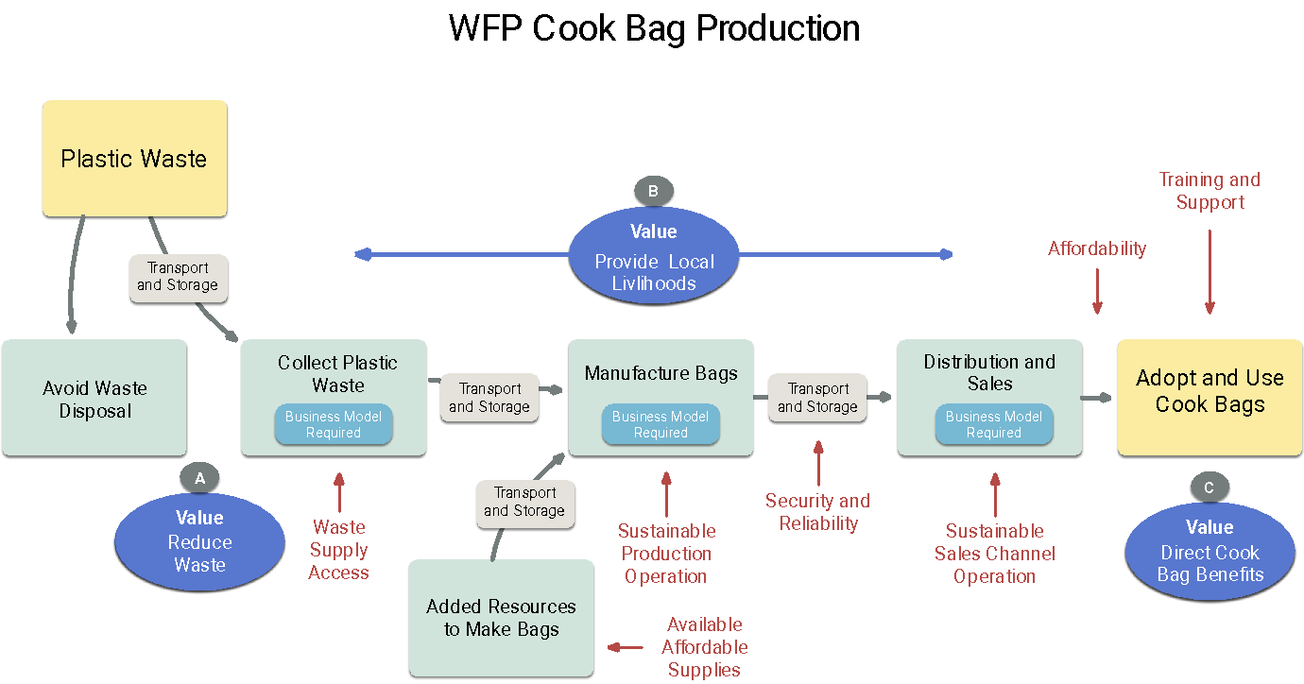

Slide 20
Funders
Clean Cooking Alliance
WFP
Transport provider
Cooks
(product users)
Waste collectors & sorters
Plastic processor
Manufacturer
Trainers
Material supplier

Slide 21
The Innovation is a System
(Investors / grant makers are creating portfolios
of these sophisticated powerful innovations)
Notes:
https://commons.wikimedia.org/wiki/File:Lady_Gaga_Bad_Romance_JWT,_2017-11-03.jpg

Slide 22
Strategy Shift 1
Begin with a Big Picture View of the Challenge

Slide 23
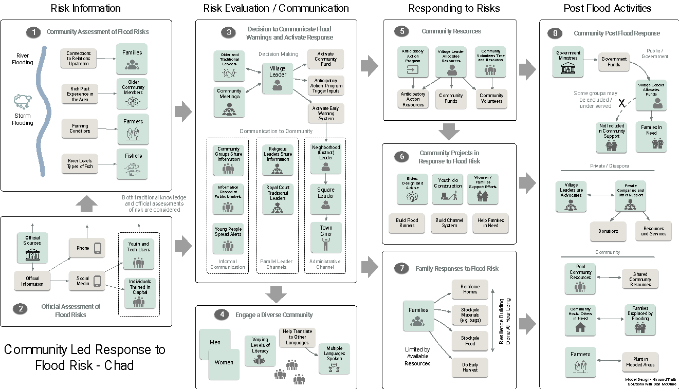
Step back and see the whole challenge – understand a complex problem

Slide 24
Strategy Shift 2
Start with the System
(complete view of the destination)

Slide 25
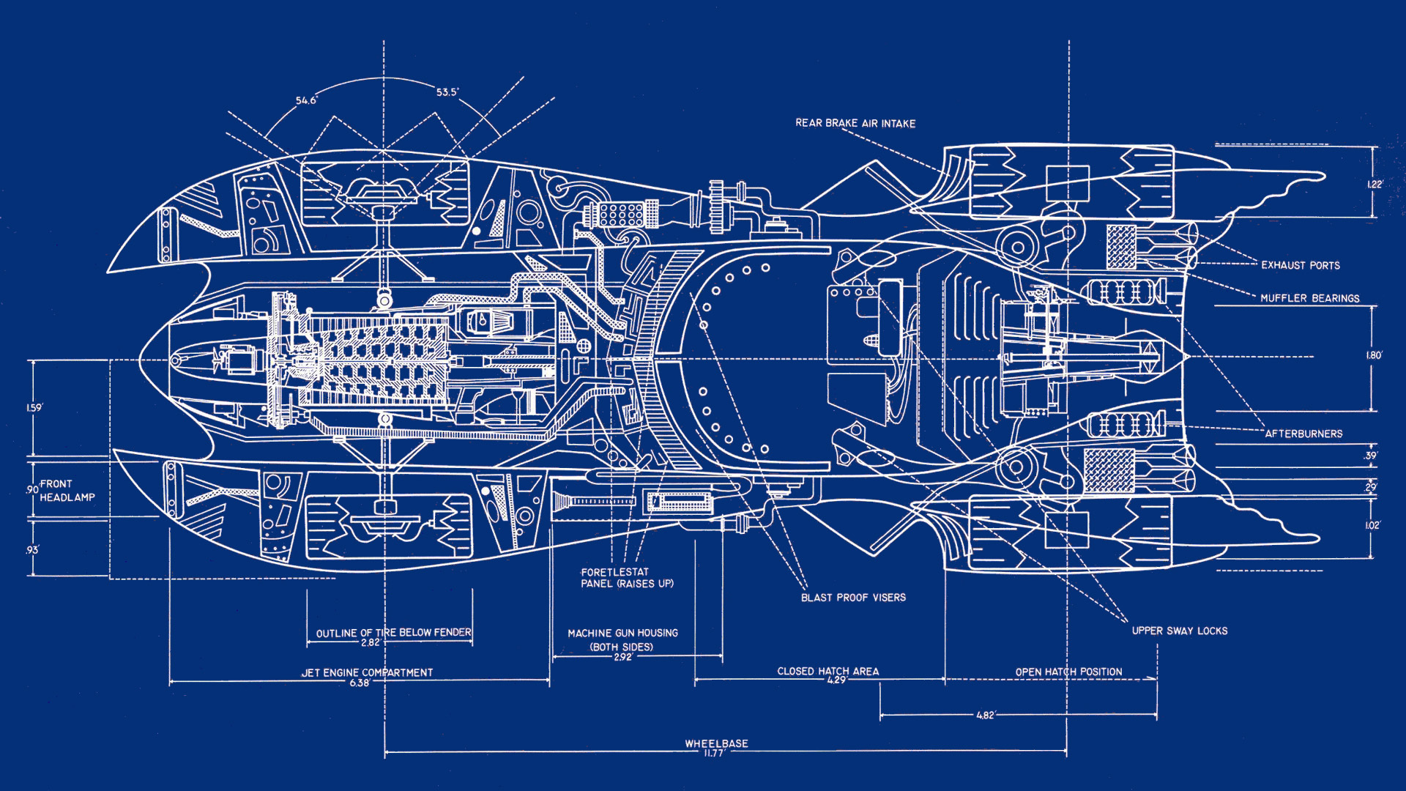
Think of BLUEPRINTS ... They show all the parts and how they fit together
Notes:
https://www.goodfon.com/fantasy/wallpaper-download-1920x1080-batmobile-batman-schematic.html

Slide 26
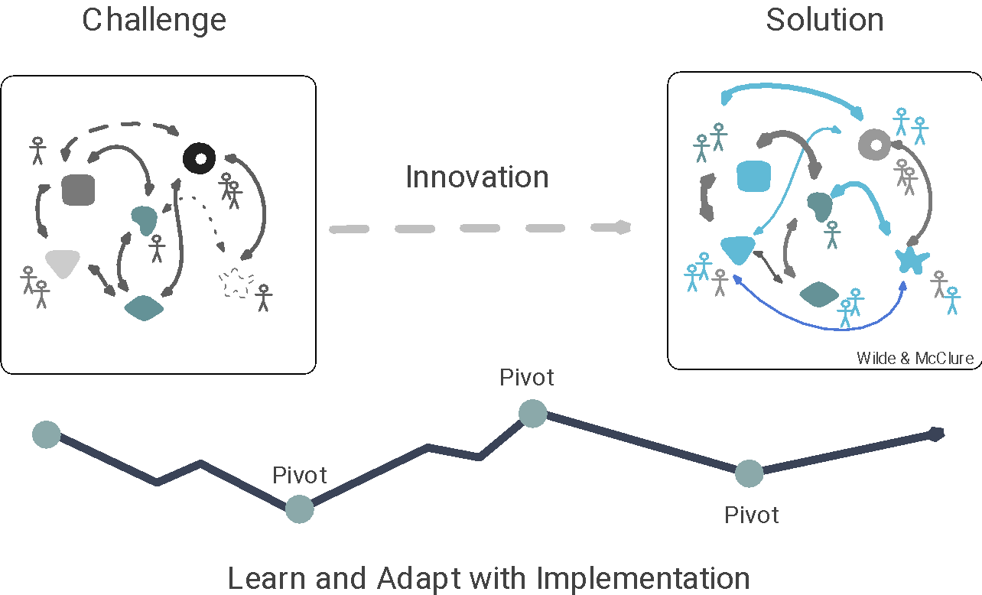
Envision the Whole Solution – Then Iteratively Evolve the Entire System

Slide 27
Algeria
IOM
Precious Plastic
Norwegian Church Aid

Slide 28
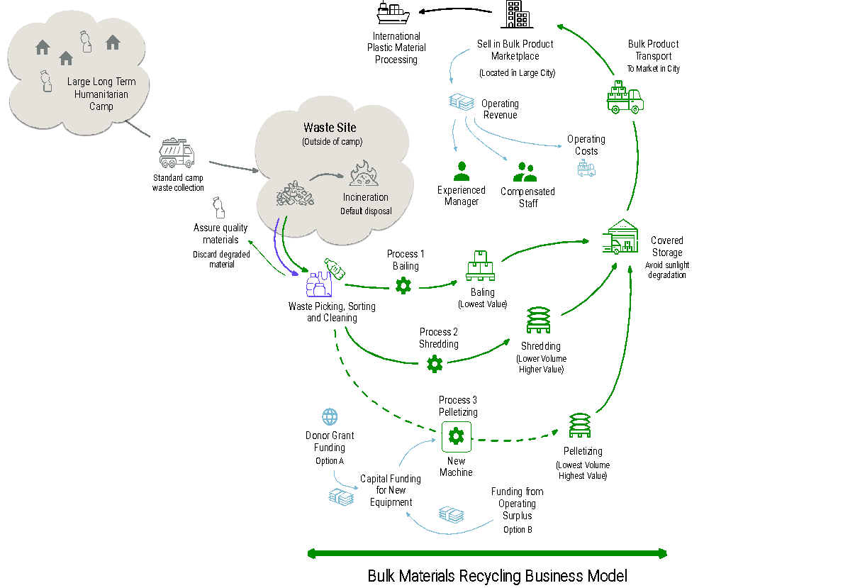
Refugee Camps in Algeria
Collect, process and sell bulk plastic waste
Supply international / urban markets
Meet commercial quality standards
Professional management
Staff compensation
Equipment investments
End to end supply chain
5 Long term camps in the Sahrawi desert produce 20,000 tons of waste of which 20% is plastic.

Slide 29
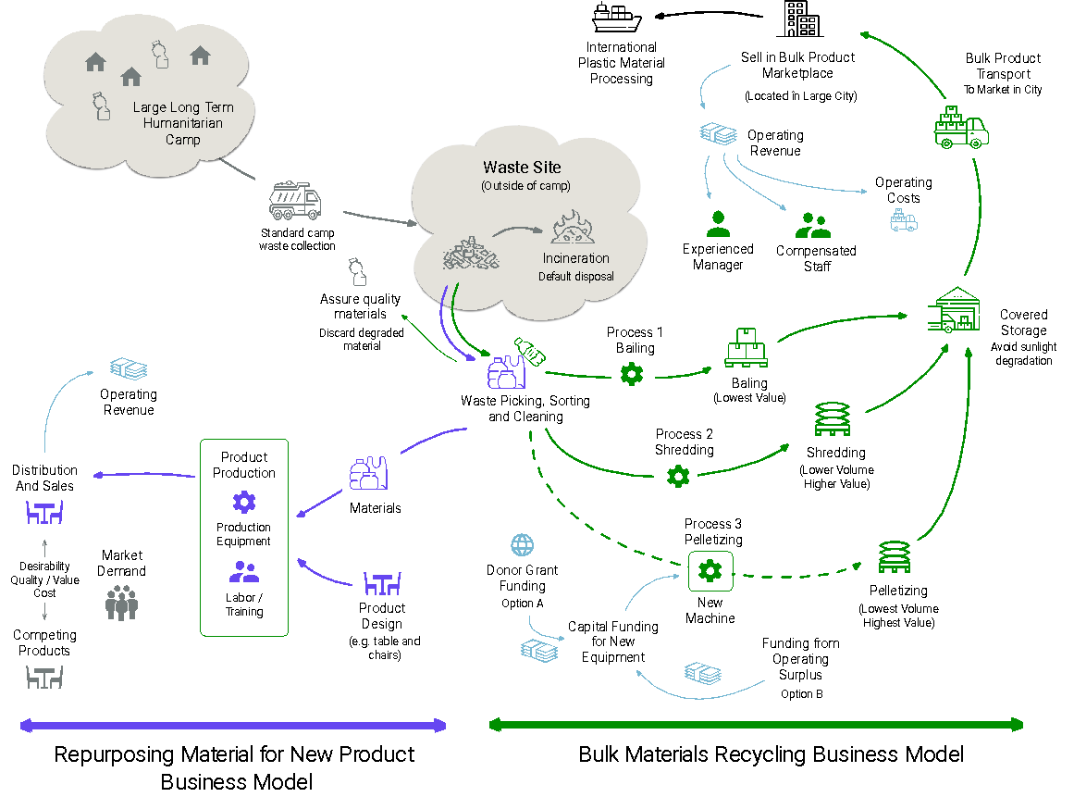
Adapting and Extending
Systems

Slide 30
Strategy Shift 3
Become a System Choreographer
(synergies and connections)

Slide 31
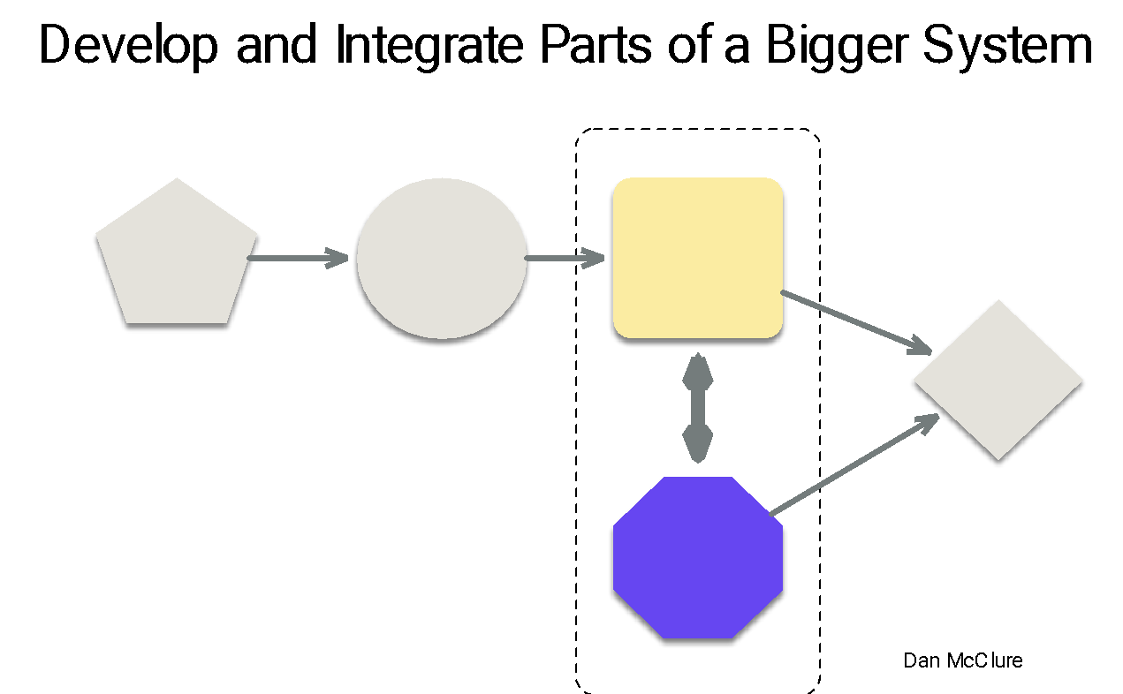
Connect Projects Across the Portfolio to Build a Bigger Solution

Slide 32
Connect Projects Across the Portfolio to Create Synergies

Slide 33
A Real World Example
of the Challenge of Creating an Innovation that is a System
Notes:
https://commons.wikimedia.org/wiki/File:Lady_Gaga_Bad_Romance_JWT,_2017-11-03.jpg

Slide 34
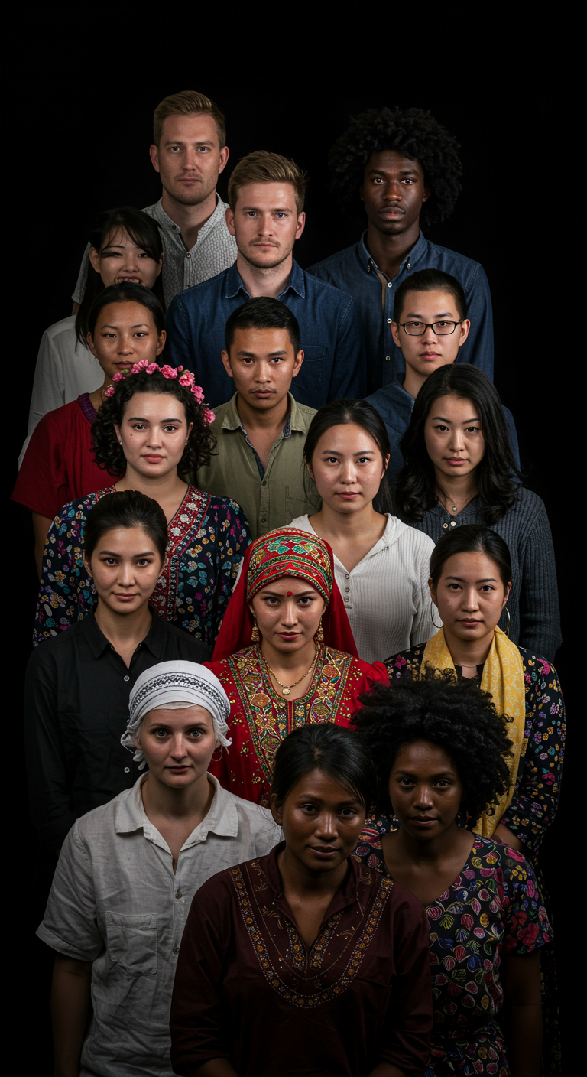
How do you scale an innovation that is a complex system?
Notes:
https://commons.wikimedia.org/wiki/File:Lady_Gaga_Bad_Romance_JWT,_2017-11-03.jpg

Slide 35
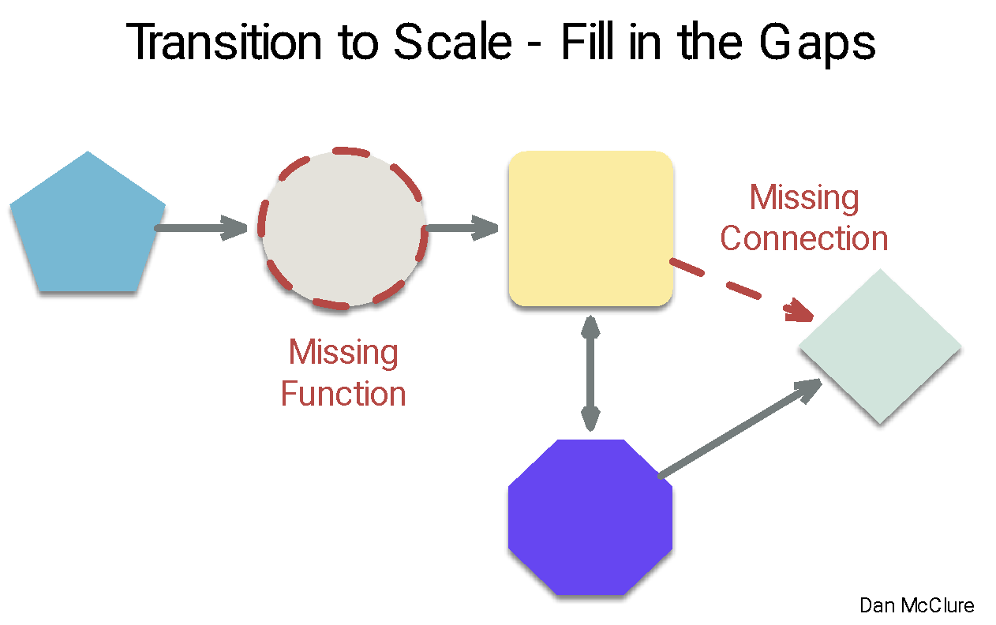
First
Finish the
Job of Creating a Working System

Slide 36
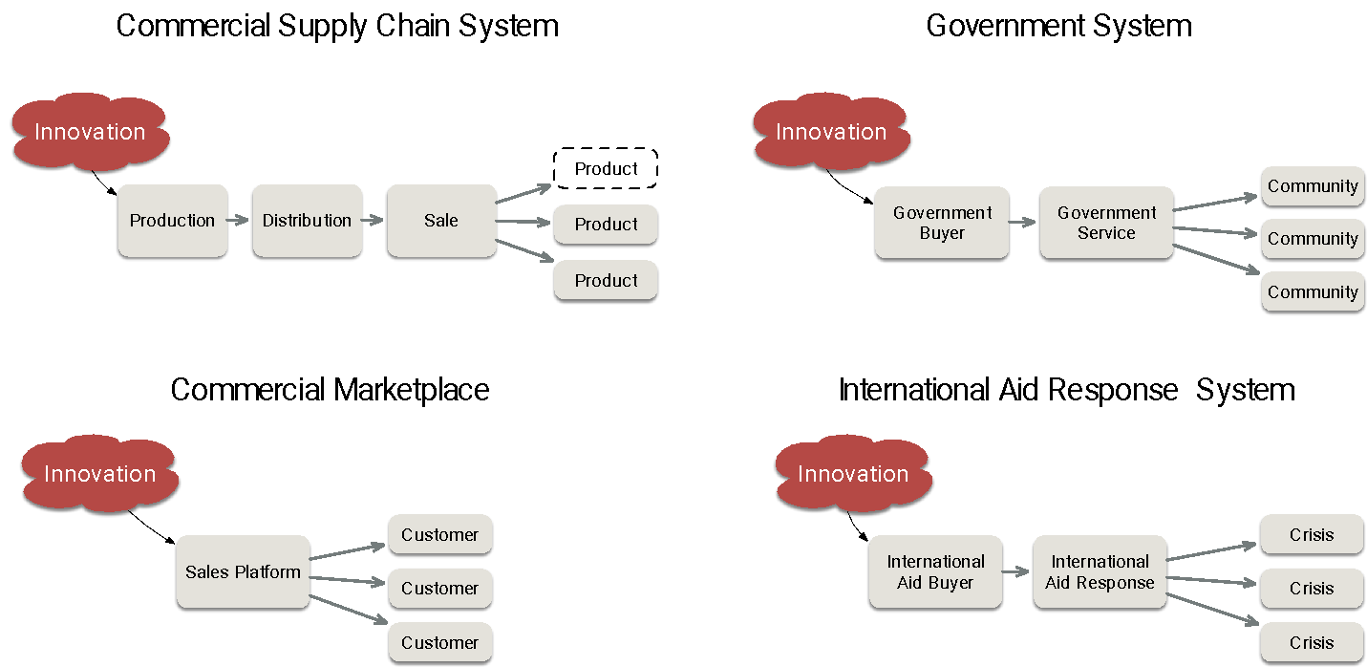
Then ... Plug the bounded innovation into a bigger system (pilots work here)

Slide 37
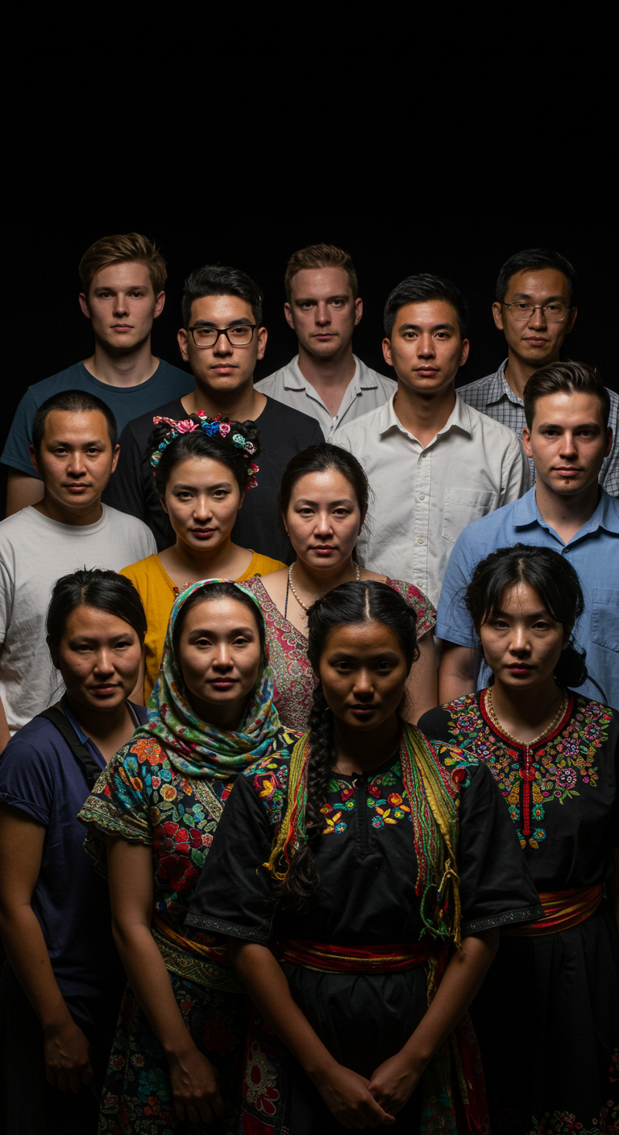
Scaling systems (consistently) fails because each context is different
Capabilities and resources
Culture, priorities, desires
Issues to address
Leaders and participants
Partners and collaborators
History of working together
Notes:
https://commons.wikimedia.org/wiki/File:Lady_Gaga_Bad_Romance_JWT,_2017-11-03.jpg

Slide 38
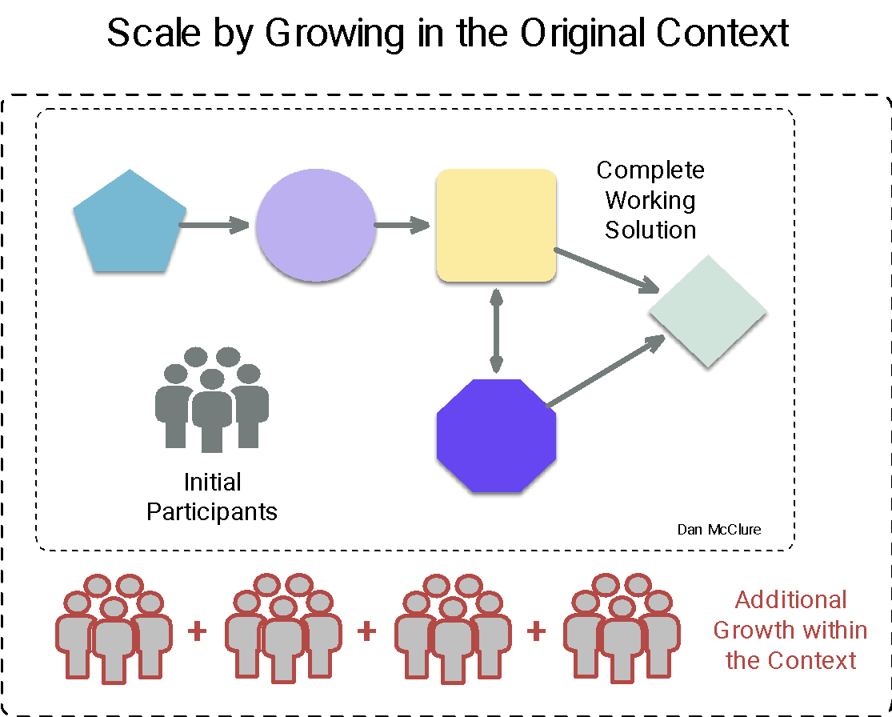
Fall back to scaling the system in place?

Slide 39
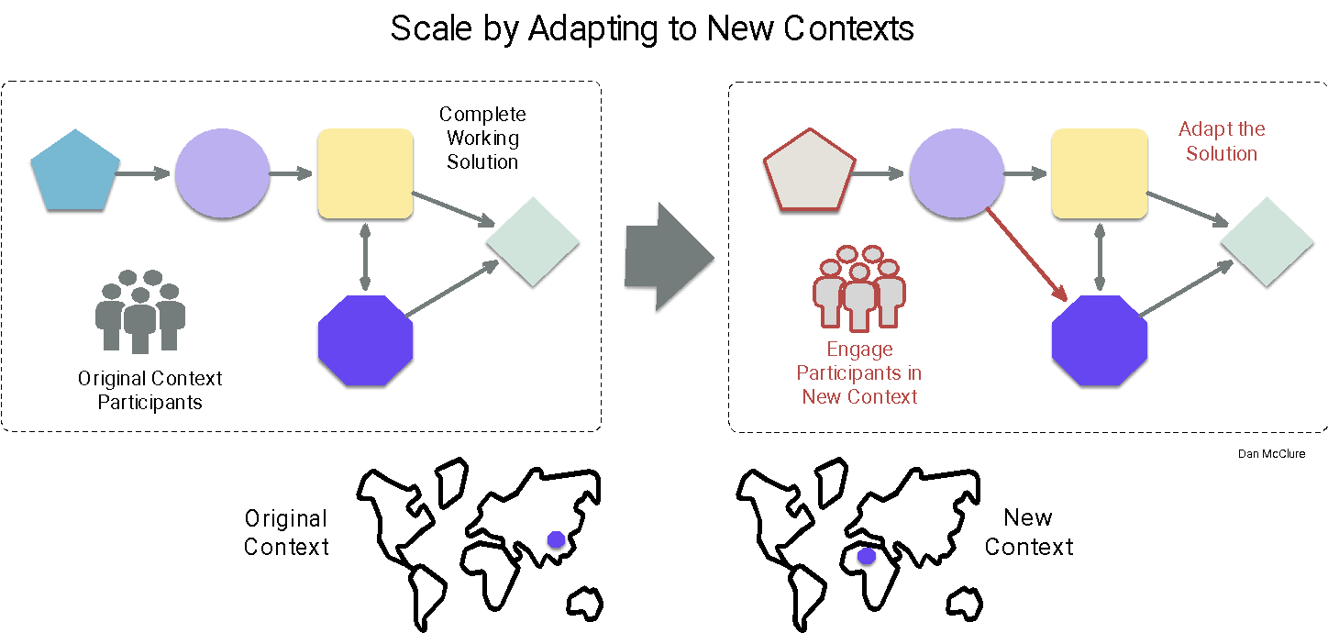
Harder but better: Transfer and Adapt

Slide 40
Harder but better: Transfer and Adapt
TRANSFER

Slide 41
Harder but better: Transfer and Adapt
TRANSFER
ADAPT

Slide 43
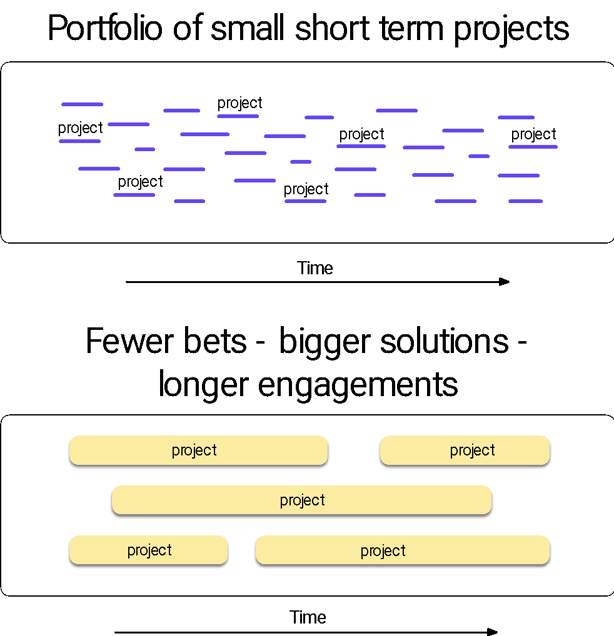
Adapt Investments to System Innovations with Transfer and Adapt Scaling

Slide 44
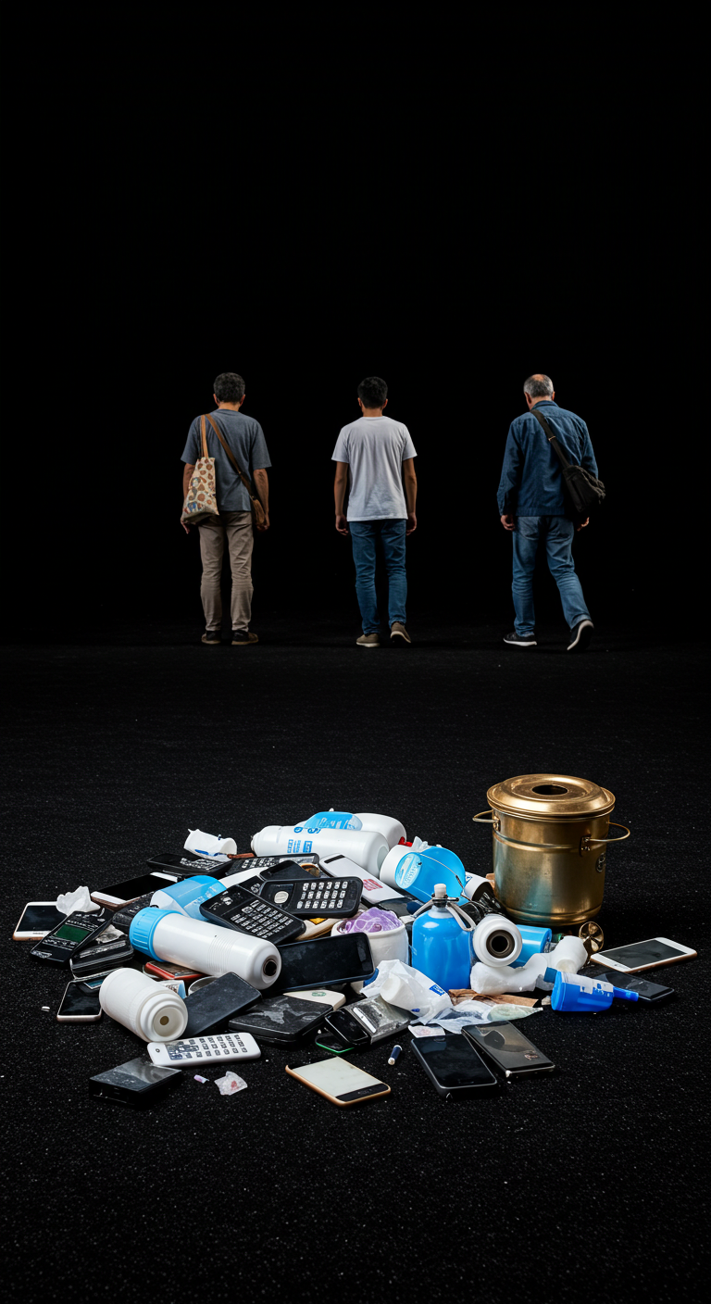
Abandon Silicon Valley Fail Fast Pilots
Instead - Start with System in Mind
Create an Innovation that is a System and then Scale via Transfer and Adapt
Notes:
https://commons.wikimedia.org/wiki/File:Lady_Gaga_Bad_Romance_JWT,_2017-11-03.jpg

Slide 45
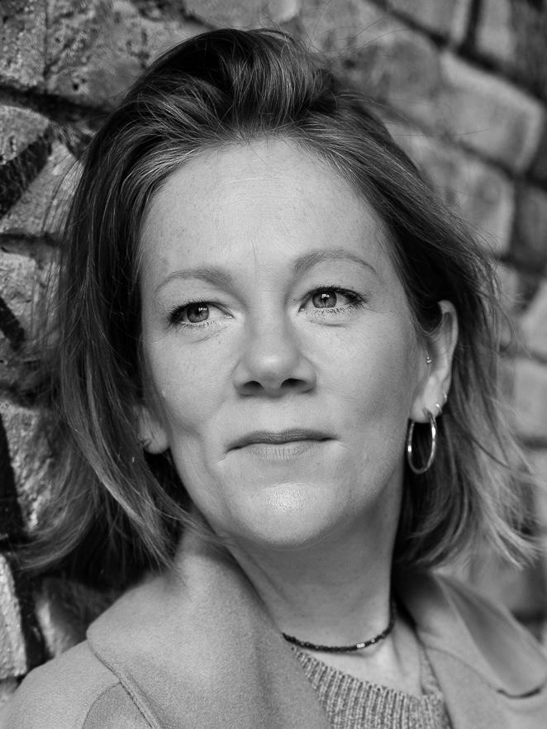
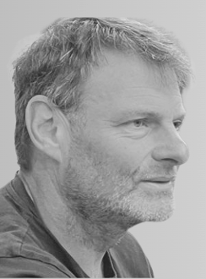
Dan McClure
danmcclure@innovationecosystem.com
Hannah Reichardt
hanreichardt@gmail.com
Neil Townsend
neil@freerangestrategy.com
Thank You!
Notes:
https://commons.wikimedia.org/wiki/User:Jedchela

