Slide 1
April 2025

Slide 2
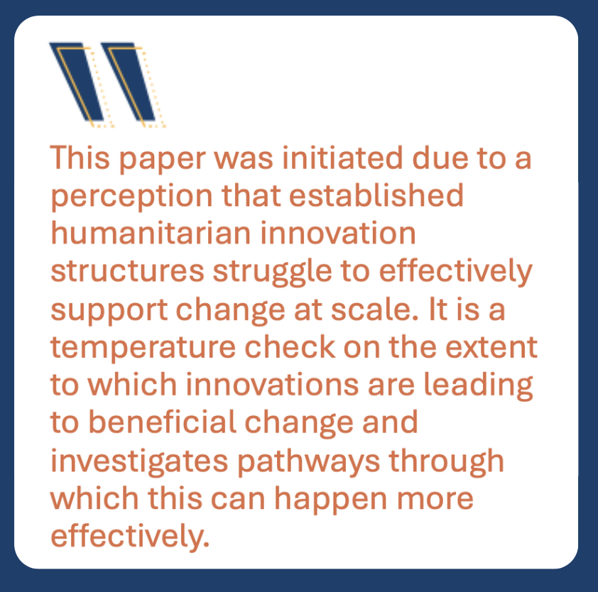
Why This Report ?
https://www.elrha.org/wp-content/uploads/2024/10/Failure_to_Scale_Report.pdf

Slide 3
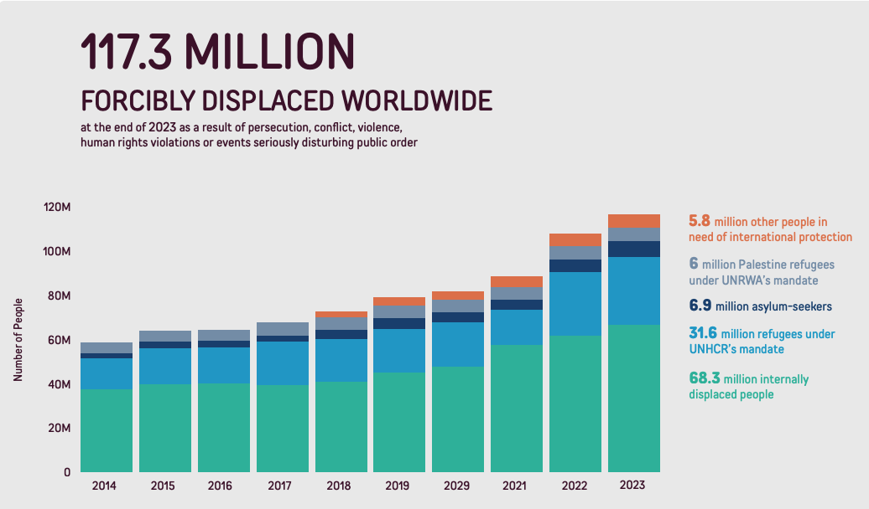

Slide 4
Last decade - increasing humanitarian needs from conflict and natural disasters
Climate change set to worsen the situation
Context of increasing nationalism, shrinking resources
Response systems carry a heavy load and under immense strain,
mismatched structures to nature of need
struggling to match the values of the time

Slide 5
History of change and adaptation in the humanitarian sector - activity and energy for change
Formal innovation sub-sector is relatively young
High hopes for innovation as the solution…..
Fundamental mis-match between innovation models, opportunities and the expectations of change

Slide 6
Weak incentives for change
Arcane grant funding models create useful barriers to entry
Revenue models reward higher costs rather than solving problems, efficiency or risk taking
Poor connections with ‘frontline’ innovation signals
Funding and mechanisms that are limited and outdated
Investment not incentivised
Requirements can be exclusionary
Limited instruments

Slide 7
And as a result…
Participation opportunities remain inequitable
focus on lower relevance problems
Personal costs for innovators very high - people and skills are lost
Few new sources of capital – opportunities missed
Short-term, low risk pilots proliferate
Effective solutions funded short term, orphaned when they really need cash

Slide 8
Problems are well known
Need a collective intent to tackle hard to change systems
Many innovators are ‘complexity aware’, frustrated at what lies outside of their control
Phased and coherent response is necessary
Deliberate design of complete, systemic pathways for change

Slide 9
With special thanks to:
The research interviewees and workshop participants
Aradhana Gurung (Impact 447)
Shirin Maarin (HIF)
HIF Advisory Group
Contact:
Neil@freerangestrategy.com
https://docs.google.com/presentation/d/1HdrWTVMHM6MePSWxgXhBCcw7lBETxWsv/edit?usp=sharing&ouid=112497497846719225721&rtpof=true&sd=true

