Slide 1
Catholic Relief Services
Catalyzing Humanitarian & Development Outcomes at Scale
SCoP January 2025
Notes:
Thank you for that introduction, Richard, and very warm greetings to everyone who joined us today. I am very pleased to be opening the CRS panel presentation noting that while I have only been with CRS for 6 months in my role as Director for CASCADE, which stands for Catalyzing Scale through Evidence, I am actually standing on the shoulders of Erin Baldridge and Sanela Imamovic, our two speakers today who have done amazing work on the process of scaling outcomes in CRS. As you can see on this slide, CRS uses the tagline catalyzing humanitarian and development outcomes at scale and our two speakers will be elaborating on this.

Slide 2
Notes:
But before I hand over to our speakers, I want to highlight CRS's current strategy called Vision 2030: In Their Own Hands. The strategy references the long history of CRS's work to address poverty, injustice and violence and why, given current challenges, CRS sees the need to be bolder and more ambitious in effecting transformational change. The 2030 strategy has four interlinked strategic approaches, the first is the shift to being a catalyst and recognizing that this means breaking out of traditional paradigms. The strategy created six strategic change platforms that focus our efforts to catalyze scaled outcomes. The strategy also spurred the creation of CASCADE.

Slide 3
Definition of CRS’ role in Catalyzing Humanitarian and Development Outcomes at Scale
CRS has defined the way we Catalyze Humanitarian and Development Outcomes at Scale as:
CRS collaborates with, convenes, and accompanies a variety of stakeholders within systems to support local actors to achieve humanitarian and development outcomes that are equitable, inclusive, and at the scale that is appropriate for the size of the problem.
Notes:
As you'll be hearing from my colleagues Erin and Sanela, CASCADE started the task of supporting CRS to become a catalyst for scale by first learning from our experiences of scale. 53 CRS case studies from across geographies, sectors and working with a variety of actors were collected, analyzed and curated. Insights and trends were distilled from these into learning that we triangulated with the field experiences of colleagues. We convened many stakeholders across CRS to define HOW CRS engages in scale and have come up with this definition of CRS's approach to catalyzing scale: CRS collaborates with, convenes, and accompanies a variety of stakeholders within systems to support local actors to achieve humanitarian and development outcomes that are equitable, inclusive, and at the scale that is appropriate for the size of the problem
This definition is different from the more usual definition that's premised on innovation that is then scaled. This definition's emphasis is on systems, local actors and scale that's relative to the size of the problem.
We're still on this journey and while we have learned a lot, we continue to build on that learning.

Slide 4
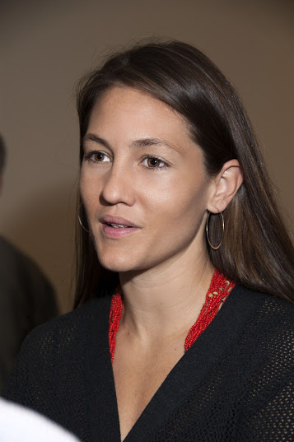
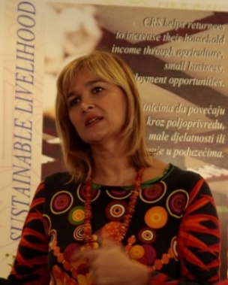
Meet the Panel
Erin Baldridge
CRS Deputy Regional Director for Latin America and the Caribbean
Sanela Imamović
CRS Country Representative BiH/Balkan
Notes:
NOTE: IF RICHARD KOHL INTRODUCES THE CRS SPEAKERS, WE WILL NOT SHOW THIS SLIDE. With that, I'll now introduce our speakers:
-Erin Baldridge is currently the Deputy Regional Director for Latin America and the Caribbean. But before that, she was the CASCADE Director who did all the groundbreaking work. Erin will share agency-wide initiatives and investments to translate Vision 2030 into action, share challenges and lessons.
-Sanela Imamovic is the Country Representative in Bosnia and Herzegovina, and was one of the pioneers of the CRS's approach to catalyzing scale. Sanela will her own experience and a country perspective on catalyzing scale, including her transformation.
Over to you, Erin.

Slide 5
GHR’s Legacy Grants to CRS
Saving Lives protecting Livelihoods
2006-2011
Strength in Solidarity SiS
2012-2019
Catalyzing Scale through Evidence CASCADE
2020-2023 (been extended to 2030)
Meet urgent needs
Strengthen local partners
Catalyze outcomes at scale
Notes:
GHR’s Legacy Grants to CRS
GHR Foundation has provided a “legacy grant” to CRS for several years with the intention of supporting CRS’ institutional capacity. CRS chose to focus on our institutional capacity to catalyze transformational change at scale in support of Vision 2030 In Their Own Hands.

Slide 6
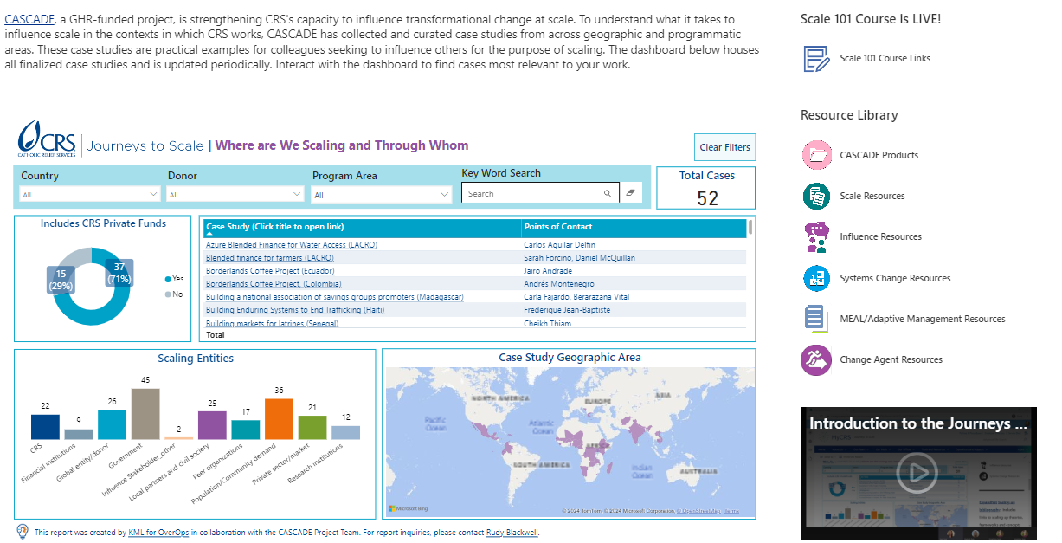
Evidence | Learning | Shared understanding
Notes:
Started by learning from our diverse experience across the agency (case studies, qualitative analysis, dashboard, convening learning events to triangulate experience such as the peer to peer expert panels on scale through gov’t, scale through private sector SCP cross-learning events, etc).

Slide 7
Learning from case studies
An innovation is not a pre-requisite but an understanding of the system is
Evidence is necessary but not sufficient.
Importance of convening and accompaniment
Constant learning and adaptation is needed
Strategic Change Platforms’ learning
Understanding the systems takes time.
Projects as building blocks for a larger strategy.
Get the teams right.
Engaged leadership.

Slide 8
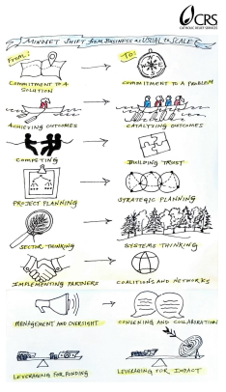
Notes:
-Describe how the Mindset Shift came about
-Based on learning, identified the mindset shifts needed, capabilities, enablers and barriers
-Continued focus on mindset shifts at all levels
-How is this shift being done across the agency?

Slide 9
Influence and Representation Capability
Understands stakeholders' needs and interests and negotiates mutually beneficial strategies
Brokers relationships between organizations
Nurtures long term relationships with partners and groups
Represents how the agency's work contributes to impact at scale
Inspires and supports collaborating with systems actors to contribute to impact at scale
Leads with an influence agenda linked to agency strategy
Champions influencing collective action for impact at scale
Is a resource on collective approaches to enhance or scale impact
Notes:
To further embed the mindset shifts and organizational transformation, through CASCADE’s work, CRS revised and updated the definition of influence and representation functional capability, which refers to the capability of CRS leaders and staff to work with others to achieve collective impact. Functional capability is the knowledge and skills that CRS staff should have and demonstrate to be successful in their role. A systems perspective and supporting local systems actors to achieve impact at scale were woven into the capability description to align with the emphasis on systems in the definition of catalyzing scale. This move is strategic because capability definitions inform various processes throughout CRS: from recruitment, onboarding, professional development planning, agency development programs and workforce planning. This institutionalizes the expectation that leaders and staff demonstrate collective impact mindsets.
CASCADE curates learning opportunities that will enable staff to strengthen their capability in this area and develop to Level 5

Slide 10
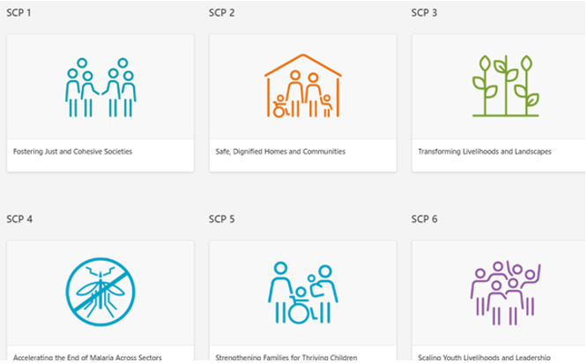
Support from
Strategic Change Platforms
Notes:
-Important role of investment in SCPs

Slide 11
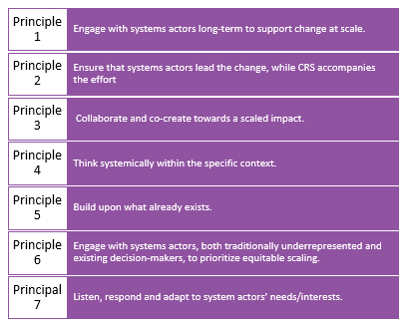
Utilization Focused Evaluation
CASCADE led the development of 7 Scaling Principals for CRS
Notes:
CRS Scale Principles - distinguishes the CRS approach to scale from traditional approaches to development.
Micheal Quinn Patton and Charmagne from the Utilization Focused Evaluation held focus group discussions with CRS colleagues around the world and across sectors who are working on scale initiatives and translated the opportunities and barriers they see in practice into these scale principles.

Slide 12
Challenges
Time for strategic focus vs daily requirements
Designing a system for adaptive management and MEAL for scale has been successful, however as we move into data collection and data analysis this has proven challenging.
CRS is a large, decentralized organization which makes agency-wide shifts challenging. CRS’ staff place high value on field-driven solutions.
Notes:
The challenge is that staff are often overstretched and have little time to learn a new methodology and operationalize the new framework.
Designing a system for adaptive management and MEAL for scale has been successful, however as we move into data collection and data analysis this has proven challenging.
CRS is a large, decentralized organization which makes agency-wide shifts challenging. CRS’ staff place high value on field-driven solutions.
The geographic and technical diversity of CRS makes it imperative to meet each region where they are. The CASCADE team is planning to facilitate a self-assessment across CPs and regions in early FY25 to better understand the extent to which teams think they are institutionalizing scale, so that CASCADE can organize support to regions that builds on existing foundations and continue to build momentum.

Slide 13
Challenges
5) CRS is a project-based organization, dependent on institutional donor funding. Shifting just CRS’ way of working will not be sufficient.
6) Influence donor thinking -Donors perceive scale as connected to innovation not localization.
Notes:
5) CRS is a project-based organization, highly dependent on institutional donor funding. Shifting just CRS’ way of working will not be sufficient. ) Finding solutions that enable the flexible use of discretionary resources across multiple years will be critical for the long-term sustainability of scale work, as reliable multi-year commitments enable us to strategize for scale and leverage private funds for scaled results. We recommend for the ELT to consider the viability of multi-year planning and budgeting to strengthen the utilization of private funds to achieve scaled outcomes. We also recommend to consider using discretionary funds to set up a “scale” fund which would not be a “pilot fund” but rather a supplement to ongoing and funded initiatives in a country strategy that demonstrates strong progress towards scale but require additional investment.
6) Influence donor thinking -Donors perceive scale as connected to innovation not localization. CASCADE is already making progress in shifting our own colleagues’ perceptions on the connection between sustainable impact-at-scale and local leadership. We have made strong progress in shifting these perceptions within CRS and some progress outside of CRS. We will continue to work on influencing donors to recognize the foundational role of permanent local actors in sustainable impact-at-scale and the importance of innovation being linked to changing systemic conditions that hold problems in place. SCPs can be a source of evidence of this if we are more intentional in our documentation.

Slide 14
Applying Lessons Learned
At CRS, mindsets are shifting in favor of systems and scale thinking. This is seen primarily among teams actively working on their respective scale initiatives, and there is still a long way to go for this to be institutionalized.
Some CRS staff have the impression that scale initiatives must be primarily privately funded.
Resources, guidance and tools for scale-enabling initiatives are important but the process of co-designing, testing AND sharing them is just as important.
Vision 2030 is about catalyzing scale, and many CRS teams are working with scale in mind.
Measuring collective impact or systems change requires a high degree of strategic learning. CRS Global Influence Results are unique among our peers as a way of measuring results to which our influence contributed.
There are various ways to achieve scale but understanding and then working to improve or change systems is the foundation for achieving sustainable impact at the scale of the problem we are trying to address.
Notes:
Notes for 1) What’s needed is to intentionally consider how all initiatives that are working towards scale are also working to institutionalize this and not just towards the outcomes of their initiatives.
Notes for 2) We know this is not true, but this perception makes scale less attractive to CP and regional leaders who are mandated to reduce the use of private resources and attract more institutional donor funds. We should consider how to better link multiple donor-funded initiatives and utilize private funds for strategic purposes that lead to scale and achieving the vision of being a catalyst of scale.
Notes for 3) Collaboration takes more time but there is value in doing so to produce CRS scale champions. CASCADE collaborates with several groups and teams for co-design and testing (Change Agents, ProPack Systems training team in Asia and ISD). In addition, plans for light-touch data collection to understand the current state of regional knowledge, attitudes and practices to support systems practice and scale are planned for FY25. There are also plans to support FY25 regional strategy updates and operational plans in several regions.
Notes for 4) we need to un-silo our ways of working and determine how funding could be distributed based on a high-level strategic vision. It will be important to clarify who is functioning in this role as we come to the second half of Vision 2030.
Notes for 5) Measuring collective impact or systems change requires a high degree of strategic learning. CRS Global Influence Results are unique among our peers as a way of measuring results to which our influence contributed.
Notes for 6) CRS is proactively strengthening teams’ capacities for understanding, strengthening and/or changing systems toward large scale impact (through updating guidance creating practical training and resources, and changing some of our approaches to smooth the way for systems change through local actors to be easier in projects).
Thank you. I'm happy to answer questions later in the Q&A but for now, I'll hand over to Sanela.

Slide 15
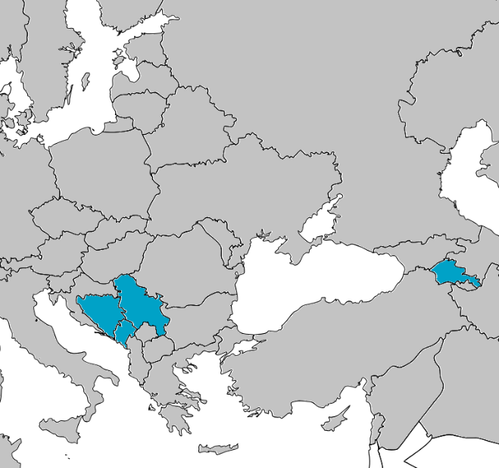
A Case Study Catalyzing Social Housing Outcomes at Scale to Create Long-Term Solutions for Displacement Lessons from Bosnia and Herzegovina Sanela Imamović Country Representative for Balkans and Europe Outreach Countries sanela.imamovic@crs.org January 23, 2025
Notes:
I am very grateful for the opportunity to share with you my story and insight into how CRS BiH successfully catalyzes the scope and results of the social housing model working in partnership with government and NGO partners.

Slide 16
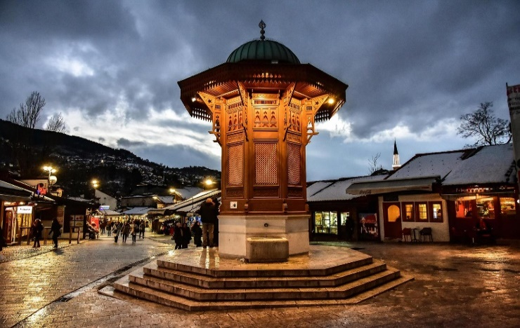
Welcome to Bosnia and Herzegovina!
Roman Empire
Middle Ages:
Bosnian Church
Roman Catholic Church
Eastern Orthodox Church
Kingdom of Bosnia
Ottoman Empire
Austro-Hungarian Empire
SFR Yugoslavia
Bosnia and Herzegovina

Slide 17
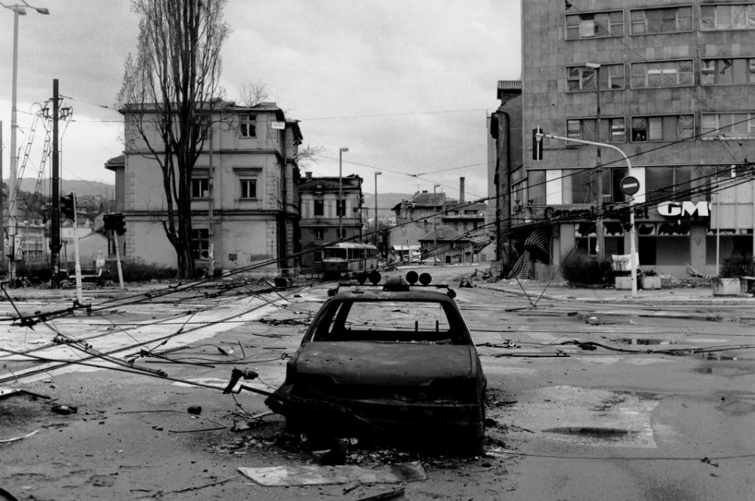
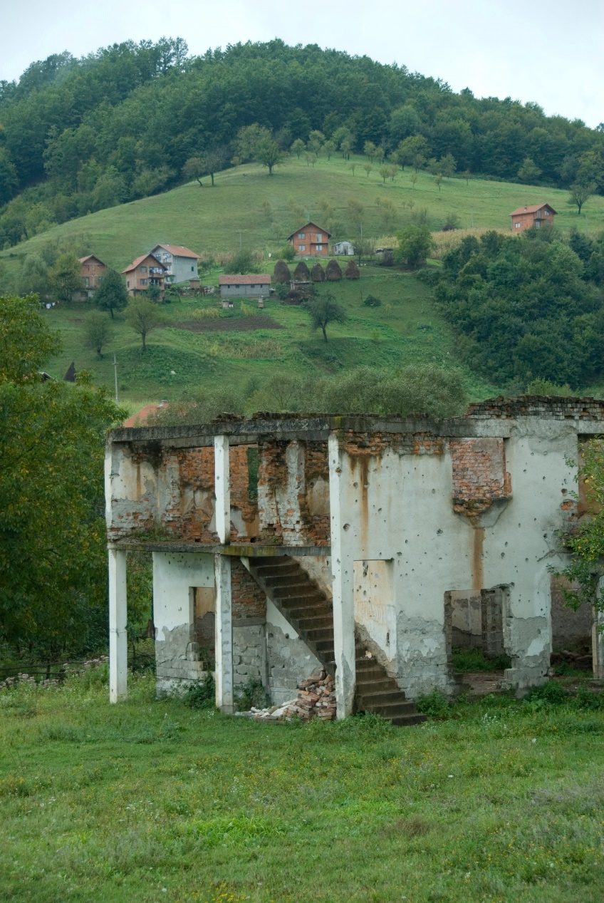
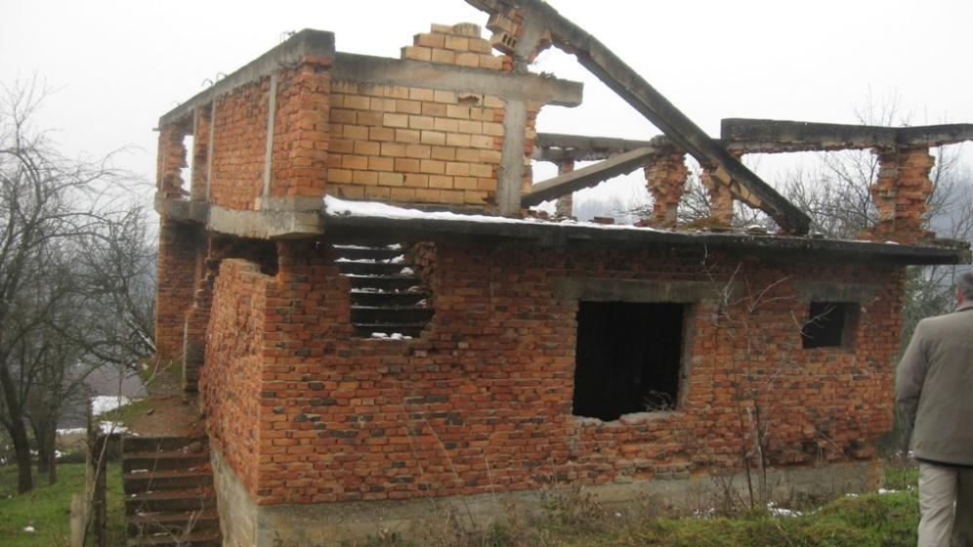
Bosnia and Herzegovina: Post-Conflict Housing Context
Large-scale housing need
2 million displaced persons (50% population)
40% housing stock destroyed
Widespread privatization of housing stock
Government lacking legislation, standards, and regulations for public housing
Unable to access external funding for public housing and thus address the needs
Notes:
Allow me to briefly introduce you to the context in which we worked in the period from 1995 to 2007 and what motivated us to change our approach to move away from the recovery process and humanitarian actions towards development program.
People could not return to their homes, and they were living in collective centres and alternative accommodations which were poorly conditioned facilities where often several families lived together shared basic sanitation space.
Without proper law regulations, our government could not find solutions for people leaving in Collective Centres. The country was also running out of public housing stock because of the post-war expanding privatization, which means, it did not have the facilities to accommodate displaced families. Because all of this, our government was not able to access external funding for public housing.
In 2007 when we started social housing in Bosnia and Herzegovina, approximately 20,000 persons lived in more than 130 collective centers (12 years after the end of the war).

Slide 18
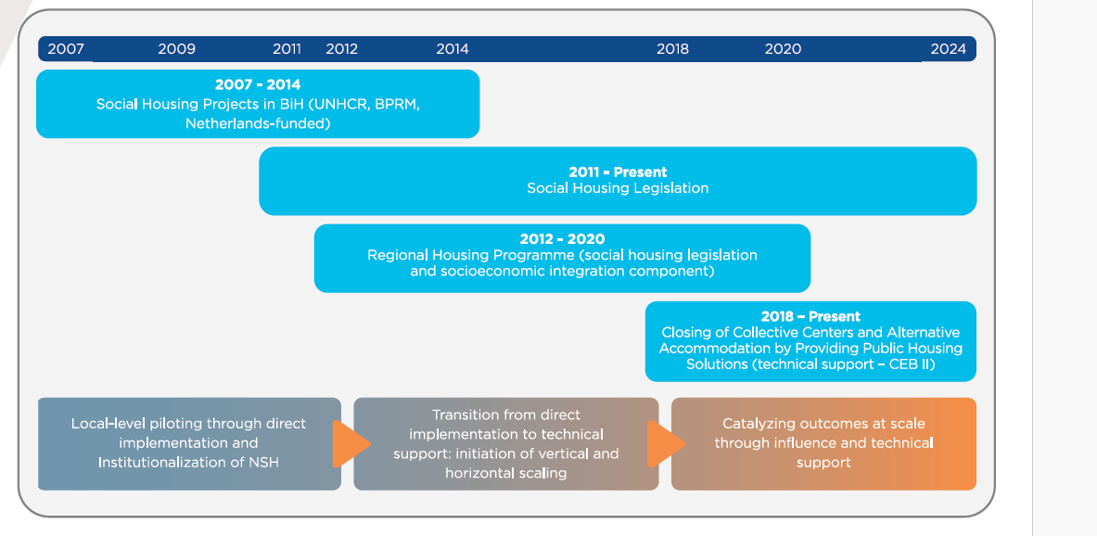
CRS’ Journey with NPSH in BiH
Notes:
This slide shows our journey. What is important to emphasize is that this is truly a process that takes time. When we started, we had a vision of why we need SH and how it can help the government solve the important problem of providing adequate and permanent housing for displaced persons, but we could not have imagined that we would reach today's results. We also had a lot of questions about how we would implement this, I can now say that it was a joint journey with the relevant ministries for displaced persons, refugees and NGOs.
This process was divided in three phases – from exploring, piloting through direct implementation and institutionalization of SH, moving to technical support to government, towards close-out phase in which we are now catalyzing outcomes at scale through influence and technical support.

Slide 19
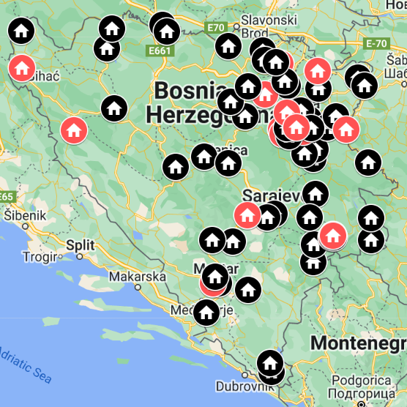
Results
Replicated SH Bosnia model to Serbia, Montenegro and Armenia
Legal codification and adoption of social housing in BiH
Institutionalization of social housing system in BiH
From 290 families provided with housing in 10 municipalities to 3,500 families in 54 municipalities
Supported BiH government to access $60 million from CEB
Plans to close remaining collective centers in the next 3 years and provide housing for more than 5,000 families (14,350 people)
Notes:
We usually present the results at the end of PP presentation, but I want to show them to you now, because in the coming minutes I will talk about How we did it and Who we involved to get to them.
1. Replicated and adapted through the regional housing project in Montenegro and Serbia. 2. Established entire legislative system on a four-level governance structure and secured institutionalization of the process through maintenance and management systems, selection criteria, housing councils, rulebooks etc.
3. From 290 families as a pilot project with external funding and an additional $60 million from the Council of the European Bank, our country was able to expand the social housing stock to provide adequate housing for 3,500 families (approximately 10,000 persons) in 54 municipalities and closed 105 collective canters. The government also provided resources to expand support to a total of 5,000 families by 2027 and fulfil the plan to close the remaining 25 collective centres in that period.

Slide 20
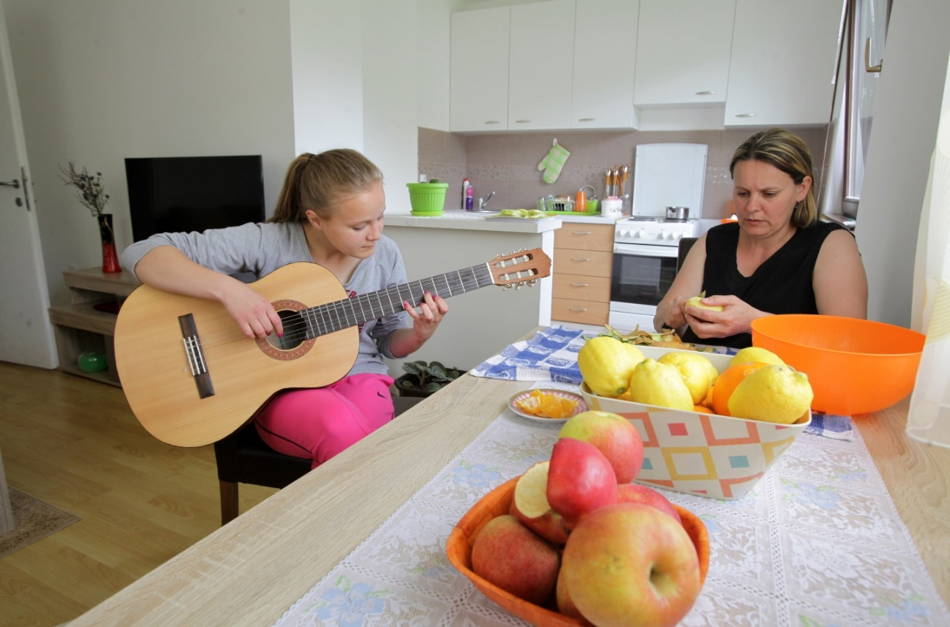
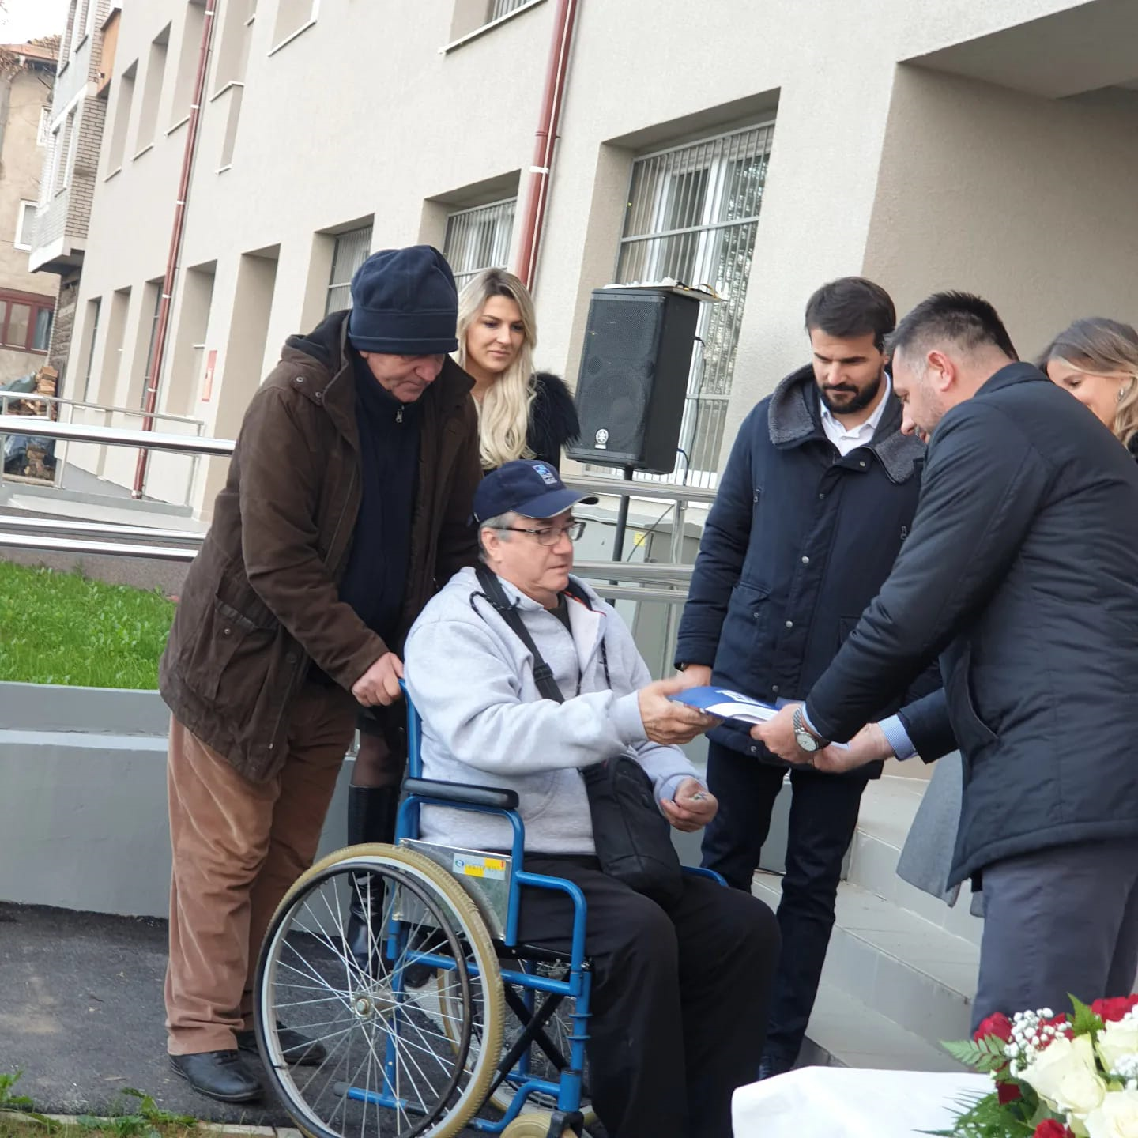
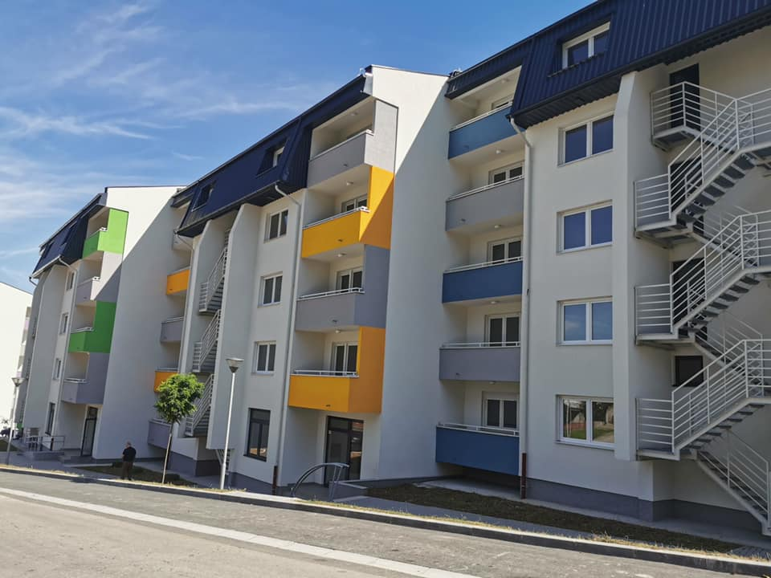
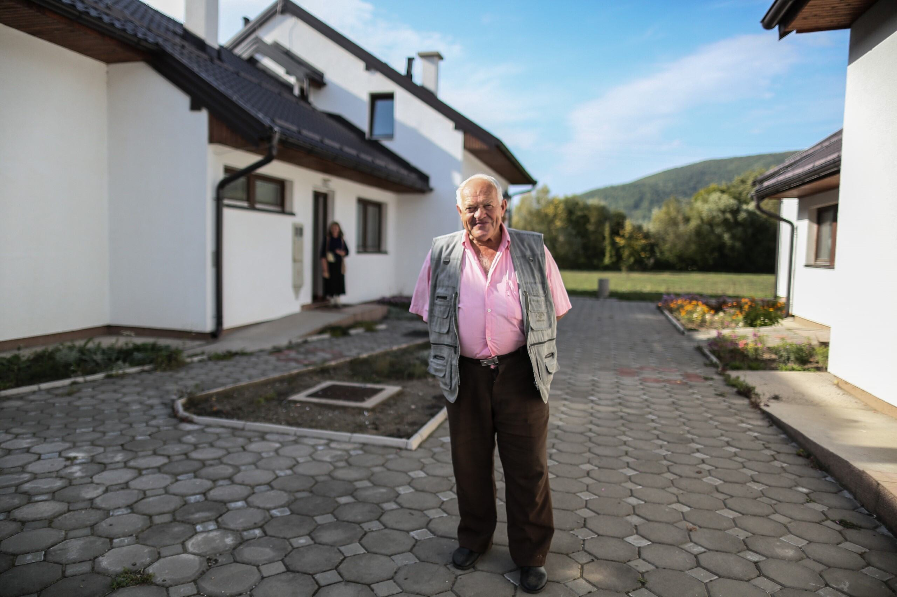
Results
Notes:
Here you can see some of the tenants of our buildings - people of different age and social status , showing that with high-quality technical solutions adapted to the needs, housing issues can be solved for a wider population, enhancing the developmental character of communities in general.

Slide 21
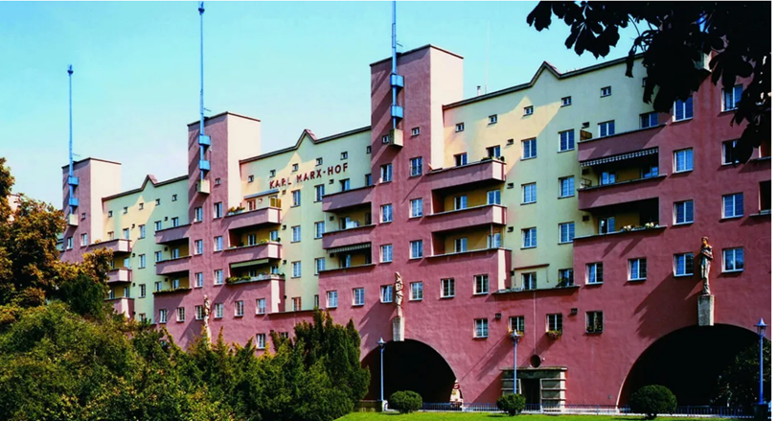
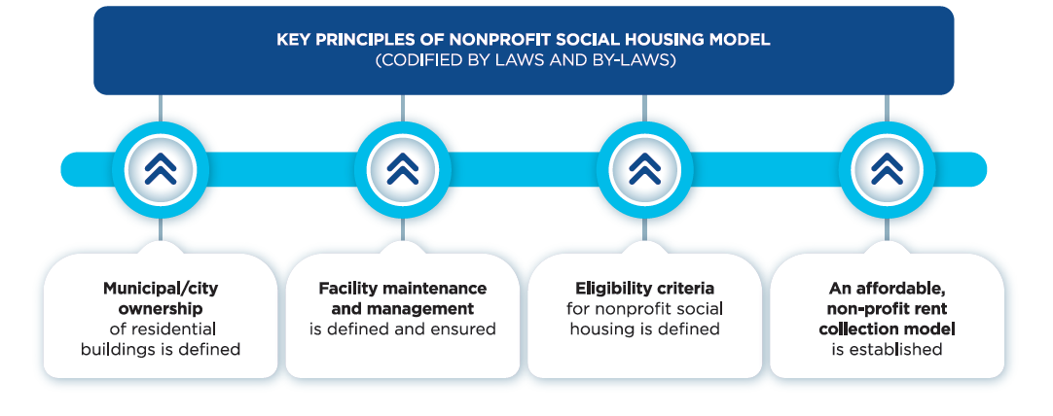
Identifying Possible Solutions
Social housing study visit (Viennese model)
Establishment of Social Housing Principles
Piloted different models
Case management system
Fundraising roadmap
Notes:
So, how it all started? First, we prepared a CN that showed the problem, what we want to achieve and what we need to do, and what we don't know and what BiH doesn't have to establish and implement SH. This phase was learning. Together with representatives of relevant institutions of BiH, local communities and NGOs we worked to respond to all these questions.
To find model for housing solutions which will be adequate and efficient in resolving the problem of displacement and support the needs of people in Bosnia and Herzegovina- we first analysed existing models in Europe and the region and organized study visits together with representatives of all relevant institutions.
Based on what we learned, we established key principles of social housing which were clear ownership structure, management and maintenance, long-term eligibility criteria and nonprofit rental system.
Taking these principles into account and knowing the Bosnian context, together with the government we piloted different nonprofit social housing models in rural and urban areas, with various ownership models through different public institutions.
At that time, we realized that successful implementation of SH depends on municipal capacity to manage and maintain as well to support tenants, and we worked with municipalities to build their capacities.
Parallel with this process, we developed fundraising strategy and created a roadmap to access different funding and resource opportunities.
It is important to say: our approach was to work side by side with the government although we knew the process will take longer and be more complicated, to establish sustainable system, but all the results will be more effective and long-term. During these four years, we developed a trustful partnership and demonstrated our technical expertise as well our agency capabilities in advocacy and fundraising.

Slide 22
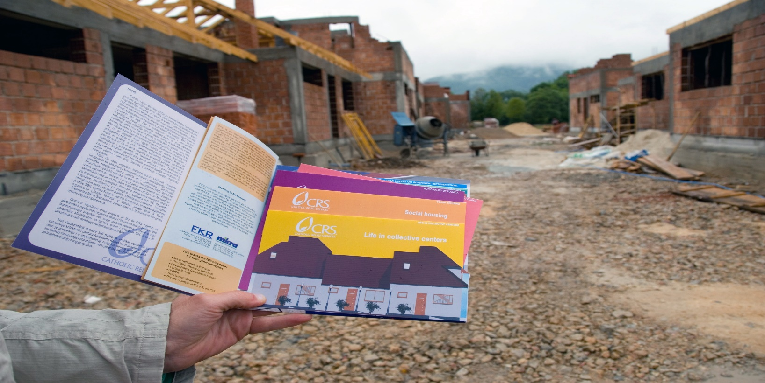
Direct Implementation
Influencing donors
Key partnerships
Changing mindsets
Leveraging media
Notes:
From this distance, I can identify and talk about four major components that enable catalyzing outcomes at scale. They came as result of needs, logic, our intuition and try to mitigate potential risks.
1. Even though this slide says "Direct Implementation," what we mean by that has also changed from just CRS building homes to everything starts with Partnership with government, with aim to help them find adequate solutions to work on their strategic priorities, to ensure the return process though adequate housing. Also, joint means for CRS to be flexible to find the best solutions and adapt program to respond to long term community needs and to properly communicate all with donors to get their support.
Direct result of this was: Trustworthy and transparent partnerships, strong state ownership and clear understanding of long-term impact on future scaling.
2.Changing the mindset of key government and community stakeholders including the NGOs, future tenants and domicile population to clearly recognize benefits, opportunities to accept the SH model as solution (needs assessment, evidence of results and advocacy campaigns). This was the most critical and most difficult to achieve.
What we did, we created a detail map of key decision makers, politicians, influencers, but also potential spoilers whom we invited to work closely with us); we organized many exchange visits and advocacy campaigns for diverse targeted groups.
3. Parallel to working with the government, we tried to keep donors informed consistently, guiding them and securing their support and enhancing the scale of the model
4. We took a similar approach with media – partnering with them and educating them to ensure adequate and fair reporting, social acceptance of the model and building awareness of the system). SH was very sensitive topic in that period.

Slide 23
Transition to Technical Support
Technical support/
Capacity building
Fundraising
Facilitate relationships
Notes:
This is a phase that came quite naturally, because we knew that the only way for social housing to be sustainable, is to be fully owned by the state and implemented in cooperation with local NGOs. So, during our direct phase, we worked on knowledge transfer and building the capacity of municipalities and the NGO sector so that they can become the right hand of the ministry in managing and maintaining SH and in case management.
This is something we planned from the beginning and in a way, we were building a path of sustainability and growth, that the state of BIH can access European funds and receive grants and loans for SH if it is in compliance with EU principles. We worked closely with the government, helping them with applications and used CRS's influence, name and knowledge to secure funding.
Our goal was dual: to support government to show capacity and that has technical support for qualitative implementation of this program and be some kind of guarantor to the donors that the return process through social housing will be implemented in the right way.
Facilitate relationships – very often this means nurturing relationships and very open and transparent communication with different stakeholders’ government, NGOs, INGO, donors and tenants and citizens. This means even after the project is completed.
Perhaps one of the best examples that illustrates this is when the mayor of one municipality told me, whenever we needed your help and advice to solve a problem, we got it, and we know that you are always there for us. SUGGESTION FOR SANELA: This slide talks about transition, so perhaps this is also a good time to talk a bit about how my own leadership approach changed. [Briefly share your personal leadership transition from being an engineer with traditional approaches to building shelters/homes to a catalyst]

Slide 24
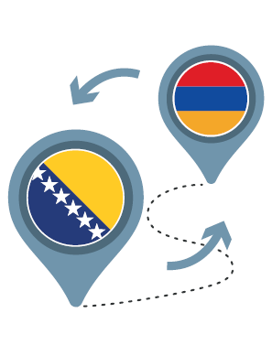
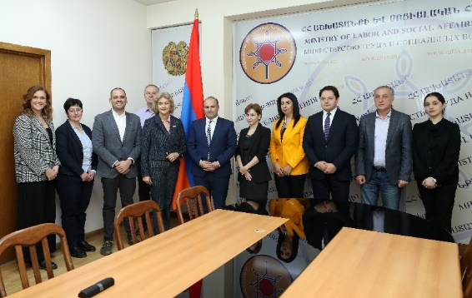
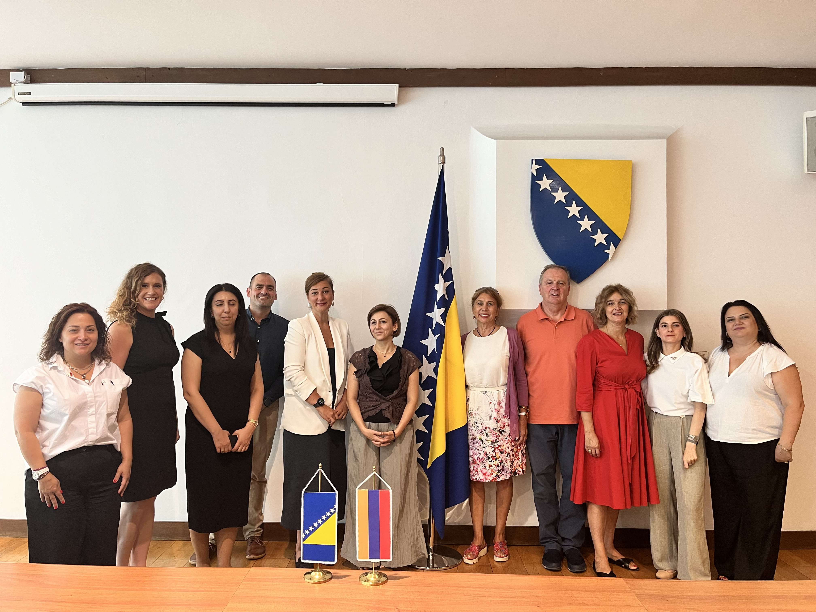
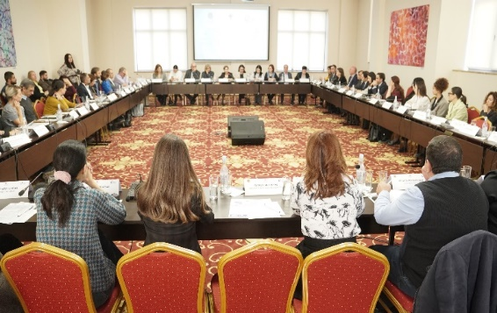
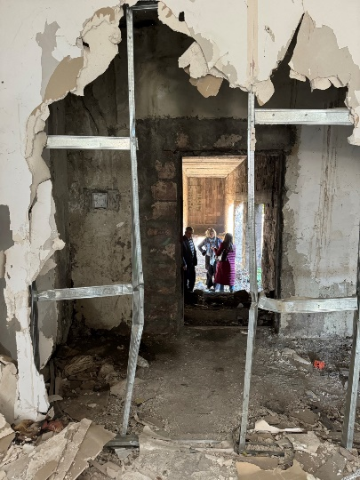
CRS’ Activities in Armenia To Date
Next Steps
Dec - Feb 2024
Complete draft ToRs/BoQs
for three buildings
April 2024
Europe Housing Forum
Participated alongside MLSA and Armenian Caritas
Sep 2 – 6, 2024
Social housing Exchange Visit
Facilitated exchange between BiH government and Armenian government, NGO, and private sector representatives.
Jan – Mar 2024
Mobilize internal & external funding for pilot project
Sept 2023
Nagorno-Karabakh displacement
Mar 2024 – Sep 2026
Implementation
NPSH Pilot Project
Oct-Nov 2024
CRS Field Visit to Armenia
Oct 2023 – July 2024
Assessments
Sep – Oct 2024
Establish Working Group
Co-chairing alongside MLSA, to coordinate technical support and pilot project development.
Oct 2024
Conduct social housing legislative comparative analysis
Between Armenia and BiH social housing legislation.
Oct 2024
Formation of
Armenian Social Housing Consortium
CRS, Caritas Armenia Mission Armenia
Oct 2024 – Ongoing Strengthen RoA’s social housing legislation
Sep – Dec 2026
Opening Ceremony
of NPSH pilot project
Notes:
Following the escalation of the decades-long conflict in Nagorno-Karabakh, in September 2023 more than one hundred thousand Armenians fled to Armenia in need of immediate lifesaving assistance and long-term housing support.
Much like Bosnia and Herzegovina, Armenia is also a country with extremely limited public housing stock due to privatization, with limited legislation, experience and capacity for social housing, and at the same time, with a huge need for housing solutions for large number of people. We knew that we could help Armenia to integrate refugees and support them in housing.
In October 2023, we conducted initial visit to Armenia and established first contact with authorities and partners and present them possible solution through BIH example. Our key partner was Strategic Change Platform for Homes & Communities, which supported us technically and financially. We managed to visit the European Housing Forum in Poland together with representatives of the governments of BiH and Armenia and to organize exchange visits of Armenian representatives to Bosnia and Herzegovina.
Both events were very carefully planned and with clear expected results. We used this exchange visit to present them what we did in the past 15 years, how we did it, what were the key steps and who were the key people in this process. It was very useful to them, and it showed them that we can do it.
This led to signing of the MOU and creating social housing working group and helped us build quality partner relationships with the Ministry of Labor and Social Affairs and local NGOs and site visits for the pilot project. This MOU and working group are a guarantee that we will jointly work on the institutionalization of SH, support the government of Armenia to raise capacities and create a legal framework that will make them eligible for funding from various donors and development banks. We will provide assistance in fundraising, as well in advocacy and raising awareness of the Armenian citizens about benefits of social housing.
We already applied for an almost 4-million-dollar support from UNHCR for the pilot project.
As I approach to the end, I hope I was able to present to you our exciting journey through social housing and catalysing the scale. Like in Bosnia and Herzegovina, Serbia, Montenegro and Armenia, millions of people in the world are in need of adequate housing and our Country program as well as our whole Agency, is striving to support governments efforts to address these needs and provide safe and dignified homes at scale.

Slide 25
Thank you

