Slide 1
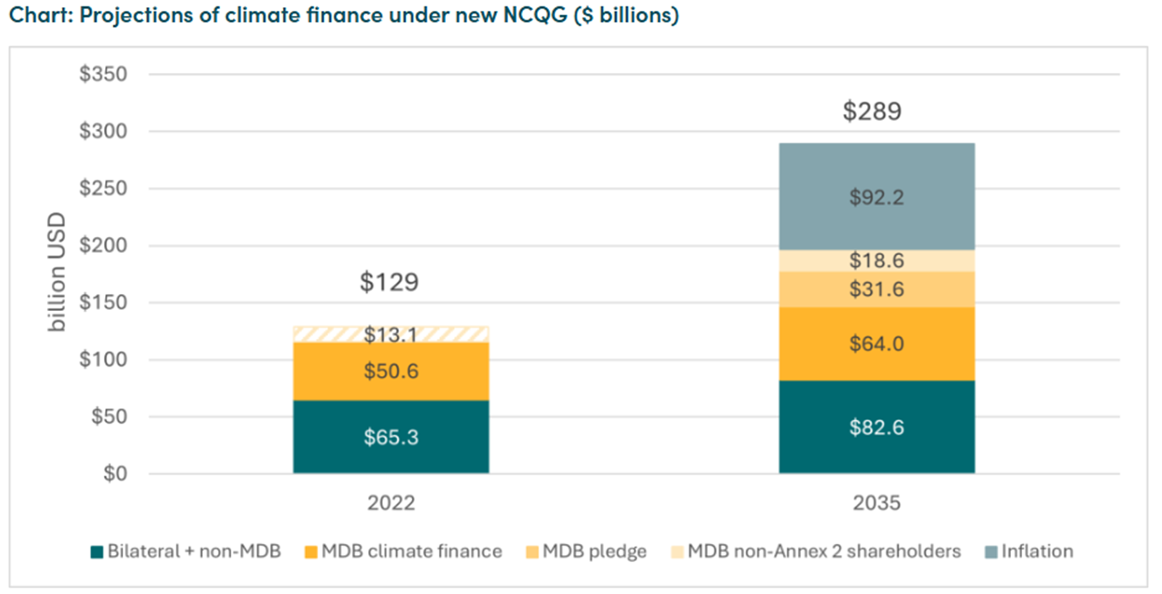
Why $300bn is unambitious
CGD blog: “The $300 Billion COP-Out: And Where We Go from Here”

