Slide 2
The Mainstreaming Initiative: Getting funders to support scaling
NOT TO BE CITED
2-year “action-research” program (see Concept Note, https://scalingcommunityofpractice.com/mainstreaming-the-scaling-agenda/)
Why: Funders can and should play an important role in facilitating scaling, but may be hindering it
Purpose: Inform on current funder practice, draw lessons → promote mainstreaming of scaling by funders
Audience: Funders, recipients, development experts and practitioners
Approach: Maximum involvement by funders for maximum impact
Key areas for year 1 (2023)
13 collaborative case studies of selected funders (posted on www.scalingcommunityofpractice.com
Cooperation with OECD-DAC and MOPAN on scaling principles and evaluation approaches
Interim Synthesis Report by end-March
Key areas for year 2 (2024)
More funder case studies, with a special focus on foundations
Possibly vertical funds, health sector
Recipient perspective
Mainstreaming tracking tool

Slide 3
Case Study Funder Partners
Organization | Phase 1 or 2
GIZ (Germany) | Phase 1 (2023)
Catholic Relief Services (CRS)
Interamerican Development Bank (IDB)
HarvestPlus
Systematic Observations Financing Facility (SOFF)
International Fund for Agricultural Development (IFAD)
Syngenta Foundation (SFSA)
Feed the Future, USAID (FtF)
Grand Challenges Canada (GCC)
IDB-Lab
CGIAR
CARE
Education (blog)
African Development Bank | Phase 2 (2024) ongoing
Global Financing Facility Every Woman Every Child (GFF)
Eleanor Crook Foundation (ECF)

Slide 4
Focus of the Mainstreaming Initiative
Principal focus is on mainstreaming scaling in funder organizations,
not on impact on the scaling process by recipients
Increased scaling by recipients and greater Impact at scale
Initial state of support for scaling in funder organization
Mainstreaming actions by funder organization
Results of main- streaming in terms of funder practice

Slide 5
Potential Funder Roles along the Scaling Pathway
Funders operate (in principle) at different, multiple stages along the scaling pathway
No funder (in sample) covers all stages in any systematic or integrated way
Source: IDIA
Research funders: CGIAR, ECF
Medium size official funders: GIZ, IFAD
Challenge funds/labs: GCC, IDB-Lab
Vertical funds: GFF, SOFF,
Foundations: Syngenta Foundation
Large multi/bilaterals: MDBs, USAID, AFD. IDB
Good news: overlaps in principle
Bad news: big gaps in practice
Large INGOs: CARE, CRS

Slide 6
Funder types
We have identified several differences in types of funders relevant for roles in mainstreaming and scaling pathway/ecosystem
Smaller funders – mostly research and innovation funders or implementers: foundations, challenge funds, small bilaterals. The main challenge:
How to bridge the “valley of death” in funding scaling of innovative solutions (at stages 3 or 4 and beyond); no effective hand-off to larger funders
Large funders – large bilaterals and foundations, MDBs and UN organizations (usually project funders). Their challenges:
Don’t systematically integrate scaling into own designs
Could, but don’t systematically fund/support scaling stages 4-6. No explicit, systematic links between projects and innovations, even when affiliated (IDB/IDB-Lab)
Don’t prepare for effective hand-off at project-end to government, private business and/or other funders to achieve sustainable scaling beyond project end, either in funding or implementation
Result is valley of death for innovations and “pilots to nowhere” for projects here, too

Slide 7
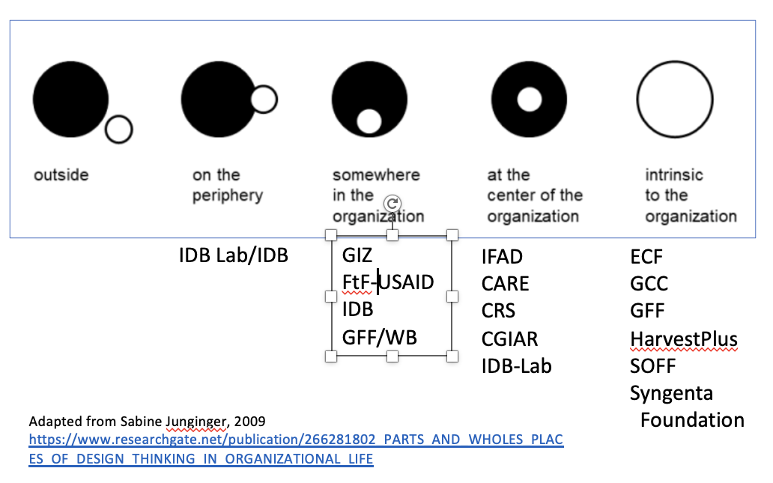
State of mainstreaming
NOT TO BE CITED
Interest by funders in scaling has grown
Confirmed by funder interest in participating in our initiative
Driven by urgency of development and climate challenges and need to demonstrate impact, given constrained financial resources
But mainstreaming in our sample still has a ways to go

Slide 8
Overall Findings: General
A number of organizations have “impact at scale” or scaling explicitly mentioned in their multi-year missions and strategies
Fewer have set explicit targets for impact at scale (HarvestPlus, CGIAR, GCC, IFAD).
Few have created dedicated internal support units; those that exist, have limited leverage with operational units and limited human resources
Little or no integration of scaling into MEAL indicators, frameworks
Ex-post evaluations of most large funders do not focus on scaling (IFAD does).
CGIAR, GCC and other smaller/innovation funders now including more and more
Significant confusion about transactional vs. transformational scaling
Near-universal commitment to leveraging partnerships to scale, actual experience creating scaling partnerships highly variable
Mostly transactional partnerships for larger funders; allows for greater scale, but not scaling
Smaller funders have difficulty finding partners who fund scaling, Stages 5 and 6

Slide 9
Transactional vs. Transformational Scaling
Transactional scaling
Scaling defined simply as “more”: more money, bigger projects, more people or places
Focuses on the impact a one-off project or program is expected to achieve at completion.
Considered in absolute numbers, relation to baseline, not to long-term need, size of the problem.
When transformational scales does occurs after transactional through follow-up projects, usually involve significant and unnecessary costs and delays that could have been avoided.
Transformational scaling
Innovations or projects are pursued with full attention to achieving long-term scale goals and following potential pathways to achieve these goals; directly or through handoffs
Projects/programs are designed, implemented and evaluated as steppingstones to sustainable scale. Preferably scaling continues after handoff to domestic actors
Explicit efforts to address systemic barriers, align intervention with enabling conditions for sustainability
Impacts are measured in relation to the long-term target, size of the problem, denominator

Slide 10
Overall Findings – Small Organizations
More progress on mainstreaming than larger funders, especially foundations and research and innovation organizations
Several organizations (ECF, GCC, Syngenta Foundation, SOFF, HarvestPlus) have largely mainstreamed scaling or are in the process
Several have tried to push ‘downstream’ and/or making explicit handoff, partnership and exit strategies (GCC, Syngenta, HarvestPlus). Includes providing funding for transition to scale (TOS) and filling systems gaps
Changing organizational culture seems easier than for large funders; and more important than changes in operational policies and processes
For innovation funders and implementers, links to large funders remain elusive. Often difficult to find partners for later scaling stages

Slide 11
Overall Findings: Larger Organizations
Integration of guidelines into project/investment design highly variable; mostly not.
Explicit commitment of financial resources for transformational scaling (Stages 5 or 6) uncommon or minimal; when focus on scale or replication, generally transactional
Middle management and frontline staff are overwhelmed by scaling coming on top of too many unfunded cross-cutting theme; e.g. gender, climate change, youth.
Challenging to apply scaling to legacy projects/research. Problems of lack of information on costs, role of context, other requirements. Often threatens internal vested interests.
Change in organizational culture or incentives has yet to happen or very early days
Complex or rigid procurement, contracting, and financial management reporting requirements contrary to iterative, adaptive, learning necessary for scaling
Country ownership and localization work in progress at best, but essential for long-term sustainable impact at scale
Highly risk averse, prefer “successful” one-off projects to risks of long-term sustainable impact that addresses the size of the problem

Slide 12
Lessons: Key Enabling Factors of Mainstreaming
Sustained leadership is the principal driver for organization-wide mainstreaming.
Leadership needs to:
Set organizational scaling vision and explicit targets that can be linked to individual projects/programs
Offer a clear definition of scale and scaling, with focus on transformational scaling
Provide front-line staff with analytical tools, training and knowledge management support combined with access to central technical support, resource people
Formulate operational policies and procedures to integrate scaling into program/investment designs, review criteria and quality assurance
Dedicate financial and human resources for scaling, aligning incentives for staff and management so scaling is understood and implemented as a core mandate

Slide 13
Key Enabling Factors of Mainstreaming (cont.)
Recognize mainstreaming as an “all of organization” effort, integrated into the design and implementation of all other mandates (poverty, gender, climate, etc.)
Integrate scaling into MEAL to generate information for scaling and tracking progress in scaling; and to serve as an accountability mechanism for scaling
Leverage localization through country-led platforms/institutions to pursue coordination and alignment with national and international partners, recognizing that this is not costless
Act as a intermediary for scaling, with support for capacity building and sustained system change, including creating local intermediaries in support of scaling
Explicitly link funding by larger funders to internal and external innovators and smaller funders, provide financial resources and implement scaling at the later scaling stages
Recognize and address tensions and tradeoffs, e.g., between scale v equity; quantity v quality; focus on short-term results v long-term goals

Slide 14
In Conclusion
Funders differ where they are on their mainstreaming journey and in the gaps they need to address.
Three overarching messages define the challenge and opportunity:
Mainstreaming is a complex change management process that requires long-term commitment with a focus on transformational scaling
It requires consistent, sustained senior leadership with integration into processes, with alignment of incentives for mid-level management and staff, esp. in larger organizations and commitment of resources
For effective implementation, mainstreaming needs planning, prioritizing, sequencing, monitoring and evaluation, and mid-course correction.

Slide 15
Annexes

Slide 16
Why Funders (aka Donors)
NOT TO BE CITED
Set or influence program goals, strategies, results and deliverables
Approve strategies designs, workplans
Provide technical assistance, capacity building and policy and institutional reform
Require specific implementation, procurement and M&E practices
If Funders don’t fund it (scaling), the implementers or grantees often can’t/don’t do it
Many NGOs, social enterprises, implementing partners state that they want to scale, but can’t find financial support for scaling
Funding for scaling of innovations proven to be particularly challenging

Slide 17
Specific Questions Addressed
NOT TO BE CITED
What is the overall state of mainstreaming (as represented by this sample)?
Drivers: why funder organizations have pursued mainstreaming
What specific forms mainstreaming is taking (or not)?
What are the key enablers of mainstreaming?
Has mainstreaming integrated proven scaling practices?
What have been the key tradeoffs and tensions in mainstreaming?
What are the lessons for organizations contemplating mainstreaming or looking to go further in mainstreaming?

