Slide 1
Reporting against SDG 4.1.1 Colin Watson, ACER UK 19 March 2024

Slide 2
What are the options for reporting on SDG indicator 4.1.1? – Learning Data Resource Center (unesco.org)
Notes:
As a technical partner of the UNESCO Institute for Statistics (UIS), ACER has been developing methods and tools that countries can use to monitor and report progress towards achieving SDG 4.
The link takes you to a page of options for reporting on SDG 4.1.1a

Slide 3
International and Regional Assessments
4.1.1a
Progress in International Reading Literacy Study (PIRLS)
Trends in International Mathematics and Science Study (TIMSS -4th Grade)
Regional Comparative and Explanatory Study (ERCE)
Programme for the Analysis of Education Systems (PASEC)
Pacific Islands Literacy and Numeracy Assessment (PILNA)

Slide 4
International and Regional Assessments
4.1.1b
PIRLS
TIMSS -4th Grade
ERCE
PASEC
PILNA
Southeast Asia Primary Learning Metrics (SEA-PLM)
The Southern and Eastern Africa Consortium for Monitoring Education Quality (SACMEQ)

Slide 5
International and Regional Assessments
4.1.1c
Programme for International Student Assessment (PISA)
TIMSS -8th Grade

Slide 6
National assessments Global standards
Targeted to local contexts
Provide evidence for local curriculum, pedagogy and policy
Build local capacity in assessment development, analysis and reporting
Are set in learning areas universally accepted as critical to learning
Results are internationally comparable
Can be used as reference points in national assessments
Notes:
However, this excludes a significant number of countries, typically in low and middle income contexts, that are not regularly participating in international assessments.
Also, using national assessments for global monitoring provides an additional, global perspective to locally relevant data, and helps to build local capacity in assessment development, analysis and reporting.
That’s why we wanted to be involved in developing methods that enable countries to use their own national learning assessments for global monitoring.

Slide 7
Quality criteria for national assessments
Notes:
UIS, with support of a technical advisory group, are currently finalising a range of criteria that a national assessment must meet in order to be eligible for SDG reporting. It is anticipated that the next (maybe final) draft of these will be ready by end of March.
All evidence that an assessment meets these criteria must be in the public domain.

Slide 8
Eligibility Criteria
Is the assessment aligned to the MPL and GPF?
Is there evidence that the items in the assessment have been reviewed qualitatively and quantitatively?
Is the sample of learners that took the assessment representative of the population against which the results will be reporting?
Notes:
These are the draft criteria and are subject to change

Slide 9
Eligibility Criteria
Is there evidence that the assessment was administered in an appropriate and standardized way?
Is the assessment sufficiently reliable?
How does the assessment link to the MPL?

Slide 10
Linking national assessments to global standards
Notes:
The preferred method is some form of statistical linking, using a common person design (learners take the national assessment alongside an assessment that is already linked to the MPL such as AMPL). This, however, can be expensive and so two judgemental methods have been proposed – Policy Linking and the Pairwise Comparison Method.

Slide 11
Assessment for Minimum Proficiency Level (AMPL)
AMPLs are robust tools to measure the attainment of a single proficiency level (a or b) for reading and mathematics at a given level of the education cycle.
AMPLs allow to identify the proportion of learners achieving at least the Minimum Proficiency Level (MPL).
https://ampl.uis.unesco.org/
Notes:
Administration of AMPL is managed by UIS and countries wishing to implement AMPL must gain approval from UIS.
The website provides lots of information about AMPL, including a report on the most recent administrations in 2023 in The Gambia, Kenya, Lesotho and Zambia

Slide 12
Linking a national assessment to AMPL
Standalone
Administering AMPL to a sample of learners at around the same time as the national assessment is administered
Integrated
Including a portion of the AMPL into the national assessment
Notes:
You can administer the AMPL as standalone without linking to the national assessment (as most countries to date have) but this means the national assessment cannot be used for reporting.
To date, no country has administered an integrated AMPL.

Slide 13
The Pairwise Comparison Method
Notes:
Policy linking has been around for a while, so I won’t discuss here (the toolkit is available at https://gaml.uis.unesco.org/policy-linking/)
Instead, I’ll focus on the PCM

Slide 14
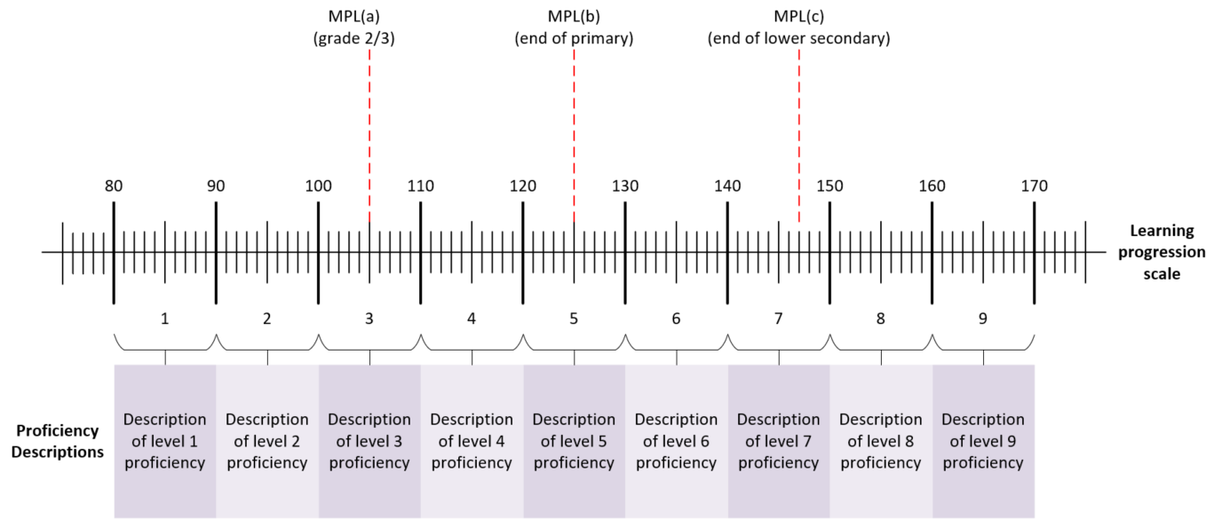
Learning progression scale with MPL benchmarks
https://learning-progression-explorer.acer.org/
https://tcg.uis.unesco.org/wp-content/uploads/sites/4/2022/11/WG_GAML_5_ISSE_ACER.pdf
Notes:
ACER has created an empirical learning progression using items from a range of assessments (in English) and conducted an international standard setting exercise to locate the MPLs on that scale.
More information about the learning progression and the international standard setting exercise is available at the links.

Slide 15
The Pairwise Comparison Method – steps
Step 1: a self-assessment to determine whether the assessment instrument is of sufficient validity to be suitable for SDG 4.1.1 reporting.
Step 2: a pairwise comparisons exercise to place items from the assessment instrument onto the Learning Progression Scale (LPS).
Step 3: statistical, common items, linking to place MPL benchmarks on the assessment instrument reporting scale.

Slide 16
Step 1 – assessment appropriateness
See earlier slide regarding eligibility criteria

Slide 17
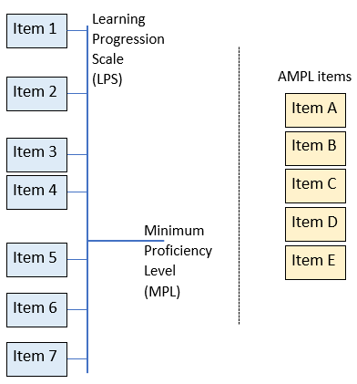
Step 2 – the Pairwise Comparison Method
Twos sets of items:
One set that are already mapped to the learning progression scale
One set from A.N.Other assessment that we wish to map onto the scale

Slide 18
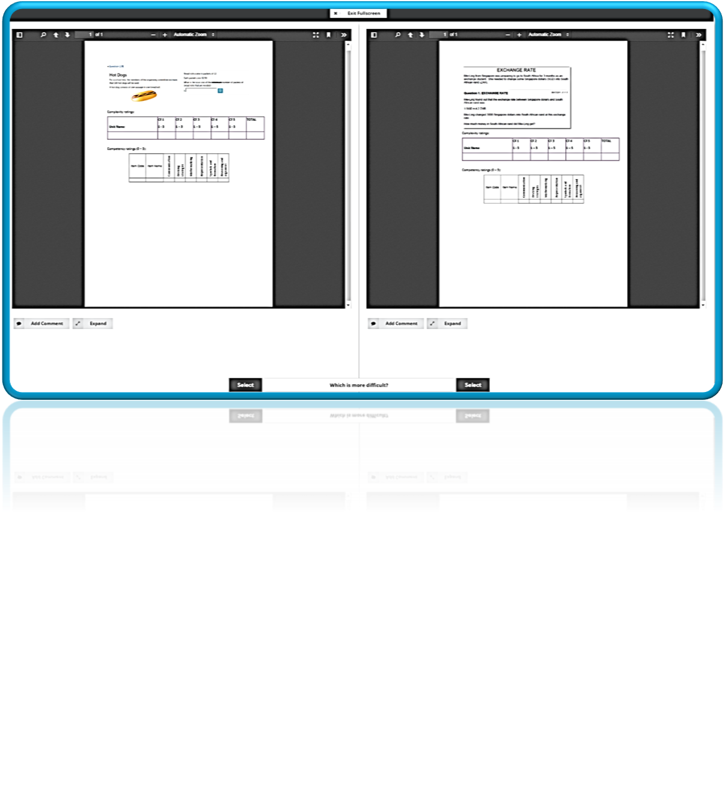
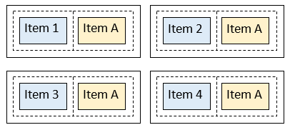
Step 2 – the Pairwise Comparison Method
Consider pairs of items at a time
Which of the pair of items is more difficult?
Notes:
As with any standard pairwise comparison exercise, items across these two sets are compared in pairs – multiple times. That is, we see one item many times during the process as we compare it to many others, one at a time.
In the example here, item A is a new item that is being compared to existing items 1, 2, 3 and 4.

Slide 19
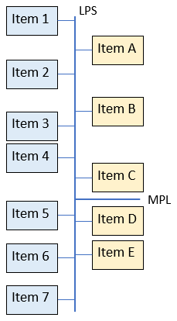
Step 3 – statistical linking to set MPL benchmarks
Once all the comparisons are made, we can map the new items on the same scale as the old items
We can also determine the cut score on A.N.Other assessment that equates to the minimum proficiency level
Notes:
Combining the comparisons of many judges allows us to place the new set of items into a difficulty order, and through the comparisons with the existing item set we can map these new items to the existing scale.

Slide 20
PCM advantages for setting global benchmarks
Cheaper and faster than other statistical linking methods.
Panellist training is simple and does not require extensive preparation.
Can be implemented consistently using an online application.
New assessment items can be added to LPS to build an invaluable resource to support capacity development and strengthen the LPS and SDG 4.1.1 reporting.

Slide 21
Evaluating the PCM core postulate
ACER conducted studies to determine the efficacy of the approach. Here we present the evidence relating to the following questions:
How good are judges at determining item difficulty?
Strong correlation between outcomes of PCM and empirical item difficulty (r=0.96 for reading and r=0.93 for mathematics)
Do different judges produce the same outcomes?
Strong correlation between two different sets of judges (r=0.97 for reading and r=0.94 mathematics
Pairwise Comparison Method: Concept note – Global Alliance for Measuring Learning (GAML) paper, November 2022. https://tcg.uis.unesco.org/wp-content/uploads/sites/4/2022/11/WG_GAML_12_Pairwise-Comparison-Method_ACER.pdf

Slide 22
Operational deployment
ACER and UIS have published a toolkit for implementing the PCM – https://research.acer.edu.au/gem/20/
Item exposure rate should be set to at least 40
At least 15 judges should participate in an exercise, more is desirable
The number of comparisons by each judge does not seem to have an impact on the reliability of item location estimates
The exercise can be successfully done remotely
Notes:
Based on our studies, we have determined that PCM provides reliable item location estimates enabling robust statistical linking of assessment instruments and MPLs cut-scores via LPSs

Slide 23
Thank You Colin.Watson@acer.uk

