Slide 2
POLITICAL ECONOMY OF SCALING-UP. BASIC HEALTH SERVICES IN AFGHGHANISTAN
Scaling Up Community of Practice
Annual Forum 2024
Alastair McKechnie
Senior Research Associate, ODI

Slide 3
Health sector in Afghanistan in 2002 Initial conditions
Emerging from 30 years of war, 3 years of drought and risk of famine. Almost total collapse of public administration.
Health indicators, e.g. maternal mortality, infant mortality among lowest in world.
Non-functional Ministry of Public Health due to exodus of medical staff to NGOs & abroad, very low-quality administration under Taliban, no direct funding.
Health services provided mainly by NGOs:
Humanitarian based -- no system for setting and meeting priorities. -- no coordination at either national, regional or provincial levels.
Geographically scattered -- underserved regions – service driven by NGO/donor priorities, security, accessibility, local attitudes towards foreigners;
NGO funding -- project-based, volatile and not planned to be long-term.

Slide 4
A confused, chaotic initial international response in 2002
Quick action to secure peace demanded by Afghanistan’s international partners. New government had clear strategic priorities and wanted funding & coordination through national budget.
Most donors had little knowledge of Afghanistan, although the UN and NGOs did. Donors assumed there was no Afghan institutional capacity, after not looking very hard to find any.
Humanitarian surge with large amount of funding to continue especially for health of women & children. Scramble by NGOs and UN to secure funding, with incentives to over-promise.
Short-termism, no strategy for what comes next, little to strengthen MoPH or conceptualize Afghanistan’s health system, or systematically connect priorities, strategy, equitable access to services and national health outcomes at scale.
Donors multiplied and coordination problems got worse.
World Bank decided not to fund health or education in its first interim country strategy. Social sectors relatively overfunded, driven by donors, chaotic and lacked coherent approaches. Bank offered assistance to emerging MoPH -- strategic advice and funding of any gaps. It also established Afghanistan Reconstruction Trust Fund (ARTF) to pool and coordinate donor funding around national priorities across all sectors. This was expected to be small.

Slide 5
2002 - 2003 -- Initiation of a national programme to provide a package of basic health services at scale. Key principles:
Establish architecture of national health system –public finance + non-state (mostly) service delivery – progamme, not project approach
Aim for national coverage
365 Districts
New role of MoPH as ‘steward’ of health sector rather than provider
Short-term (1 yr) results. Rapidly getting to full scale (5 yrs)
Build on existing capacity of NGOs. NGOs bid competitively for provincial health delivery franchises
Design based on X-country & X-sector learning --avoided pilot phase
Establish sustainable model for long-term funding
Incentives to minimize costs for given service level. Long-term affordability -- $4 per capita per yr.
Establish system for monitoring health inputs, outputs, health outcomes & patient satisfaction – results measurement in real time, adaptive management & NGO contestability.

Slide 6
Outcomes: Did it work?
Short term results exceeded our expectations.
Fall in infant mortality equivalent of 80,000 children’s lives saved each year (total population then around 30 million).
Success strengthened government support (Palace, Finance).
Donor scepticism changed to donor support & claims of ownership.
Donor money ‘crowded in’ as donors ramped up financing, mainly through ARTF, which improved coordination, and claimed credit for the programme.
ARTF platform strengthened coordination around government leadership, priorities and budget.
Success in health sector reinforced support for National Programme concept in other sectors, e.g. rural development, education, with similar scaling-up, financing and coordination benefits.
Note: ‘Baseline’ was at 2002. ‘Current Status’ was at 2007. Some of the data presented were collected through household surveys in November 2006. More recent data from HMIS system (e.g. DPT3 coverage) showed further gains.
Source: World Bank (2008)

Slide 7
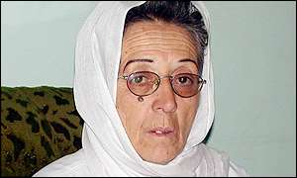
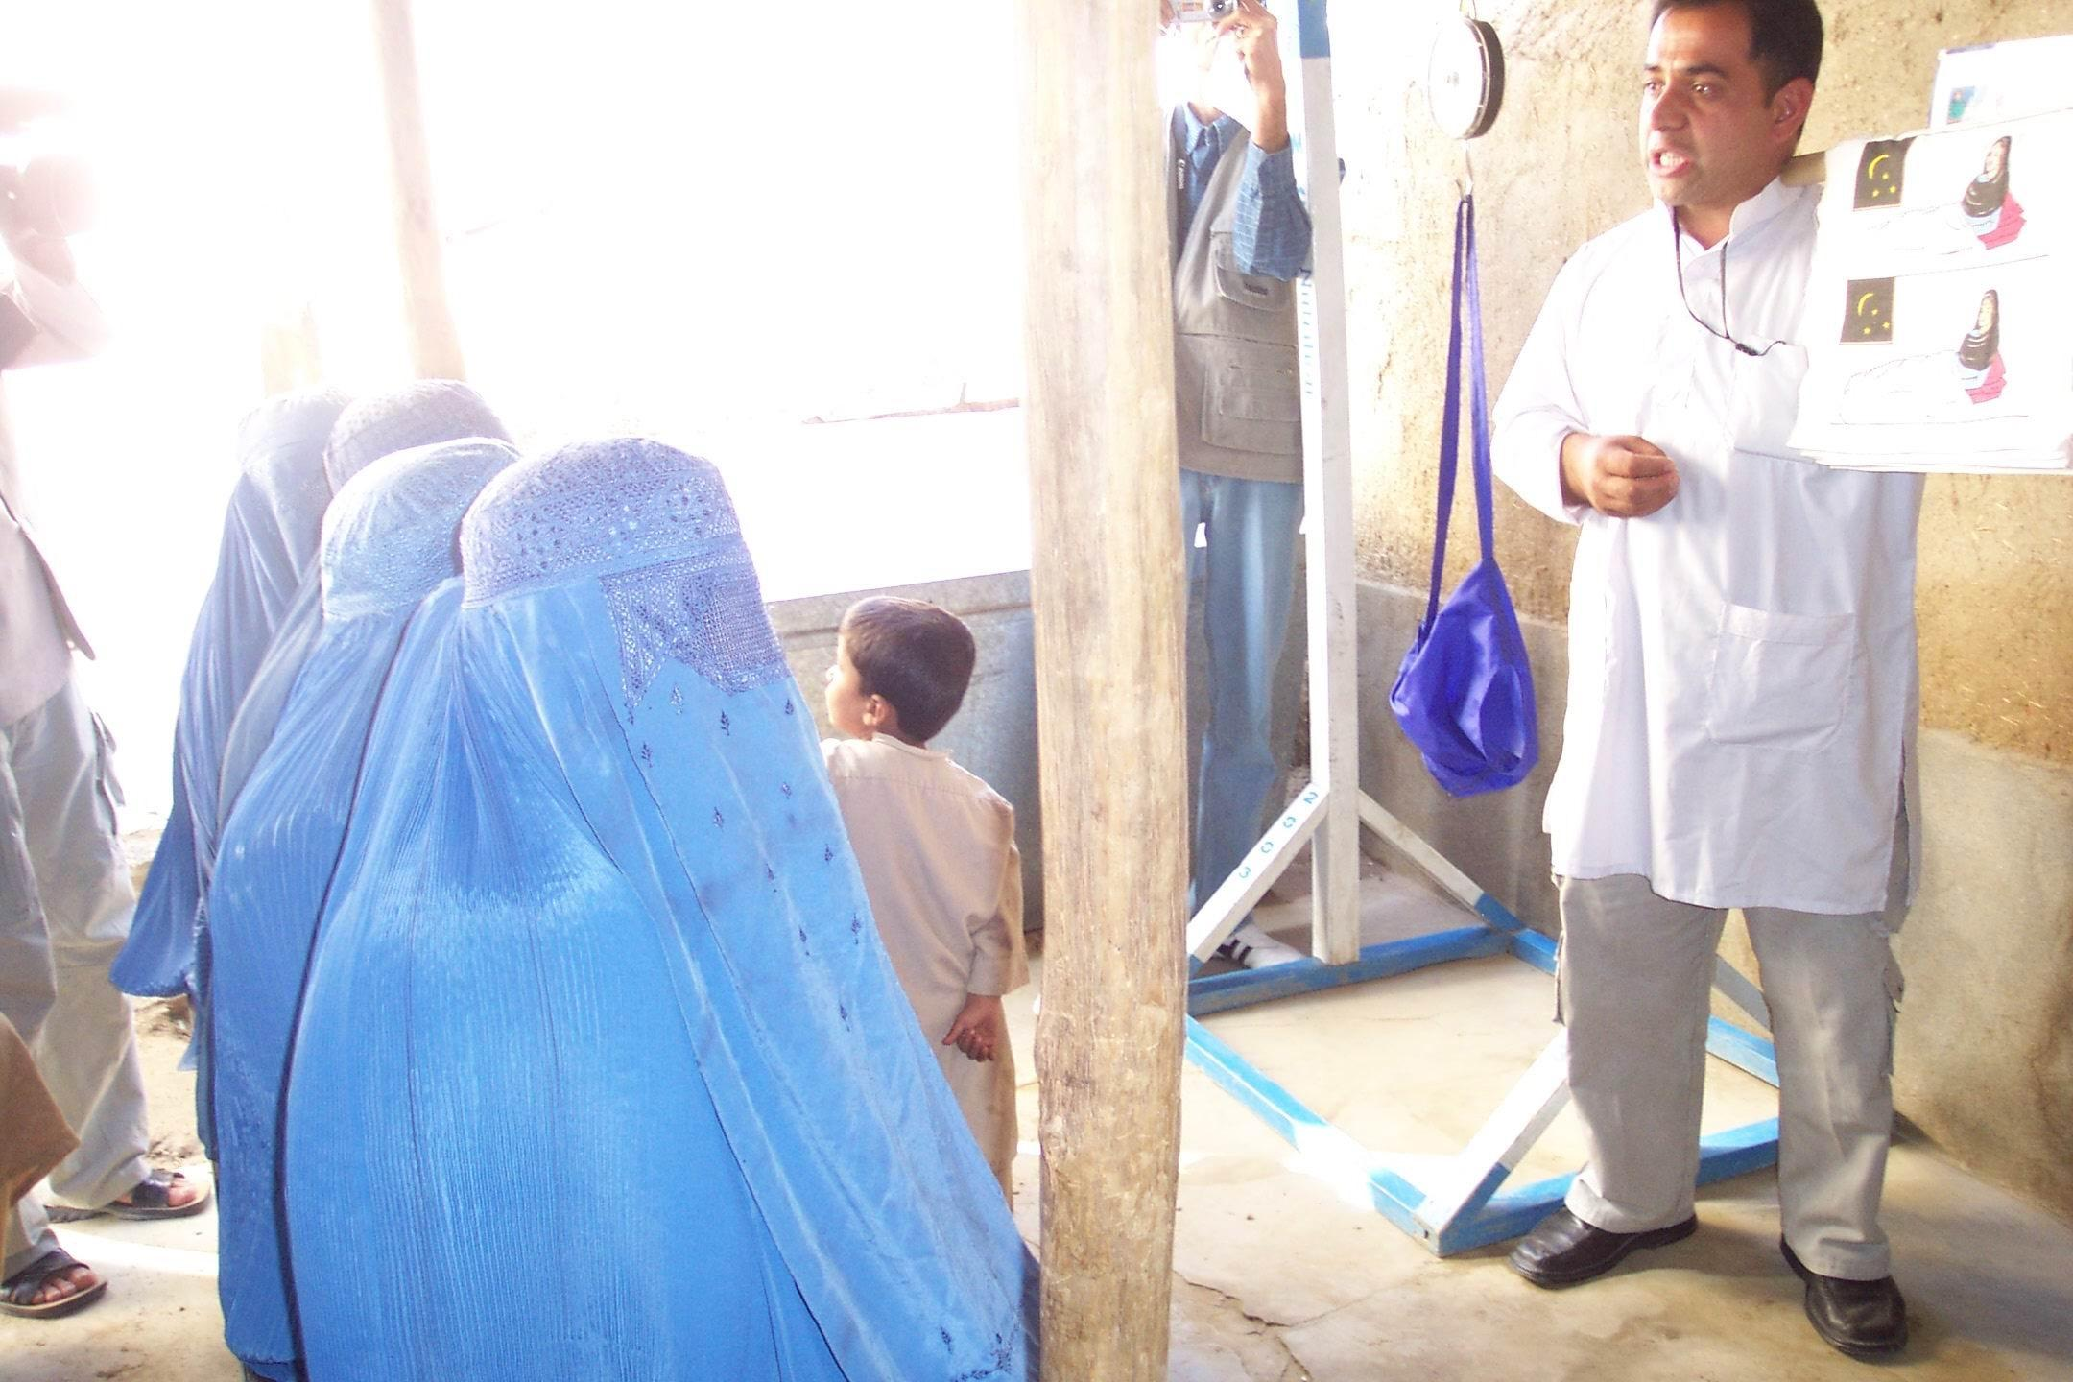
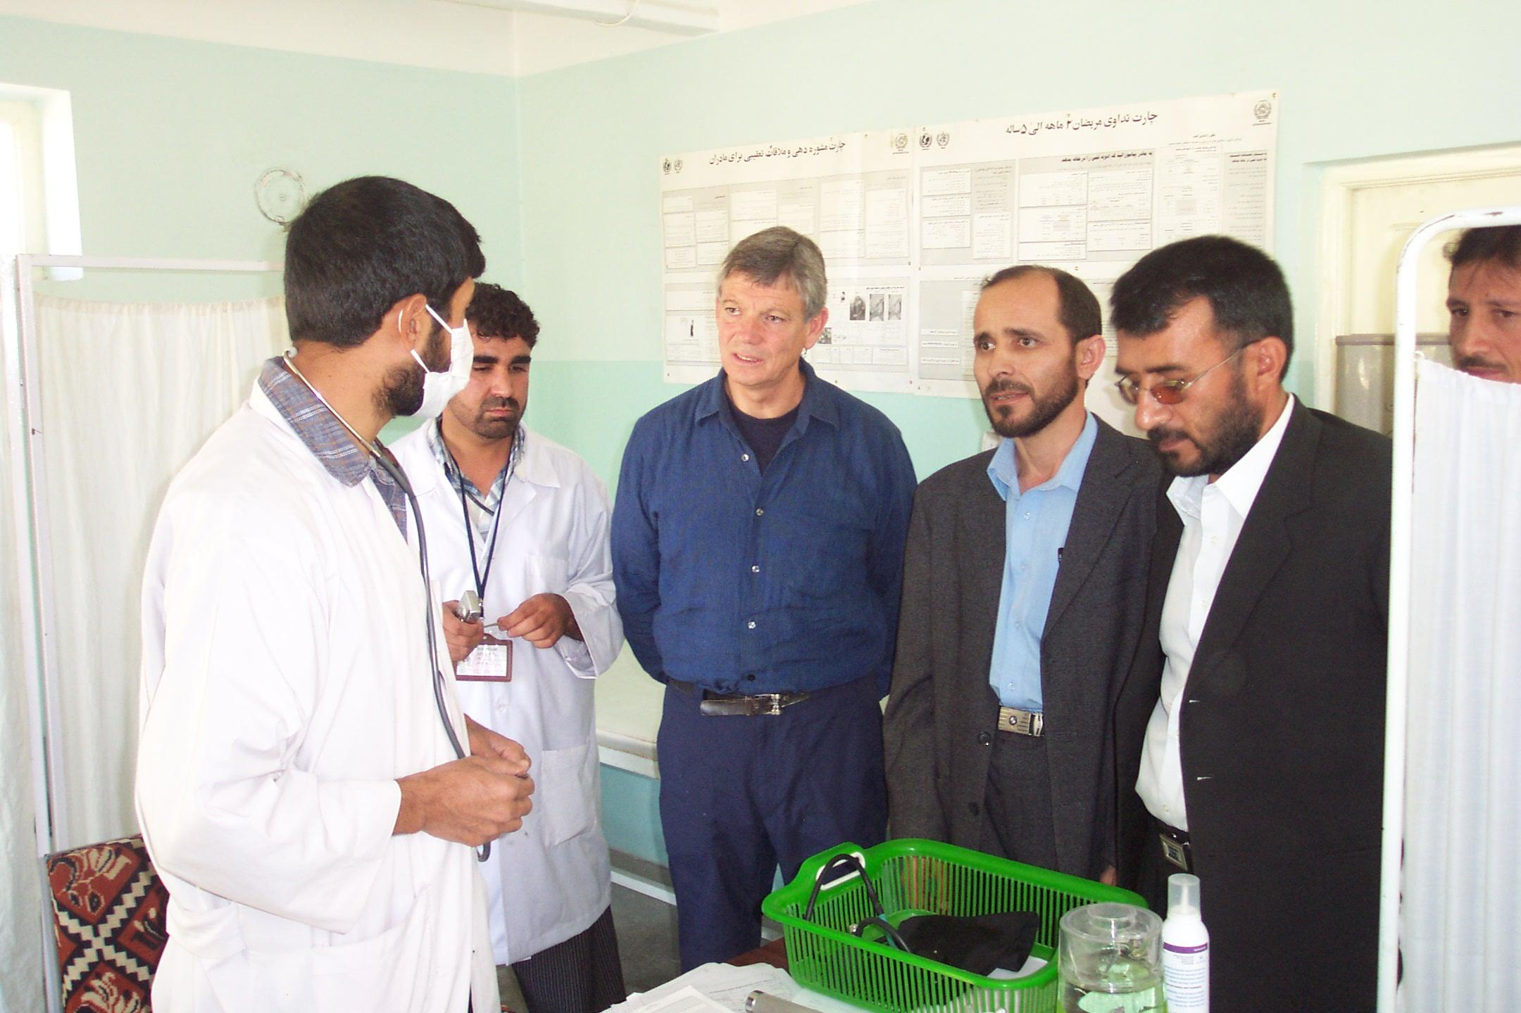
Political economy of getting to scale: some lessons
Lt Gen Suhaila Siddiq (1949 – 2020)
Minister of Public Health 2001 - 2004
Maternal health education at clinic 2006
World Bank Managing Director Graeme Wheeler visit to clinic 2006

Slide 8
Navigating the political economy. Reinforcing the interests of stakeholders.
International Partners
Some strongly opposed in joint letter “experimenting with Afghans”, “need proven approaches” to keep peace.
Staff seemed threatened by loss of role and power related to ‘their’ projects.
One tried to get WB to fire its project leader because of perceived insult.
Bilaterals & EU became partners in the programme when they saw its success.
Strong support from sovereign government brought partners into line.
MoPH
Reformist, unconventional minister (woman, General in Soviet-era Afghan army).
Technocratic deputy ministers from diaspora, drove programme.
Ministry staff – 2 provincial franchises under same terms as NGOs. Could qualify for new higher paid roles (Govt civil service reform).
Procurement under WB rules & monitoring reduced opportunities for rent-seeking.
Early results, embedded change & broad support enabled approach to survive changes in minister.
Rest of Government
President: liked +ve results, family circumstances potentially helpful, health inherently technocratic and at lower risk from patronage system.
Finance ministry: Wanted national programmes, not projects. Supported pooling of funds and better donor coordination. Liked financial sustainability.
Others: Supported NGOs operating within Afghan-led framework. Programme not part of a parallel govt.
NGOs
Apprehension at first, but persuaded that there would be enough work for most.
Saw advantage of predictable, secure, multi-year funding.
Renewable contracts when performance adequate created confidence in system.
Incentivized to localize with Afghan staff.
Rising insecurity led to scaling back in some regions.
Insurgents & warlords
Limited opportunities for rent-seeking.
Wary of interfering with programme with strong local support.
Health services available to all local residents.
Increased insecurity – low results for what as seen as govt/foreign programme.
Afghan People
Appreciated local access to health services, lower risks of mortality & morbidity, especially for women & children, and quality & responsiveness of service.
Protected facilities with local ‘ownership’.

Slide 9
Insecurity reduced results in insurgency-prone provinces.
Military-based approaches, e.g. through Provincial Reconstruction Teams failed to achieve both security and non-transient health results.
Security and results could not be achieved without a durable political settlement at the local level. For more on the complexities of Helmand see Malkasian, 2021.
2006 Taliban Offensive
+30% yr 1
Source: World Bank, 2008.

Slide 10
Managing the political economy
Reinforce strong effective leadership in MoPH: their programme, nurture their credibility to convince Afghan stakeholders and international partners of what Government wanted. ‘Working with the grain’.
Build allies in Government e.g. Finance, reformist ministers-- broadening & deepening support and momentum.
Early results to build credibility. Insufficient time for a pilot –- Afghan children would die. Accessed global knowledge & using base of existing in-country NGO capacity lowered risks of quickly going to scale and began to convince stakeholders that risks of failure were acceptable.
Early results as part of long-term strategy for country permanent institutional architecture and financially sustaintable service delivery.
No time for formal political economy analysis - not much base information at the time – therefore quality of senior staff, especially their facilitation skills and their judgement and ability to learn and adapt critical.
Quality of team leader (World Bank) critical to the success of a programme that got results at scale.
Management support at the Bank -- from the President down, broadened support at high government levels and among senior representatives of international partners & military.
Health consultative group meetings were useful initially to convince NGOs that the new arrangements would be favourable to them, and to slowly build the support of international partners.
Pooled funding arrangements – multi-partner trust fund – enabled funding to be mobilized quickly to achieve scale, to create a platform for problem solving, more efficient coordination around budget constraint, transparent accountability and to build trust among the parties. (N.B. trust fund was not just for the health sector, which created higher level interest by government and its partners).
Health system monitoring + Coms (Johns Hopkins 3rd party monitoring, then MoPH) 🡪 adaptive programme management, benchmarking of NGO providers. Linked to communications 🡪support for the programme -- “80,000 children’s lives save each year”
‘Nothing succeeds like success’ -- timely results matter to build support for getting to scale.

Slide 11
Epilogue
Programme to deliver basic package of health services evolved into System Enhancement for Health Action in Transition (SEHAT), one of the last government’s priority national programmes.
The programme has continued since the Taliban administration took over in August 2021, perhaps the greatest test of the programme’s resilience. It is still shown on the MoPH website. The latest ARTF health financing operation started in May 2022.
In 2023 ARTF received only $43 million from one donor (Germany). External (in)action and limited tax revenue from depressed economy could derail successful programmes.
The future of the programme depends on relations between Afghanistan and the international community which affects financing and the ability of NGOs to operate.
Afghanistan is currently under international sanctions with some flexibility for humanitarian action.
Current donor government polices favour a ‘humanitarian-only approach, which could lead to a return the situation identified in 2002 at the beginning of the National government

Slide 13
Bibliography
Benderly, B. (undated) Getting health results in Afghanistan – results-based financing for health. World Bank
Hansen, P., et al (2008) Measuring and managing progress in the establishment of basic health services: the Afghanistan Health Sector Balanced Scorecard. Int J Health Plann Mgmnt (2008). DOI: 10.1002/hpm.931
Loevinsohn, B, & Sayed, D.S. (2008) Lessons from the health sector in Afghanistan: how progress can be made in difficult circumstances. JAMA 2008;300(6):724-726. DOI: 10.1001/jama.300.6.724
Newbrander, W., et al (2014) Afghanistan’s Basic Package of Health Services: its development and effects on rebuilding the health system. Global Public Health, 9:sup1, S6-S28. DOI: 10.1080/17441692.2014.91635
Malkasian , C. (2021) The American war in Afghanistan. Oxford. DOI: 10.1093/oso/9780197550779.001.0001
World Bank (2008), Second additional financing for health sector emergency reconstruction and development project. Project Paper.
World Bank (2010), Health sector emergency reconstruction and development project. Implementation completion and results report.
World Bank (2013), System enhancement for health action in transition project. Emergency project paper.

