Slide 1
Embedded Labs
Learning governments for better policy
March 2024

Slide 2
Outline
Embedded Lab model & evolution
Rwanda Embedded Evidence Lab & learnings

Slide 3
Embedded lab model & evolution
Notes:
First to take a look at the embedded lab model that we are currently using, and to talk a bit about how that has evolved since the MineduLAB times

Slide 4
1
Policy impact Improvement of outcomes at national scale
Policy challenges → Mapping and prioritizing needs for data and evidence, and articulating them into policy questions
Embedded Lab
Learning cycle
Embedded Evidence Lab Team within government
3
Policy driven data and evidence creation → Descriptive, predictive, causal research
Applying evidence to policy → Communication, dissemination, translation, technical assistance
2
Notes:
First just to motivate this again: Supporting governments in using data and evidence is key for tackling poverty. By partnering with government we can:
To harness their capacity to reach millions of people and mobilizing billions of USD.
Nevertheless, government can confront multiple challenges when it comes to use of data and evidence, for example:
They lack of - or have - poor data infrastructure, and data can be of low quality
They may lack of contextualized evidence,
They may also lack of defined process and structures to undertake this efforts and incorporates these data and evidence into a systematic process of evidence use
Supporting governments to address these challenges is at the core of what we do.
An Embedded Lab as the graphic demonstrates support governments address these challenges in using data evidence through institutionalizing a learning cycle that:
Identifies policy challenges that governments confront
Translates those challenges into research questions that are addressed through data and evidence including descriptive and predictive analysis, and causal evidence on the effectiveness of interventions.
The Lab then connects the results with decision makers, and provides technical and policy assistance to facilitate use of evidence for impact
Following the learning cycle allows the government to perform this tasks in a routinary way, with a clear path to integrating the use of data and evidence into the policy cycle.

Slide 5
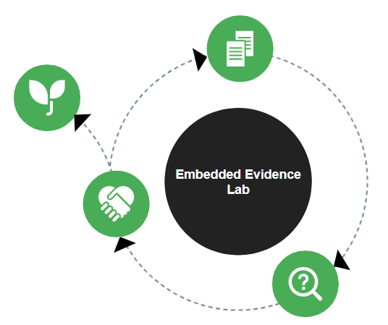
Institutionalized
within the government
Adjusted to the context and needs
Governance - an institutional structure that runs and links each step of the cycle
Capacity individual and institutional fostering data and evidence use and demand
Resources sustaining the Lab team and its cycle
Notes:
In order for government to take on the dat and evidence activities that would enable and improve their work, the Embedded Lab should be owned by government to foster demand and use, and to be sustainable across time. With that goal IPA works with the government to institutionalize the Embedded Lab by:
Adapting the learning cycle to the needs and context
Designing an institutional structure that coordinates connects each step of the cycle
Strengthening capacity in the system to be able to implement the cycle
And ensuring the allocation of resources for the sustainability of the Embedded Lab
“Institutionalization is the process by which a set of activities becomes an integral and sustainable part of a formal system.”

Slide 6
Embedded Labs Portfolio - January 2024
BURKINA FASO
LAB PIPELINE
Partner: Ministry of Agriculture
GHANA
PHILIPPINES
PHASE 1-2 | Scoping, cultivating support → Establishing Proof of Concept
Partner: Ministry of Education
Partner: Supreme Court
GUINEA-BISSAU
PHILIPPINES
PHASE 3-4 | Learn by doing → Establishing the Lab as an Institution
DOMINICAN REPUBLIC
Partner: National Institute of Statistics
Partner: Department of Education
SIERRA LEONE
NIGERIA
PHASE 5 | Exit Strategy
Partner: Banking Superintendence
Partner: Central Bank of Nigeria
Partner: Ministry of Education
NIGERIA
COLOMBIA
Partner: NAPTIP
Partner: Inspector Attorney General Office*
NIGERIA
COSTA RICA
Partner: National Social Investment Programme
Partner: Ministry of Education
COLOMBIA
Partner: Instituto Colombiano de Bienestar Familiar
KENYA
Partner: Ministry of Education
PERU
COLOMBIA
TOGO
Partner: Ministry of Education*
Partner: Banca de Oportunidades
Partner: Ministry of Digital Economy
UGANDA
PERU
Partner: Ministry of Education & Sports
Partner: Ministry of Development *
RWANDA
PERU
Partner: Ministry of Education
Partner: Ministry of Health
LIBERIA
CÔTE D’IVOIRE
PERU
Partner: Ministry of Education
Partner: Ministry of Employment
RWANDA
Partner: OEFA
ZAMBIA
Partner: Gender Monitoring Office
PERU
CÔTE D’IVOIRE
Partner: Ministry of Education
Partner: INDECOPI
Partner: Ministry of Education
RWANDA
ZAMBIA
Partner: Ministry of Local Government
*IPA has exited, and these labs function mostly independently at this time.
Partner: Ministry of Community Development
Notes:
This is the process that we are working to embed with governments in 16 countries - note the expansion of labs in Peru

Slide 7
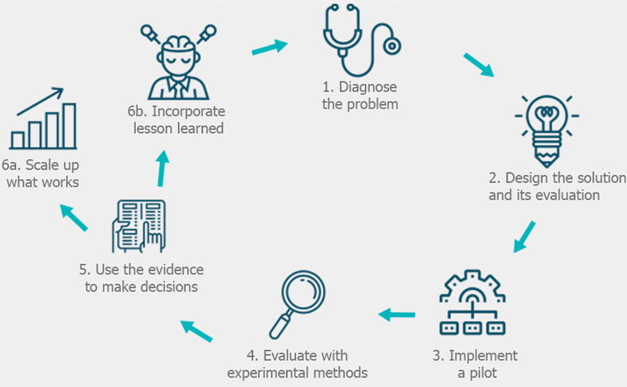
Adapting
to context
Adjusted to the context and needs
Governance - an institutional structure that runs and links each step of the cycle
Capacity individual and institutional fostering data and evidence use and demand
Resources sustaining the Lab team and its cycle
Notes:
Has the model stayed the same through this expansion? Not quite!
You will notice that this cycle looks much like the MineduLAB cycle! To make it transferable and applicable to more contexts, and based on learnings around what works to influence systemic change, the cycle was:
simplified - narrowed down to the essential steps in the process. That way, each step can be adapted appropriately to the context
However, over time the application of this cycle has been expanded; we are now taking a more “sectoral” or systemic approach to the lab and what it takes on. That is, the lab model at this point aims to address more than just one discrete policy challenge at a time. It is aiming to promote systemic change and affect organizational culture and decision making, and is also a response to the much wider variety of systems and sectors that our labs are operating in these days, and to fill gaps and meet opportunities in those contexts.
For example, in Peru, the context already had a fair amount happening in the data space in public education and Minedu - data, semáforo escuela, analysis existing. So what MineduLAB added was experimentation. That was identified through the co-design process as the thing that could be added.
In other contexts, some of these pieces are missing and so there is a co-design process to understand whether and how the lab should complement or supplement these elements

Slide 8
What does a Lab offer?
Data
reliable, available
& actionable
Improving availability and quality of data in the system
Designing and improving Monitoring, Evaluation and Learning routines
Creation
of data products and evidence
Research and learning agendas
Descriptive and predictive analysis for decision making
Intervention design and piloting
Impact evaluation to assess the effectiveness of a policy
Use
data & evidence
for policy making
Making results accessible and engaging with decision makers
Facilitating the use of evidence through scaling and other policy support
Notes:
Here we can see a wider list of activities and services that labs are conducting nowadays.
Expansion of services since MineduLAB

Slide 9
What does a Lab offer?
Data
reliable, available
& actionable
Improving availability and quality of data in the system
Designing and improving Monitoring, Evaluation and Learning routines
Creation
of data products and evidence
Research and learning agendas
Descriptive and predictive analysis for decision making
Intervention design and piloting
Impact evaluation to assess the effectiveness of a policy
Use
data & evidence
for policy making
Making results accessible and engaging with decision makers
Facilitating the use of evidence through scaling and other policy support
Notes:
To give some examples, of the more “systemic” or sectoral approach, take a closer look at some of the services → Particularly for the first step in the learning cycle [identification of the challenges that the lab will take on], there are some important additions to the services menu, and also an expanded application of these activities to give the lab a better chance of systematically influencing change.
One critical addition to the model has been around collaboratively defining a research and learning agenda for the lab that is agreed on together with locally-based researchers and policymakers, to bring alignment between research and policy priorities across the sector in which the lab is situated. [Can mention Zambia and Ghana examples here]. Of course, MineduLAB also had a research agenda, sourced from within Minedu and responded to by external PIs, but we have found that in a wider variety of settings, the research and learning agenda needs to be more flexibly interpreted and customized for each setting.
Additionally, there is also a more robust mapping of data and evidence use within the partner government. MineduLAB started with a data mapping, but this exercise has been expanded to try to provide an understanding of not just data availability but also data use as well as evidence use. This is partly because we are increasingly working in contexts where administrative data is not as available, so mapping it is not as informative, but it’s also a recognition that data availability is really different than data and evidence use, and to actually increase the use of evidence in policy in a routine, systematic way, we have to begin with a broad understanding of that dimension.
Research and learning agenda - expanded because of new learning strategies available. There is an open concept of what the agenda can be and more possibilities available.
Mineduelab - PIs take care of existing evidence and the learning strategy. They called for challenges that internal stakeholders wanted to solve. ML was a tool.

Slide 10
The Lab service offering is
tailored to the context
Peru
2014
Colombia
2022
Rwanda
2019
Côte d’Ivoire 2022
Data
reliable, available
& actionable
Improving data
Design and improvement of MEL
Descriptive analysis
Intervention design and piloting
Impact evaluation
Creation
of data products and evidence
Use
data & evidence
for policy making
Results accesible
Facilitating use of evidence
* 4 Embedded Labs in education and the year they started operations
Notes:
Here is a comparative look of services tailored to context
Services of four education labs - responding to feasibility and demand
Each country can tailor services to what is feasible and needed in country - they can be expanded over time
Note evolution since MineduLAB

Slide 11
Rwanda Embedded Evidence Lab

Slide 12
Lab workstreams
Rwanda Embedded Evidence Lab
Institutionalize and strengthen a culture of evidence-based decision-making
→ Research co-creation & capacity sharing
1
In collaboration with the Ministry of Education and gui2de, IPA has embedded three full-time staff in the Rwanda Education Board (REB), National Examination and School Inspection Authority(NESA), and the Ministry of Education (MINEDUC) to support national systems changes.
Centralized teacher assignment
2
Comprehensive Assessment
3
STARS: Supporting Teacher Achievement in Rwandan Schools
→ Scaling up an evidence-based teacher incentive program through imihigo
4
Notes:
Institutionalize and strengthen a culture of evidence and data use - agreement on the research and learning agenda, a series of targeted capacity sharing activities aligned to specific requests and opportunities
Two specific system-level supports: centralized and digitized teacher assignment, and support for the comprehensive assessment management information system, which I’ll talk more about
A specific scale up of an evidence-based program contextualized to Rwanda, which is an incentive scheme for teachers that aligns with the government’s imihigo or program of bonuses for civil servants

Slide 13
Comprehensive Assessment
& Comprehensive Assessment Management Information System (CAMIS)
2019 | 2020-21 | 2022 | 2023
Policy mandate | Pilot & Co-creation | Policy influence | Path to scale for CAMIS
Cabinet resolution to establish a comprehensive assessment system | REB requested that the lab analyze a sample of schools using the newly developed national comprehensive assessment, to provide recommendations | The lab’s findings were used to inform adjustments to the Comprehensive Assessment and CAMIS. | IPA supported NESA to pilot the new CAMIS, which led to the identification of key issues that were addressed by IPA and development partners in collaboration with NESA.
Notes:
To focus in on one of the work streams, I’ll talk a bit about CAMIS.
Challenge:
2019 the Ministry of Education of Rwanda adopted in a Cabinet Resolution the establishment of a comprehensive assessment system.
The systems confronted loss of information at the data entry stage, lack of identifiers, different scales, floor effects.
Lab services:
Piloted system improving logistics, data quality, and teacher training and incentive strategy for utilization.
Worked with software developers troubleshooting and fine tune roll out to national level, and in establishing a Help Desk.
Impact:
National roll out has reached 4,459 primary and secondary schools who are using it.
System now hosts 4m+ data points on student assessment.

Slide 14
Lessons Learned
Comprehensive Assessment & Rwanda Embedded Evidence Lab
1
2
Embedded team
Shoulder to shoulder
Mutual learning
Co-creation
Adapted to context & needs
Political and technical buy-in
3
4
Incremental change
Iterative process
Learning by doing
Enabling environment
Combine technical & political capacities
Political will &
Notes:
Designing and scaling a new information system is an incremental process that requires continuous adjustments. The process of developing the Comprehensive Assessment has taken four years, requiring multiple pilots and adjustments. It was an incremental approach, starting as small pilots until the institutional structure to host the assessment–CAMIS–was built. Even now that CAMIS has been scaled to national level, there are still some challenges in its implementation and the team acknowledges that system improvement will be a continuous process. ● To achieve this long term and iterative collaboration and deliver feasible recommendations, it required combining IPA staff technical data and statistical skills with our government counterpart's institutional knowledge on the government processes, incentives, and structures. Working through an Embedded Lab approach, both teams complemented and learnt from each other advancing the installment of CAMIS. This also allows strengthening government counterpart capacity through a learning by doing process, setting the basis for transferring the Embedded Lab ownership to the government in the future. ● This level of embeddedness allows us to work together through all the details of the establishment of CAMIS, running multi-day collaborative workshops, and enabling the government team to be part of the process of identifying and building the solution. ● Finally, through supporting NESA to strengthen the comprehensive assessment, we were able to show the value of and proof of concept for the lab. This has helped the lab receive direct requests from the Ministry for support, demonstrating the alignment between the government’s priorities and the lab’s activities.

Slide 15
Notes:
- Given these are long term engagements - how do you think about success metrics/outcomes? Both in the short run and vision for long term policy influence? Are there any specific examples you can provide?
in the shorter run, each of our labs should have its own MEL plan. We have a framework for this that we are working to implement with each lab; metrics are assigned based on the lab’s theory of change, and are designed to understand whether and how each lab is progressing through the steps of the TOC. So just to give a concrete example, one of the outputs we want to understand very early in the process of establishing a lab is the degree to which the lab is being co-designed. So for each lab, for this output, we ask several questions to help us understand the co-design process:
Data mapping exercise conducted
Use of data and evidence assessment exercise conducted
Data mapping exercise results shared with partners
Use of data and evidence assessment tool exercise results shared with partners
Recommendations from data mapping exercise included in the Lab design and workplan
Recommendations from use of data and evidence assessment tool exercise included in the Lab design and workplan
Document with Lab design has been developed
Document with Lab institutionalization strategy has been developed
Document with Lab design has been validated by gvt counterparts
Document with Lab institutionalization strategy has been validated by gvt counterparts
Formalization is ongoing through a MoU being drafted or amended being requested or similar
Formalization is achieved through a MoU being signed-amended or similar
IPA staff embedded
Government officials have been assigned as Lab's team counterparts
And that is just one output - we do this exercise for four key outputs, four early outcomes, one intermediary outcome, and one outcome that we are saying is the final outcome: of course that is the improvement in the outcome we are seeking to affect, whether it’s learning outcomes, multidimensional poverty, etc.
I am stating these as binary - did they happen or didn’t they - but of course the qualitative measurement of how these happened is an important part of understanding success here - to what degree were the steps mentioned driven by IPA or driven by the counterpart, for example
Long term vision for policy influence -
Is the lab achieving more impactful programs and policies at scale?
Narratives around systems change - changes in how people are making decisions
One example from Rwanda

