Slide 1
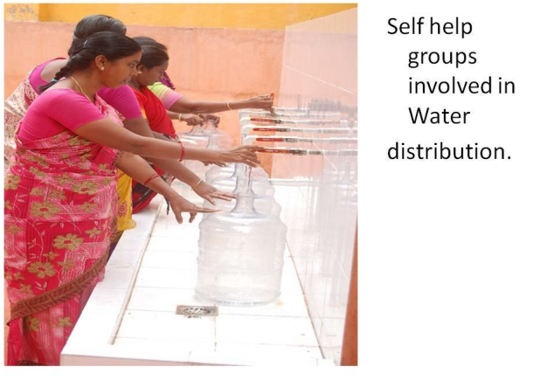
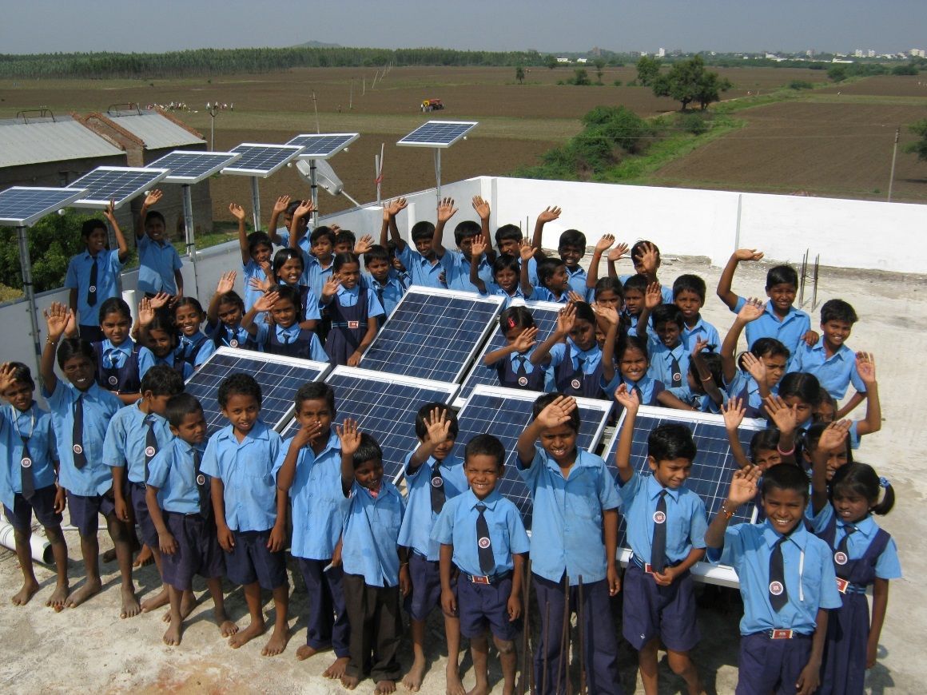
The Business of Doing Good:
Policies that support Social Entrepreneurs
Natalia Agapitova, World Bank – March 2024

Slide 2
One of the first Challenges: the definition
Private organizations that use business approaches to achieve social, environmental, and economic outcomes
CRITERIA
Financial sustainability
Social or environmental mission
Legal status, including for-profit, non-profit, and hybrid entities
1
3
5
2
4
Revenue generation and/or social objectives based on business principles
Innovative services/products or delivery models
Notes:
Must pursue a social/environmental mission
Revenues based on a business and/or entrepreneurial activities
Financial sustainable business model, which often entails reinvesting profits into operations
Legal status varies from for-profit companies to hybrid entities
Their products and services and/or delivery models often disrupt the status quo

Slide 3
Social enterprises are valuable partners for Governments
Public service delivery challenges
How social enterprises step in
Address market failures
They can serve marginalized groups and address service delivery gaps in a sustainable and cost-efficient way.
Improve the quality and equity of services and employment
They better respond to customer needs, and can increase local employment opportunities.
Increase social cohesion and economic benefits
Better “value for money”: they leverage private sector resources to increase the impact of public spending.
Notes:
Alefa Nefedova (2015). The Center was established in 2002 with the principal goal of improving economic alternatives for low-income and socially disadvantaged Russians. “The mission of RMFC is to promote the build-up of a comprehensive and generally accessible financial system in the Russian Federation, through development of micro-financing, to encourage the development of private entrepreneurship.

Slide 4
However, they face significant growth constraints
Limited access to appropriate capital Scarce early-stage capital Reduced ability to secure funding from typical investors due to hybrid business models | Volatile revenues Risky profiles of customer base Limited resources (e.g. the elderly) Lack of awareness about the value of social services offered
Legal and regulatory barriers Limited ability to secure government contracts or investment capital due to lack of clear legal status Potentially negative impact on operations | Reduced capacity Problematic focus on double or triple bottom line Limited financial resources Lack of qualified human resources

Slide 5
Scaling UP Opportunities and Challenges
Demand
1
1
Funding
Partners
2
2
Policy
Sector growth
3
3
Internal
Scaling up social enterprise innovations: Approaches and lessons – Joint WB- Brookings paper

Slide 6
Government interventions can stimulate the supply for SE goods and services
Financial Mechanisms
Concessional loans
Grants
Impact bonds
Guarantee funds
Subcidies
Outcome Funding/Pay-for-Results
Public Procurement
Regulatory measures
Standards and certifications
Tax incentives
Capacity development
Extension services
Business development skills
Support to intermediary organizations

Slide 7
i. outcome funding
Privatize the risk and execution…
..only pay for the results
Impact investor provides upfront financing
Service provider(s) expand solution
Deliver services to Beneficiaries
Verify the Outcomes
Outcome Funder pays (e.g. govt, bank loan)
Notes:
What is your measurable development outcome ?
What is the value of the outcome?
What are the solutions?
The first DIB, launched in Peru in 2015, provided technical assistance to rural communities to improve sustainable coffee and cocoa production, while the second, also in India, aimed to increase school enrollment for girls and improve learning outcomes.re last mile markets– not like paying

Slide 8
II. Social Procurement
5
Incorporating social outcomes as performance requirements, in addition to goods or services to be delivered.
4
If the agreement is fulfilled, social outcome is delivered in addition to benefits of traditional procurement
3
Selected non-state provider(s) begins work. Government develops reporting framework
2
Call for competitive offer with clear articulation of social and service or goods requirements
1
Government identifies the appropriate instrument to incentivize private providers to deliver the identified outcome
Government identifies a social need/outcome
Notes:
Social Procurement integrates social outcomes in the requirement of a contract alongside the good or services to be covered.
Example: Procurement of catering; including social value in scoring criteria (open); stipulating hiring parameters (disabled)
WB procurement – we try to be green with our bottle purchases, can we be more socially conscious in our procurement
RUSSIA Example

