Slide 1


Automotive Parts Manufacturers’ Association of Mexico
Scaling Youth Employment in Response to Opportunities Created by the Energy Transition
Committed to the Future of Mobility
ina.com.mx

Slide 2

About us
Founded in 1961, the Automotive Parts Manufacturers’ Association INA represents more than 700 auto parts manufacturing plants in Mexico.
ina.com.mx

Slide 3
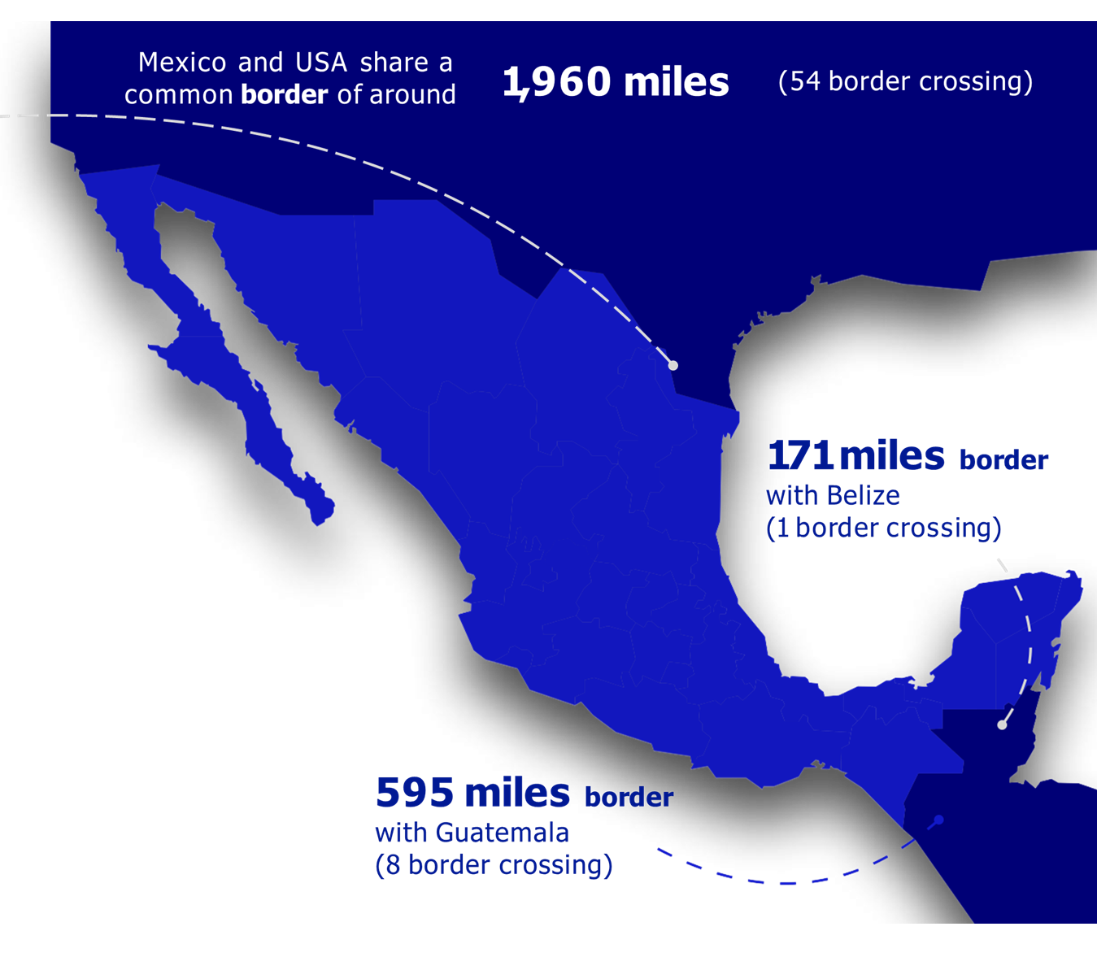
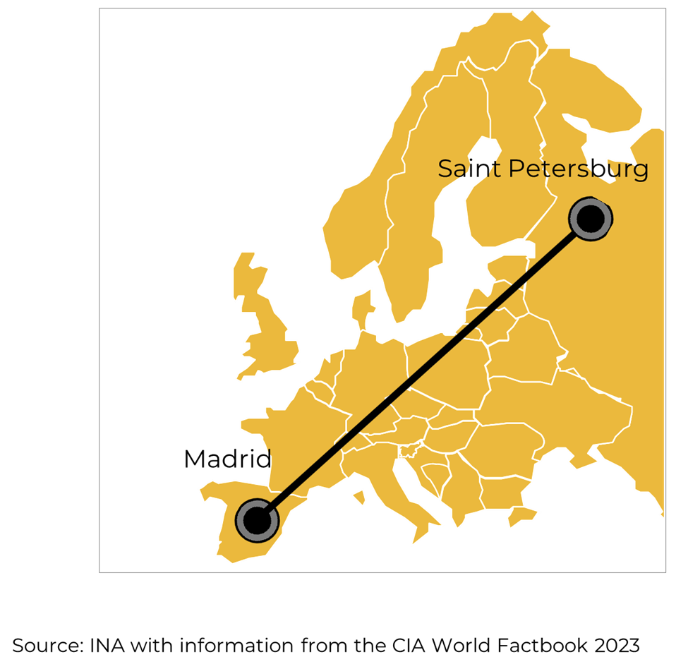
The relevance of cooperation between Mexico and the United States in environmental policies
Mexico is the biggest exporter to the US for the first time in 20 years. The latest figures from the US Department of Commerce show that it overtook China in 2023
ina.com.mx
Notes:
Para

Slide 4

Key statistics of the
automotive industry in Mexico
The average age is 36 years-old
37% women and 63% men
14 years - average schooling
1 million direct jobs
9 out of 10 are blue-collar workers
4% of the Total Gross Domestic Product (GDP)
20% of the Manufacturing GDP
1% of electric vehicle sales
43% of all autoparts imported by the U.S. comes from Mexico
ina.com.mx

Slide 5

Human capital transformation:
Reskilling - Upskilling
New skills:
  Embeded software
  Cybersecurity
  Algorithms
  Edge computing
  Cloud computing
  Data analysis
  Artificial intelligence
  Energy management
  Renewable energy
  Environment, Health & Safety
  Waste management
Sustainability
Digitalization
Security
Energy efficiency

Slide 6
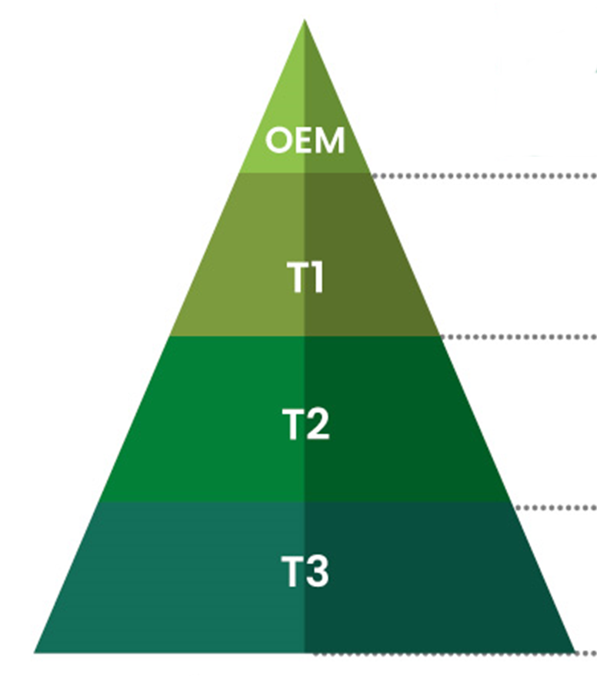
Main business opportunities in the electromobility value chain
Charging infrastructure: Installation and operators
After-sales service: Diagnosis, maintenance and repair services
Components
Sensors and radars, ADAS, cables and harnesses, powertrain components, braking systems, etc.
Assembly of batteries, casings, waste management
Raw materials, lithium, graphene, aluminum, steel
ina.com.mx

Slide 7

Committed to the future of mobility
Armando Cortés
Managing Director
www.ina.com.mx
INA Industria Nacional de Autopartes A.C.
@inaoficialmx
Industria Nacional de Autopartes, A.C.
INA Industria Nacional de Autopartes A.C.

