Slide 2
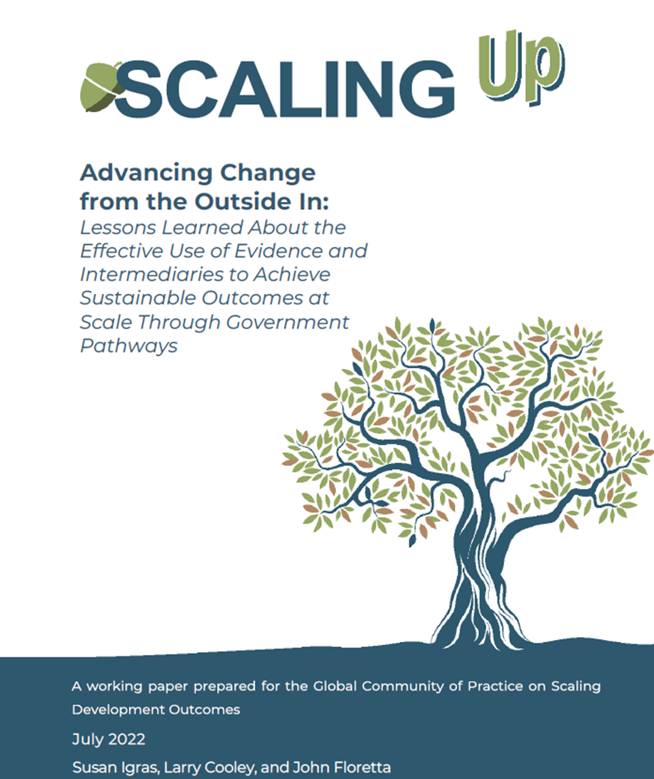
We have focused on scaling through government systems from the “Outside-In” and institutionalization

Slide 3
In this session – Looking at the Inside-Out:
Gov’t innovation and evidence labs as platforms for scaling
Notes:
J-PAL, Social Impact

Slide 4
What do we mean by “Gov’t Embedded Labs”?
Structured, multi-faucted partnerships between governments and M&E-research-policy partners
In contrast, partner in the “Outside-In” model are often an NGOs
Not centered on a scaling specific intervention
Collaborations to bolster evidence, research, and data
And also to inform government processes and approaches to working in new with with data and evidence
Different conceptualization of “institutionalization”

Slide 5
What do we mean by “Gov’t Embedded Labs”?
Common features even across diverse models
Evidence Co-creation and Use
Facilitate the co-creation, and catalyze the use, of timely, relevant, high-quality evidence and data to understand local challenges and to inform the design and implementation of locally-grounded policies and programs to address them
Capacity-building
Build the capacity of government officials at all levels to generate and use evidence and to leverage administrative data to improve program and policy design and implementation
Systems-strengthening
Support governments in strengthening processes, structures, policies, and systems to enable and incentivize evidence- and data-driven policymaking throughout their institutions
Notes:
Despite the diversity of models, there are a number of common features to our deepest partnerships with governments.
[CLICK] First, the heart of all of our partnerships is evidence co-creation and use. What do we mean by co-creation? Really understanding our government partners’ priorities, understanding the questions they would like help answering, on the timelines on which they need answers to the questions, and pairing them with researchers who want to help them answer those questions, while also contributing to global knowledge. We also support our governments in using evidence - whether that’s evidence we co-created with them or evidence from another place and time that might be really pertinent to the issues they are grappling with.
[CLICK] A second feature common to our Evidence to Policy partnerships is a focus on building capacity of policymakers to apply rigorous evidence in their work and to identify moments when they can and should be rigorously evaluating a program to inform decisions about its larger scale roll-out. These capacity-building efforts are often complemented by other efforts in our regional offices to strengthen local researcher capacity because it is often the case that local researchers have visibility into and ties with policymakers, enabling them to see policy windows as they emerge and play an important role in strengthening government use of evidence.
[CLICK] A final feature common our more mature Evidence to Policy partnerships is a focus on systems strengthening. What do I mean by that? Supporting our governmenting in strengthening processes, structures, policies, and systems to enable and incentivize evidence- and data-driven policymaking throughout their institutions. Usually once we’ve been meaningfully working for several years with a partner, we’ve established enough credibility, trust, and understanding of the system to start to see - and act on - the opportunities to support partners in this way.

Slide 6
Objectives of “Gov’t Embedded Labs”
Scale
People living in poverty reached by evidence-based programs or policies adopted at scale
Institutionalization
Signs of a broader culture of evidence- and data-driven policymaking taking hold
Learning
Stronger learning about how to ensure these partnerships have the greatest impact
Notes:
So do we hope to achieve with this expansion of our E2P Partnerships with governments?
[CLICK] First, of course is our scale ambition, which is a motivating them of our work at J-PAL more broadly. We believe that this grant will enable us to lay the groundwork for our government partners to adopt at scale evidence-based policies and programs that the well-being of at least six million people living in poverty by 2030. We think this is a conservative estimate, but also, even while conservative, a strong social return on a 6m, 5-year investment spread across 4 regions and 7 countries.
[CLICK] Second is what I’ll call our “institutionalization” outcome. We aim to see at least some of our government partners in each region demonstrating meaningful shifts toward a broader culture of evidence- and data-driven policymaking by the end of the grant in 2027. So, for example, concrete changes in systems, processes, and policies that better enable, incentivize, and encourage engagement with evidence and data.
[CLICK] Finally is our “learning” objective. This grant comes at a really opportune moment for J-PAL, wherein all of our offices - not just the ones supported by this grant - as well as many of our close partner organizations, such as Innovations for Poverty Action and the Center for Global Development, are actively grappling with this question of how do we make our support to and engagement with governments more effective. There’s tremendous demand from governments for engagement with organizations like J-PAL, in part due to Covid really re-orienting some governments toward science- and evidence-based policymaking. But we are all still sort of figuring out how to be as effective as we can in our partnerships. So, we plan to use the expansion of E2P Partnerships enabled by this grant to more intentionally and systematically strengthen our organization in ways that will enable us to be more effective in working with governments - with focus on facilitating cross-regional learning.

Slide 7
Two examples today from Peru and Rwanda
Notes:
MineduLAB is a laboratory for innovation within the Peruvian Ministry of Education and was the result of a collaboration between the Ministry, J-PAL LAC, and IPA Peru. Housed within the Ministry, MineduLAB designs, implements, and evaluates the effectiveness of low-cost interventions to improve educational outcomes, maximizing the use of administrative data. The Ministry then uses the results of these evaluations to inform its policy decisions.

Slide 9
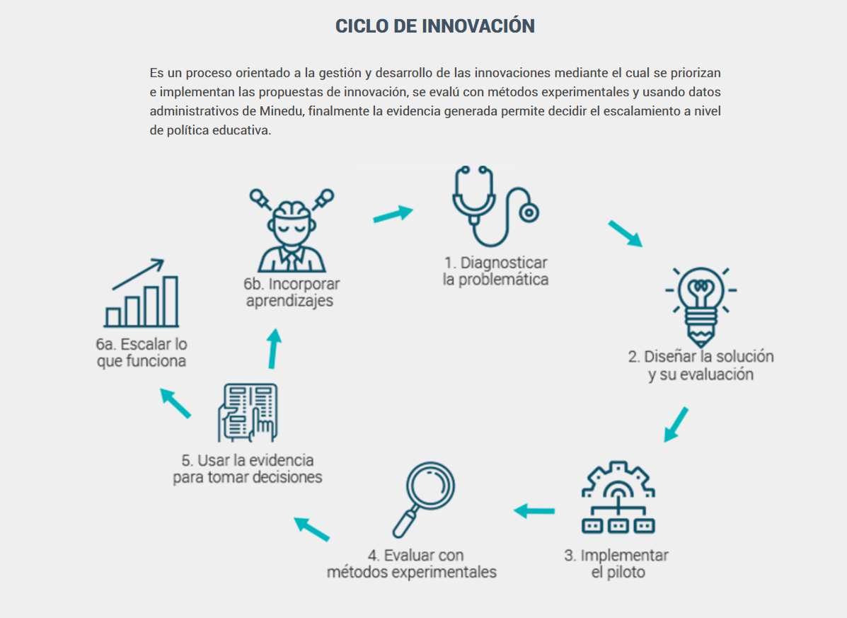
MINEDULAB (Peru)
INNOVATION CYCLE
It is a process oriented to the management and development of innovations through which innovation proposals are prioritized and implemented, evaluated with experimental methods and using administrative data from Minedu, and the evidence generated allows deciding the scaling at the educational policy level.
The Peruvian government installed an innovation lab within the Ministry of Education
1. Diagnose the problem
6b. Incorporate learnings
The project started in 2014
Commitment
Technical capacity
Reinforcement of the institutional capacities with support from J-PAL and IPA
Team focused on promoting the use of evidence
6a. Scale up what works
2. Design the solution and its evaluation
5. Use evidence for decision making
4. Evaluate with experimental methods
3. Implement the pilot
13 impact evaluations
3 scaled projects
http://www.minedu.gob.pe/minedulab/
We thank technical assistance from:
Notes:
MineduLAB is a laboratory for innovation within the Peruvian Ministry of Education and was the result of a collaboration between the Ministry, J-PAL LAC, and IPA Peru. Housed within the Ministry, MineduLAB designs, implements, and evaluates the effectiveness of low-cost interventions to improve educational outcomes, maximizing the use of administrative data. The Ministry then uses the results of these evaluations to inform its policy decisions.

Slide 10
MineduLAB has scaled up 3 effective programs nationwide and tested 13 innovations with RCTs
Policy impact
3 scale ups of education programs found to be effective
Information campaign on returns to education
Growth mindset
SMS campaign to improve educational management
Rigorous, high-quality education evaluations
4 innovation cycles completed
10 completed or ongoing RCTs
Additional 3 in design

