Slide 1
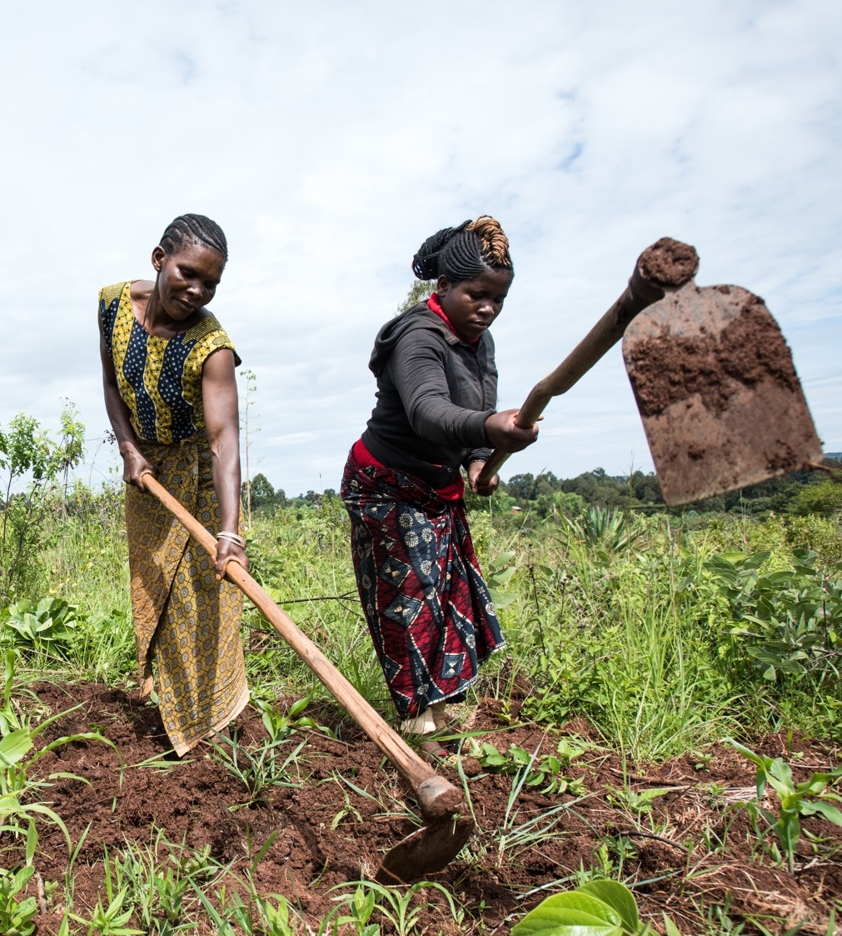
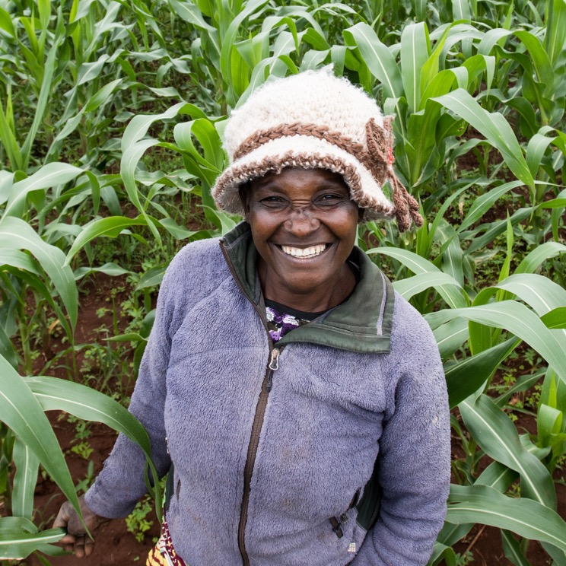
Breaking In: Trying to Position Scalable Social Enterprises in US Development Policy
A Story in Three Acts
Notes:
One Acre Fund is a Social Enterprise that provides agricultural services to about 4 million farmers in 9 countries across Africa.
We are a registered non-profit, and while we get 75% of our costs covered by farmer revenue, we are definitely on the mission end of the SE spectrum - on average a client of ours has just over an acre of land and lives below $1 a day.
(One important point to note: agricultural in the US and Europe benefit from massive government subsidy, and we shouldn’t expect any different need for smallholders in Africa; so in the agriculture space we partly see our role as showing what a more efficient approach to subsidy)
From 2015 through 2019 I ran the the 1AF Government Relations team, working with the host governments in the 9 countries, where I faced constant confusion about our model – farmers paid for services, but we weren’t an NGO. We didn’t fit into a box. This led to lots of challenges for us, and we had to learn how to communicate our vision and our hybrid model.
When I moved to DC and took on our Global Policy Director role, I drew from these lessons and set out to better explain the value of blended agriculture SE models, to encourage wider support to the sector.

Slide 2
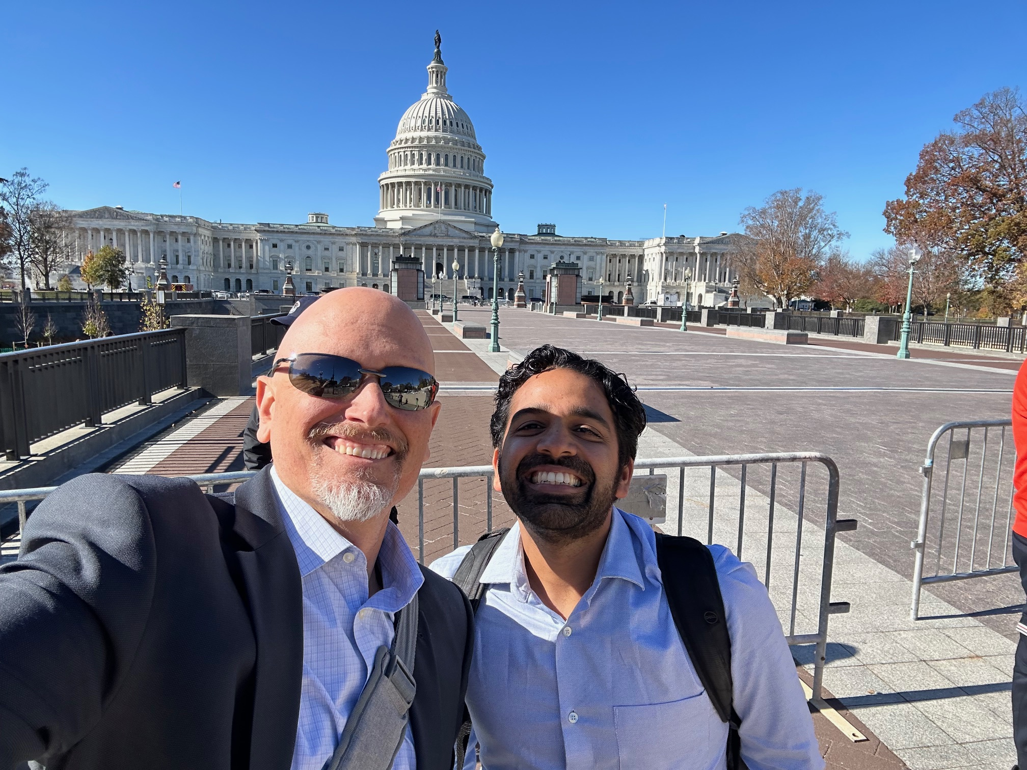
Act 1: Introduction to the Swamp
Meetings, meetings meetings.
Finding a champion
Report language!
Indictment…
Notes:
Well, it’s been in interesting journey
This is me at the Capital with our Malawi Country Director, Yash Gharat. Our early success in building interest for our work on the Hill was because of the unique field perspective we could bring. I held dozens of meetings with staffers to explain our model, and this was met with general interest but not much else .
And I should also say that I met frequently with USAID as well to discuss the role of SEs, which is a separate conversation, as my focus here is our congressionally facing work.
We got the most traction when we introduced an influential member of Congress to one of our field directors, who happened to be in DC. This led to the start of a close relationship with his office, including his chief of staff, who really understood our SE vision for a different approach to scaling development impact.
It resulted in our first legislative accomplishment: an encouragement to USAID to work more with social enterprises in the ag space, in the report section of a key appropriations bill.
Unfortunately, I then ran head long into the craziness of DC politics. Our key champion faced some legal challenges and left Congress….we’d have to start again.

Slide 3
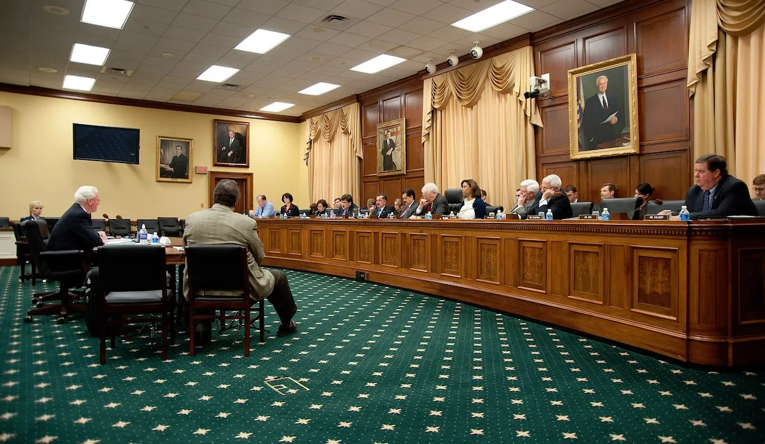
Act 2: Trying to Appropriate Change
Finding new champions: leaning into scale and sustainability
Appropriations win
Stalling out again
Notes:
So enter our second act. I started a new round of meetings looking for a new champion and recognizing that the report language really didn’t get the sector anything; so I switched to looking for that most Washington DC of goals, an earmark for what you care most about. (These are essentially Congressionally mandated directions on how a government agency needs to spend money, and are a key tool for Congress to drive priorities it cares about)
I tried to refine how I talked about the need for SEs, explaining better that unique value they provide, separate from the more traditional work of Feed the Future and other USG ag funding mechanisms. Essentially, that SEs provided a different approach to achieving impact, at scale and sustainable, through an approach where you invest in an organization rather than a short term activity.
We did end up getting a few million dollars earmarked for SEs, but this never ended up with a path to grow, and eventually was taken out of the subsequent years appropriation bill
So this effort ultimately stalled out as well
I don’t think ultimately just asking USAID for one more earmark they had to report on was helpful. To be fair to them, they get dozens of these requests from Congress, and asking for just one more didn’t set them up for success to respond.
And, even though in this push I worked loosely with a few other Ag Ses, we really didn’t have a big enough coalition to create dedicated SE funding accounts….
So we shifted our strategy again, and started Act 3…

Slide 4
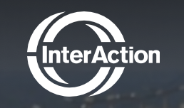
Act 3: Authorizing a New Approach to Scale
Authorizing bills: some tangible steps forward
Working with Coalitions
Opportunities: FIGDA and the Food Security Foundation
Where we go from here
Notes:
A key lesson has been that when you’re pushing for a fundamental change – like expanding support for a new (and relatively unknown) development tool – you need to ride a wave that’s already building.
Partly this is about the mechanism you use: you want to think about “authorizing” language, that creates something new. This is a different process in Congress, where you work with different committees.
And ideally you want to find something that already has wider political support behind it
But you also have to work with a truly wide coalition. Over the past few years I’ve learned to better engage with a range of groups, some more actively than others.
They won’t agree with everything you have to say, but the process of reaching consensus is important, as ultimately – despite the ugly partisanship of our era – compromise is still largely the best path for moving things forward on the Hill
So through this new approach, there are now two possible opportunities that would benefit the SE sector, even though they are not explicitly ABOUT SEs.
FIGDA – the Fostering Innovation in Development Act, a bi-partisan House bill led by Reps Castro and Kim – now mentions SEs as a tool in a broader push to support USAID in scaling what they call ”proven solutions”
And the International Food Security Foundation Act, a bi-partisan Senate bill, led by Sen. Graham, Coons and Boozman, that would create a new 501c3, partly supported by the USG, which would bring in more co-financing for an increased private-sector led approach to ag development, and now includes language about an outcome-based approach that would put farmer impact front and center.
The story is very much ongoing, I don’t know where it will end. But join me if you are interested!

Slide 5
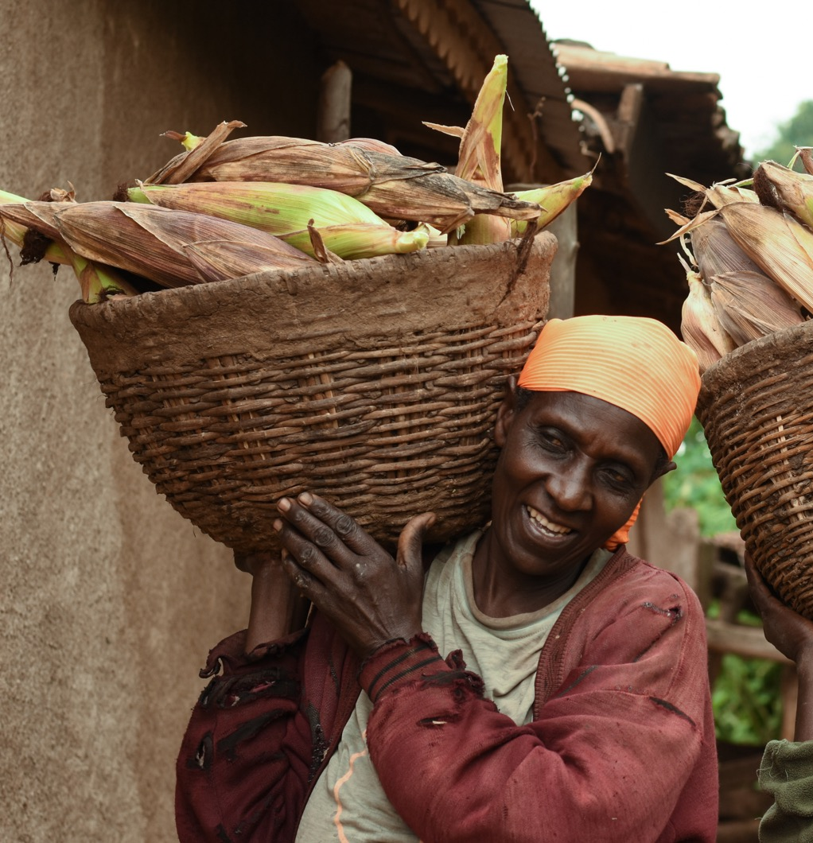
Key Lessons Learned
Don’t get lost in the definition
Break down component parts of what you care about.
The mechanism matters
Build for long-term
Effectively work with coalitions
Notes:
I think a key lesson has been not to get lost in the definition of Social Enterprise. Part of the limits to what I could achieve early on was because people, including me, focused too much on the term social enterprise, vs focusing on policy outcomes we care about (scalability, farmer impact etc), and mechanisms that are well set up for SEs even if not explicitly so.
I’ve honestly shifted to saying SE less, and referring more to just market-based solutions, then driving towards these outcomes.
I realized you want a policy outcome that can last, and getting authorizing language is key; also a good reminder that this helps ensure policy solutions outlast executive branch administrations.
Coalitions are key…how to use them effectively is the big question

