Slide 1
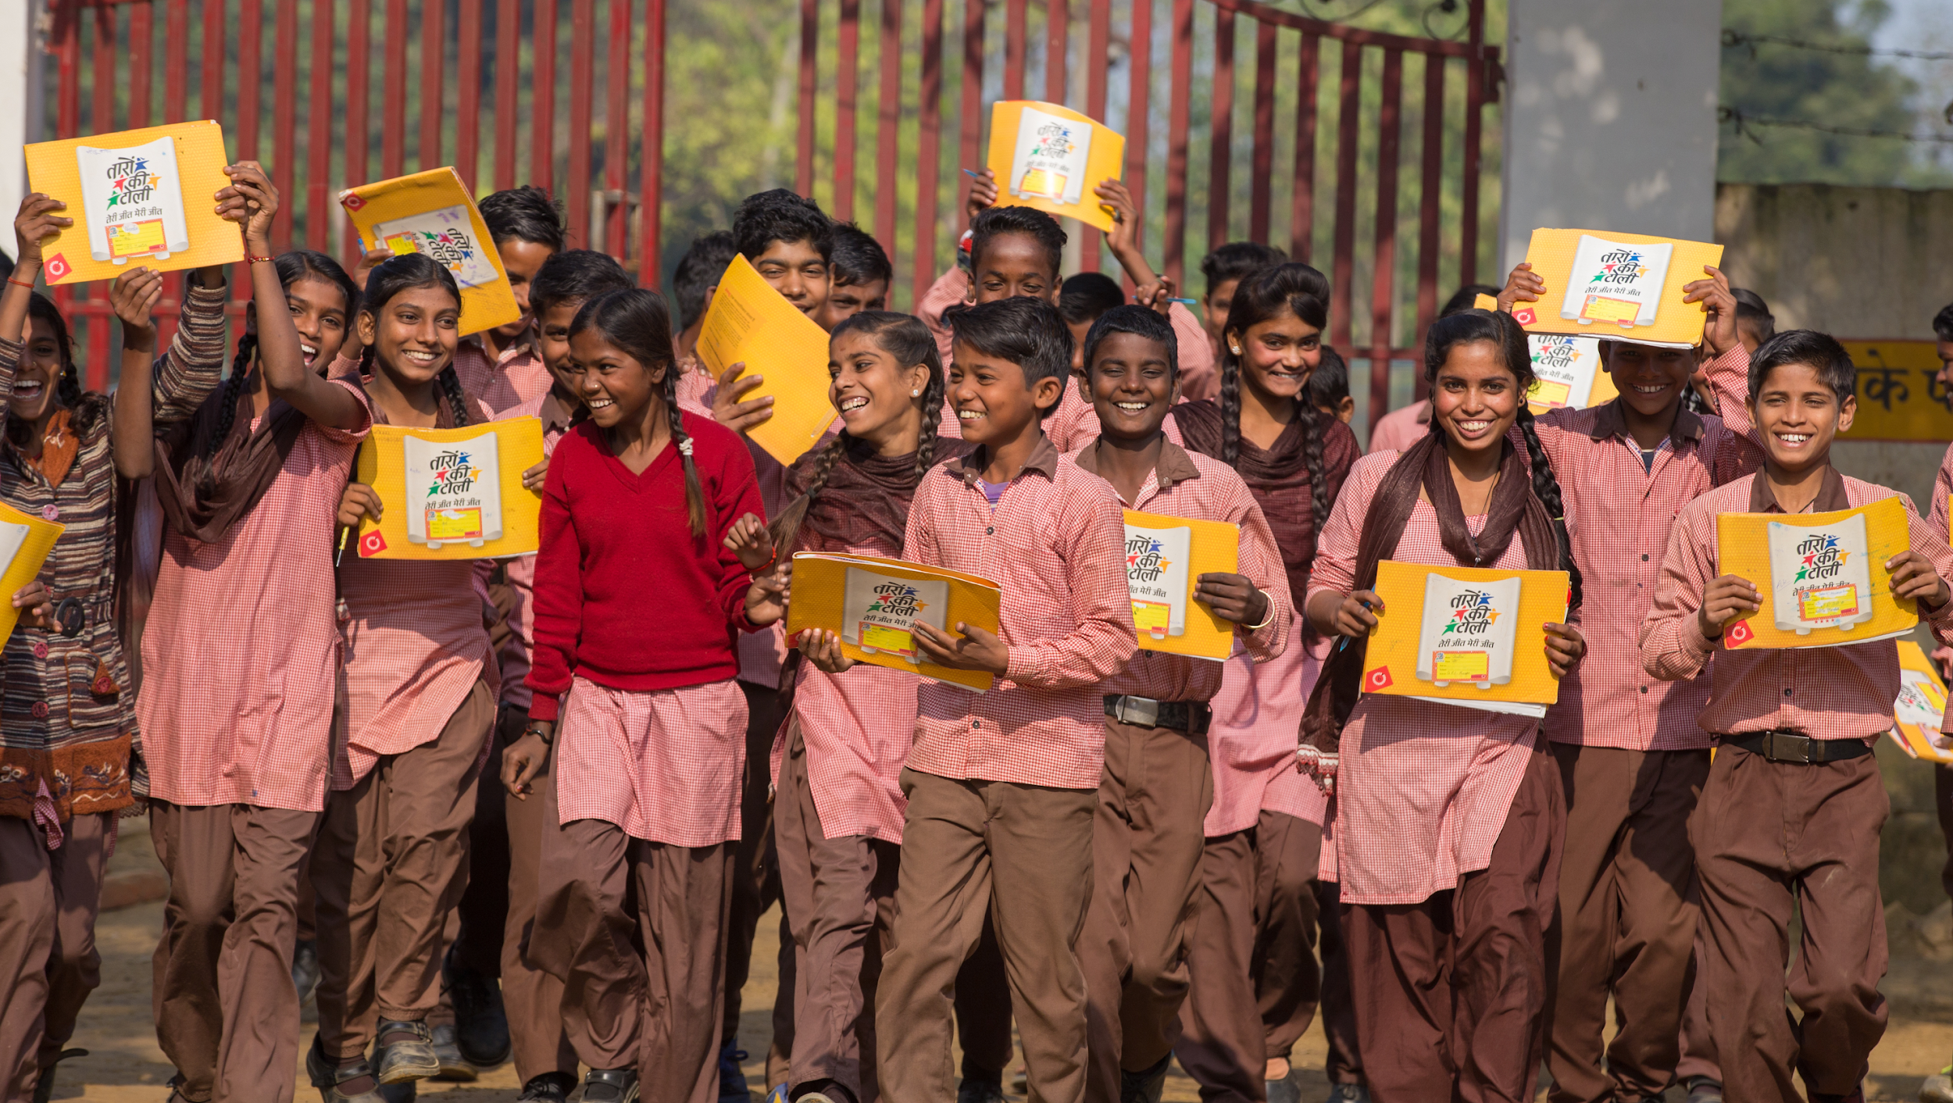
SCALING UP A GENDER EQUITY PROGRAMME
USE OF EVIDENCE IN INSTITUTIONALISING GENDER INTERVENTIONS THROUGH GOVT. SYSTEMS

Slide 2
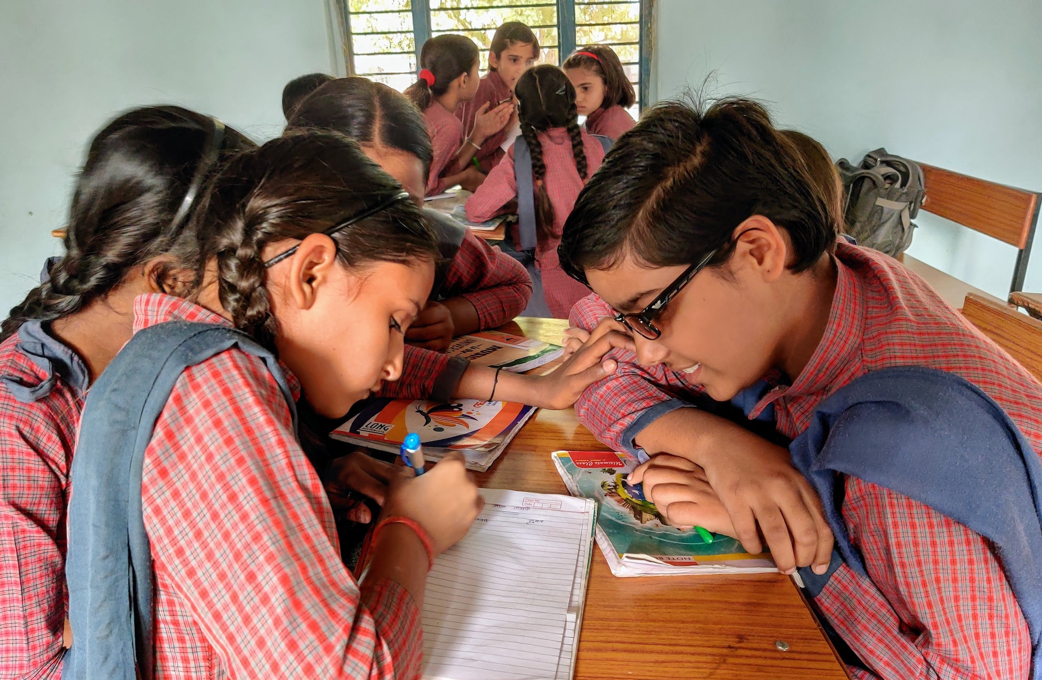
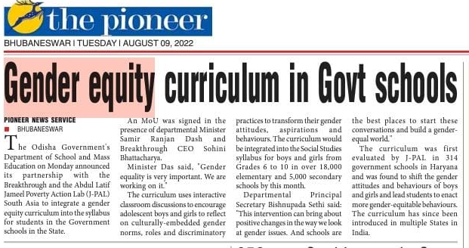
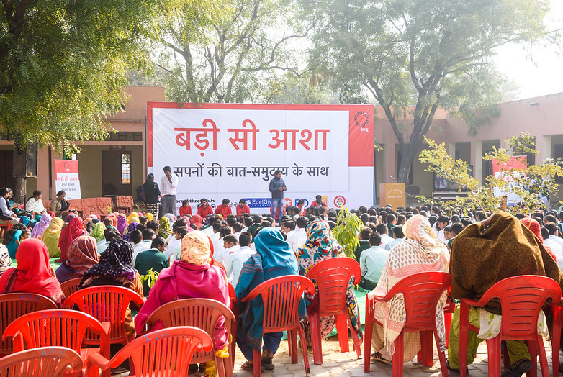
Breakthrough – Over 23 years of working to change the cultural norms that perpetuate violence and discrimination against women & girls
WE WORK ACROSS THREE BROAD AREAS
Deep Transformation - adolescents and their communities in 4 states
Systems change work in partnership with two state Govts
Cross cutting work on popular culture/ media campaigns

Slide 3
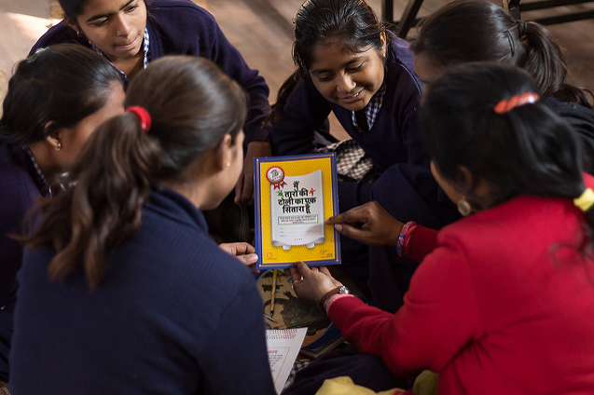
Taaron ki Toli (Gang of stars) – shaping adolescent gender views to bring generational shifts in social norms
Introduced in 2013, in Haryana, covering 150 schools and 18,000 children
Tripartite partnership with J-PAL and Govt. of Haryana
Works with boys and girls across grades 6-8
2.5 year RCT conducted across 314 schools and 14,000 students; continue to follow the cohort
2-year curriculum comprising 28 fortnightly, 45 min sessions, plus group activities
Delivered by trained Breakthrough facilitators, recruited from local communities

Slide 4
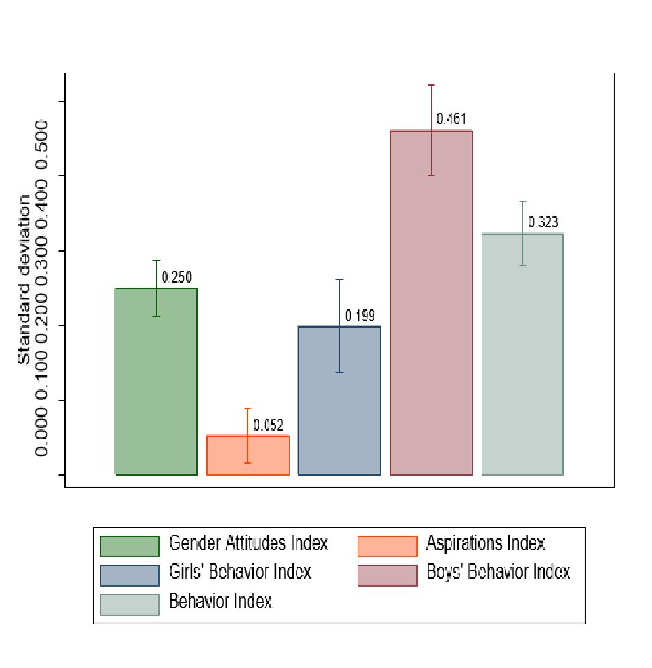
RCT Results
Significant shifts in gender attitudes and behaviours of BOTH boys and girls
Boys’ behaviours shifted even more than girls possibly because of greater social sanction
The effects on children from the most gender conservative homes were similar to those from regular homes
Five years after baseline, attitudes persist! Overall, we saw roughly 16% of cases converting from gender regressive thinking to more equitable attitudes
Continue to follow the cohort to see impact on life choices like marriage, career and age at first birth

Slide 5
Scale Up – building a new generation of gender equal citizens
Deep Transformation - Reached over 200,000 adolescents directly with the Taaron ki Toli curriculum; used a socio-ecological model to engage community members/ parents
Systems Change: Partnership with the Govts. of Punjab & Odisha introduce elements of gender equity into subject curricula for grades 6-8/6-10
30,000 middle schools
Over 80,000 teachers to be trained
Over 4 million adolescents will be reached over 5 years
Introduction into school textbooks, tested through routine exams
Breakthrough will ensure training and handholding of teachers; monitor delivery quality
In addition, Breakthrough will work with other stakeholders to make gender equity a priority – principals, govt officials, parents
JPAL – process evaluation

Slide 6
Using research and monitoring to work on specific challenge areas; key questions we are asking ourselves…
Teachers – how do we ensure teachers are motivated to deliver the curriculum effectively, demonstrate gender-equal behaviours?
Given the scale, how do we monitor progress effectively month-on-month to enable a process of continuous improvement?
How do we assess the incremental value of stakeholder engagement like parental engagement, middle management outreach on adolescents’ gender views/ behaviours?

Slide 7
Not one big evaluation but several pieces coming together to ascertain the best model for state-wide scale up and transfer to govt.
External evaluation by J-PAL (Baseline & Endline) to assess the effectiveness of the intervention, as well as fidelity to original RCT results
Odisha to have 10 districts and Punjab 5 districts with added stakeholder engagement; evaluation to cover two different programmatic approaches :
curriculum inclusion+teacher training
curriculum inclusion+teacher training+engagement with middle management and parents

Slide 8
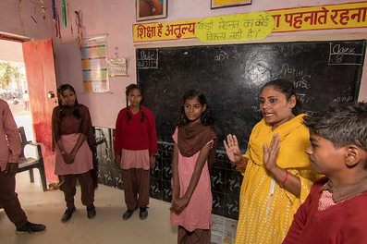
Improving teacher effectiveness and motivation is key to the success of the programme; RCT to test different routes for a cost-benefit analysis
RCT in 1-2 districts with 3 arms:
Treatment 1: Low cost teacher nudges, rewards and recognition that can be easily scaled up (low touch)
Treatment 2: Additional in person visit by Breakthrough personnel for training at district level (high touch)
Control
Behavioural nudges to enhance teacher effectiveness and motivation:
To be developed with BE specialists (Busara) through workshops with teachers to determine barriers
nudges to be piloted in a few schools before being implemented in the RCT

Slide 9
Monitoring to ensure we keep track of progress against outcomes
OUTCOMES WE HOPE TO SEE AT THE END OF FIVE YEARS:
Girls stay in school longer (reduced dropout rates)
Adolescents demonstrate more gender equitable attitudes and behaviours
Teachers demonstrate improved gender sensitive behavior/ actions in the classroom
Annual dipstick surveys by Breakthrough for regular tracking of progress against outcomes
Process monitoring by Breakthrough and partners including:
self reporting by teachers
monitoring visits by Breakthrough personnel to a sample of schools across both states

Slide 10
Learnings from our monitoring & evaluation so far..
Stakeholder mapping is critical
Engagement with government officials on data availability and accessibility helpful
Use of government processes/platforms is not always user friendly
Piloting of tools crucial (experience with student survey, observation tool)
Leadership buy-in critical, change of government officials a challenge

Slide 11
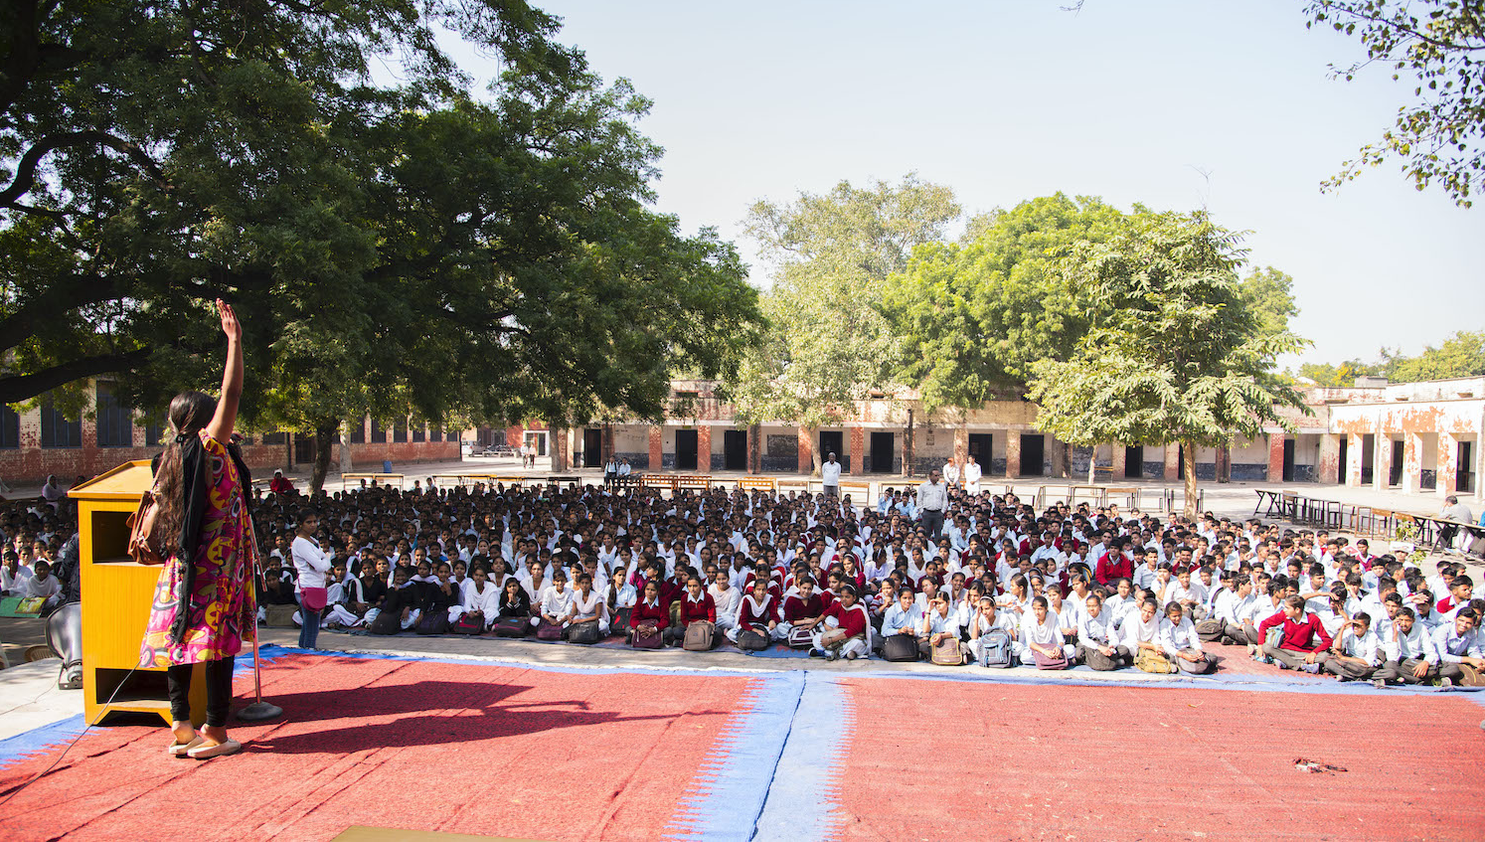
THANK YOU! www.inbreakthrough.org

