Slide 1
DELIVERING NUTRITION THROUGH BIOFORTIFICATION
Atinuke Lebile

Slide 2
WHY BIOFORTIFICATION AND HARVESTPLUS

Slide 3
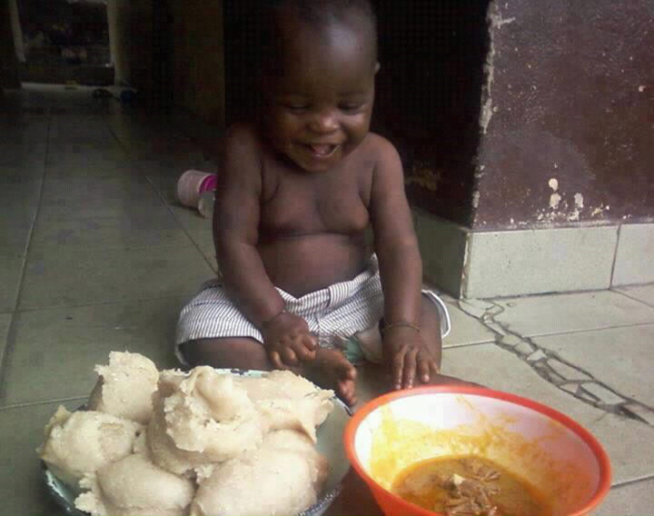
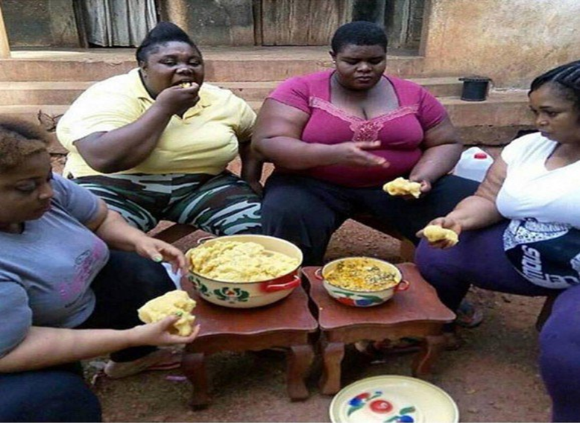
NUTRITION AND HIDDEN HUNGER IN THE RURAL AREA

Slide 4
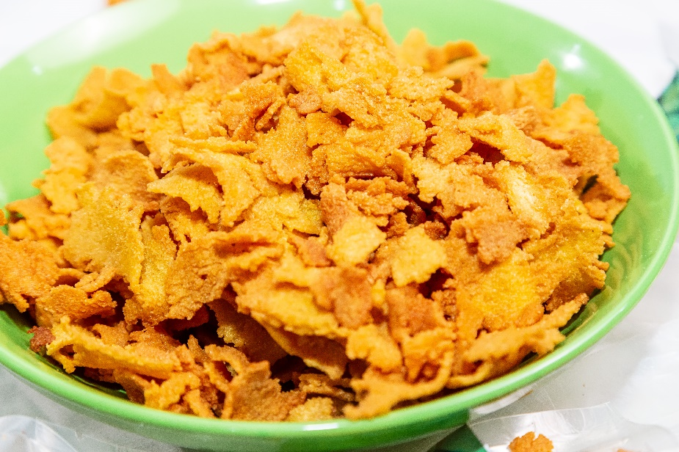
NUTRITION AND PRODUCT DEVELOPMENT TECHNICAL CAPACITY
OVER 25 NEW PRODUCTS DEVELOPED AND ALSO A RECIPE BOOK

Slide 5
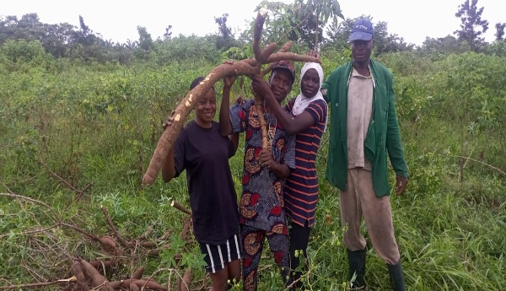
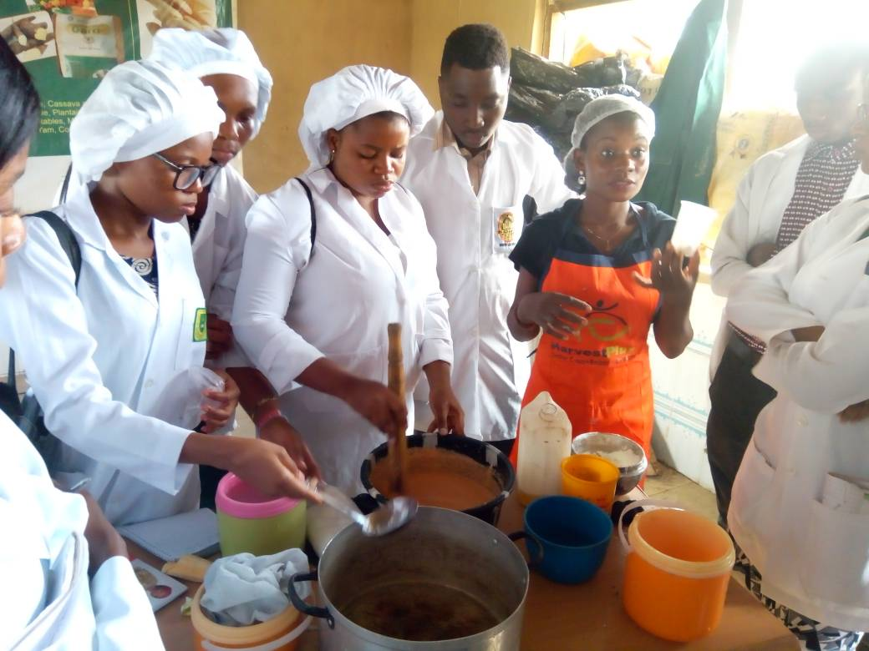
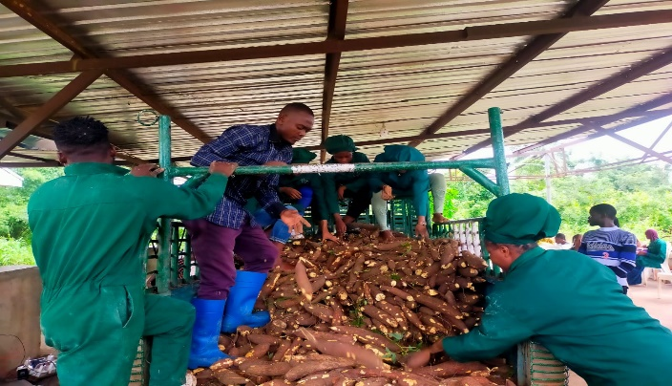
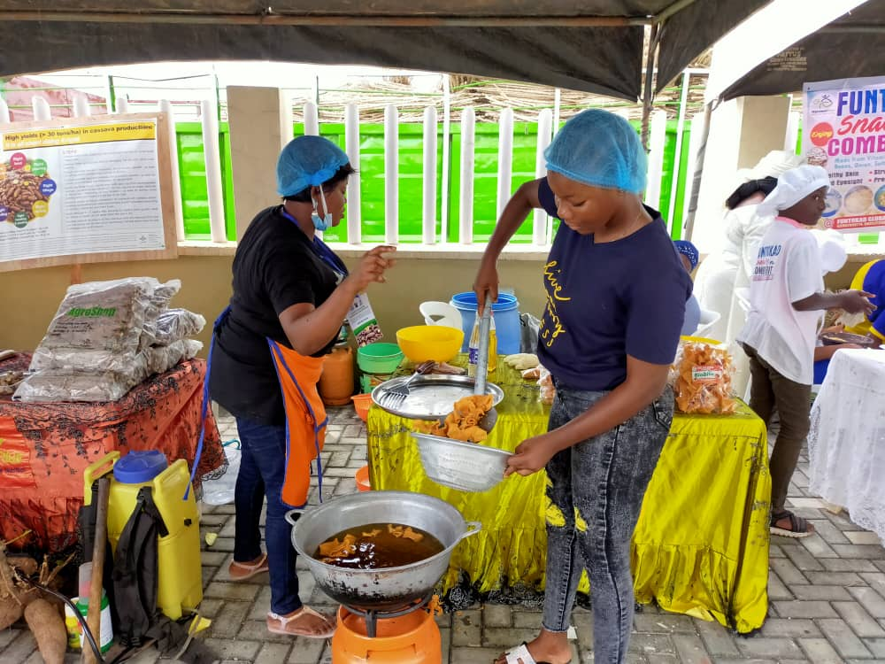
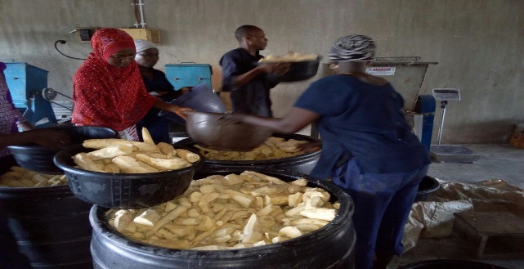
WOMEN AND YOUTH INVOLVEMENT IN DELIVERING NUTRITION

Slide 6
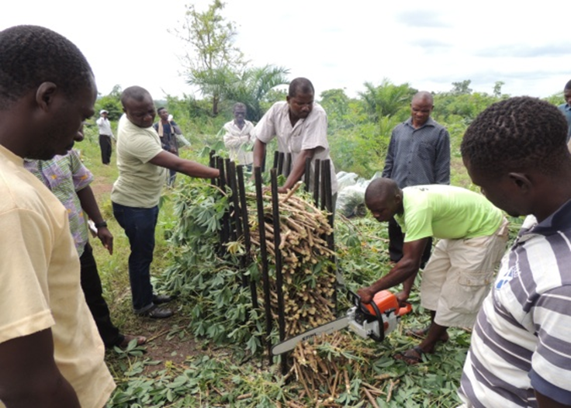
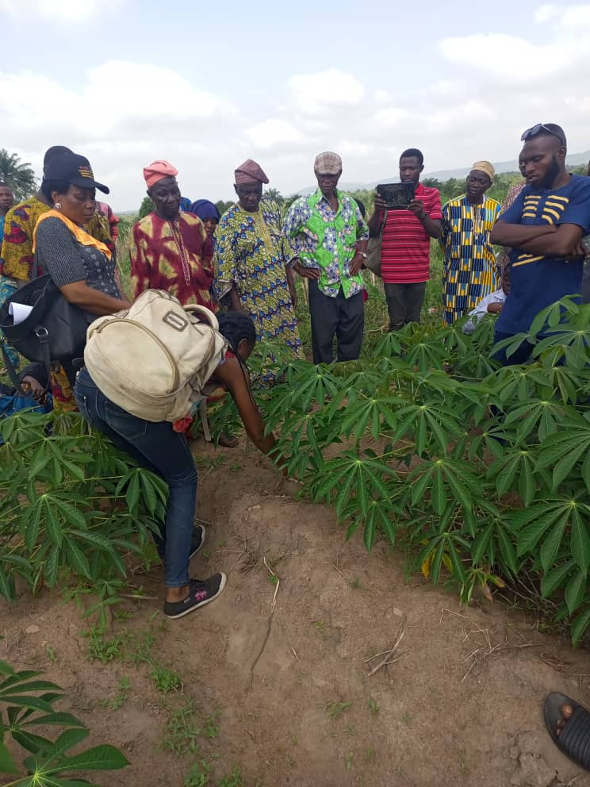
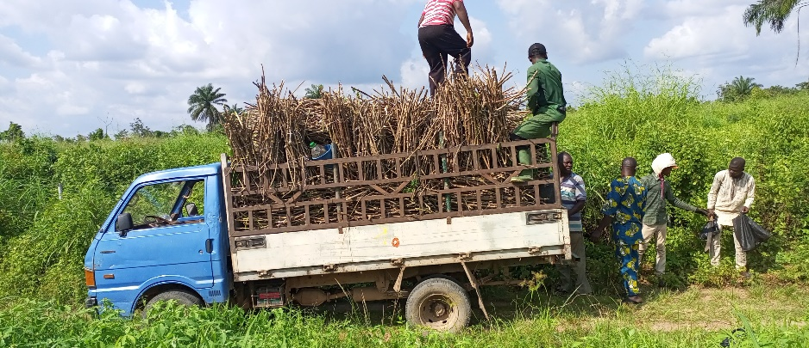
FARMING HOUSEHOLDS AND NUTRITION

Slide 7
More To Do
Help in raising funding for the private sector to push biortification to reach more target audience and address malnutrition

Slide 8
THANK YOU
atinuke@catofoods.com

