Slide 1
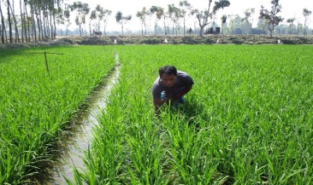
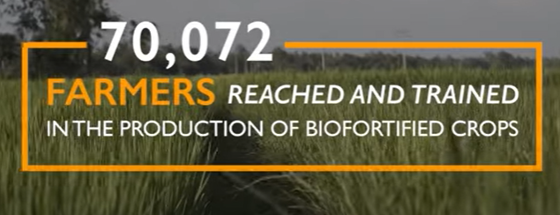
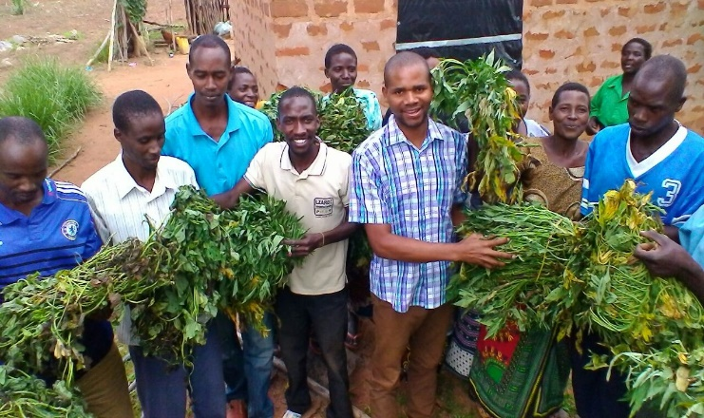
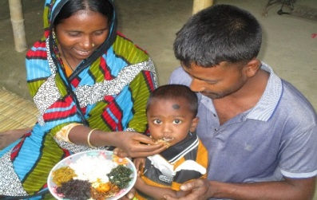
BIOFORTIFICATION
Bangladesh, Kenya & Tanzania
1. Demand creation:
Farmers were sensitized on the nutritional benefits and income value of biofortified crops which increased demand in the communities,
2. Training of lead farmers:
The project provided training to lead farmers, government line ministries and partners staff in the production and utilization of bio-fortified crops,
Distribution of biofortified crops seeds and planting materials,
Harvest Plus and local government partners led the training and field demonstrations,
Enhancing Nutrition Services to Improve Maternal and Child Health in Asia and Africa (ENRICH), 2016-2021
Bangladesh: Zinc Rice
Kenya: OFSP and High Iron Beans
Tanzania : OFSP
Home | 1000 Day Journey (worldvision.ca)
Realizing Gender Equality, Attitudinal Change & Transformative Systems in Nutrition (REACTS-IN) 2023- 2030.
Bangladesh, Kenya, Somalia and Tanzania.

