Slide 1
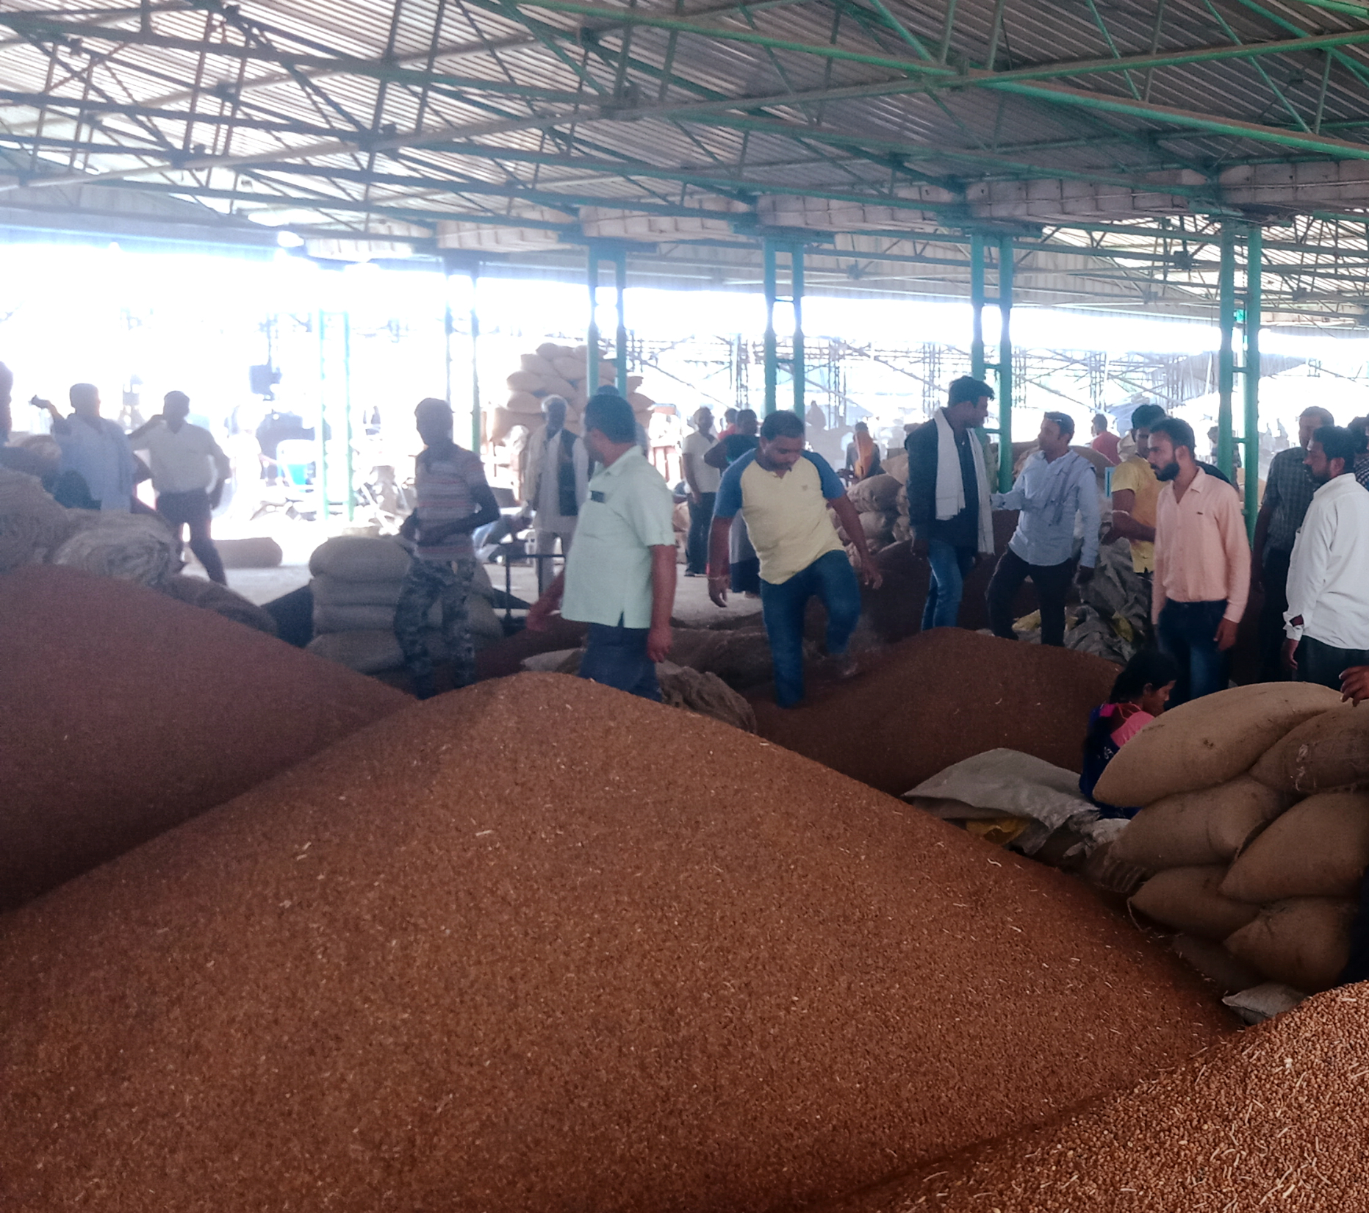


Scaling built into delivery models:
Reaching 100 million consumers with Nutrient Enriched Staple foods
The case of HarvestPlus & biofortification
Jenny Walton
Katharina Diehl
Notes:
Thank you Richard and thank you to the community of practice for the opportunity to show our case.
Katharina and will spend 25 minutes outlining our case and today we focus more on reach - Impact is a separate discussion.

Slide 2
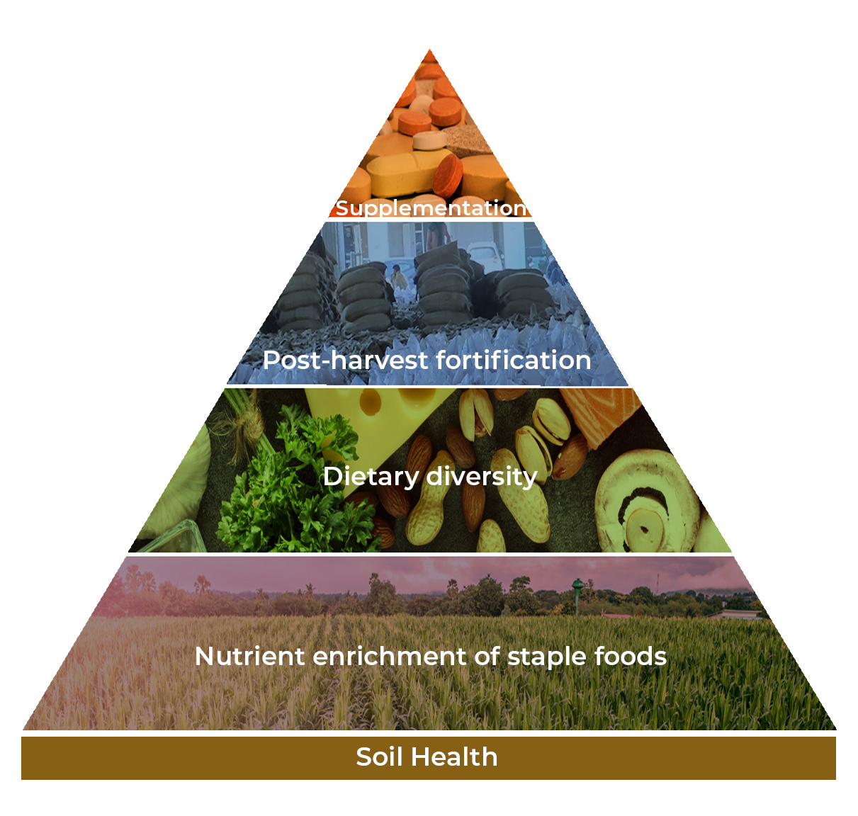
Complementary approaches to tackling micronutrient deficiencies
1 in 2 children and two in three women worldwide are affected by preventable micronutrient deficiencies.
9 in 10 women in several countries in South Asia and Sub-Saharan Africa are affected by at least one deficiency.
Make staple foods better - Equitable solution that reach everyone simultaneously
Notes:
I would like to start with the driving force behind the HarvestPlus idea and subsequent program – hidden hunger, micronutrient malnutrition. one in two children and two in three women worldwide are affected by preventable micronutrient deficiencies.
People living in low- and middle-income countries bear most of the burden. Alarmingly, as high as nine in 10 women in several countries in South Asia and Sub-Saharan Africa are affected by at least one deficiency.
This situation isn’t unique to low income. Developed countries such as the UK or the US have increasing deficiencies.
This isn’t just a case for underweight and stunted micro nutrient deficiency co-exist with obesity
India, this year we hit the number of 101 million people - 11.4% of the country's population - are living with diabetes. A disease that benefit from increased zinc as with other non communicable disease. We have been working on this problem, but we are battling against the headwinds of Covid, climate change, natural disaster and war – unfortunately the numbers are not improving.
This problem has a potential to get worst still as humans we need less calories to be healthy, nutrient density of the diet it critical – we need the most nutrients per calorie
Biofortification, the term coined 20 years ago, was using plant breeding to improve the micronutrition content of foods on a MASS scale. Staple foods are the common thread that unite us all. If its French bread, Italian pizza, Irish potatoes or Rwanda beans – the major calorie providers – we all all them. IF we can improve them then we can reach the most people From an economists POV the most cost effective and equitable way to reach as many people as possible – improve the foods that we all eat starting from the ground and the seed – it reaches everyone
There are other ways, and we need all, dietary diversity it s a human right, everyone should have access to full range of fruit, veg, meat fish and eggs, but even when consumers do get that – micronutrient deficiency still exists. Post harvest fortification of flour, oil, salt sugar – effective but doesn’t reach those who grow their own food, also difficult to scale in some commodities such as rice, and supplementation – a very effective solution to fix acute malnutrition, but expensive and unsustainable – that leaves Biofortification, improving all of the plants (And animal foods) through the growing phase. This leads me on to our founder (NEXT SLIDE)

Slide 3
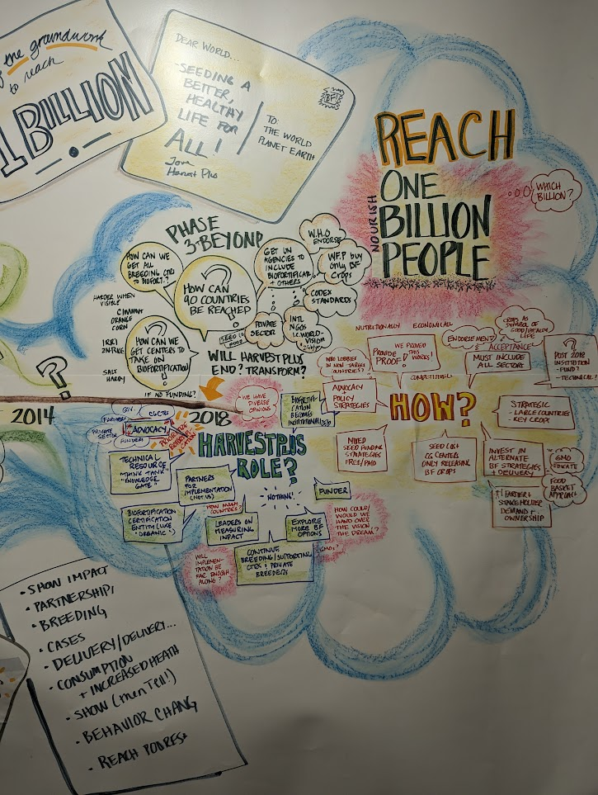
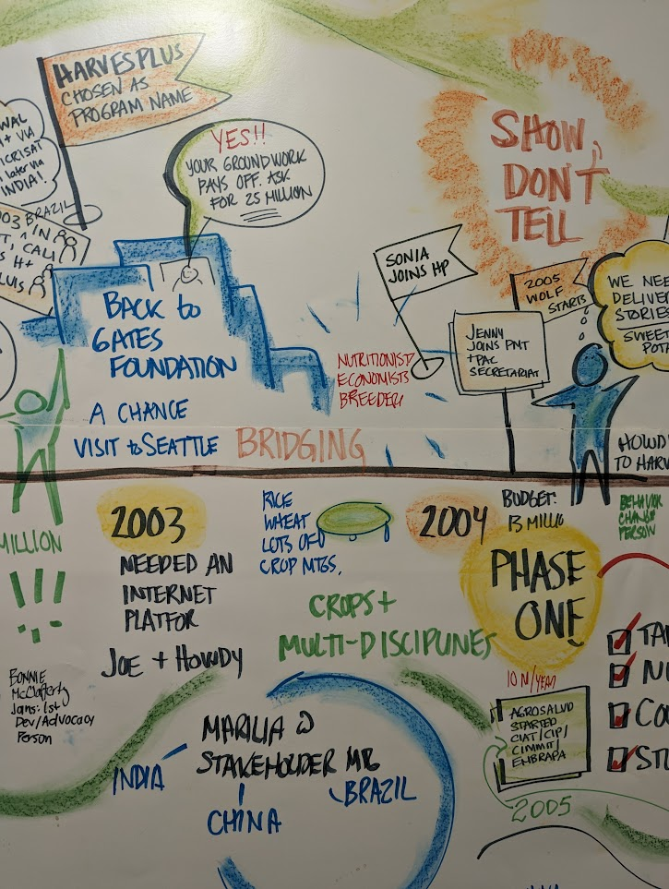

Scaling from the outset
World Food Prize laureate Howarth “Howdy” Bouis, the founder of HarvestPlus,
“Can we breed common staple crops
to contain higher levels of micronutrients
so they are readily available to hundreds
of millions of smallholder farming families?”
Can we make the crops do the
work to make people healthy?
Notes:
This idea wasn’t born from a nutritionist, but an economist who was thinking “how do we reach everyone” and this is where HarvestPlus started. We use the terms food system transformation but 20 years ago it was unheard of – I guess that’s how you win the world food prize with a visionary approach
I am sure many of us have been to these meetings where there is an artist or a cartoonist drawing the noting the major points of a meeting – but in the case of the HarvestPlus program it is this artist illustration that guides us to this day – 20 years ago the team saw the goal of 1 billion. The program was led by scale and the solution and delivery developed around the target number
In 20 years there has been rapid development – if you worked at HarvestPlus even 2 years ago you wouldn’t recognize us now.
20 years ago there was the Proof of concept & the crop development. The nutrition studies started to gather the evidence that real, physical outcomes change, the Impact research
The advocacy, public policy, and then in the last 7 years the formalization of Delivery – to scaling – and commercialization – just a note on language here and depending what community you are from. Harvestplus country programs were initially called delivery – commercialization was immediate in seed sectors and followed on in grain and food – Now we are in the scaling phase but the other work doesn’t stop – its not job done – Katharina will talk more about this cycle – and now on to the And these are the ‘delivery vehicles’

Slide 4

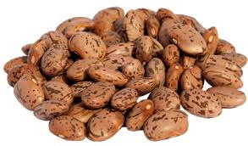


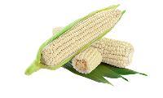
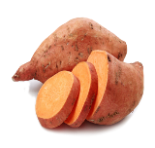

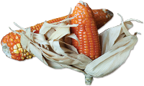
Biofortified Products Developed by CGIAR HarvestPlus and Our Partners
Iron
Zinc
+ Zinc
+ Iron
Pearl Millet
Provides up to 80% of daily iron needs
Beans
Provides up to 80% of daily iron needs
Wheat
Provides up to 50% of
daily zinc needs
Rice
Provides up to 40% of
daily zinc needs
Maize
Provides up to 70% of
daily zinc needs
Vitamin A
Sweet Potato
Provides up to 100% of daily vitamin A needs
Cassava
Provides up to 100% of daily vitamin A needs
Maize
Provides up to 50% of daily vitamin A needs
Notes:
the crops to reach everyone – pretty much everyone on the planet will consume at least one of these in significant quantity on a daily basis – simple hey – increase the nutrition of these guys and we will change micronutrient intake of everyone on the planet – that might be an over simplistic vision – and then you need a targeted breeding and a comprehensive delivery model

Slide 5
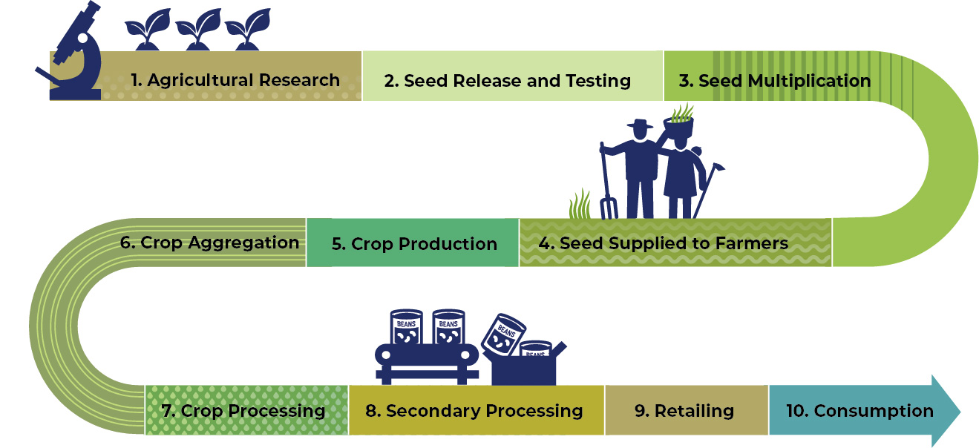


Value chain delivery model – with a scaling strategy
Notes:
And that methodology, that delivery model, is how you then take the seeds, grains and foods to consumers. This delivery model was honed over 15 years of development. Reach was slow in the early days of HarvestPlus, the R&D for seeds takes years, we then had the crop release phase and our most patient donors understood the lifecycle of agricultural R&D. But when the seeds are released and you invest in early generation seed production – seed multiplication. Once you start seed production and get momentum this is when you start to scale production and reach.
The biofortification value chain is long. Its not just a case of supply at step one, you have to cultivate and generate demand at every step and then meet that demand with supply at every step. This truly is chain and if that supply and demand breaks down at any of these steps then scaling stalls, it can generate a bad reputation for the actors and the reputation of HarvestPlus and biofortification. We will come on to more examples of how that has broken down but to continue our focus on this deliver model.
A sequence of events, at each step of the value chain, carried out by subject matter experts in each area for soil, to seed, to grain, to food to the consumers plate.
With the delivery model, the tools to enable the environment to policy inclusion, technical guides to food processors and importantly more recently the strategic use of technology and digitization to enable scale – a fortunate biproduct of the covid pandemic when we had to continue our work in a non contact environment.
And then the scaling strategy – you have to remember that whilst the ambition was always the billion the HarvestPlus team we scaling without really appreciating the value of what they were doing –
HarvestPlus were scaling before it was even a thing – There is the stepwise delivery model and then a scaling strategy that is applied on a country and crop basis. With membership such as this community of practice and scaling experts like Katharina
From introduction, of the seeds, to scaling of the seeds, grains and foods, to anchoring into the food system and then sustaining. This isn’t all happening in each market and each crop at the same time – the phase zinc rice is in Indonesia is very different to that of vitamin A casava in Nigeria. Critical to note that this isn’t a linear process which we cant emphasize enough with Katharina will now explain more about

Slide 6
Working market push factors
Working market pull factors
Technical Assistance
Product development support
Market development support
Scaling
A solution for biofortified staple crops that are
Available
Affordable
Accessible
to poor and vulnerable households
Improving the global food system
H+
Maintaining a robust value chain that
Reaches farmers households
Increases resilience
Supports nutrition security
Introducing
Anchoring
Value creation
Health impact
Notes:
Katharina

Slide 7
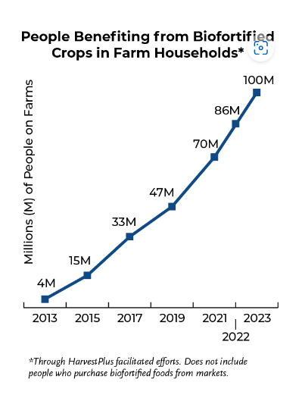
Results
Global consumer reach
Commercial market status 2021
Country crop | Market share
Nigeria maize | 7 % grain production
Nigeria casava | 22 % roots
Bangladesh rice | 10 % seed market
Pakistan (Punjab) | 28 % wheat production
Rwanda | 40 % dry bean market
For every 100 people that eat on farm, 15 others will eat biofortified foods through purchasing from the market
Notes:
While success can be reported by a range of indicators, today we want to concentrate on reach and market share. Reach shows the amount of people, individuals who access and consume biofortified crops. Market share describes the percentage of biofortified crops in the market as compared to non-biofortified, regular crops.
In 2023 The HarvestPlus program will have reached 100 million consumers worldwide and that is a very conservative estimation. For every 100 people that eat on farm, 15 others will eat biofortified foods through purchasing from the market.
When looking at the market share, it is perhaps relevant to mention that HarvestPlus has worked on just about 400 varieties of staple crops with focus regions in Africa and Asia Now in a way this is almost counterintuitive to the idea of scaling, because while we want to scale biofortified crops as a better alternative, the products in each country will differ, for example in multiplication rates, but also in usage. (Boiled cassava works better with a different variety. Drought prone areas work better with Nyota beans, while wetter areas work better with Faida or Angaza beans). In the case of beans, some varieties are hardly distinguishable from non-biofortified beans. In the vit A crops the products differ in colour but this will also need to be explained to consumers. Thirdly, the market price is often influenced by political or infrastructural settings as well as weather, and not only by market penetration and consumer willingness to pay. (The iPhone may be the same all over the globe, but food products are often slightly different even under the same brands - Coca Cola tastes slightly different in every country).
Overall, the delivery model was refined from the summary of experiences and has proven successful over time, countries and crops.
With a lot of variance in the product there is no ‘one size fits all’

Slide 8
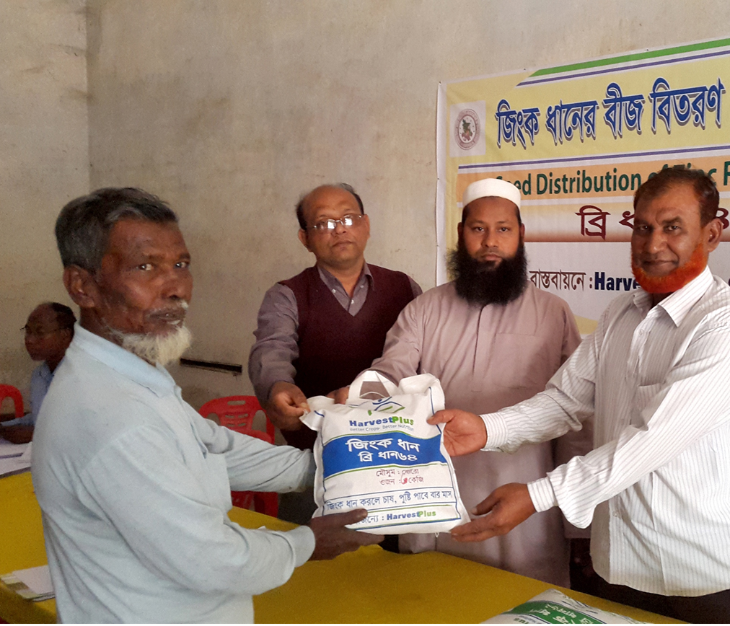
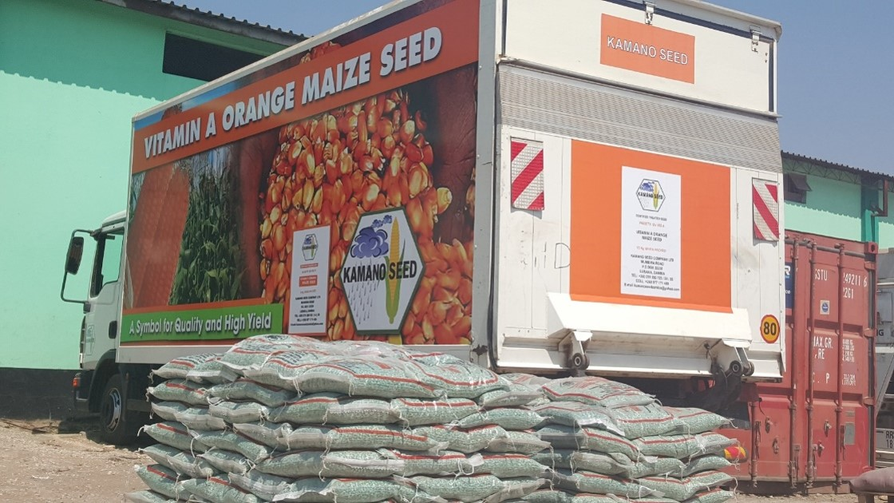
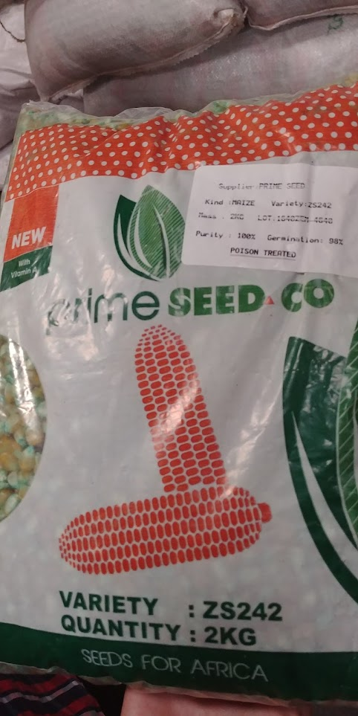
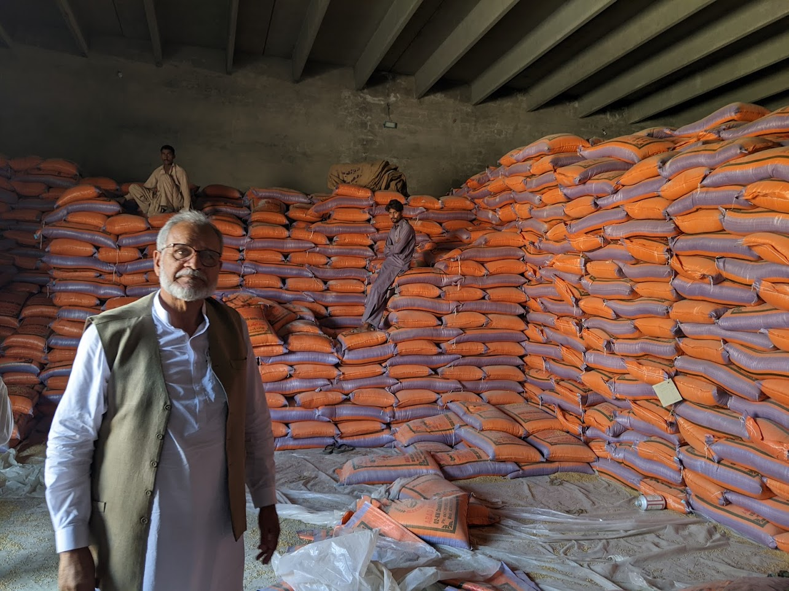
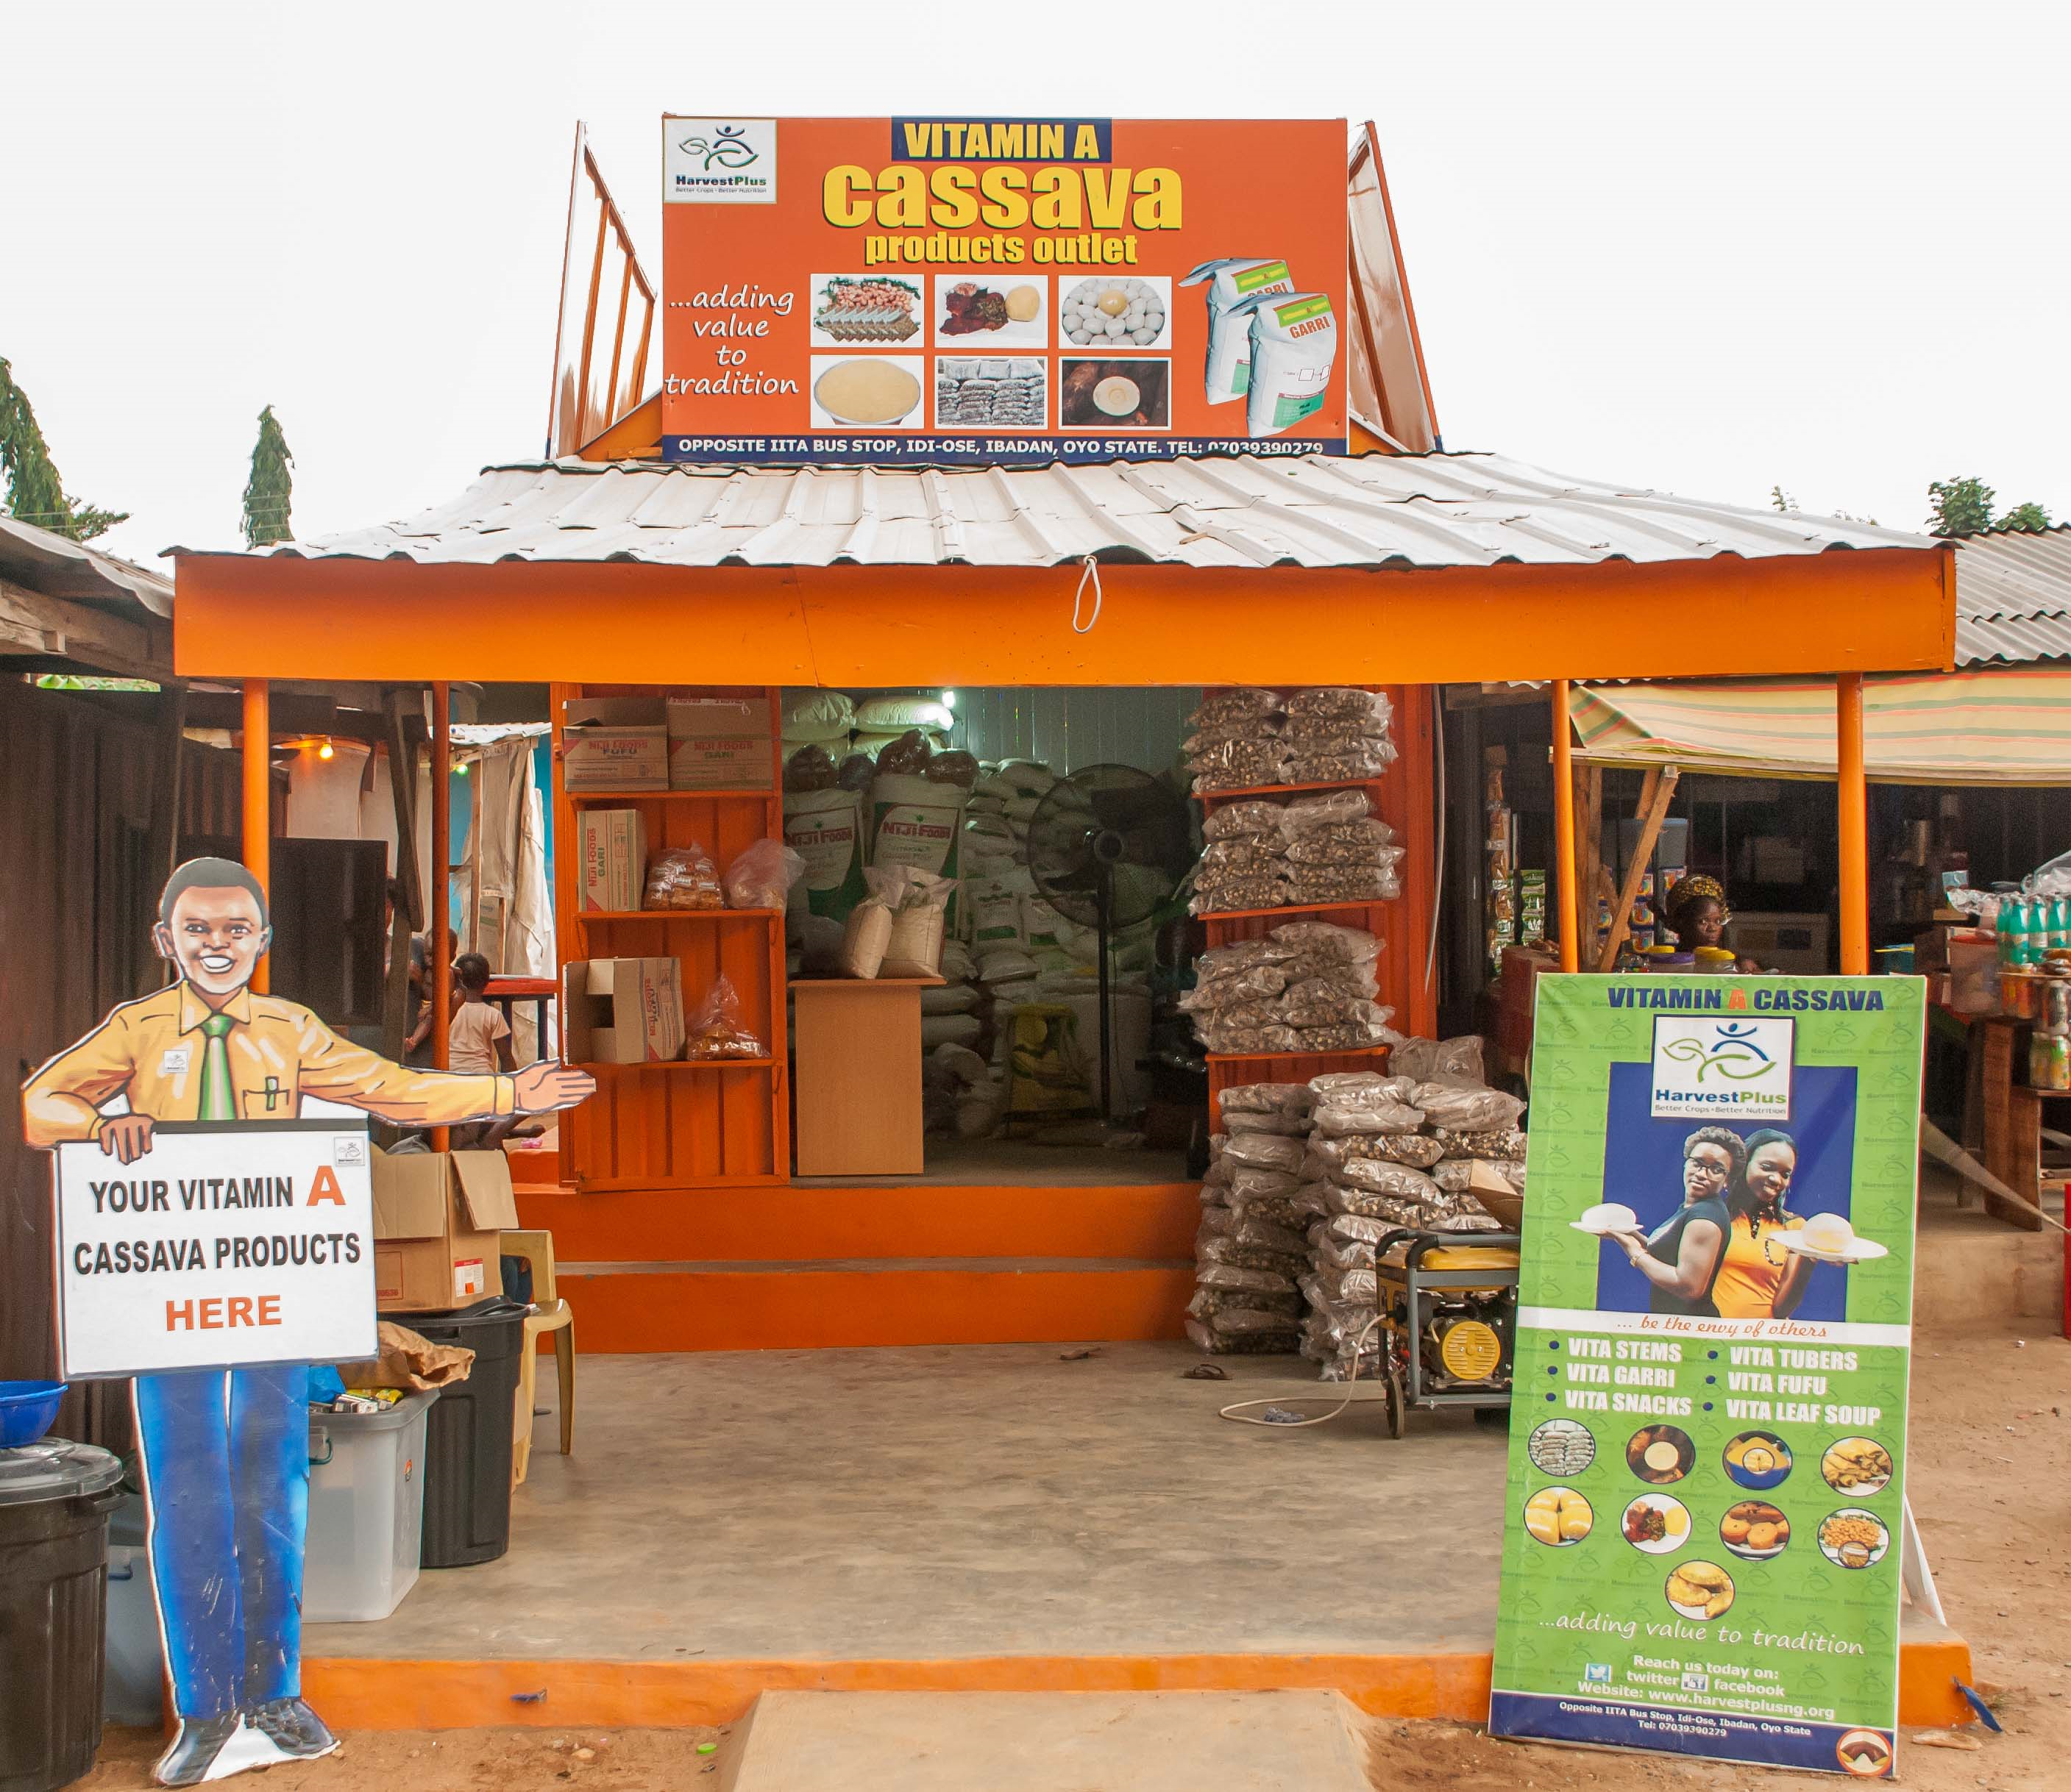

Commercially available biofortified seed products
Notes:
Seed – here are examples of commercially available seeds from all over the world
Seed is one of the most important objectives we are working on to avoid bottlenecks later in the value chain. We work with partners in research, breeding, National Agricultural Research Institutes responsible for testing and release and other partners to ensure that the seed reaches the seed producing companies in the public and private sector, and ultimately the farmers

Slide 9
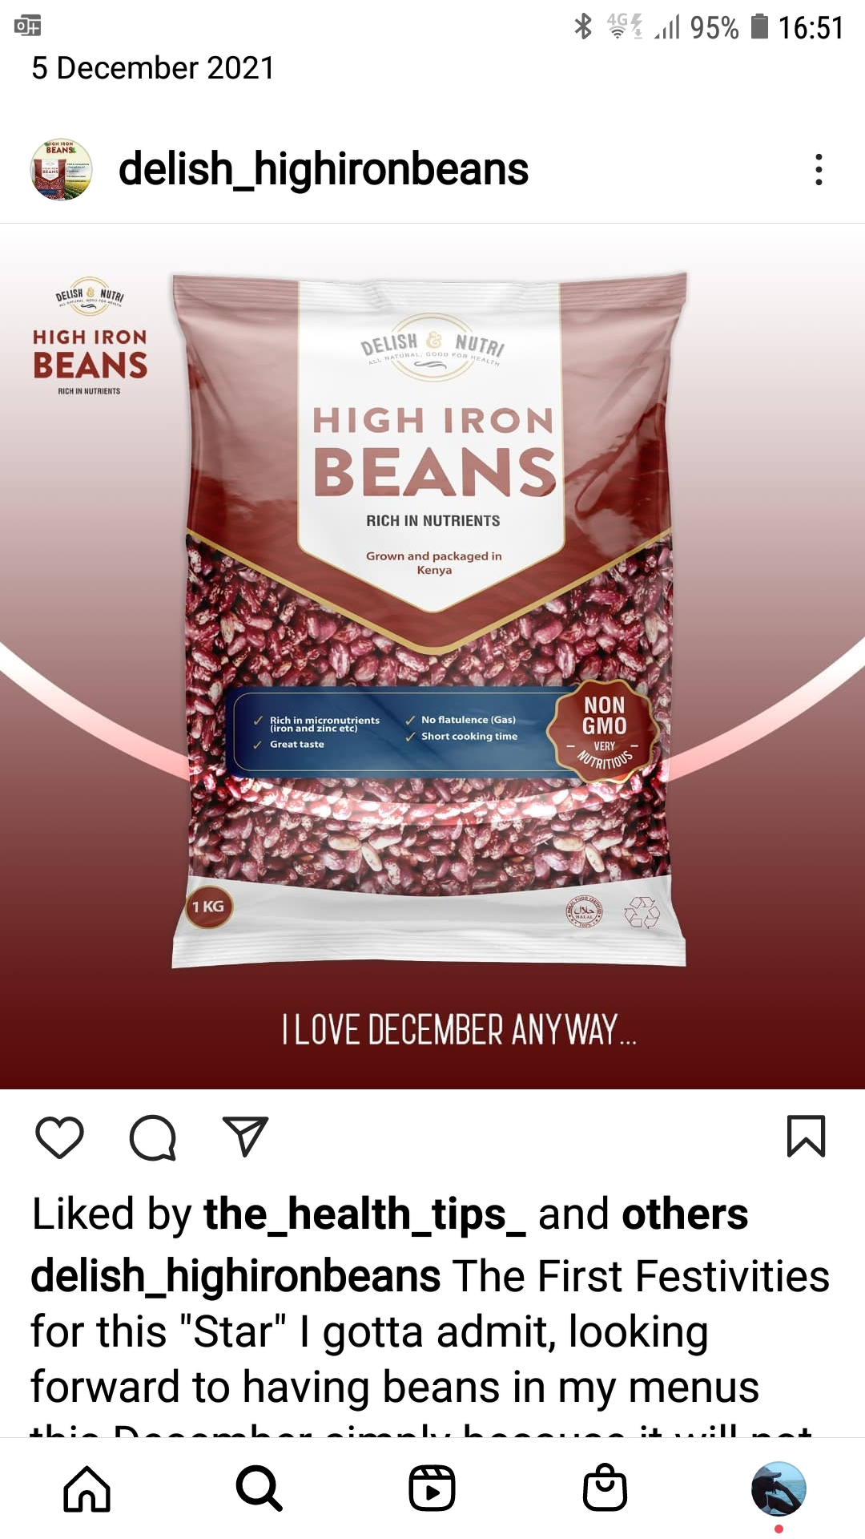
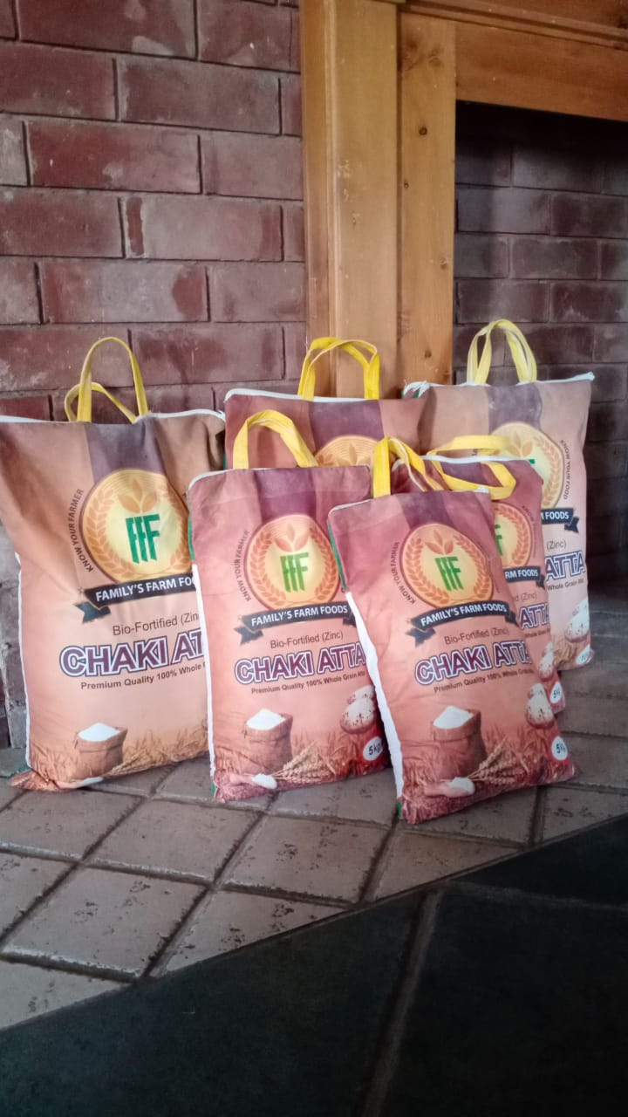
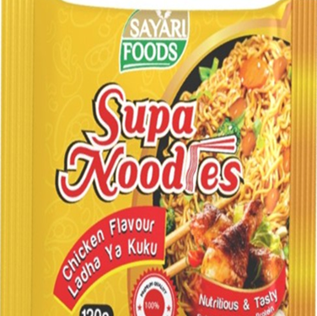
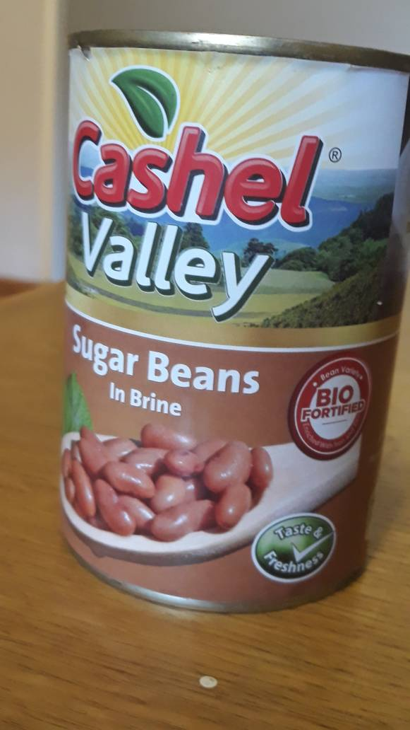
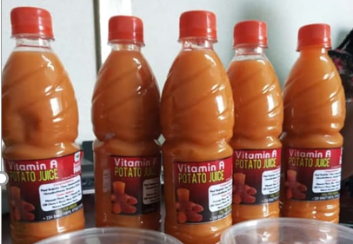
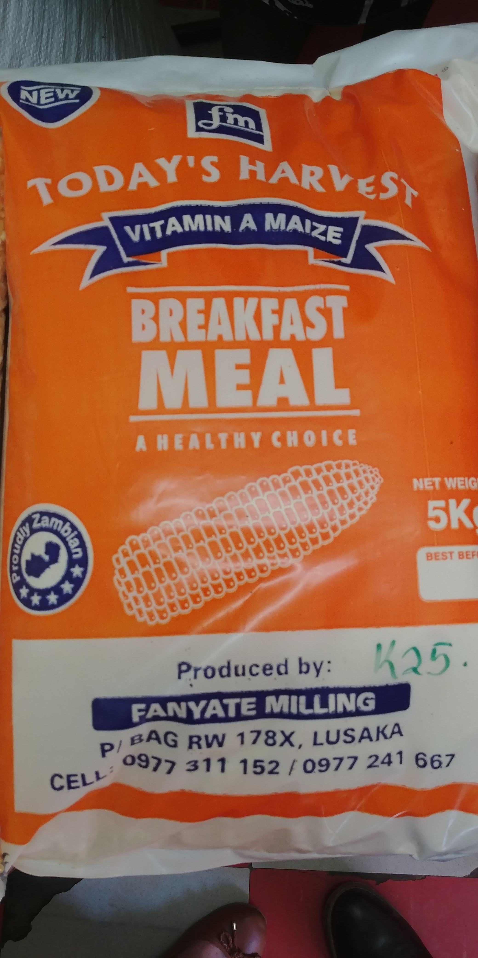
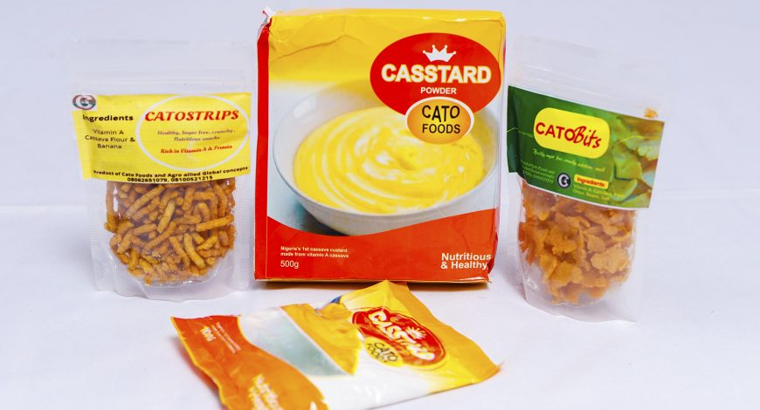
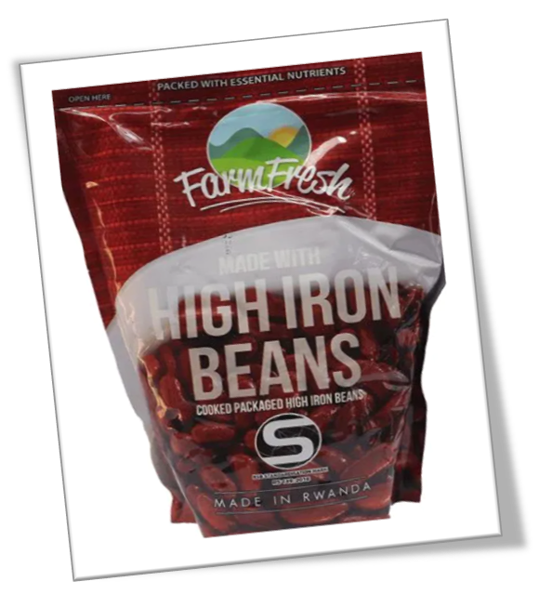
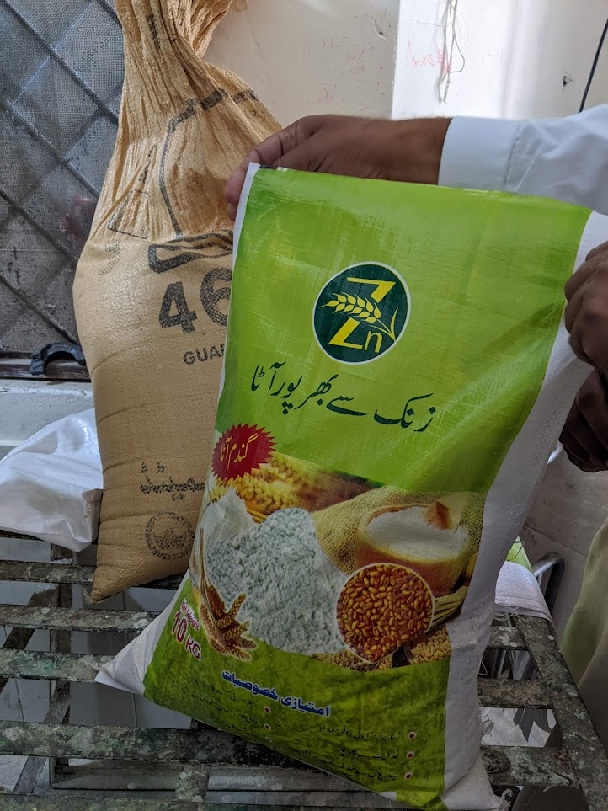
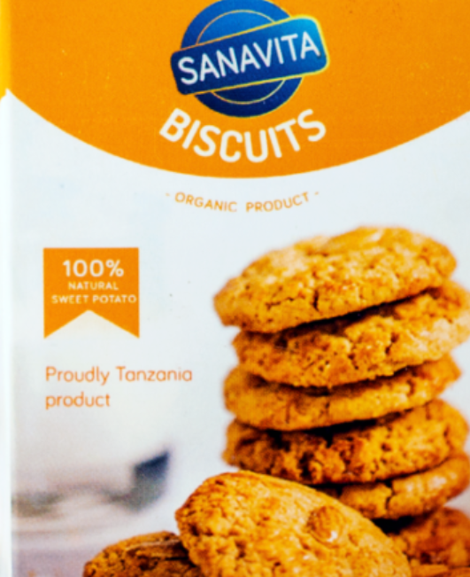
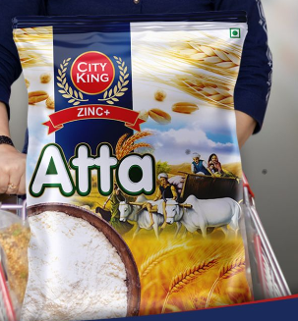
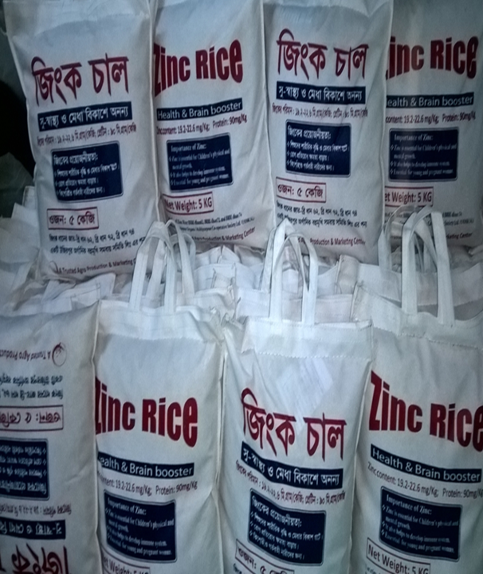
Commercially available biofortified Food products
Notes:
Likewise, the variety of foods produced from biofortified crops is increasing. By offering tasty and healthy foods, food producers not only help to popularize biofortified foods. More importantly, is that the offtake of stable volumes of biofortified crop are also an incentive for farmers to increase the quality of their crops, to formalize their buyer-seller relationships, and to increase their production volumes, for example by aggregating or cooperating in trading and sales.
If we want to add a word on gender: While seed production is still very much a man’s world, the biofortified food production is very much not

Slide 10
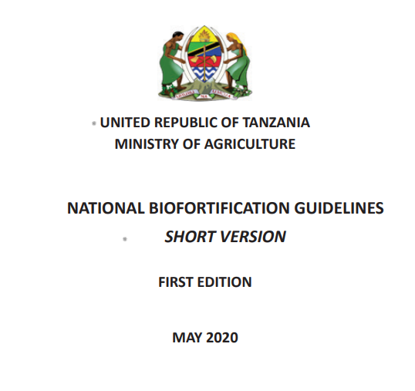

Programming lessons learned – cost and operational impact
Policy
Standards
Advocacy
Digital marketing & promotion
Digital farmer training & extension
Impact
Market / commercial research
Marketing
Promotions
Seed subsidy – early incentive - market acceleration
Seed give away / pay it forward
Farmer training in person
Cost
Prices and financial incentives to seed sellers
Grain and food subsidies
Research regularly published on the HP website
Notes:
Coming back to how we got here. From the very beginning the Harvestplus delivery program was a case of trial and error with many lessons learnt.
Though 2017 FCDO then pushed HP to formalize their learning journey and become from streamlined in the activities of the delivery program. As a global team we went through a process of looking at the cost and benefits of all of the activities. Lessons learnt have been published in greater detail, but let us just highlight a few.
One key message here is that we need to balance a line between activities with high impact versus cost effectiveness. Some activities are necessary to address disrupted agricultural infrastructures, field days and trainings are work intensive but very effective in terms if impact. Standards help us to be more effective at an aggregated level and pave the way for commercialization.
Market incentives …
The country programs naturally gravitated to commercial value chains, to commercial seed markets and Nigeria was one of the first countries to get into commercial food products.
Politically enabling environment in many countries works positive for us.
Counterintuitive to scaling is the issue of market prices: case of beans often biofortified is also a premium product, the introduction of new varieties requires investment costs, both raises the market price, which shouldn’t happen if we want to reach vulnerable and low income target groups. On the other hand if seed or food products are to attract private investment, a higher market price would be in favour of scaling. So, it is also a matter of consideration of how to balance the socially beneficial, impact-oriented activities that match well with public funding, third party donors and institutionalized support, and commercialization-oriented activities with private sector partners and investment and strong market linkage. This is another line we have to balance carefully and consider locations and socio-economic settings when planning our activities.
Global changes currently prove our products to be increasingly timely, and we therefore hope that as we move further into scaling up, this will provide an even better enabling environment for biofortified crops. This includes for example changing dietary behaviours and increasing awareness of nutritious diets. Also there is an overall requirement for improved seeds due to climate change and subsequent changes in disease patterns, storage requirements and pest resilience. And with the COVID pandemic we have seen ruptures in traditional import-export relationships that have made governments give more priority to national production systems.
For HarvestPlus, the Covid era had another side-effect in that it pushed us towards digitization and, and we are now having many digital projects in action in our programs.

Slide 11


High level learnings for the path forward
1 Billion consumers
Overview of the entire ecosystem and supply chain – seed grain food consumer
Think reach from the outset – from the project or product design phase
Make mistakes fast – don’t be embarrassed of the mistakes – share
Think wider than what you want to promote – consider all other external factors and incentives – the commercial hook for farmers is not nutrition
Be future focused
R&D and delivery/scaling are in inextricably linked! Without R&D in the seed scale we will go backwards
Can not scale without the private sector or commercial food systems
Reach Vs impact
100
Million
1993
2023
2030
Notes:
These are the big picture learnings that we have to follow to get us to the 1 billion by 2030.
We don’t just do biofortification – we have to consider the entire eco system that the seed seller, farmer, aggregator, miller, retailer and consumer are living in – offering incentives to participate in the Biofortification value chain through helping businesses grow, providing access to finance, links to digital support – put ourselves in the shoes of the value chain actors we are trying to impact.
The end goal is the guiding light – results driven
We have and will continue to make mistakes - not all country and crops will be a success, our digital projects may sometimes be expensive and not yield results
We have to support and elevate women – we cant fix the food system unless we simultaneously tackle gender issues in agriculture and food production, its not for other people to fix.
Digitisation and technology is fast, efficient and will quadruple our efforts
Private sector mind set, efficient, commercial, proffit orientated
Don’t forget our primary beneficiaries – the most vulnerable
R&D and scaling are inextricably linked – without investment in breeding scaling will reverse .
To our donors, sponsors and partners – this is not job done – the acceleration is fast – yes we have scale but if we slow down now we wont have the impact and the story of biofortification will have an unhappy ending – we have to continue the investment and the hard work to fully and sustainably embedded biofortified staple crops into global food systems – it is only at that point we can walk away – if we slow down the energy and investment now that early work could go to waste
The difference between reach (scale) and impact (health) – we talked today deliberately about scale and reach, this was intentional – the scale is what we need to have impact BUT the impact is reducing hidden hunger – we have the studies to show impact in controlled conditions but time will tell the impact on population health

Slide 12

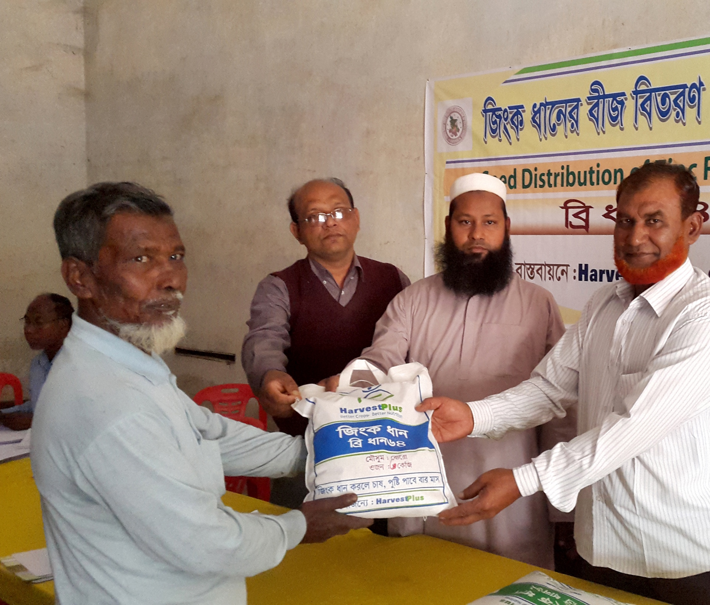
Thank You
Katharina Diel c.diehl@cgiar.com
Jenny Walton
j.walton@cgiar.com
Notes:
Thank you – and for more information of the impact research and evidence here is the link to the evidence.
We thank you for this opportunity to tell our story and welcome your questions, our door is always open to share more evidence

