Slide 1
SCALING UP ACTION
BY LOWERING FINANCING COSTS OF NEW CLIMATE SOLUTIONS
Scaling Up Action Post-COP 27
Yannick Glemarec
Executive Director, Green Climate Fund
February 3rd, 2023

Slide 2
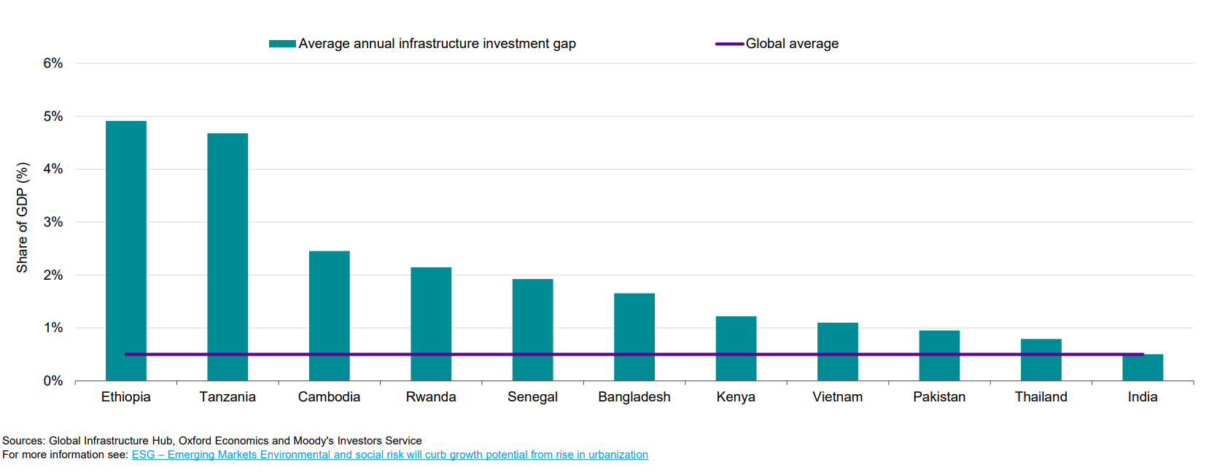
Estimated average annual infrastructure investment gap 2016-40
% of GDP

Slide 3
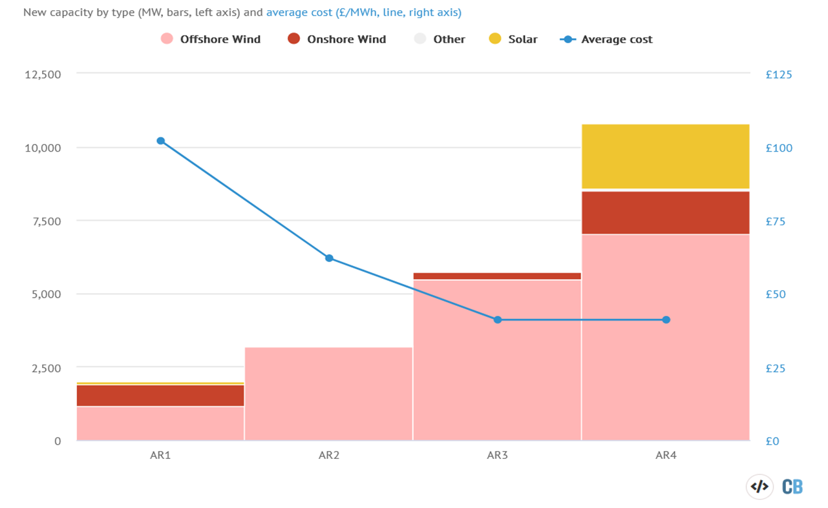
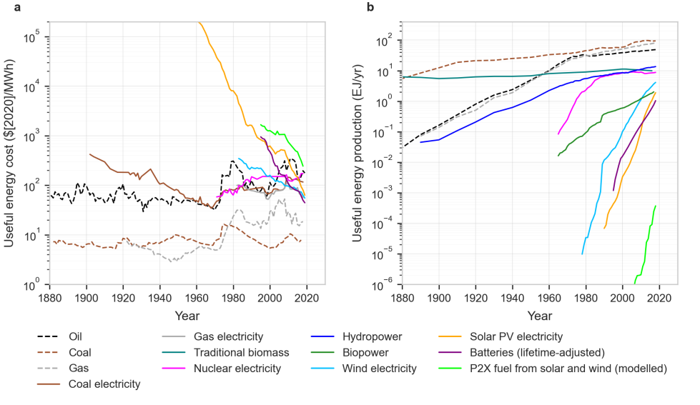
Evolution of Energy Generation Costs
The prices of fossil fuels, after adjusting for inflation, are very similar to what they were 140 years ago. Nuclear has a negative learning curve.
In contrast, the costs of solar photovoltaics (PV), wind, and batteries have dropped exponentially at a rate near 10% per year for several decades.
Renewable energy capacity is expected to increase by 50%, or 1,200 GW in the next five years.
Source: Way and al, 2021
Notes:
According to Way and al., a global zero-emissions economy can be achieved by mid-century without relying massively on offsets from nature-based solutions or on negative emissions technologies beyond the transition period (ETC, 2020). Renewable capacity growth has doubled in the last ten years, with total global installed capacity reaching almost 2,400 GW in 2018 (IRENA, 2019). Renewable power capacity is projected to increase by approximately 50%, or 1,200 GW in the next five years.
Most of the growth is from solar PV and onshore wind, which account for 60% and 25% of the additional installations, respectively. Hydro will start to play a diminished but still significant role (10% of added capacity), while offshore wind capacity (4% of added capacity) is projected to triple. The lion’s share of renewable capacity additions before 2024 is expected to occur in China (40%), with the EU, US, and India being other frontrunners (IEA, 2019).
The UK government has committed to getting 95% of the country’s electricity from low-carbon sources by 2030 and to fully decarbonise the grid by 2035. It is also aiming for “up to” 50GW of offshore wind by 2030, including “up to” 5GW from floating offshore schemes.
CfD auctions for new renewable energy capacity are the UK’s primary route for achieving these targets. Auctions have been held every two years since 2015 but will now be held annually. The contracts are awarded in a reverse auction, where the lowest bid wins. The auction is divided into various “pots”, where contracts are reserved for different groups of technologies. This system of “pots” is designed to allow emerging technologies to win contracts even though they may be more expensive than established options.
Under the contracts, projects agree to generate electricity for a “strike price” that is fixed in real terms, meaning it is index-linked to inflation. Once projects have been built, the money they earn from generating electricity is compared with a market reference price. If this is lower than the strike price, the project receives a subsidy to make up the difference. When prices are higher, the project must pay back the extra money. Amid a global energy crisis, current market prices are extremely high, due to the soaring cost of gas. They are expected to remain elevated for several years. As a result, the bulk of this week’s auction winners are expected to pay back to consumers for much of their lives
As an illustration of this dramatic reduction in price, the UK’s fourth biannual CfD auction secured a record 11 gigawatts (GW) of new renewable energy capacity that will generate electricity nine times more cheaply than current gas prices in August 2022. The projects are all due to start operating within the next five years up to 2026/27 and have agreed to generate electricity for an average price of £48 per megawatt hour (MWh) in today’s money. This was nine times cheaper than the £446/MWh current cost of running gas-fired power stations at that time. Moreover, this price for gas reflects the cost of running existing power plants – buying fuel and permits to emit carbon dioxide – whereas the CfD prices are for building entirely new projects from scratch.
Most of the new capacity – some 7GW – will be offshore wind. Notably, for the first time, these projects were cheaper at £37/MWh than the 1.5GW of onshore wind or 2.2GW of solar. According to some estimates, these projects would pay back £1.5bn a year towards the end of the 2020s, based on their latest price forecasts. The UK government has estimated that the cost of integrating variable wind and solar into the energy system is around £10/MWh when the generation mix is 50-65% renewable, with the figure rising to £25-30/MWh at 75-90% renewables.
Once the pre-approved projects are built, Carbon Brief (2022) estimates they will generate 45 terawatt hours (TWh) of electricity per year, enough to meet around 14% of current UK demand. This 45TWh of new renewable generation, which is due to be up and running in five years, can be compared with the roughly 25TWh of electricity that will be produced by the Hinkley C new nuclear plant in Somerset. Hinkley C has a CfD for £92.50/MWh in 2012 prices (£110/MWh today) and is due to start operating 10 years after its contract

Slide 4
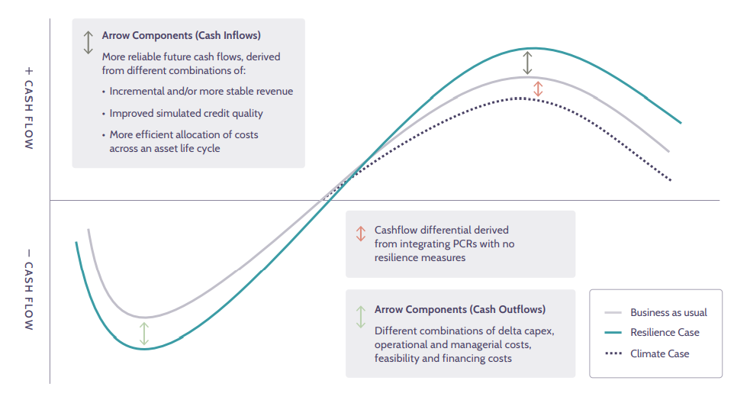
Climate Resilient Infrastructure
Reduced physical and transition risk leads to a different project cashflow profile that can in turn translates into a tangible valuation benefit and a reduced cost of financing for adaptation and mitigation projects.
Source: “The physical climate risk assessment methodology (PCRAM) – Guidelines for integrating physical climate risks in infrastructure investment appraisal”, Coalition for Climate Resilient Investment (CCRI).
Notes:
Novel technologies and practices are hampered by an array of barriers. These barriers can be broadly placed into the following four clusters: (i) higher perceived policy and regulatory risks in comparison to incumbent technologies and practices; (ii) higher perceived technical and operational risks in comparison to incumbent technologies and practices; (iii) higher perceived market and socio-economic risks in comparison to incumbent technologies and practices; and (iv) lack of access to affordable, long-term project finance.
Risks also vary across the life of the project. Entrepreneurs are particularly exposed to development phase risks as they are usually financed by personal equity and represent a sunk cost. Construction, operation, and termination phase risks will be taken into consideration in the investment calculus of both entrepreneurs and financiers.
Political and regulatory risk:
Political and regulatory risks arise from governmental action, including changes in policies or regulations that adversely impact infrastructure investments (OECD, 2015). They include:
Procurement of permits (land, construction, environmental): Obtaining the necessary land, construction or environmental permits might prove more costly or take longer (and thus increase costs) than expected.
Cancellation of permits: The risk of a public authority cancelling necessary permits.
Contract renegotiation: The risk of a public authority forcing renegotiation of contracts, thereby changing the financial arrangements of the original project.
Change in tariff regulation: The risk of a price change in regulated markets due to a political decision.
Contract duration: The length of the contact is appropriately matched to the length of the useful lifespan of the asset.
Decommission: Risk related to the disposal of the asset at the end of the contract agreement, or useful life of the asset. This risk is especially related to large assets that may generate toxic wastes or environmental risks that need to be cleaned up before the asset may be retired.
Asset transfer: The feasibility and cost of transfer of the asset at the end of the contract agreement. The risk that an asset could become “stranded” due to changing government regulation or policy
Enforceability of contracts, collateral and security: This risk is closely related to the legal environment that is associated with infrastructure finance such as PPP frameworks, and the enforceability of leases, concessions, and other contracted payment schemes.
Changes in wider regulatory or legal environment: Any modification of the regulatory or legal environment can have widespread consequences on affected companies. This risk can be differentiated through the range of affected entities. A general change in law applies to all businesses in the country, a specific change in law to a defined industry and a discriminatory change in law singles out one company. The ability to cope with or even anticipate such changes can be important for the continued economic viability of a project.
Changes in taxation: Changes in taxation of company or project revenues, output delivered by the project, financial transactions or any other element of the project structure including taxation levied on investors themselves. Changes might be categorised similarly to changes in regulatory or legal environment.
Currency convertibility: sufficient amounts of requested foreign currencies are available at the time needed to repay foreign debt or repatriate dividends and principal. This risk generally does not apply to developed economies with stable and developed foreign-exchange markets.
Social acceptance: This risk applies specifically to large-scale public infrastructure projects and is explained by the condition when the general population does not support the project. Consequences can impact all phases of the project. Protest might lead to a delay in construction or hamper proper operation leading to a loss of revenue; official bodies supporting the project might come under pressure from public opinion translating into political action.
Macroeconomic and business risk
Market and macro-economic risks are subject to governmental action but can also arise from broader shifts in the industry and/or economic environment. These include macroeconomic variables like inflation and exchange rate fluctuations, creating significant currency risks when projects are financed in foreign currencies (OECD, 2015). They include:
Default of counterparty: default of any party involved in the project agreement including government, suppliers, lenders, and insurers.
Availability of Prefunding: The availability of funds to perform viability and feasibility studies. Prefunding is a sunk cost thus making it difficult to raise from private sources before commercial viability can be established.
Exchange rate fluctuation: If liabilities and revenues are in different currencies from one-another, project participants can be exposed to exchange rate risk due to the volatility of exchange rates over time.
Liquidity risk: The risk that assets will generate enough cash flow to service debt payments and any other obligation. Also the risk associated with pricing assets where market prices are not observable.
Refinancing risk: if a project is initially financed via agreements with shorter duration than the project life itself, there is a risk of an inability to refinance loans at maturity due to performance issues or unfavourable market conditions (liquidity, interest rates).
Inflation risk: The risk that aggregate prices increase in an economy, and the asset is exposed to rising prices in a detrimental manner. The risk that the replacement cost of the asset increases over time. Interest rates tend to be correlated with inflation, thus inflation risk can be thought of as interest rate risk.
Real interest rate risk: A component of nominal interest rates, an increase in real interest rates translates to an increase in the real cost of finance, which can strongly affect profitability. Volatility of demand/revenue risk: The risk that the project company might fail to generate sufficient demand (usage of facilities or service) at the projected price of usage, ultimately leading to a lower level of revenue than projected. Profitability can also be affected by an unforeseen increase in costs.
Technical risk
Technical, operational and liquidity risks are determined by the skills of the operators and managers and are related to the features of the project, project complexity, construction, and technology. Liquidity risks arise from operational delays and cost overruns due to limited familiarity with a novel technology or practice. They include:
Archaeological: Additional costs might arise if archaeological discoveries (historical sites, fossils) are discovered on the land intended for construction.
Obsolescence: The technology might become outdated and lose its economic appeal or become the subject of constraining regulation rendering it uncompetitive in the market. This is true for established technologies but is also applicable to new technologies, where unintended consequences might lead to higher costs or removal from the market.
Technology risk: A (new) technology might not perform as projected or have unforeseen consequences, for example on the environment. Lenders are more reluctant to lend against a project usingnovel technologies due to a lack of performance benchmarks and increased uncertainty of risks. Yescombe (2014) notes that project finance is more suitable for projects using established technologies.
Governance and management of the project: Failure to deliver and operate the project to the standards agreed due to poor management or poor risk control procedures.
Reliability of forecasts for construction costs and delivery time: The risk that the construction authority fails to deliver the project on time and on budget. The reasons can be due to a performance deficit of the construction contractor, unexpected events leading to a longer construction period or the failure of third parties to provide auxiliary services necessary for operation. The consequences could be a rise in financing costs, including interest payments during a prolonged construction period, loss or deference of project revenue, as well as financial penalties payable to the contracting authority. A delay in construction thus very often leads to the need for additional funding, responsibilities for which should be allocated in the contract signed between the relevant parties.
Qualitative deficit of physical structure/service: The risk that the project might not deliver the agreed output at agreed conditions.
Force Majeure: Risk of forces outside the control of any project participant and affecting the proper delivery, operation and termination of the project. This includes direct (physical damage) and economic (loss of revenue) consequences from natural disasters, as well as economic (strike) and political (war) developments. Force Majeure events might be defined in insurance or risk transfer agreements.
Environmental risk: A project’s impact on the environment does not only have significant financial implications but is also an increasingly important factor for potential investors operating under ESG guidelines. The direct, quantifiable impact on the environment such as the production of waste and carbon emission may be reflected in the form of permits or additional taxes, thus creating a cost factor which needs to be estimated and managed. Indirect risks stemming from a project’s impact on the environment include public opposition to construction or operation, as well as negative image effects for involved sponsors or lenders. Legislation and regulation defining environmental requirements and standards might substantially change, in extremis rendering a technology obsolete. New technologies might have unintended negative consequences on the environment, exposing projects to a possible surge in costs and endangering the business model. Since infrastructure assets are built for long operation phases, this risk is especially relevant for them. An Environmental Impact Assessment might help quantifying the exposure to environmental risk and establish compliance with current laws, but does not protect from unforeseen events. On the financing side, environmental factors become increasingly important to potential investors, illustrated by the spread of guidelines and principles they are adhering to.
Termination value: Since infrastructure assets are long-lived, any issues with forecasting, particularly related to salvage values and depreciation of assets over time can affect the expected termination value of an investment. For PPP contracts where the terminal value is zero, this is less of an issue. This risk can be greater for direct equity owners such as corporate balance sheets or direct equity sponsors.

Slide 5
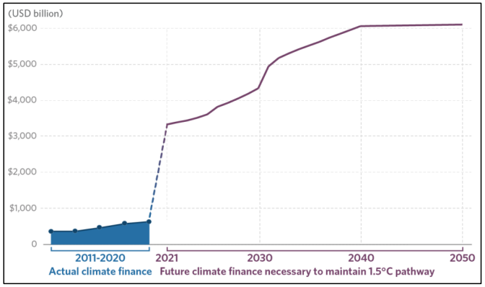
The Financing Gap
The Climate Financing Gap
Source: CPI (2021)

Slide 6
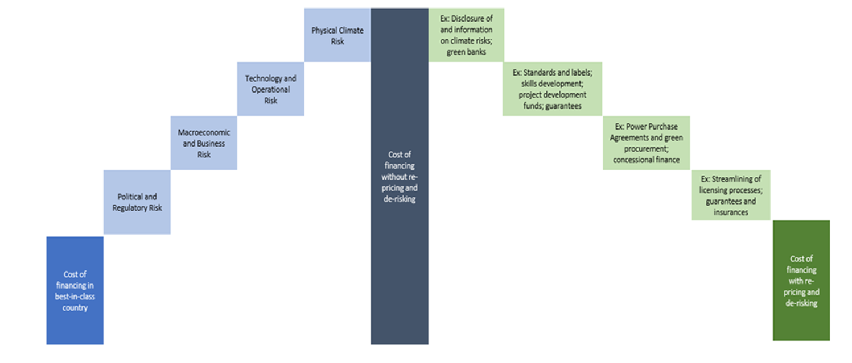
Re-Pricing and De-risking Climate Assets

Slide 7
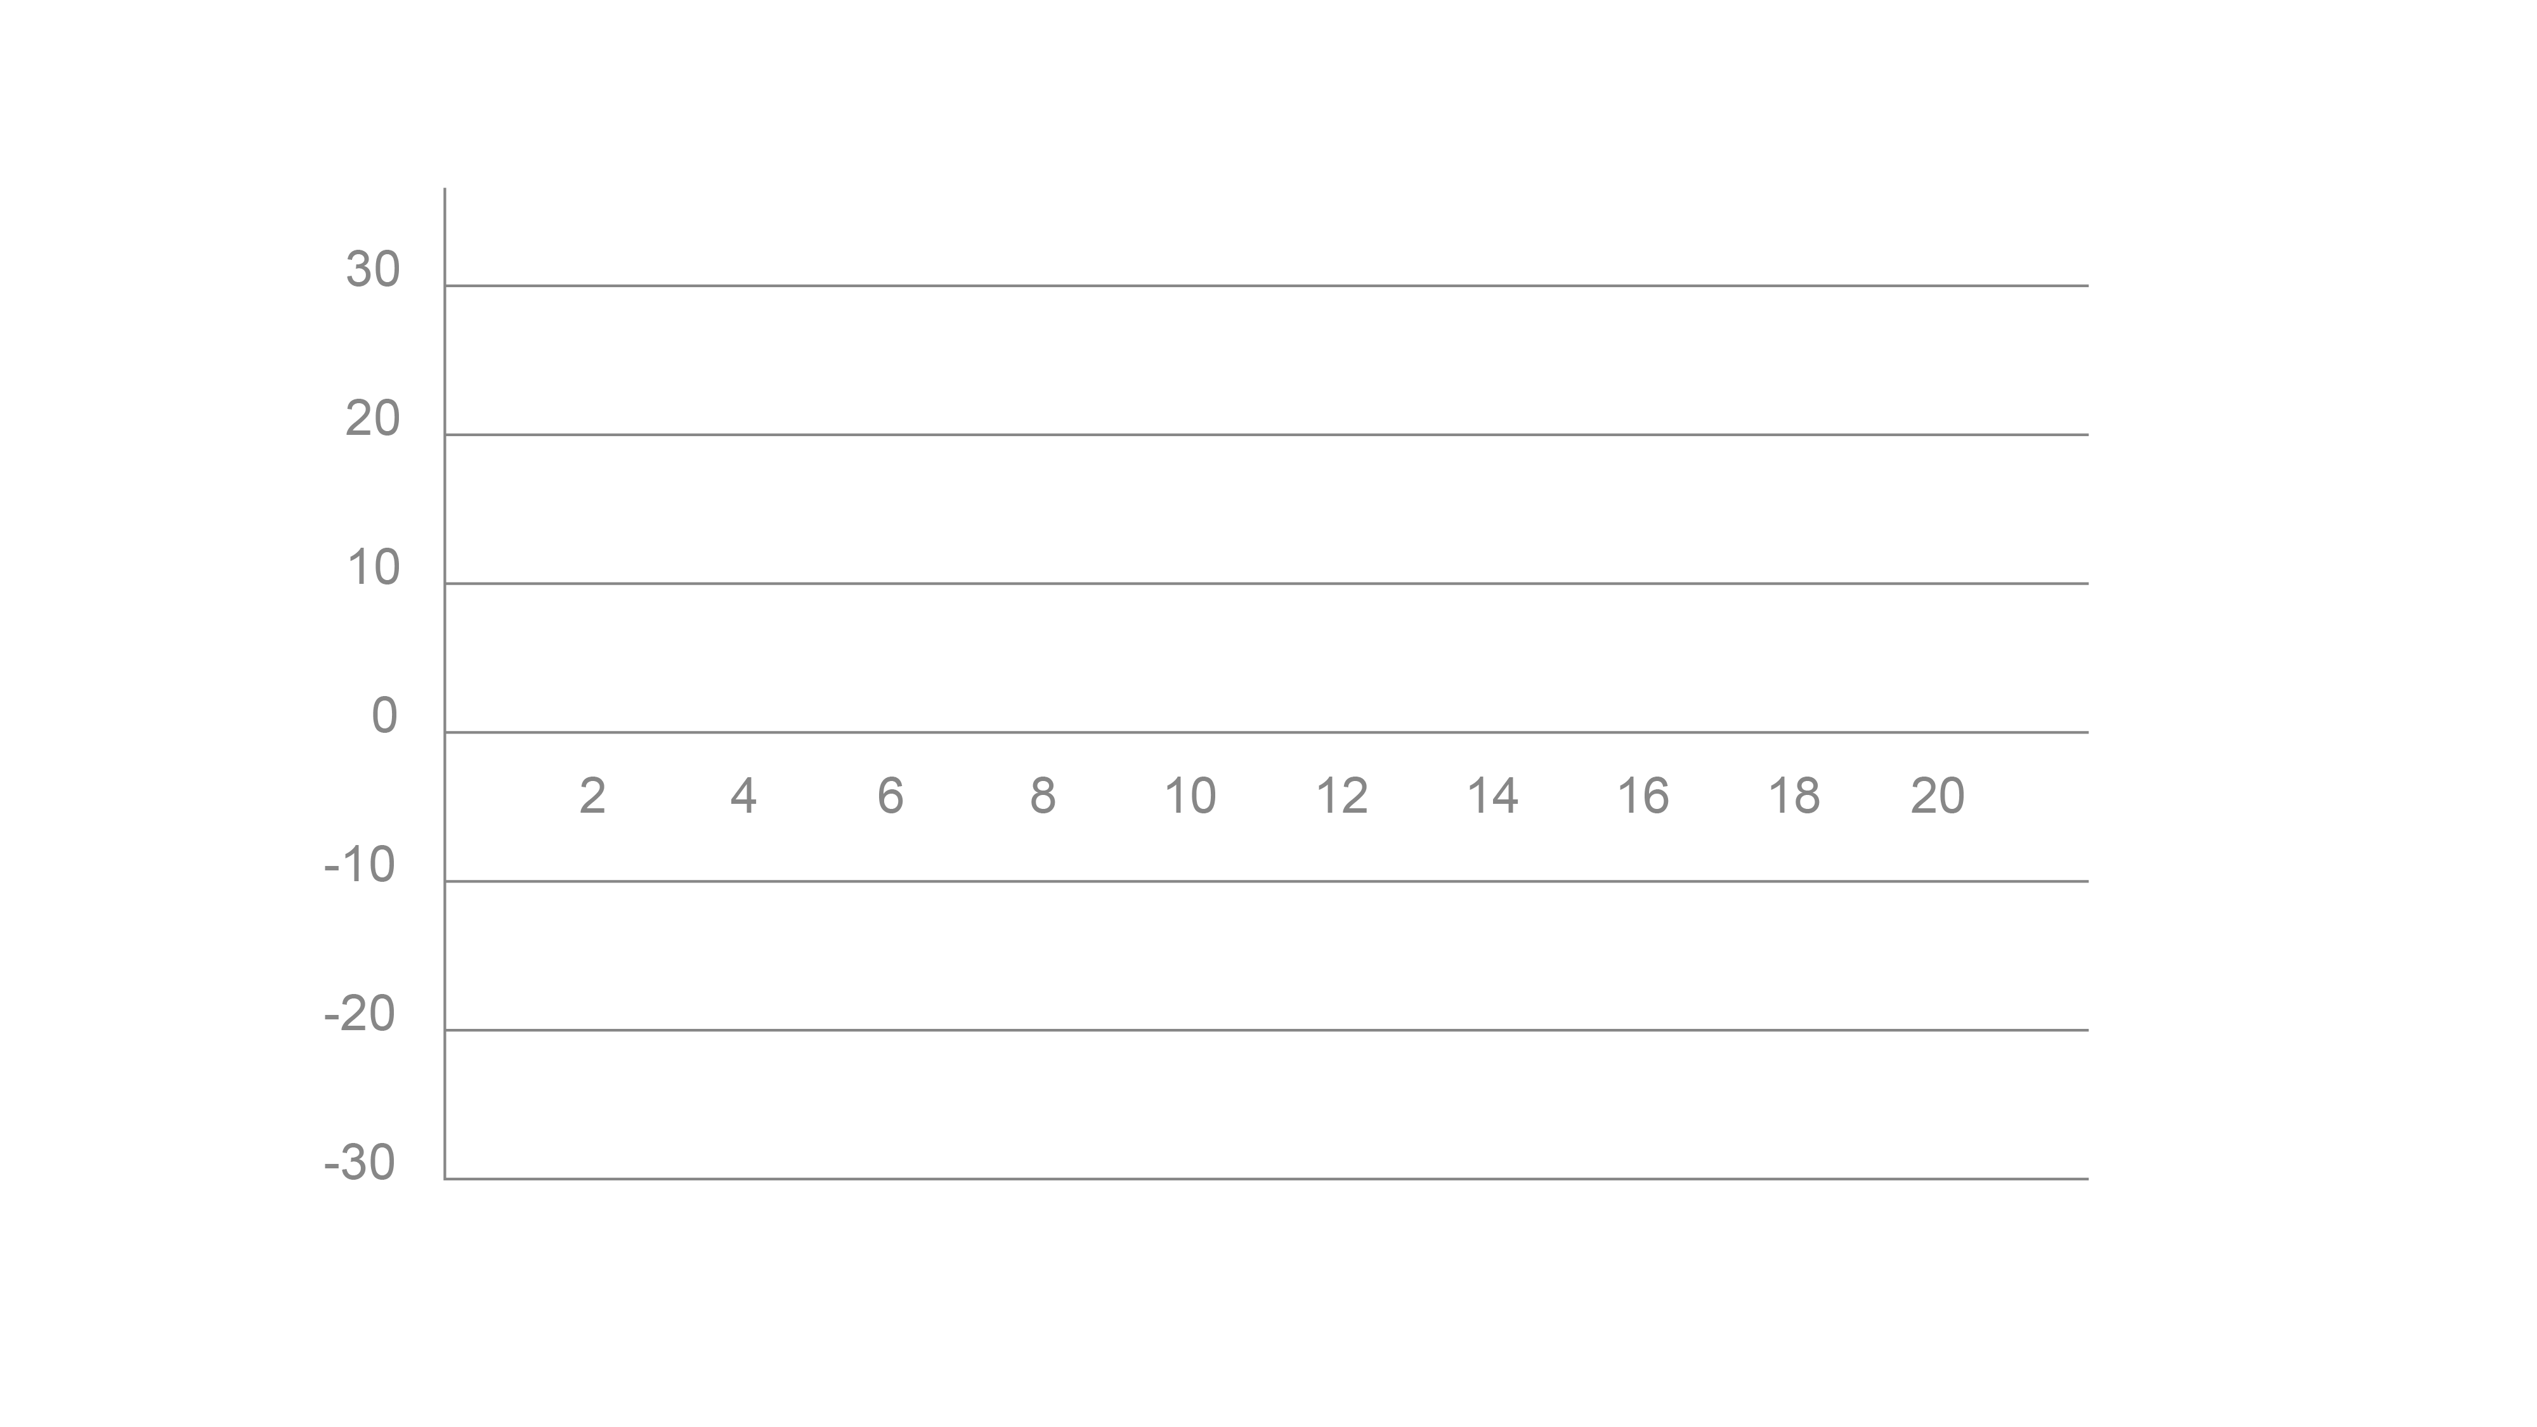
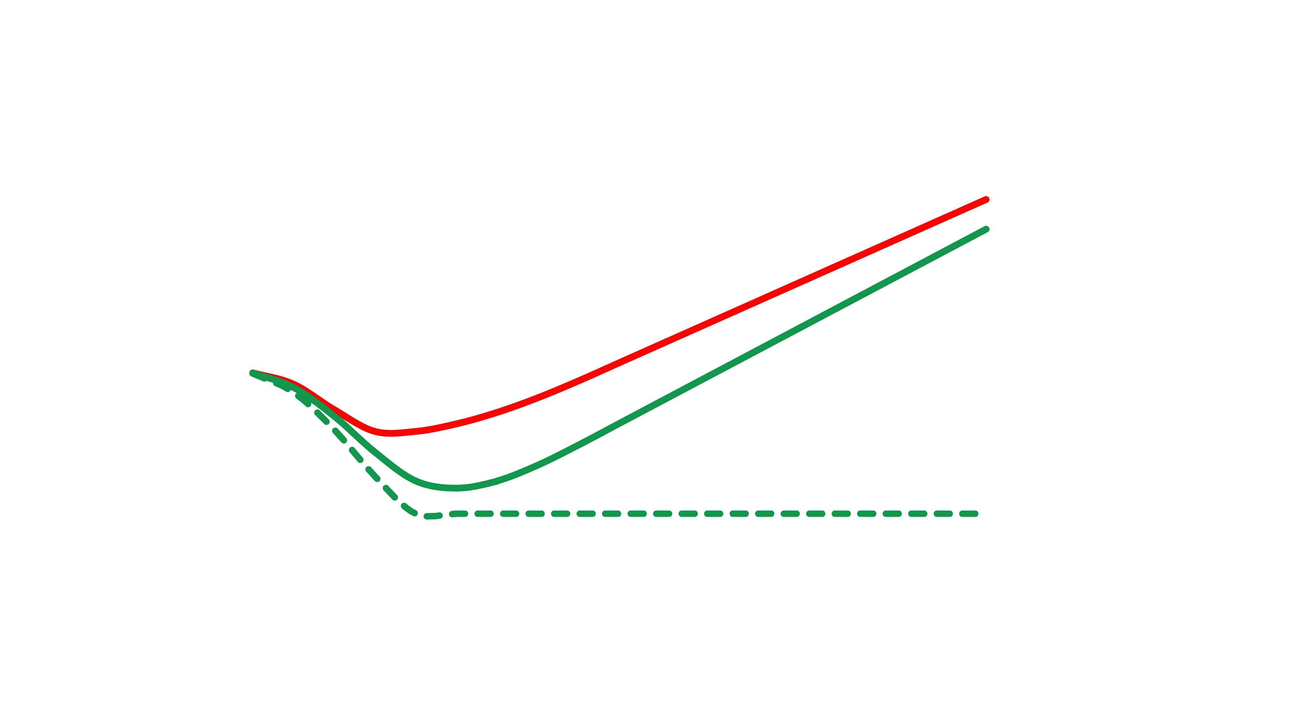
De-Risking and repricing in high financing cost environment
FROM
to
Lower Return and Higher Cost Overrun Risks
Higher Return and Lower Operational Risks
Business as Usual
Current Perception
Business as Usual
Current Perception
Source: Adapted from GCF (2021)

Slide 8
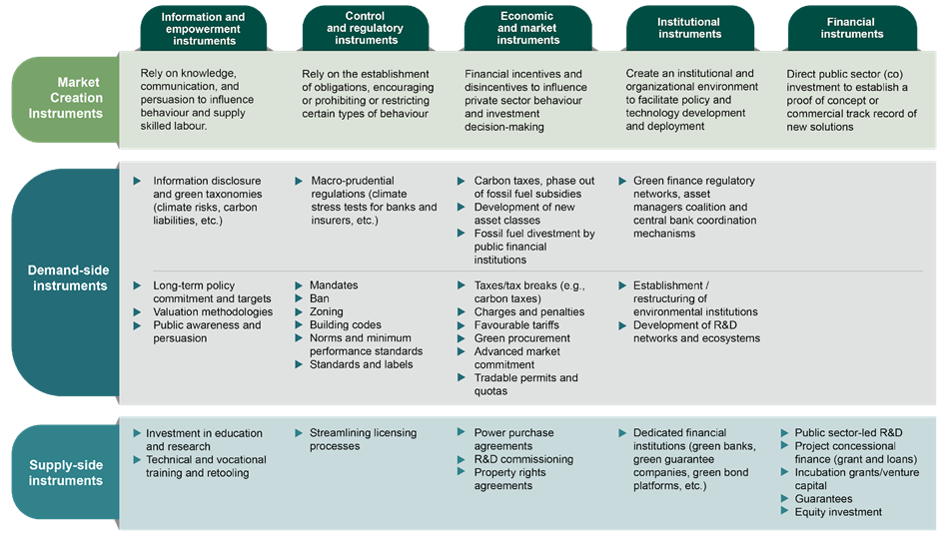
Identifying the most Effective Re-Pricing and De-Risking Instruments
GCF (2020).

Slide 9
Identifying the most Effective Re-Pricing and De-Risking Instruments
Policy instruments* can address supply and demand barriers to the financing of mitigation and adaptation projects in a systemic way.
(*) For instance, for the energy sector, the International Energy Agency policy database includes more than 7,000 policies.

Slide 10
Residual Risk and Financial De-risking Instruments
Financial instruments address residual risk by removing barriers to supply in a targeted manner to establish a commercial track record for new climate solutions.
Adapted from GCF (2020).

Slide 11
Climate Investor One:
Combining several de-risking instruments
Notes:
GCF first deployed this generic structure to support renewable energy investment in developing countries. In 2018, it committed USD 20 million reimbursable grant for funding project development activities and USD 80 million in first loss equity to Climate Investor One (CIO), a USD 800 million blended finance vehicle designed to accelerate the development, construction and implementation of renewable energy infrastructure projects in developing markets (GCF 2018). CIO aims to support about 30 projects and comprises three inter-linked investment funds: (a) a development fund providing reimbursable project development loans; (b) a construction fund providing equity; and (c) a refinancing fund (CIO and Convergence 2021).
Entrepreneurs are particularly exposed to development-phase risks. The first two funds supplement the personal equity of entrepreneurs during the development phase and mitigate the liquidity risk due to cost overrun during the construction phase. Project risks drop substantially once a renewable project has been commissioned. The refinancing fund provides equity exits once working loans have been secured from institutional investors with a longer investment time horizon but a lower risk tolerance.
As a project progresses through its development cycle, capital is replenished to each sub-fund. Equity disbursed from the construction fund to finance up to 75% of project construction costs is also used to repay the reimbursable project development loan with a premium to offset losses accrued from other failed projects at the development stage. Similarly, the equity fund is replenished when the project turns to debt capital markets for refinancing of commissioned assets (CIO and Convergence 2021). As of December 2021, CIO has invested in a total of 14 projects in developing countries, with a leveraging ratio of 9 to 80 at the individual investment level.

Slide 12
2024-2027 Strategic Objectives
OBJECTIVE 1: Strengthening country climate investment capacity
1A: Country capacity for climate investment planning
1B: Direct access programming capacity
OBJECTIVE 2:Accelerating innovation of new climate solutions
2A: Incubating & accelerating emerging climate technologies/practices
2B: Proof of new business models/instruments, NB for adaptation
OBJECTIVE 3: Building resilience to urgent climate threats
3A: Rapidly expanding coverage of CIEWS & comprehensive risk mgt
3B: Scaling up locally led adaptation action for most vulnerable
OBJECTIVE 4: Forging coalitions for just systems transitions
4A: Investment collaborations for country-led sector/system transitions
4B: Blended finance for de-risking private sector investment at scale
OBJECTIVE 5: Greening financial systems
5A: Building financial institutions’ capacity to mainstream climate risk
5B: Enhancing access to capital markets for climate investments

