Slide 1
Challenges for the deployment of climate finance Ian Mitchell Senior Policy Fellow; Co-Director, Europe Programme Center for Global Development 3 February 2023

Slide 2
Outline
Impact at Scale - UN and ODA architecture matters
Effectiveness – how could finance be better-deployed?

Slide 3
Scale: UN and ODA architecture matters
UN and ODA architecture matters
Climate money isn’t really new and additional
Official climate finance was
~$83bn, but TOTAL devt finance increased by $47bn since 2009
Devt finance 0.3 per cent of GNI in 2009, same now
UN COP $100bn per year climate finance target
expressed in terms of face value: incentivized lending.
ODA rules also incentivized lending by over-counting loans.
Mitigation easier to do in middle income countries.
Now adaptation target by 2025 ($40bn).
Implications – agree post-2025 target with better incentives; new funding mechanism for L&D; Ensure coherence with ODA and with climate finance, reform ODA;

Slide 4
Climate Finance Effectiveness
How could it be better deployed? Lots of ways!
Climate development finance still relatively new
From low $tens of billions, to $80bn, at least quadrupled in a decade
New organisations (inc GCF, but also CTF)
US, the largest provider, but essentially new to the scene
Already big challenges to development effectiveness, some tackled, some not – not surprising climate finance needs to overcome them

Slide 5
How does climate finance compare to devt finance?
Beata Cichocka and I highlight six in our paper
Low disbursement – 59% on adaptation vs 91% on all ODA.
Debt sustainability – for highly-indebted LICs, 30% of finance was loan-based
More providers, smaller projects
59 vs 47 on edu/ health
Project size under $3m in LICS, down 25% since 2015 (
High and rising unidentified recipients (29% for mitigation vs 18% for all official flows)
Lower use of country institutions (80% project-type vs 62% all ODA; all ODA = 15% budget support, climate = 7)
Evidence on impact -
Notes:
1 and 2 = 2020 figs
2. it was 2% in 2013

Slide 6
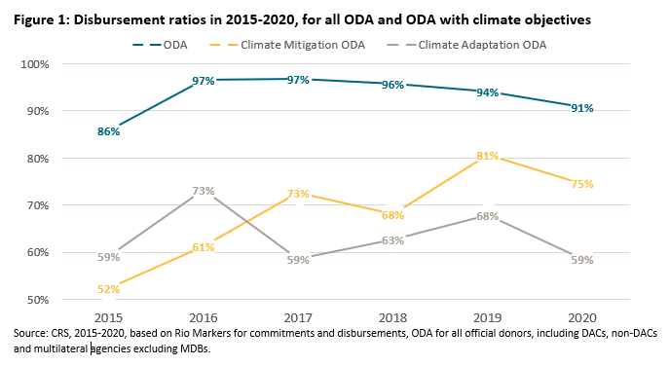
1. Low disbursement
Notes:
1. Latest disbursement = 91% ODA; 75% Mitigation; 59% Adaptation
2. Also, loans in Climate = 68% vs 52% in ODA

Slide 7
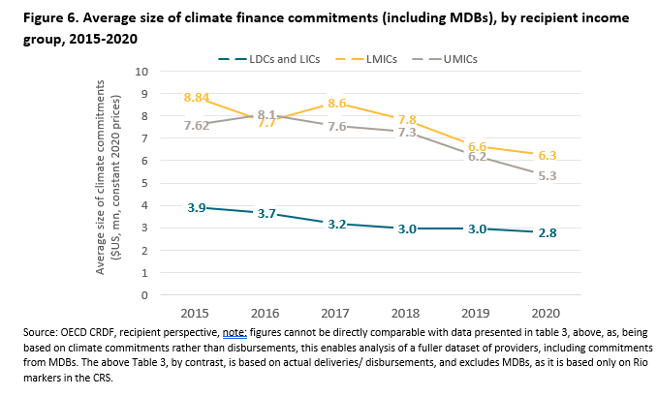
3. More providers, smaller projects

Slide 8
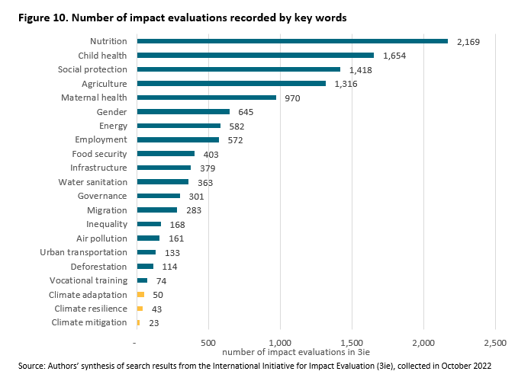
6. Evidence on impact
Surprisingly little.
High quality evaluations:
<120 impact studies out of 10,000
Very few synthesis papers
Partly an economics problem
By Aug 2019, just 57 articles of ~77,000 published (Oswald and Stern, 2019)
Notes:
Key words: [add]
“even fewer systematic reviews which can synthesize findings across a variety of different financial sources and contexts so as to provide more general insights on the pre-conditions for climate project successes”

Slide 9
What actions will make a difference?
UN Target and ODA architecture
– agree post-2025 target with better incentives; new funding mechanism for Loss and Damage;
Ensure coherence with ODA and with climate finance, reform measurement of ODA;
Bigger, quicker projects. Some promising efforts
Core tension – quality of projects and willingness of providers to support budgets/ policy change
$100bn delivery action Plan (Canada and Germany)
Access taskforce – COP26/ UK led effort, some promise but lacking buy-in
JETP promising, large, - but must evaluate/ learn
But need a step change in evaluation effort, sharing and learning
Multilaterals and bilateral invest in evaluation
Publish their data – (GCF a model)
But also collate and share evaluation findings

