Slide 1
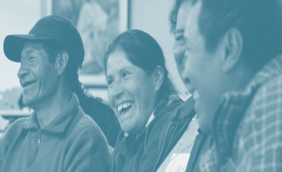
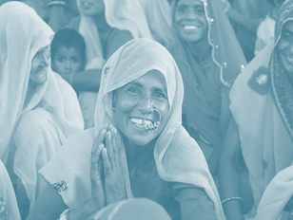
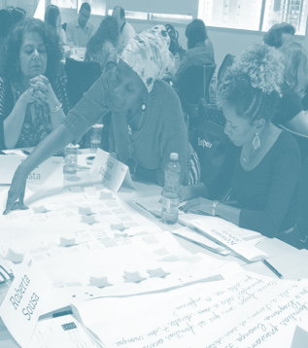
The Role of Donors in Supporting the Scale-up of Social Enterprises
February 6, 2023

Slide 2
Agenda
10:00 – 10:10: Isabel Guerrero, Imago. Introduction to the session. 10:10 – 10:20: Álvaro Henzler, Mosaico 10:20 – 10:30: Ernenek Duran, One Drop Foundation (Lazos de Agua Program) 10:30 – 10:40: María Elena Nawar, IDB Lab 10:40 – 10:50: Habiba Ali, Sosai Renewable Energies Company 10:50 – 11:00: Nicola Okero, Food4Education 11:00 – 11:30: Discussion moderated by Isabel Guerrero

Slide 3
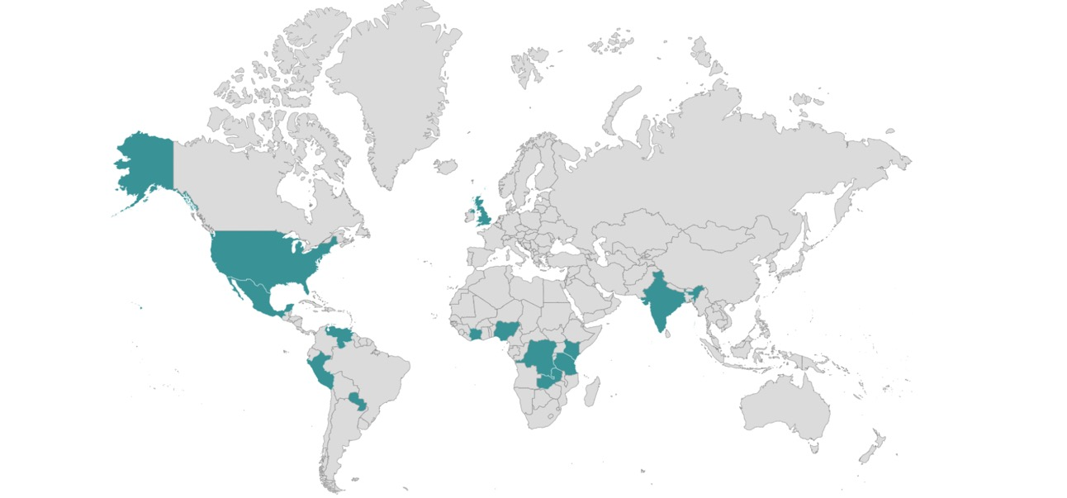
ABOUT IMAGO
The organizations we support reach over 12.5 million people across the world
OUR VISION
A world in which the innovations and solutions developed at the grassroots can reach global scale
Partner since 2020
Partner since 2017
Partner since 2019
Partner since 2017
Partner since 2020
Partner since 2019
Partner since 2017
Partner since 2017
United Kingdom
c. 2018
OUR MISSION
Changing development thinking and practices around poverty alleviation
Partner since 2014
Partner since 2019
Partner since 2018
Partner since 2014
Partner since 2017
Partner since 2016
Partner since 2018
Partner since 2014
Partner since 2016
Partner since 2020

Slide 4
THE MISSING MIDDLE
Governments, Aid Agencies and Impact Investors
Rich in financial resources and technical capacity
Fail to reach the poorest
Rich in local knowledge, innovation and community buy-in
Stuck at a low resource and capacity level and unable to capitalize external opportunities
Missing middle
Local NGOs, Grassroots Organizations and Social Enterprises

Slide 5
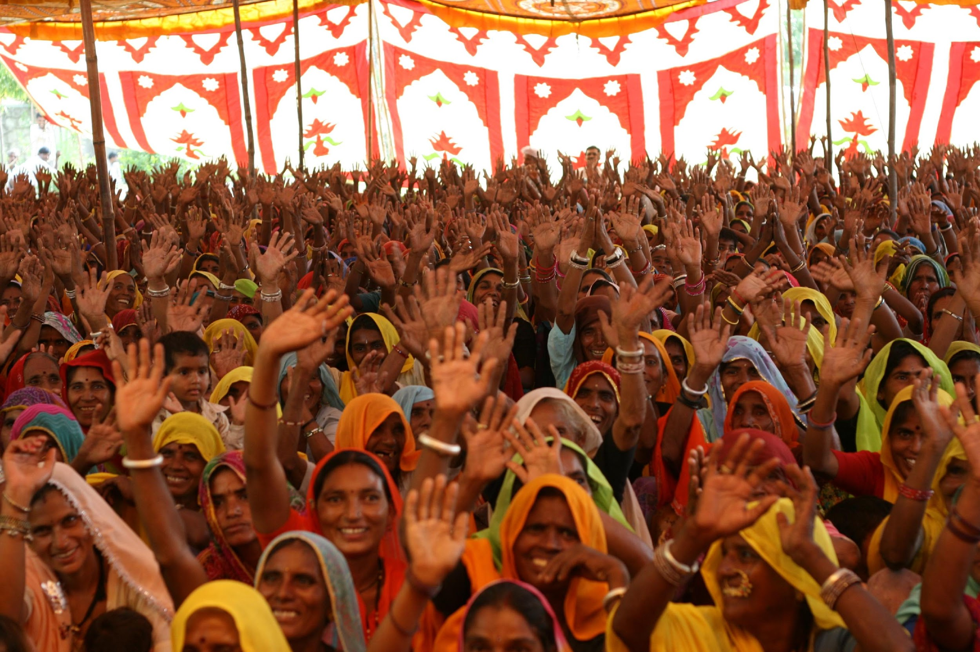
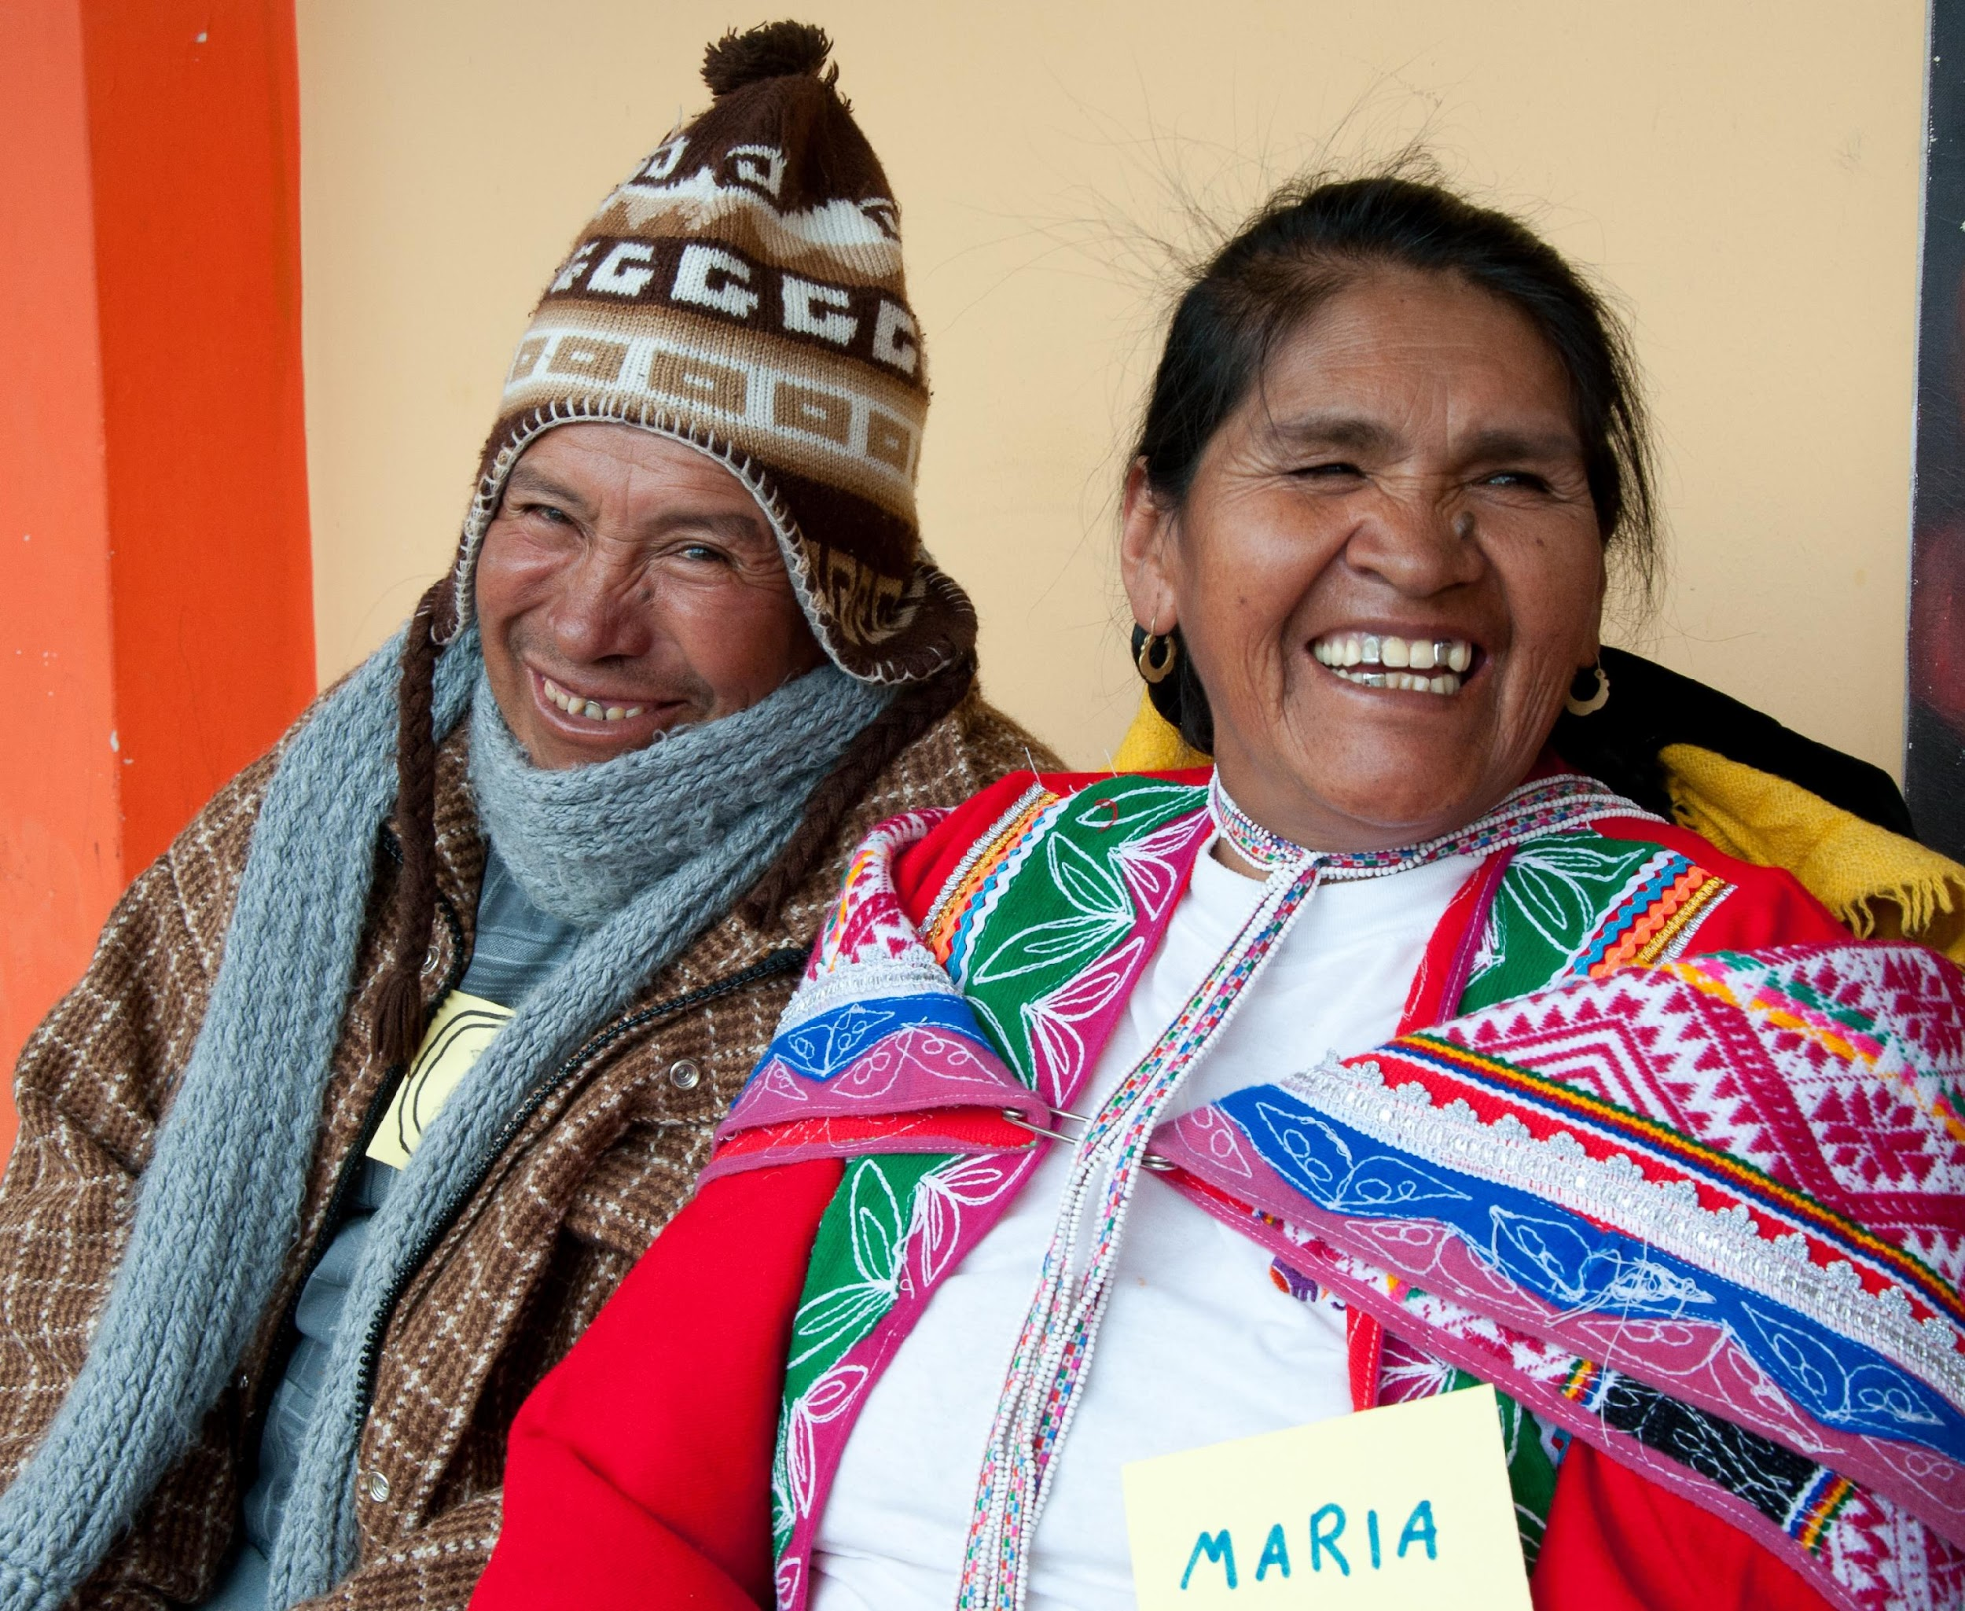
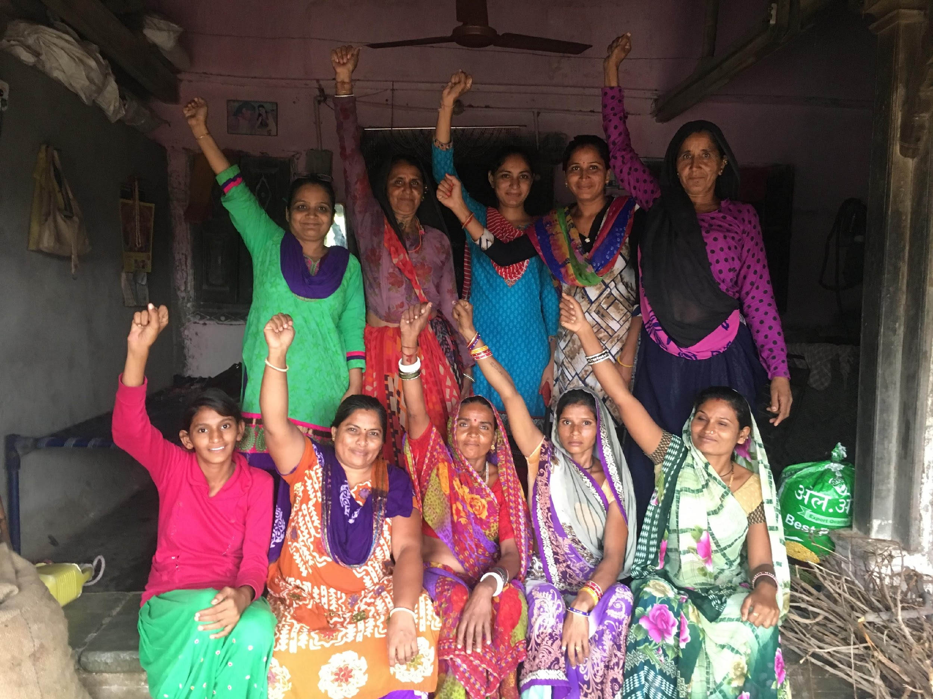
THE CHALLENGE WITH DONORS
Financing is available for innovations, but not for scaling up, even when donors have scale in their mission.
The intermediation role is very important for scaling up, but it’s underfunded.
It’s very challenging to scale innovations from the base of the pyramid through the government.
01
02
03

Slide 6
DONORS CONTINUUM
High-risk philanthropy ($50,000 to $100,000)
Pilot (Up to $200,000)
Test and Position for Scale (up to $1.5 million)
Transition to Scale (up to $15 million)
Bilateral Funders ($100 to $200 million)
Vertical funds ($100 to $200 million)
Multilateral DFIs, foundations ($100 to $200 million)
Scaling through government – Multilateral Development Banks (More than $250 million)
Angel investors
UNDP Lab
Peery Foundation
DIV (Development Innovation Ventures from USAID)
GIF (Global Innovation Fund)
Philanthropy
DIV
GIF
IDB Lab
Philanthropy
DIV
GIF
Philanthropy
UNDP
USAID
UKAID
Australian Aid
Unilever
McArthur Foundation
GIZ
SIDA
AFD
JICA
Global Affairs Canada
IFAD
WFP
Global Financing Facility
Global Fund
GCF (Green Climate Fund)
GEF (Global Environment Facility)
MULTILATERALS DFIs
IFC
IDB Invest
FOUNDATIONS
Bezos Earth Fund
BMGF
Rockefeller Foundation
World Bank
IADB
AfDB
AsDB
Evidence grants (Up to $1.5 million)

Slide 7
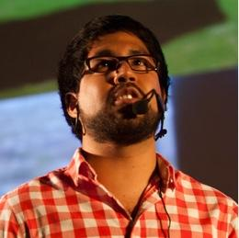
ALVARO HENZLER
Co-Founder and President
MOSAICO LAB
Orchestrator of social change in Latin America. He serves as co-founder and President of Mosaico Social Lab and co-founder and former CEO of EnseñaPerú (Teach For America partner in Peru). Previously, he was economic advisor to the Ambassador of Peru in the US and Executive director of Intercorp Leadership Center. Has a MPA at Harvard Kennedy School, Leadership studies at Georgetown University and received his bachelor’s degree in economics from Universidad del Pacífico. Fulbright, Ford Foundation and Fundación Carolina fellow. He was Research Fellow at Ash Center at Harvard University. Board member at Transparencia, PerúTeQuiero, Ruralia, CARE Peru, EnseñaPeru and Coalición Ciudadana.

Slide 8
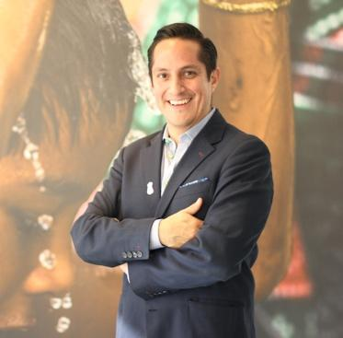
ERNENEK DURAN
Senior Director of Programs, Latin America
ONE DROP FOUNDATION (Lazos de Agua Program)
As Director of Programs at One Drop since 2016, Ernenek leads the Lazos de Agua regional initiative in Latin America. In his role, he is responsible for overseeing the implementation of One Drop’s portfolio of projects in Latin America, which includes building complex multi-stakeholder alliances, leading the design and operational execution of projects and managing a multi-disciplinary team of professionals. Before his current role, Ernenek occupied two other positions at One Drop, namely Project Development Manager and Project Manager for India. Prior to joining the Foundation, Ernenek worked with Oxfam-Quebec. Ernenek holds an MBA in Corporate Social Responsibility from Laval University, a master’s in Management and Information Technology from the Instituto Tecnológico Autónomo de México and an engineer degree in Computer Systems.

Slide 9
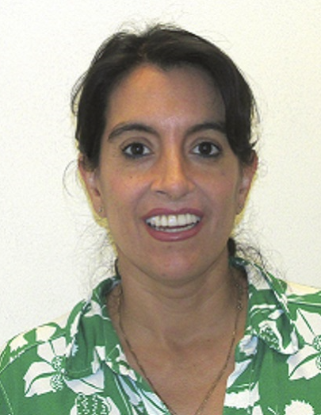
MARIA ELENA NAWAR
Senior Advisor
IDB LAB
Sr. Advisor in the Scalability, Knowledge, and Impact Unit of IDB Lab, the innovation arm of the Inter-American Development Bank Group. She is responsible for generating, disseminating, and applying practical knowledge in the operational cycle to enrich IDB Lab projects’ overall impact. María Elena has more than 25 years of experience designing and monitoring projects in technical and digital work force development, skills standards and certification, STEM education, youth training, labor relations and modernization, accounting and auditing, strengthening of microfinance institutions and business development services.

Slide 10
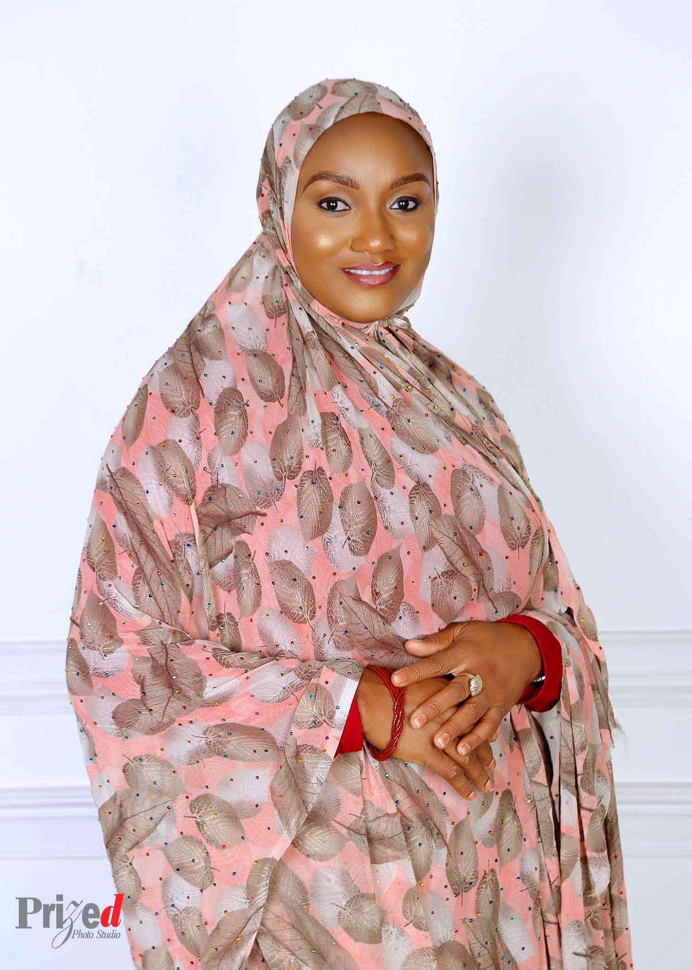
HABIBA ALI
Managing director and CEO
SOSAI RENEWABLE ENERGIES COMPANY
Habiba Ali is the managing director and CEO of Sosai Renewable Energies Company, one of the largest distributors of renewable energy in Nigeria. She has been with the renewable energy industry since 2005. She started by Working with Developmental Association for Renewable Energies (DARE) as a co-founder and National Coordinator. Where she worked on the CDM project Efficient Cook Stoves for Nigeria, The Solar Lamps Assembly and sales training programme, Solar Dryers for Healthy foods project and a host of others. She possesses a Bachelor’s degree in Accounting, A master’s in Banking and Finance and currently at Dissertation level of PhD in Management (Finance). .

Slide 11
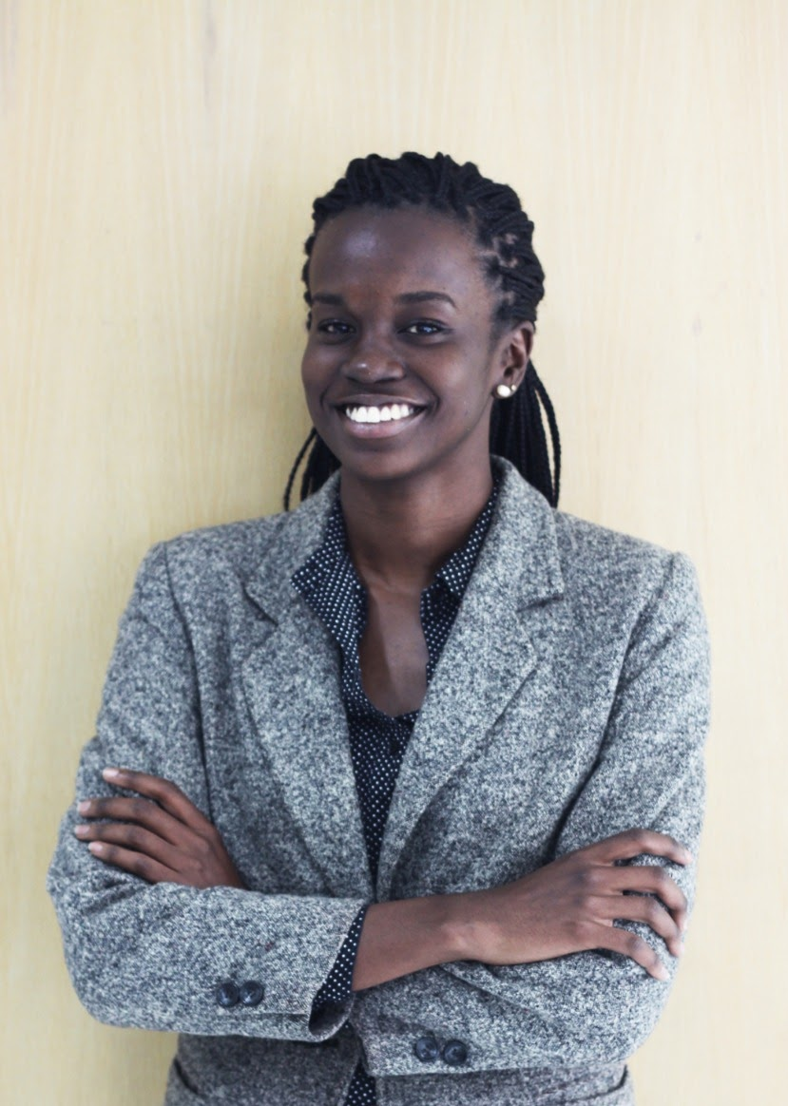
NICOLA OKERO
Policy Officer
FOOD4EDUCATION
Nicola Okero is a policy enthusiast with a legal background. Born and raised in Kenya, she has worked with organizations in Kenya, India and Saudi Arabia. Previously, she worked with the International Finance Corporation (IFC) in the Creating Markets Advisory team. She is currently the Policy Officer at Food 4 Education, an organization that provides high quality, nutritious meals to students in Kenyan public primary schools to improve nutrition and education outcomes.

