Slide 1
Information Technology to Improve Healthcare
Artificial Intelligence Will Transform it All
Telemedicine E-consult Remote Monitoring ECHO Project
Sanjeev Arora, MD, MACP
Distinguished Professor of Medicine (Gastroenterology/Hepatology)
Director of Project ECHO®
Department of Medicine, University of New Mexico Health Sciences Center

Slide 2
Project ECHO®
Moving Knowledge, Not People

Slide 3
At ECHO, our mission is to democratize implementation of best practices for health care and education to underserved people all over the world.

Slide 4
Four Guiding Principles of All ECHO Projects
Equity
Democratize the implementation of best practices (guided practice, all teach all learn)
Build agency at the front line
Enable organizations to achieve their mission with speed, scale, fidelity and at a significantly lower cost

Slide 6
The ECHO Model

Slide 7
Arora S., Thornton K., Murata G., et al. N Eng J Med. 2011;364(23):2199-207.

Slide 8
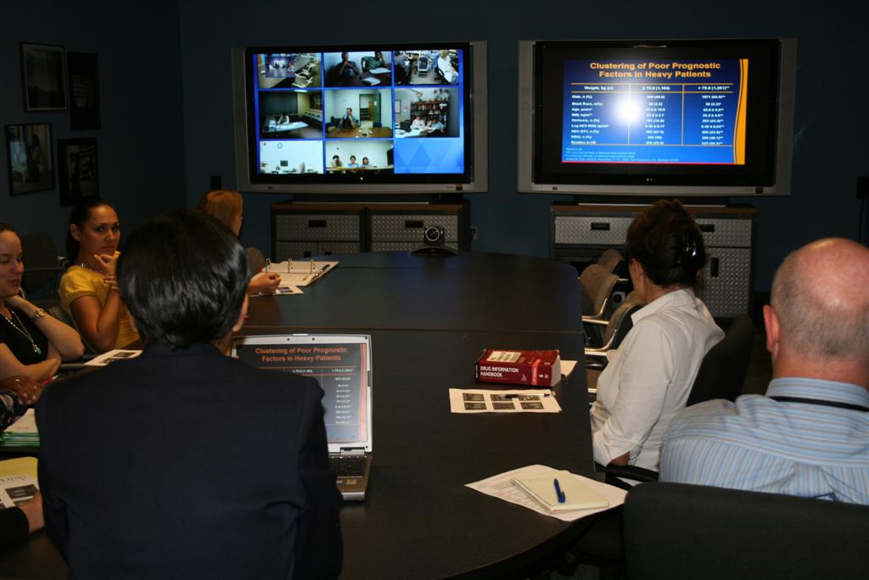
Arora S., Kalishman S., Thornton K., et al. Hepatol. 2010;52(3):1124-33.

Slide 9
Results of the HCV Outcomes Study
Outcomes of Treatment for Hepatitis C Virus Infection by Primary Care Providers
Arora S., Thornton K., Murata G., et al. N Eng J Med. 2011;364(23):2199-207.

Slide 10
ECHO Now Reaches a Breadth of Areas
Antimicrobial Stewardship
Autism
Behavioral Health
Bone Health
Cancer
Cardiology
Chronic Lung Disease
Chronic Pain
Crisis Intervention
Diabetes and Endocrinology
Education
Geriatrics
Good Health and Wellness in Indian Country
Hepatitis
High-Risk Pregnancy
HIV/AIDS
Infectious Disease
Integrated Addictions & Psychiatry
Laboratory Medicine
LGBTQ Health
Opioid Use Disorder
Palliative Care
Pediatrics
Prison Peer Education
Quality Improvement
Rheumatology
Sexually Transmitted Diseases
Trauma-Informed Care
Tuberculosis
Notes:
Antimicrobial Stewardship
Autism
Behavioral Health
Bone Health
Cancer
Cardiology
Chronic Lung Disease
Chronic Pain
Crisis Intervention
Diabetes and Endocrinology
Education
Geriatrics
Good Health and Wellness in Indian Country
Hepatitis
High-Risk Pregnancy
HIV/AIDS
Infectious Disease
Integrated Addictions & Psychiatry
Laboratory Medicine
LGBT Health
Opioid Use Disorder
Palliative Care
Pediatrics
Prison Peer Education
Quality Improvement
Rheumatology
Sexually Transmitted Diseases
Trauma-Informed Care
Tuberculosis

Slide 11
STUDY: VA SCAN-ECHO for Liver Disease University of Michigan
513 patients who had a liver SCAN-ECHO visit were found within the cohort. Patients who had completed a virtual SCAN-ECHO visit were more likely younger, rural, with more significant liver disease, and evidence for cirrhosis. Propensity adjusted mortality rates using Cox Proportional Hazard Model showed that a SCAN-ECHO visit was associated with a hazard ratio of 0.54 (95% CI 0.36-0.81, p = 0.003) compared to no visit.
Virtual Consultations through the Veterans Administration SCAN-ECHO Project Improves Survival for Veterans with Liver Disease Su. GL, Glass L, et al; Hepatology . 2018 May 5. doi: 10.1002/hep.30074

Slide 12
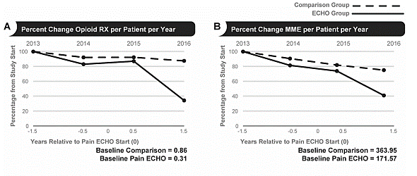
STUDY: ECHO Pain
Intervention group (99 clinics participating in ECHO Pain); Control group (1283 clinics)
Method: Rx counts for [de-identified] patients enrolled with PCC teams from FY 2013-FY 2016.
The average annual decline of # of Rx/patient/year decreased 23% for ECHO Pain participants compared to 9.2% for non-participants (p=.004).
Katzman, J. G., Qualls, C. R., Satterfield, W. A., Kistin, M., Hofmann, K., Greenberg, N., ... & Arora, S. (2019). Army and Navy ECHO Pain Telementoring Improves Clinician Opioid Prescribing for Military Patients: an Observational Cohort Study. Journal of general internal medicine, 34(3), 387-395.

Slide 13
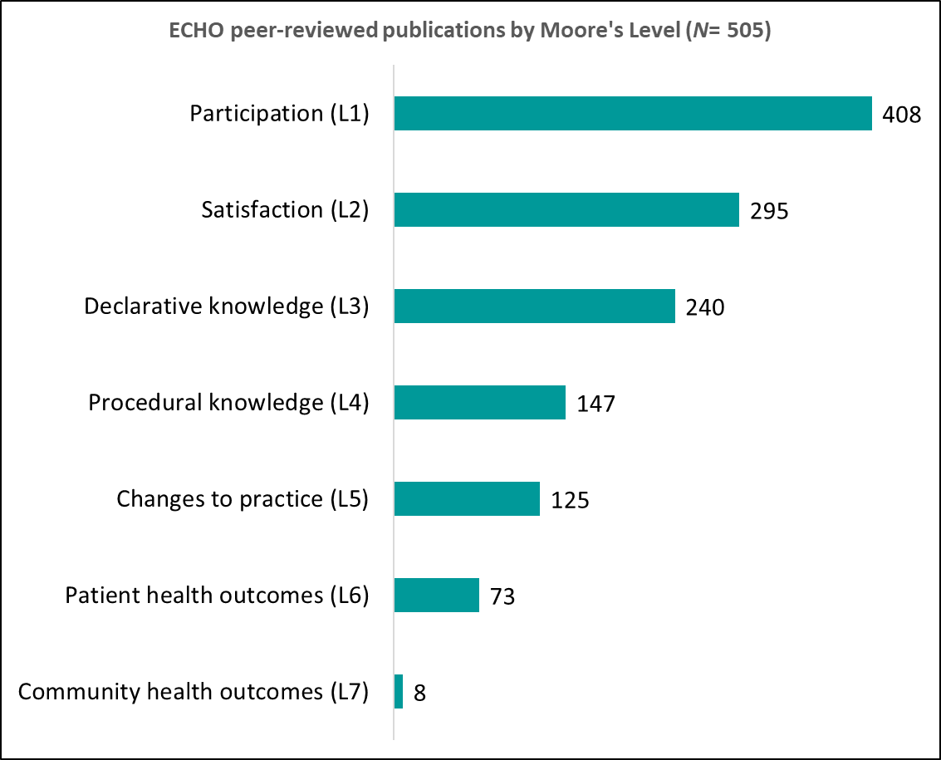
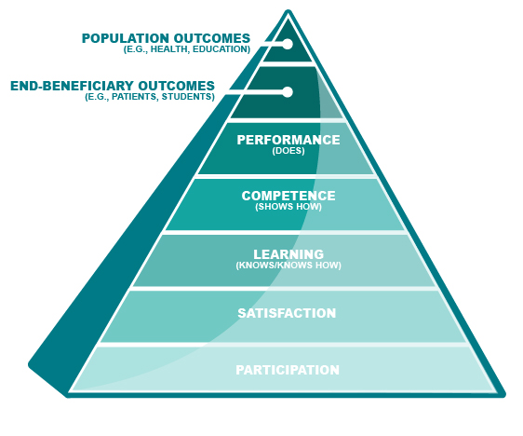
ECHO Publications by Outcome Levels
500+ Publications

Slide 14
Benefits of the ECHO Model
Quality and safety
Rapid learning and best-practice dissemination
Reduce variations in care
Access for rural and underserved patients, reduced disparities
Workforce training and force multiplier
Improving professional satisfaction/retention
Supporting the medical home model
Cost-effective care - avoid excessive testing and travel
Prevent cost of untreated disease (e.g., liver transplant or dialysis)
Integration of public health into treatment paradigm
Democratize Expertise

Slide 15
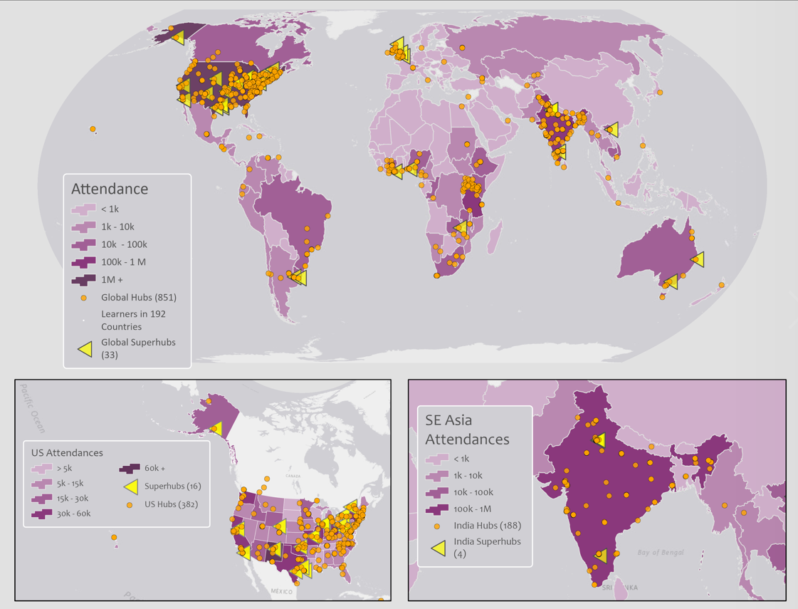
Global Hubs & Superhubs

Slide 16
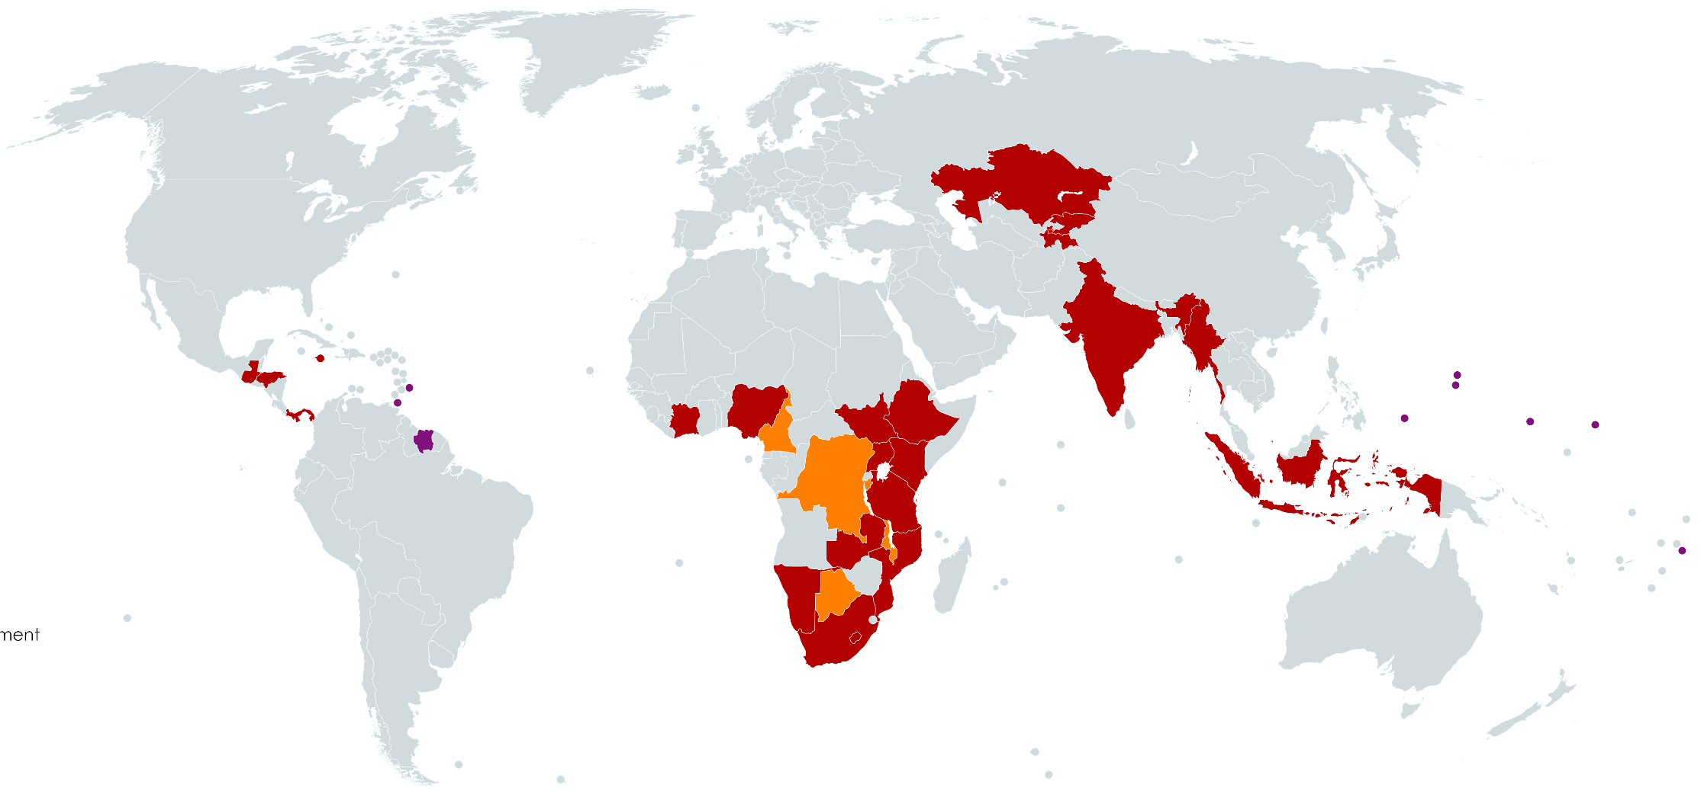
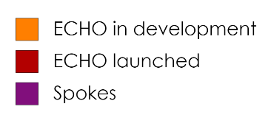
ECHO Projects Africa
HIV
TB/MDR TB
Global Health Security
Antimicrobial Resistance
Outbreaks
Other
Surveillance
Emergency Preparedness
Laboratory Strengthening
Quality Improvement
Lab HIV rapid testing
Viral Load Scale Up
Chemical Pathology
Infection Control Prevention
Safe Surgery
Cancer
Chronic Disease
Autism
FETP

Slide 17
Major Growth In Demand Since COVID 19:
Cumulative Attendance Across ECHO Network
2006 – 2023
3.98 million
Note: Data represents program attendance reported by ECHO Hubs thus far and may not entirely reflect all global ECHO attendance.
Notes:
Updated 8/19/22

Slide 18
What Makes ECHO Work?
Team Based Care
Community of Practice
(Social Network)
Task Shifting
Technology
Force Multiplication
Joy of Work
Interprofessional Consultation
De-monopolizing Knowledge
All Teach All Learn
Mentor/Mentee Relationship
Movement Building Vs.
Organization Building
Guided Practice

