Slide 1
Harnessing the Power of IT as a Game Changer for Scaling
Verna L. Lalbeharie, Executive Director
@GlobalEdTechHub edtechhub.org

Slide 2
EdTech Hub is a global research & practice partner.
Our goal is to empower people by giving them the evidence they need to make decisions about technology in education.

Slide 3
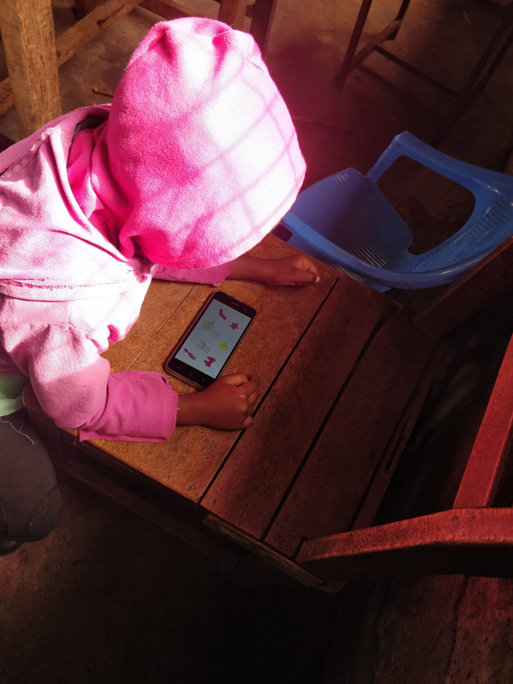
Technology has the potential to help solve the global learning crisis. But that potential is not being fully realised…
due to gaps in evidence
and gaps in the use of evidence.

Slide 4
Game-Changer…..
Building an Evidence-Driven Future for EdTech: Our Five Question Challenge to the Sector
ur Challenge to the EdTech Sector:
Our Challenge to

Slide 5
Will this use of technology lead to a sustained impact on learning outcomes?
Will this use of technology work for the most marginalised children and enhance equity?
Will this use of technology be feasible to scale in a cost-effective manner that is affordable for the context?
Will this use of technology be effective in the specific implementation context?
Will this use of technology align with government priorities and lead to the strengthening of national education systems?
1
2
3
4
5

Slide 6
Will this use of technology lead to a sustained impact on learning outcomes?
1
Practical Steps
Commit to measuring success based on specific medium- and long-term outcome indicators
Align as much as possible with government learning assessments and comparable global measurements
Use the functionality built into the technology to enable regular and detailed tracking of learning gains

Slide 7
Will this use of technology work for the most marginalised children and enhance equity?
2
Practical Steps
Test the viability of an EdTech intervention with marginalised populations from the outset
Base EdTech interventions on the best available evidence from the wider education sector for reaching the most marginalised
Embed the ability to track marginalised groups effectively with disaggregated data into all interventions

Slide 8
Will this use of technology be feasible to scale in a cost-effective manner that is affordable for the context?
3
Practical Steps
Decide on an intervention after all suppliers have provided transparent and independently verified cost calculations
Use calculations of national spending per child per year
Make cost data openly available and align with the nascent minimum standards on EdTech cost-effectiveness

Slide 9
Will this use of technology be effective in the specific implementation context?
4
Practical Steps
Base programs on a detailed understanding of the technical evidence base, plus the local evidence base, and the differences between them
Prioritise embedding research within implementation to learn and adapt to contextual realities
Be explicit about which findings are generalisable and which are likely to be context-specific

Slide 10
Will this use of technology align with government Priorities and lead to the strengthening of national education systems?
5
Practical Steps
Ensure that new EdTech initiatives take time to understand current evidence and education context, and align with the national education system Conduct future-focused feasibility studies at the outset
Make all national curricula and associated learning and teaching resources open-access

Slide 11
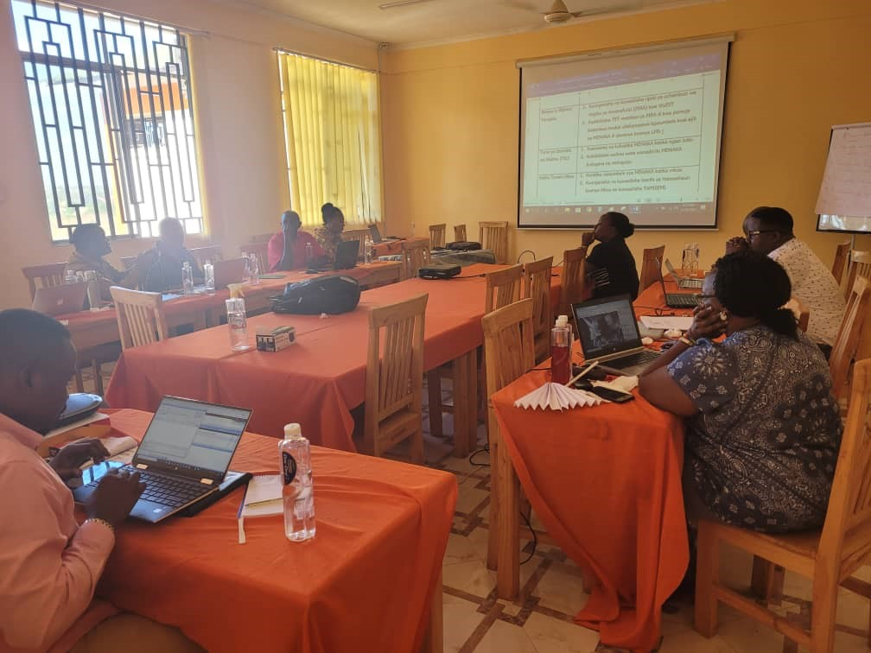
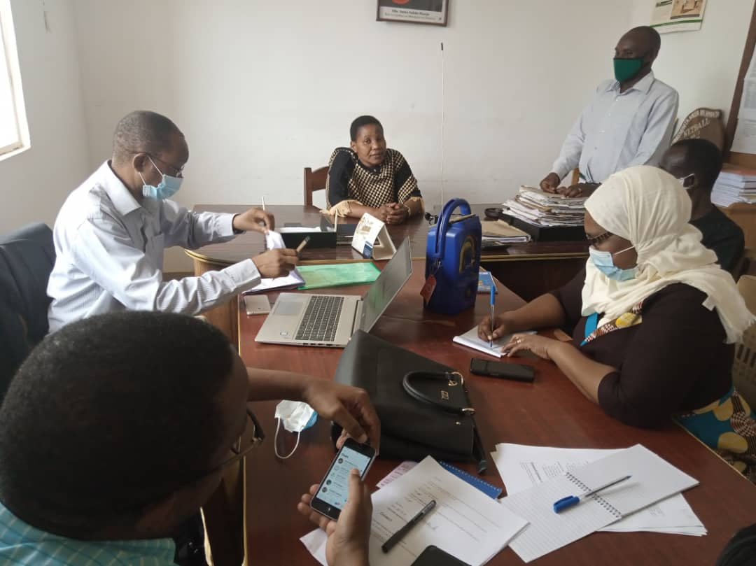
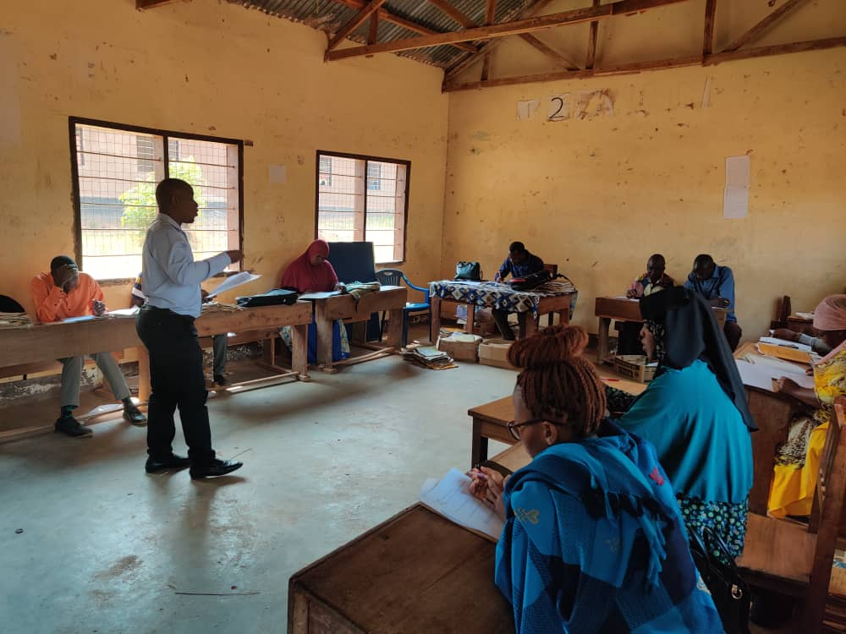
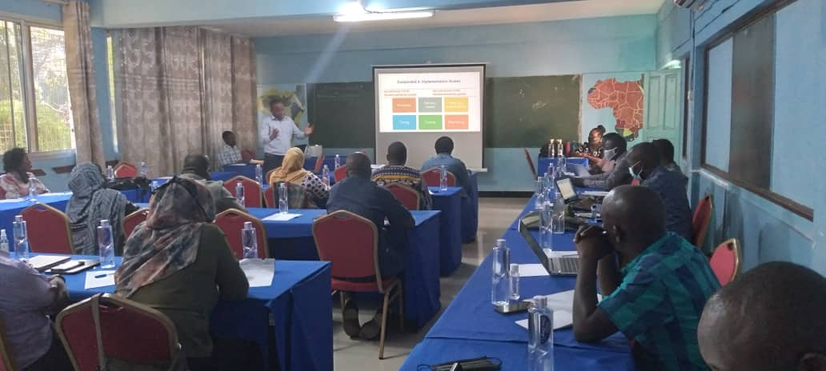
Example: Teacher Professional Development in Tanzania
In Tanzania we are supporting the Tanzania Institute of Education (TIE) use technology to reach their teacher professional development improvement ambitions.
The Tanzania Institute of Education (TIE) is planning a new, tech-enabled and school-based national teacher continuous professional development programme
EdTech Hub has been providing TA to help bring evidence to the design of the TCPD model
We are also supporting a Sandbox to test assumptions about the design and usability of the learning management system (LMS).
The Hub has also initiated a large research study, which will last 3 years to assess the impact of the TIE TCPD model on learning outcomes. The study uses mixed methods including DiD and qualitative research to compare intervention arms.

Slide 12
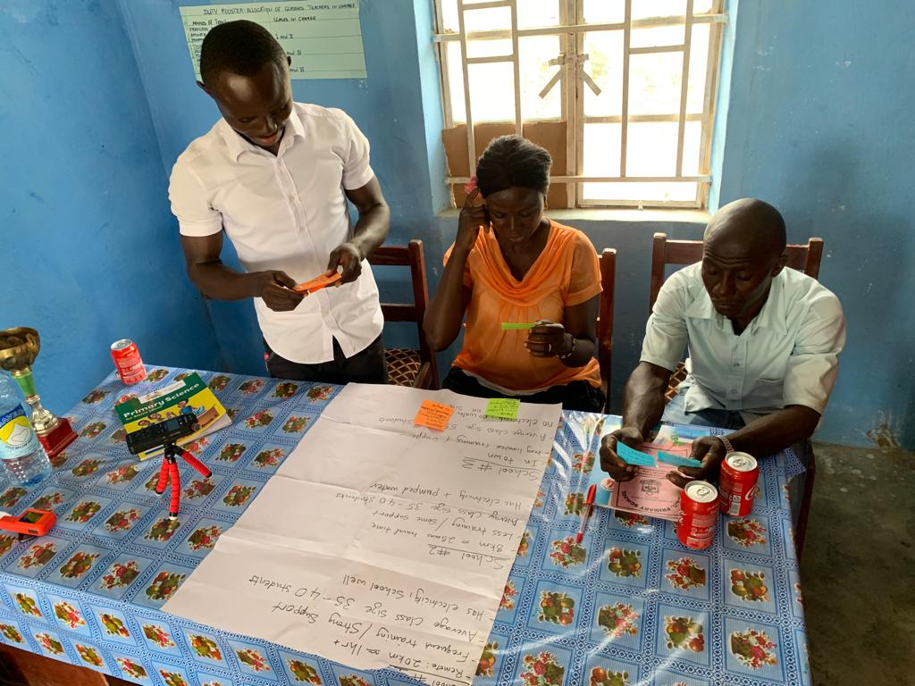
Example: Data Driven Decision Making in Sierra Leone
In Sierra Leone, EdTech Hub is supporting the Teaching Service Commission to use technology to increase the use of data in decisions on teacher deployment.
The Teaching Service Commission (TSC) intends to adopt a new GIS-supported preference matching model to inform teacher allocation
EdTech Hub will run a Sandbox to assess the usability and accessibility of Sierra Leone’s first digital recruitment portal
We are providing TA to integrate the government’s education and financial information systems to enable data-driven recruitment decisions
At the same time, the Hub recently launched an at-scale research study to evaluate the impact of the GIS-supported preference matching model on teacher retention and attendance. Here, we will conduct a systemic mixed-methods study that includes an RCT.
Notes:
Provide TA to map and consolidate data systems to enable system
Sandbox

Slide 13
Risks: Reasons why EdTech Doesn’t Scale
There isn’t enough robust evidence
There’s a gap in programmes that support transition to scale
There is a gulf between creators and users of knowledge
EdTech interventions are treated like a ‘silver bullet’
Education is under-financed, meanwhile, private sector EdTech is booming
There is a tendency to think of the product rather than the problem
EdTech doesn’t reach the most marginalised
Government is often a time-pressed, uninformed customer of technology within a fragmented market

Slide 14
www.linkedin.com/company/edtechhub/
@GlobalEdTechHub
edtechhub.org
Notes:
Thank you for your time today and I look forward to all the ways this room will take up the challenge!

