Slide 1
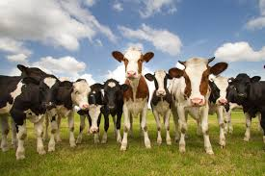
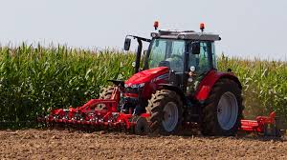
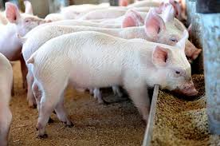
Coordination of Food System Programs in Rwanda
Planning for Wealth
Accountability-Teamwork-Effectiveness & Efficiency

Slide 2
Content
1. Overview of Food system in Rwanda
2. Key lesson learnt/ Best Practices
3. Coordination mechanism of food system in Agriculture Sector
Notes:
‹#›

Slide 3
Overview of Food System in Rwanda
Planning for Wealth
Accountability-Teamwork-Effectiveness & Efficiency

Slide 4
The Government of Rwanda is taking action to advance from food system dialogues and pathways to actionable investments
National Dialogues
(Report validated& published)
Pathways & Game-Changing Priorities
(report validated yet to be published)
Food Systems implementation Strategy & Investment Plan
(Currently underway)
A series of national dialogues bringing together stakeholders from key ministries and other sectors including academia, DPs, NGOs, Professional bodies…
A set of game changing ideas which can accelerate Food Systems transformation by tackling observed gaps in Food Systems sub-sectors and presenting opportunities to integrate market-driven interventions
An actionable, pragmatic set of investment areas within the game-changing priorities which will catalyze food systems transformation
We are in a critical opportunity-window for engaging public, private, and social sector actors to co-create concrete investment ideas and identify policy and other enablers to facilitate the operationalization of these investment ideas for Rwanda’s food systems transformation
Notes:
‹#›

Slide 5
At the UN Food Systems Summit, Rwanda set ambitious goals and targets for Food Systems transformation
Ensuring access to safe and nutritious food for all
Strategic Objectives
Ensuring food and nutrition security for all while ensuring sustainable environment
Promoting decent livelihoods to farmers and others in the food chain while also promoting rural development
#1: Nutritious food programmes
#2: Food loss and waste management
#3: Inclusive markets and food value chains
#4: Sustainable and resilient food production systems
#5: Inclusive financing and innovative investments
#6: Effective mainstreaming of youth and women in food systems
Game changing solutions
These are aligned with the country’s broader Vision 2050 and are clear and actionable to fast-track implementation
Notes:
‹#›

Slide 6
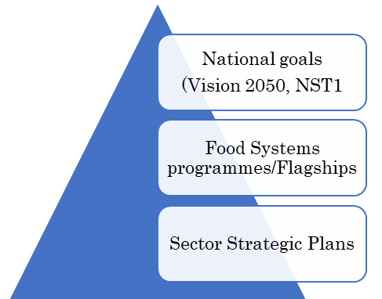
Implementation model and Indicative priority programs (14)
1. Nutritious food programmes
2. Food loss and waste management
3. Inclusive markets and food value chains
4. Sustainable and resilient food production systems
5. Inclusive innovative financing/investment
6. Effective mainstreaming youth and women in food systems
School feeding programme
Enabling environment for private sector led food loss and waste management
National strategic Diversified food reserves
Climate resilient and regenerative agriculture
Inclusive and innovative financing schemes for small scale farmers
Access to finance
Early Childhood Development Programme (ECD)
Improved market access
Behavior Change Communication programme
Knowledge exchange and customized extension services.
Public Private Partnerships (PPPs) for investment in food systems (e.g., Processing, transport, storage/upstream components of value chains).
Specific skills and capacity development
Food safety programmes
Social food safety nets

Slide 7
Designing of flagship programs to address critical areas for food system in Rwanda
Programs | Descriptions
Scaling up Africa improved food | Production of nutritious food and markets to farmers
School feeding program | Ensure availability of nutritious food among children
Black soldier larvae flies initiatives | Scaling production of insect-based animal feed and organic fertilizer
Crop Intensification Program | Support farmers in having access to improved seeds, mineral fertilizers, and lime to increase productivity for priority crops
Livestock Intensification Program | Improve the competitiveness of the livestock subsector in regional and international markets
Gako Integrated Beef | Increase beef production for local and international markets
Gabiro Agri-Business Hub | Increase export of high value crops and agriculture-generated, value-added, products
Commercialization & De-Risking for Agricultural Transformation Project (CDAT) | Increase irrigation, commercialization, and access to finance and agriculture insurance for farmers in the different value chain

Slide 8
Key lessons / Best Practices
Planning for Wealth
Accountability-Teamwork-Effectiveness & Efficiency

Slide 9
Key Lessons/Best Practices
Evidence-based Policy and Strategy: Vision 2050, National Strategy for Transformation (NST 1), National Agriculture Policy (NAP); Strategic Plan for Agriculture Transformation (PSTA 4);
Strong Sector Coordination: Agriculture Joint Sector Review (twice a year), Agriculture Sector Working Groups (Monthly), Clusters and Value chains platforms (Upon request);
Decentralization of agriculture programs/projects to promote efficient and effective implementation;
Sector digitalization: MIS records & monitors progress of the agriculture sector’s performance.
Scale up Home Grown Solutions (examples):
Crop Intensification Program (CIP): to improve agricultural productivity and food security through Land consolidation approach; Improved Seeds and Fertilizers subsidy; Agriculture Extension model (Twigire Muhinzi);
One cow per poor family (Girinka): program to cut food insecurity through increased milk production and consumption;
Livestock Intensification Program: to increase animal protein products consumption to beneficiaries (poor women and youth);
National Strategic Food Reserves: GoR initiative to address potential shocks of food supply, in situation that cannot be adequately addressed by markets and other programs;

Slide 10
Agriculture Sector Coordination mechanisms
Planning for Wealth
Accountability-Teamwork-Effectiveness & Efficiency

Slide 11
Stakeholders Coordination and Involvement
Agriculture Joint Sector Review [Backward & Forward Looking]
ASWG
Cluster 1: Planning and Budgeting
Planning & Budget
M&E,
Gender
Capacity Building
Cluster 2: Crop Devt.
Seeds, Fertilizers & Lime
Extension services
Soil Conservation
Irrigation & Mechanization
Nutrition
Environment
Post-Harvest
Cluster 3: Agribusiness, Markets &Trade, Export Devt.
Agribusiness
Export Promotion
Agri-finance
Market prices
Rural Feeder Roads
Cluster 4: Animal Resources Devt.
Animal Feeds
Dairy
Fish & Aquaculture
Value Chain Platforms: Horticulture, Maize, Cassava, I. Potatoes, Rice, Poultry, Milk

Slide 12
Murakoze
Thank you
Merci
Planning for Wealth
Accountability-Teamwork-Effectiveness & Efficiency

