Slide 1
Transforming Agriculture and Food Systems through Data-driven Digital
Agriculture Innovations

Slide 2
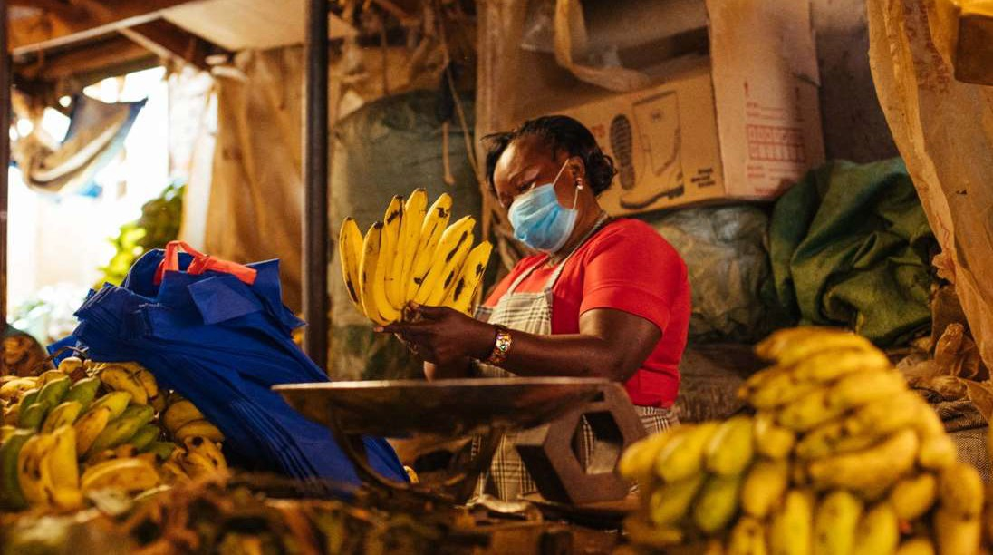
Valentine Barasa: Banana farmer in (Nyakinyua village in SIRENDE ward Trans Nzoia County ) Kenya
A member of Siwahoma Banana Producer Organization
Sale volume increased 150%, from 7.2 to 18 metric tons (annual) Total sales volume increased 300 %, from 720 to 2945 USD (annual)
Market price increased 63%, from 11 KES to 18 KES per kg

Slide 3
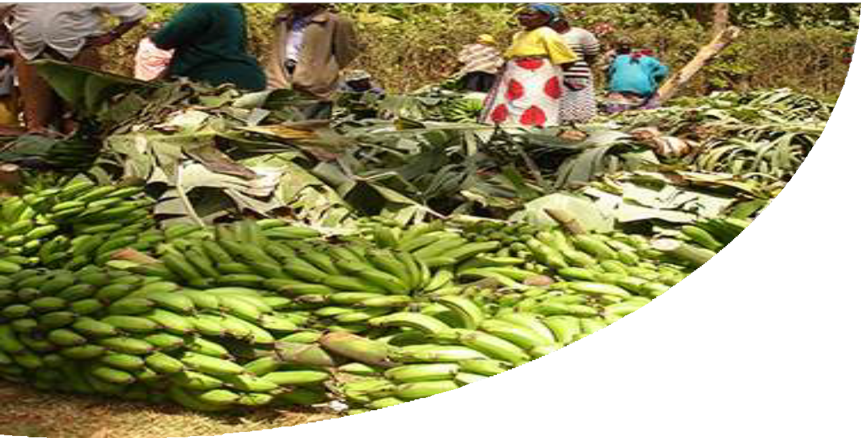
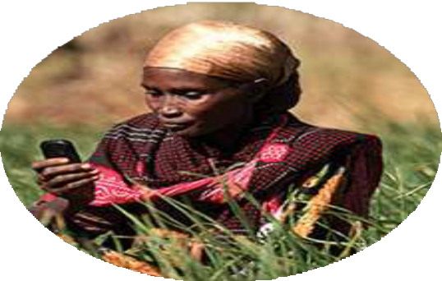
M-shamba: Providing market access and digital extension services to farmers
Data-driven Digital Agriculture Solutions
Interactive Voice Service
Virtual Call Centre
Interactive SMS
Customized Mobile Applications
Current scale
68,546
smallholder farmer
400,040
Acres of land covered
90
Farmer cooperatives

Slide 4
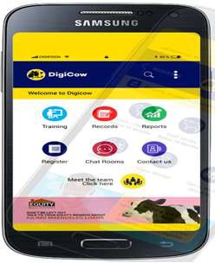
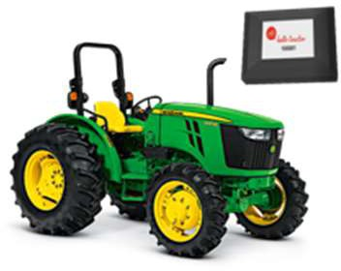
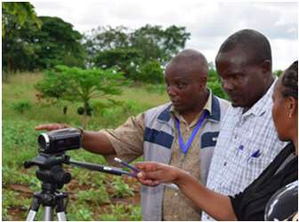
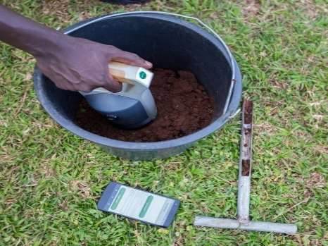
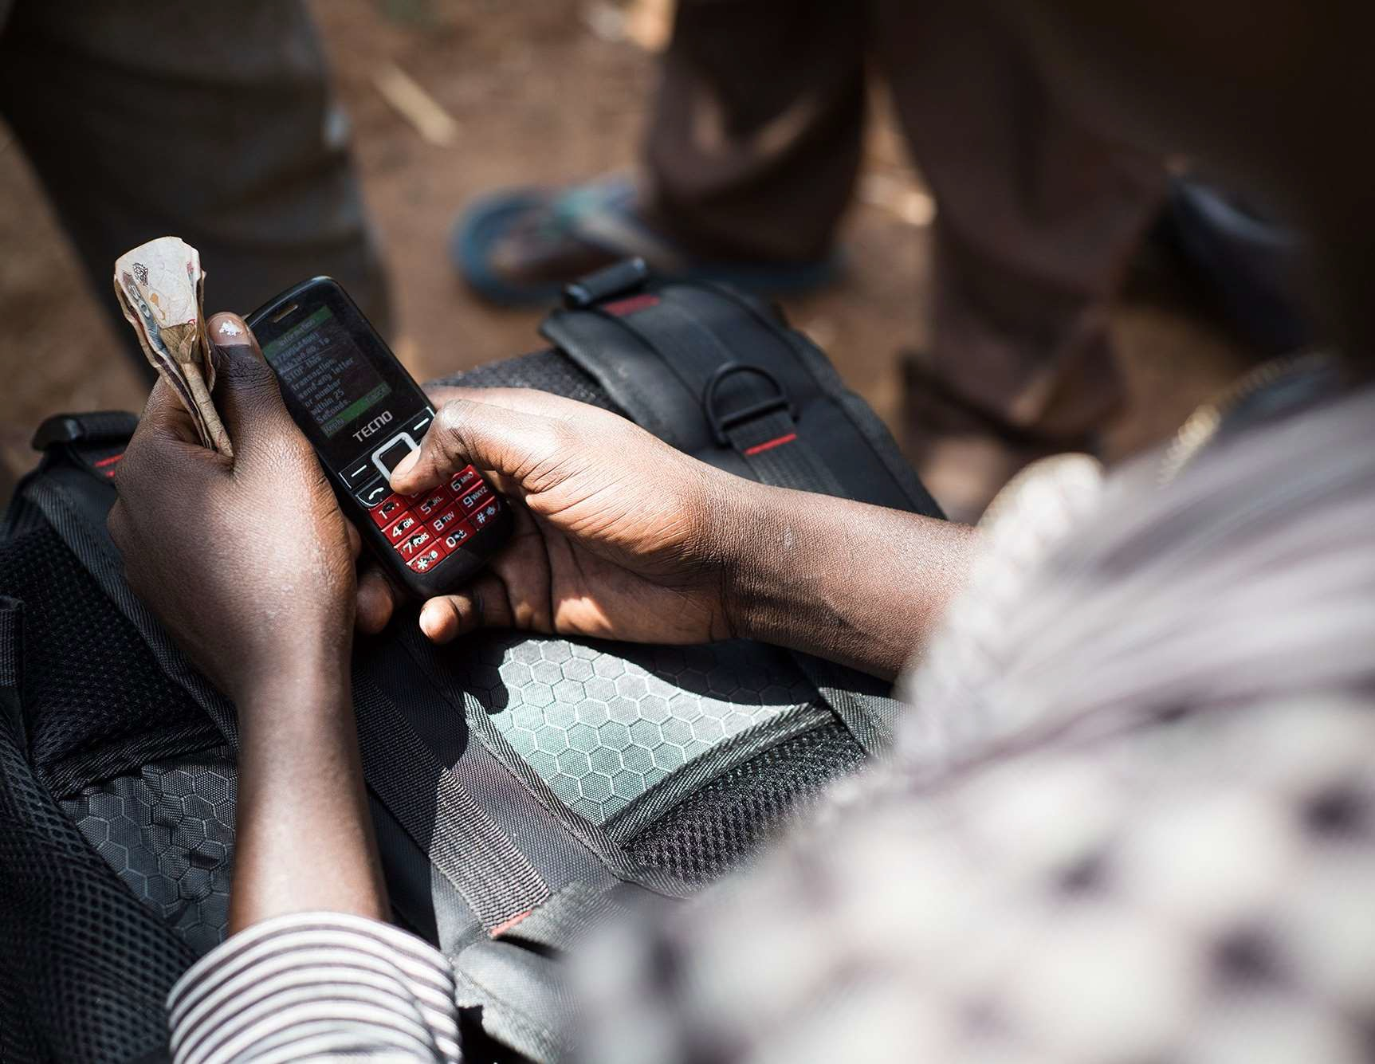
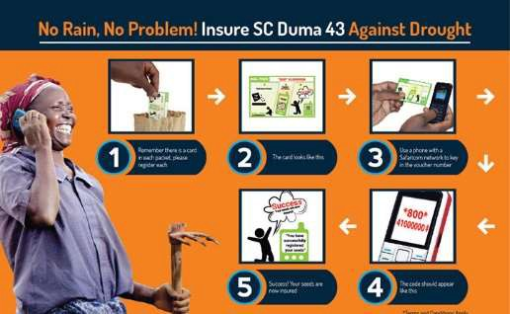
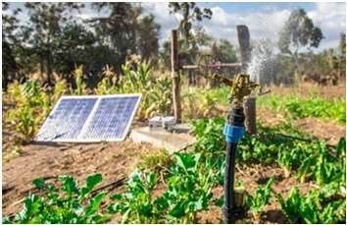
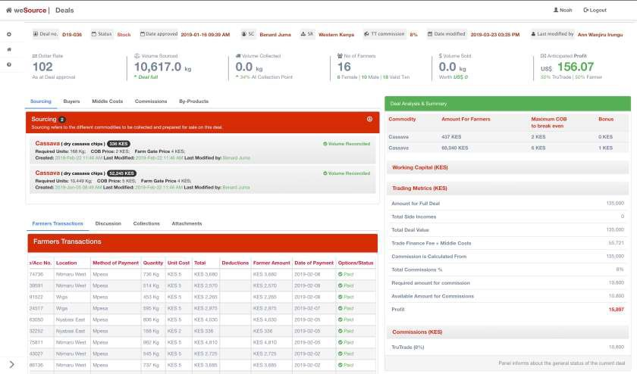
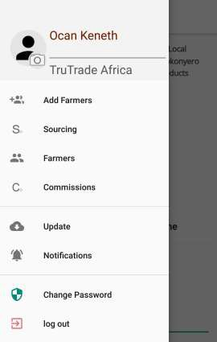
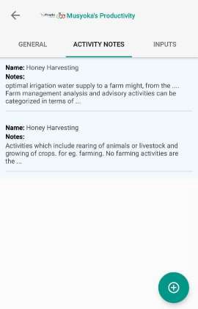
Example: Leveraging our experience in Kenya
26 AgTech start-ups and innovators providing Data-driven Digital Agriculture solutions and services
One Million Farmers are expected to access digital solutions and innovations
DigiCow:
Uber of Veterinary Services
Hello Tractor: Uberizing farm mechanization
Digital Green: video-based extension service
AgroCares: IoT soil scanner
SunCulture:
Solar powered irrigation
Digitally enabled supply chain finance: AgriWallet
Weather-index based Crop and Livestock insurance: ACRE Africa
TruTrade Africa:
Increasing Market access and price
Sourcing Digital Solutions through Innovation Challenge
4

Slide 5
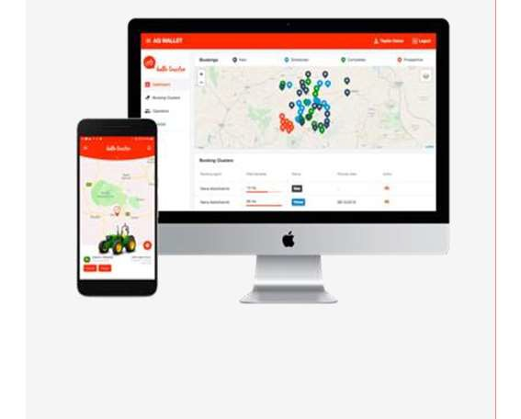
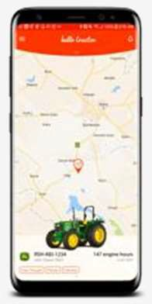
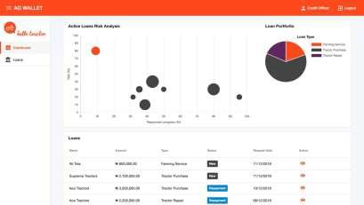
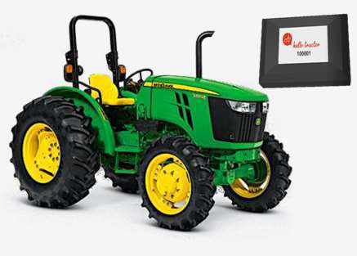
Hello Tractor
Telematics Device
Tractor Contractor Application
Tractor Booking Application
Enterprise Applications
Hardware to connect, protect, and track tractor fleets
SaaS to manage equipment, operators, and farmer bookings
SaaS to book services from connected tractors
SaaS for banks and customized solutions
Device Price: $110
Annual Price: $200
Transaction Fee: 5%
Price: Bespoke
TRACK
MANAGE
CONNECT
CUSTOMIZE & GROW

Slide 6
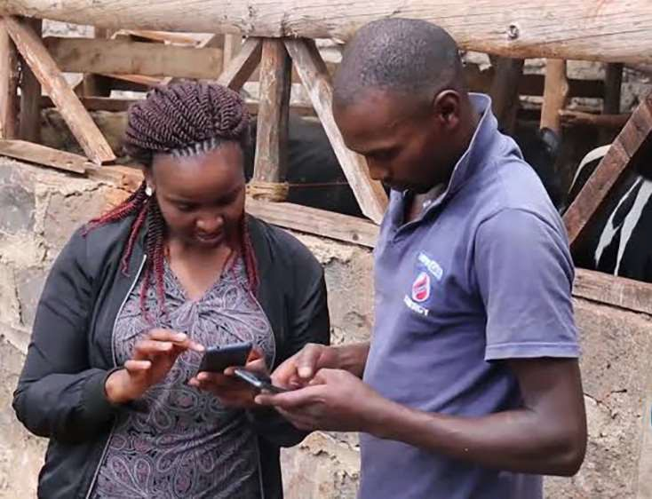
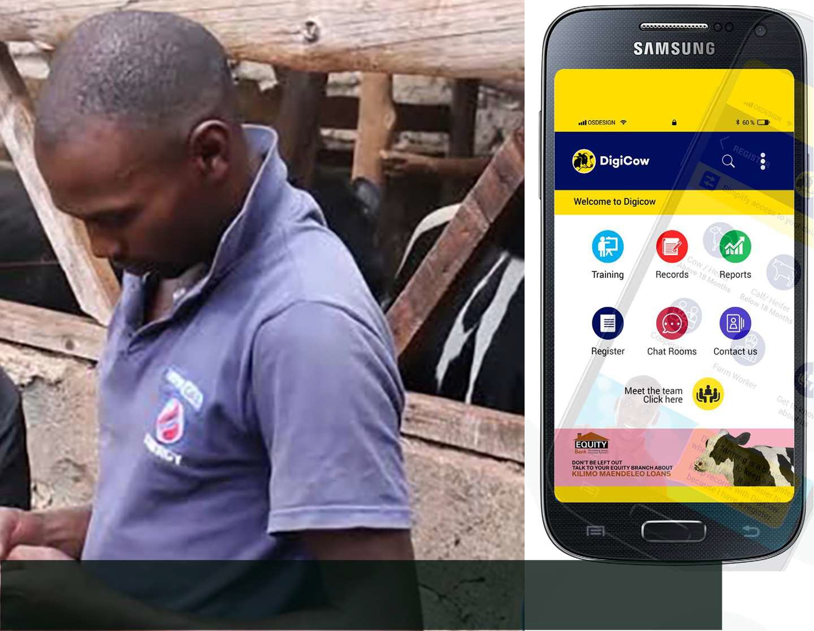
Peninah Wanja
Founder & Managing Director DigiCow “Uber” of Veterinary Services
10,000 farmers accessing services
Affordable Vet services available within 1 hour An average increase by 4 liters per cow per day

Slide 7
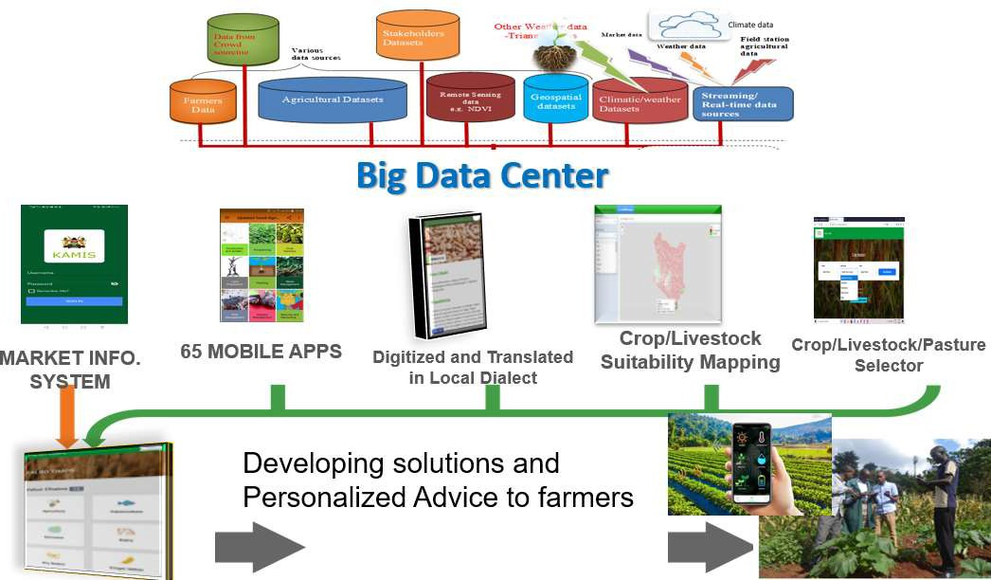
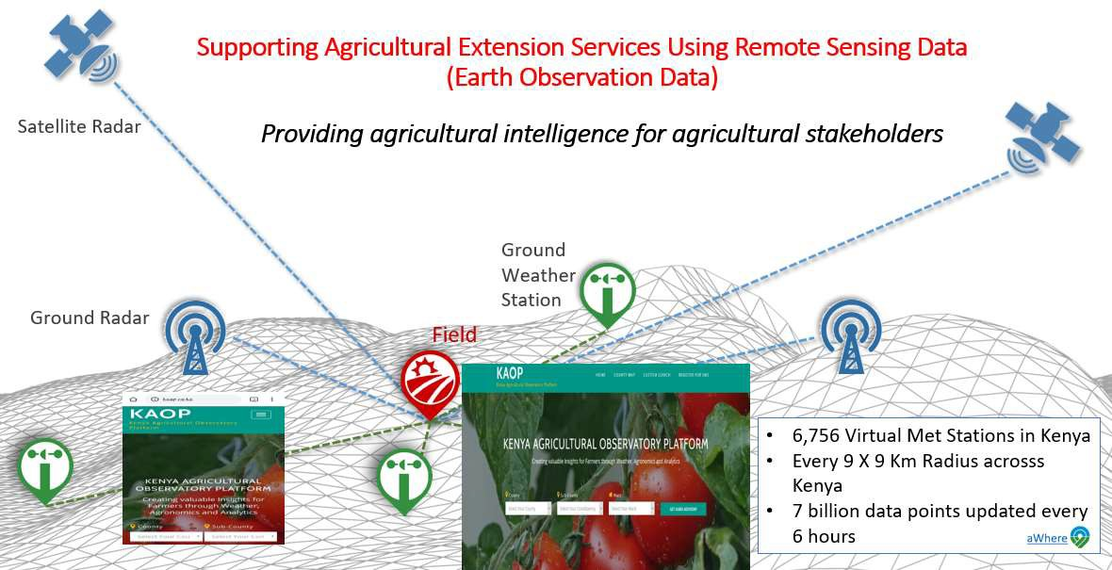
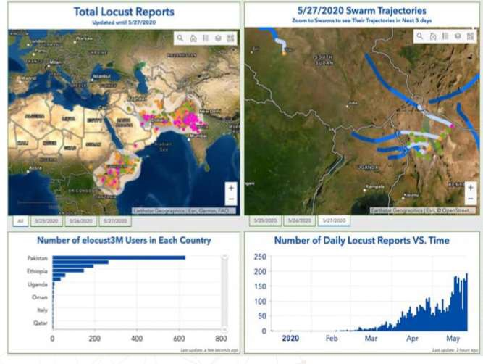
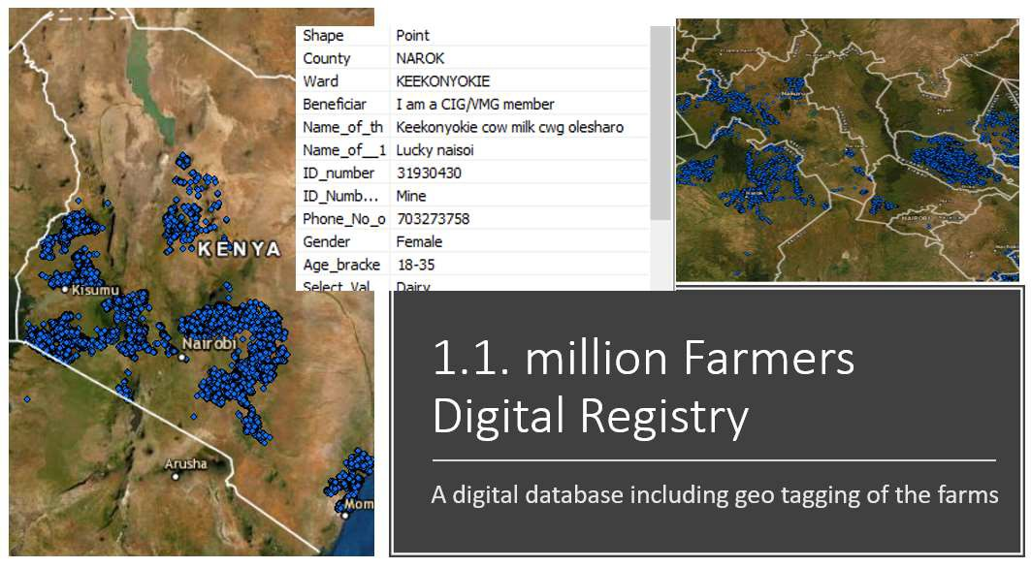
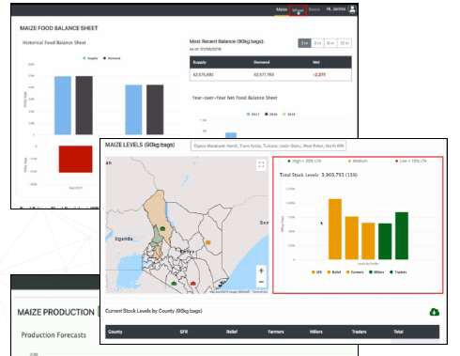
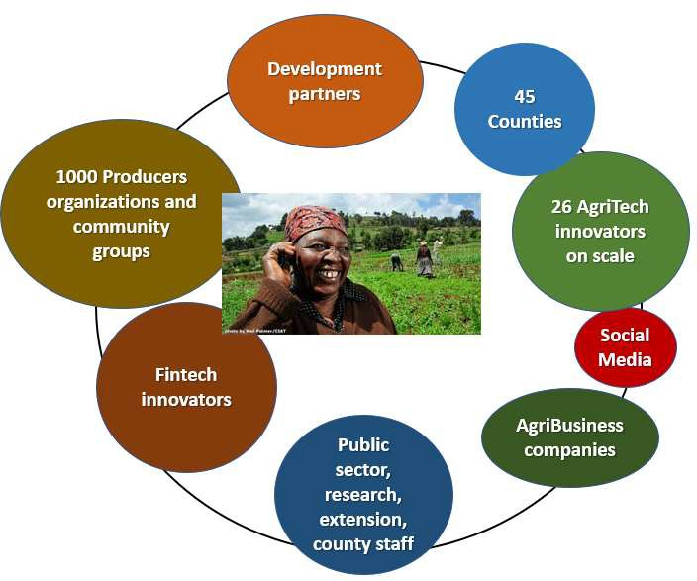
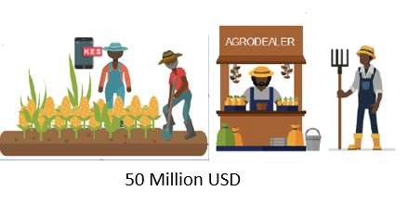
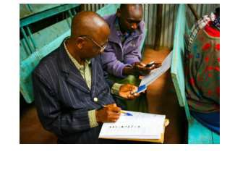
Key Data and Digital interventions
Kenya Big Data Center
Micro Weather Observatory ^{Desert Locusts warning}
Farmers Digital Registry and Farm Geotagging
and response
Digital Food Balance Sheet
One Million Farmers Platform
Digital e-voucher system
Digitizing Producer Organizations

Slide 8
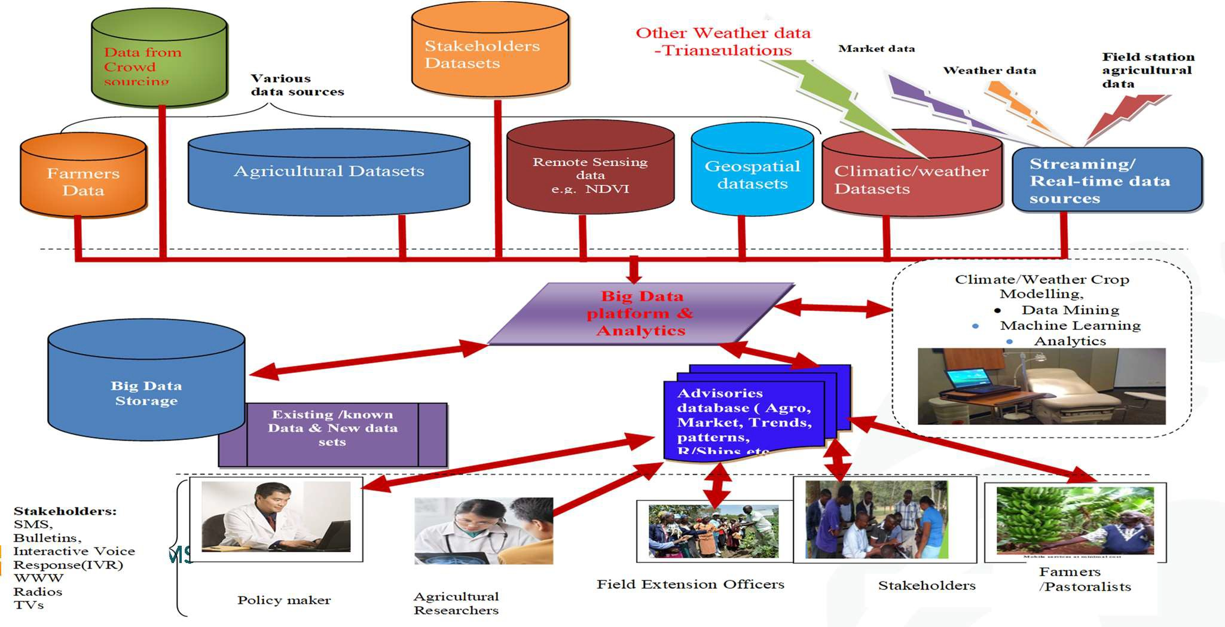
The Game changer: The Big Data Platform & Ecosystem
8

Slide 9
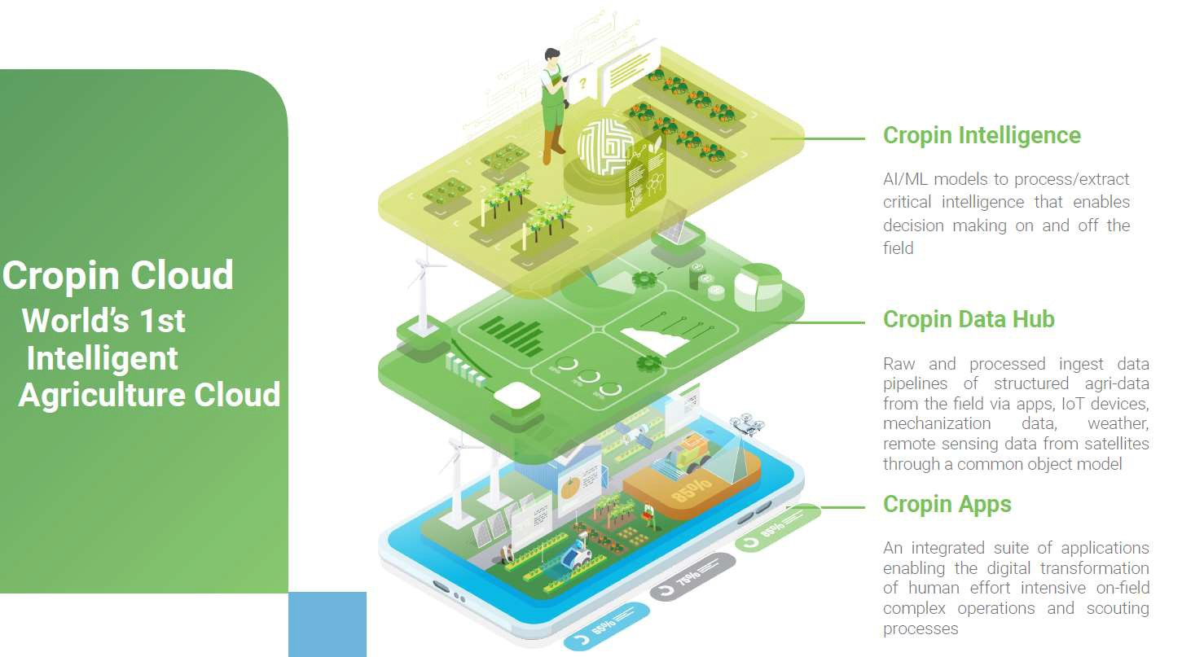

Slide 10
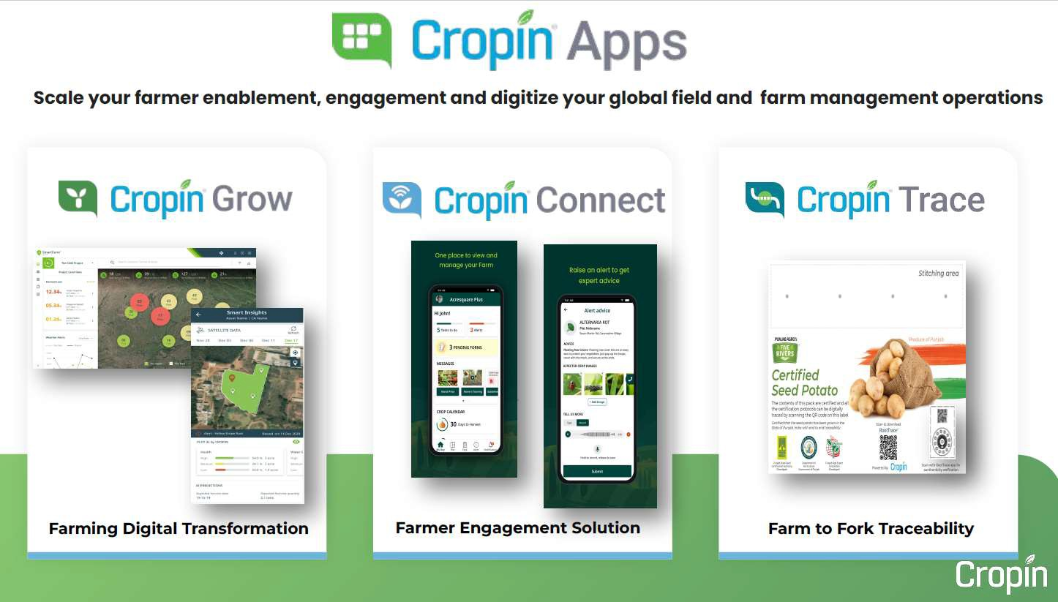

Slide 12
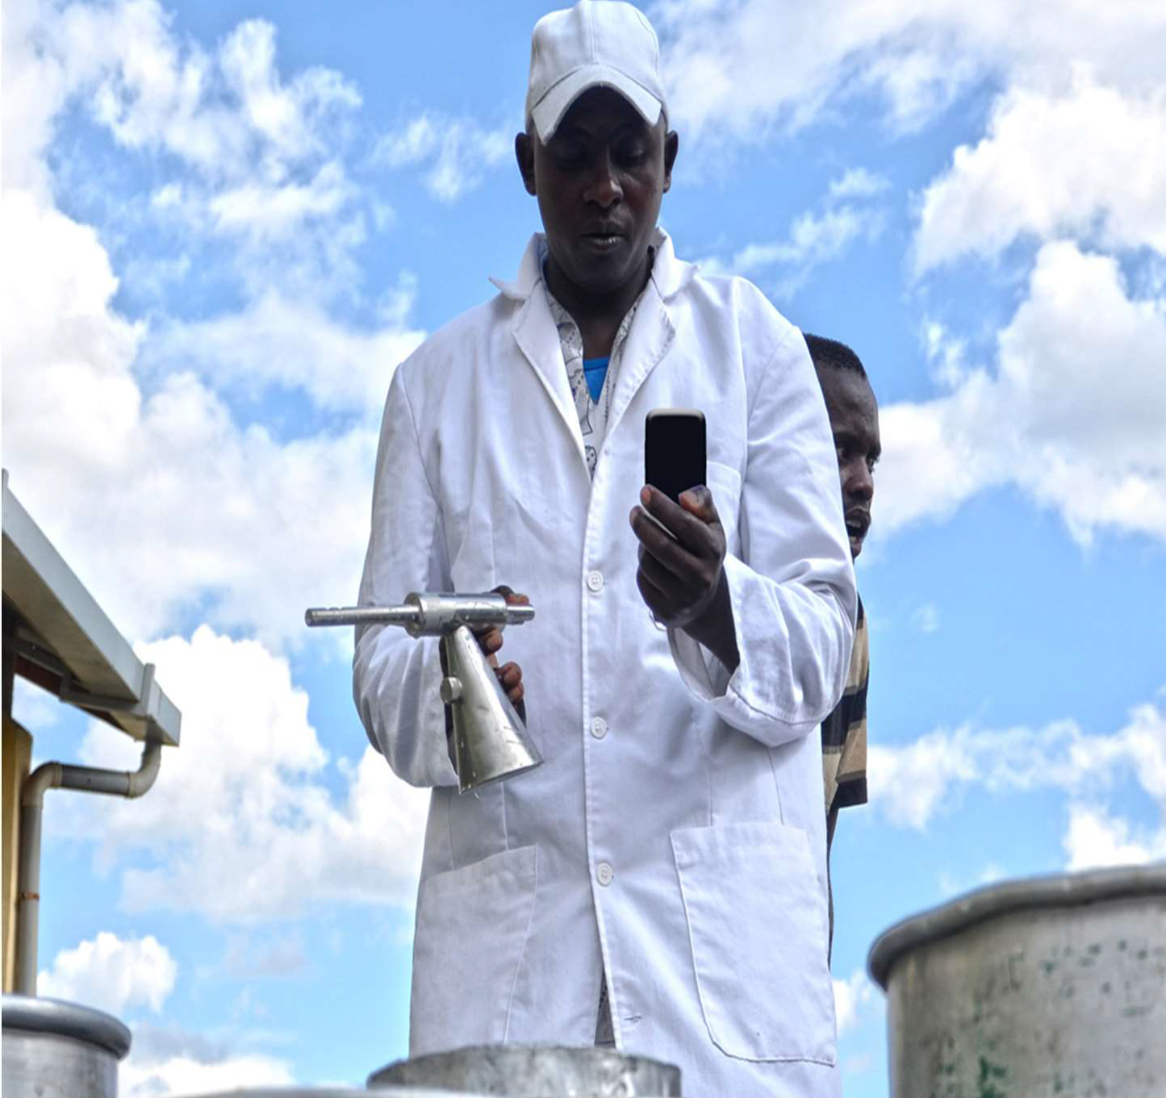
Vision
Transform Food Systems through Digital Innovation
Scaling digital technologies and innovations that work for farmers, entrepreneurs and countries’ governments
12

Slide 13
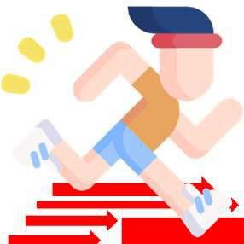
Digital transformation of agri-food systems requires addressing three fronts
Developing the Innovation ecosystem
for content creation and service delivery
Fast tracking the creation of a Digital Innovation Ecosystem?
Building blocks for Digital Agriculture and Food Ecosystem
Adopting a consortium approach as the core principle for our action for leveraging global and local expertise on all fronts of the ecosystem
Institutional innovation
in Governments and for PPPs and supporting Innovation
Developing the Data ecosystem for Governments and innovators
Leapfrogging the digital transformation by linking global knowledge, capacity, data, analytics and innovations to local needs
And many more

Slide 14
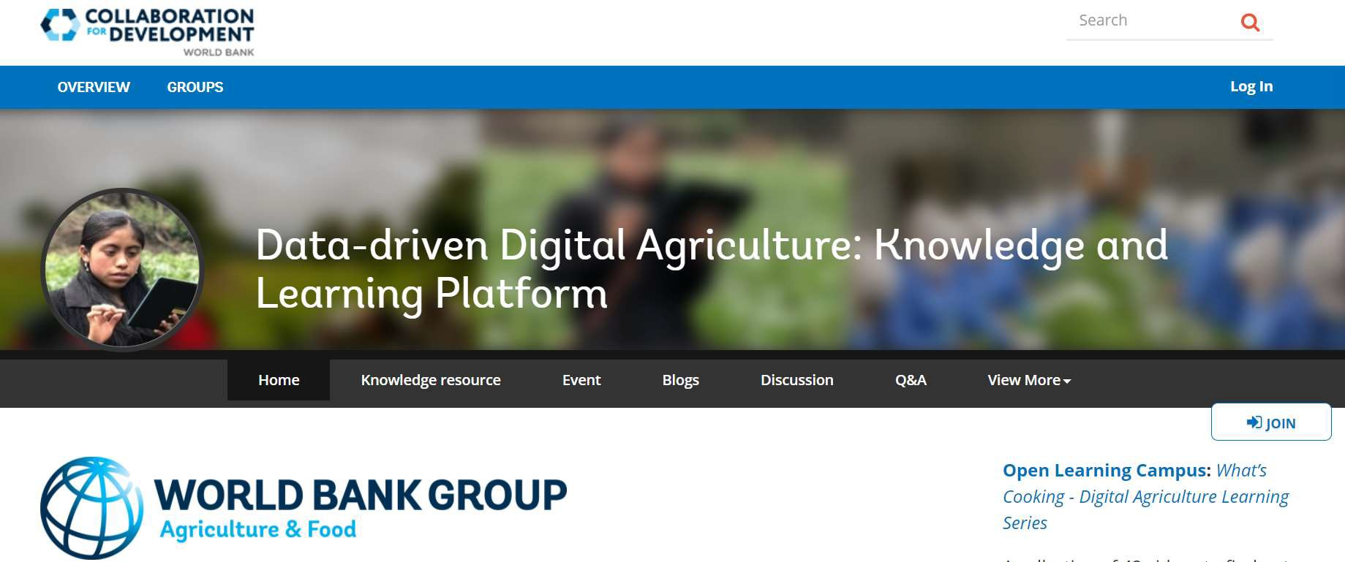
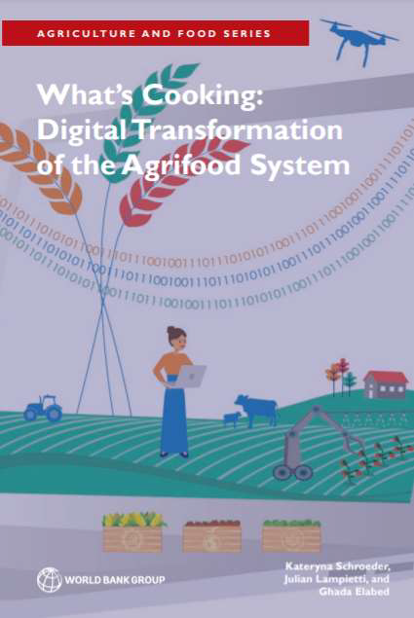
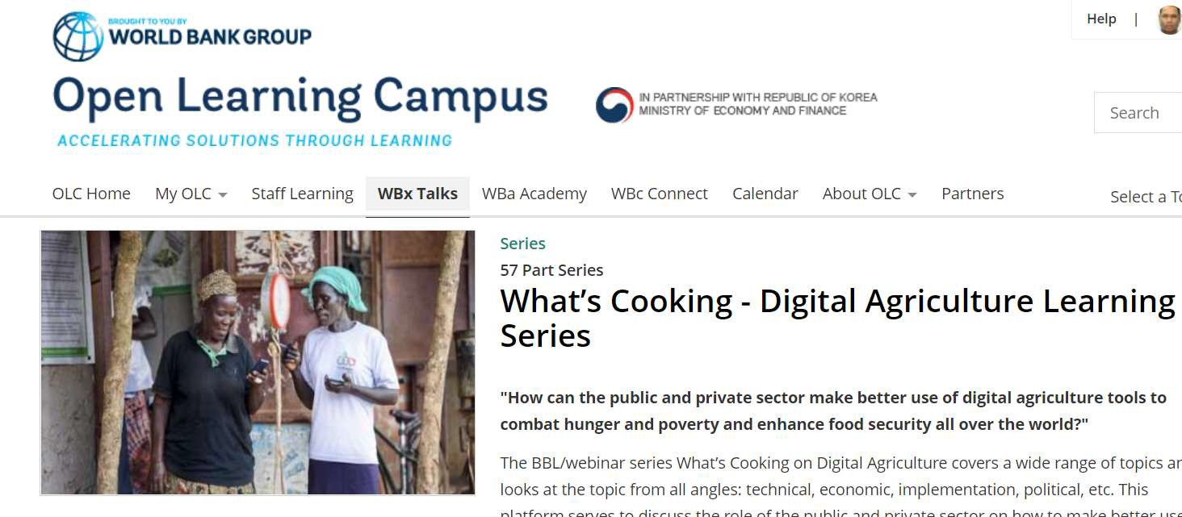
Creating and sharing knowledge
Digital Agriculture Flagship
A One-Stop-Shop to share knowledge, analytics, innovations, tools, and best practices among practitioners, policymakers, innovators, researchers, and experts in the area of Data-driven Digital Agriculture.
Delivered 57 webinars during the pandemic and created a
Other activities :
pool of 5000 + global audience
A manual and toolkit on data Hackathons and Innovation Challenges and organize six data Hackathons and Innovation Challenges at the country level;
Customized courses for clients in six countries;
A toolkit for practitioners on
ms-throug^{in}-d^{t}a^{e}t^{g}a-^{r}dªri^{t}ve^{in}n-^{g}d g^{d}it^{i}a^{g}l-^{i}a^{t}gªri^{l}cu^{t}lt^{e}u^{c}re^{h}-l^{n}eaºrn^{l}iºng^{g}-0^{ies into}
agriculture projects

Slide 15
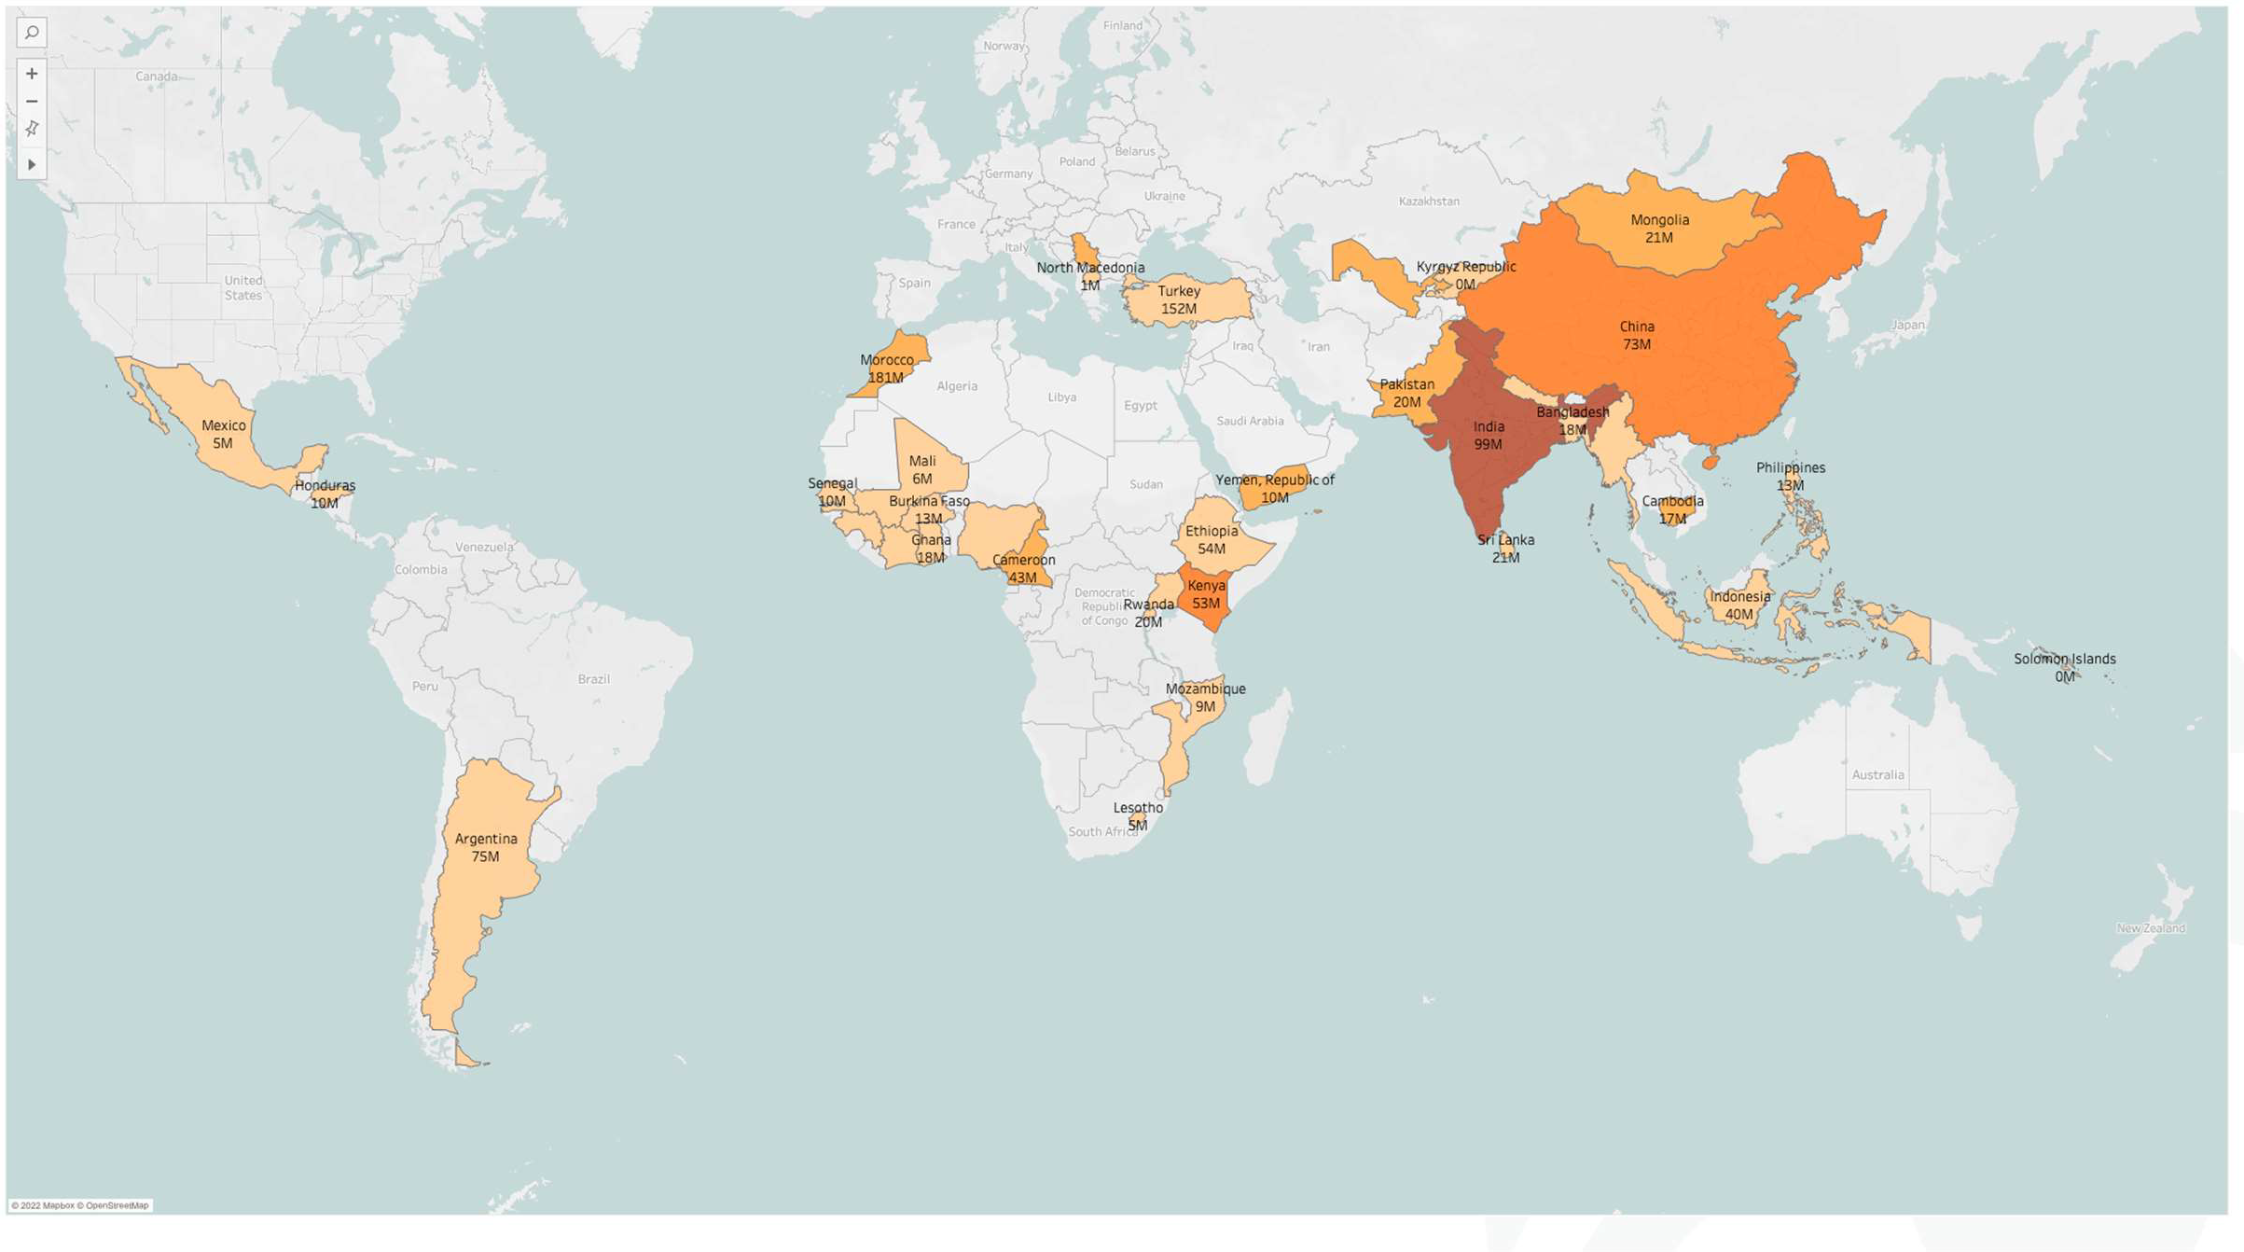
Influencing Lending Operations
~ 1.15 Billion USD investments in Data and Digital Components related to Agriculture
Lending Instrument
3 PforR
50 IPF
53 projects
36 countries
Avg. 13% Investments in the selected projects

Slide 16
Next steps: A Global Data & Digital Agriculture Advisory Program to go to scale
Catalyze investments in digital agriculture through operationalizing data, analytics, innovation and global knowledge on digital solutions in the agrifood system and linking them to local needs, ensuring their adoption by smallholder farmers.

Slide 17
For more information:
What’s Cooking - Digital Agriculture Learning Series
Link: https://olc.worldbank.org/content/what’s-cooking-digital-agriculture-learning-series
Data-driven Digital Agriculture: Knowledge and Learning Platform
Link: www.worldbank.org/digitalagriculture

Slide 18
Parmesh Shah, Global Lead, Data-Driven Digital Agriculture
pshah@worldbank.org

