Slide 1
Can children learn to read on their own using mobile devices?
After researching 80 apps in 7 countries with 7000 children over 6 years… and then 2M downloads in the subsequent 2 years!
YES! They can.
IT BEGAN WITH A QUESTION...

Slide 2
Create and curate - high impact open source early learning content
Localise - mother-tongue content
Distribute - reach children via parent/caregiver smartphones (also works with dedicated devices in schools/learning centres/refugee centres)
SO WHAT DO WE DO?

Slide 3
Content Suite
Feed the Monster App - reading fundamentals app, EduApp4Syria winner, available in over 50 language versions.
Curious Reader - developed to provide interesting and content-rich stories in a familiar context. Curious Readers support exposure and acquisition of new vocabulary words presented in an engaging environment.
Numeracy App - built by Chimple Learning, Global Learning XPRIZE finalist.
Global Digital Library - collection of high-quality open educational reading resources, available on web, mobile and for print. The GDL currently offers 6000+ books in 72 languages.
Digital Assessment - measures early literacy skills with deep data feedback, built with UCSF, UConn, MIT, & Learning Ally, and further developed in partnership with Norad and World Bank DIME.

Slide 4
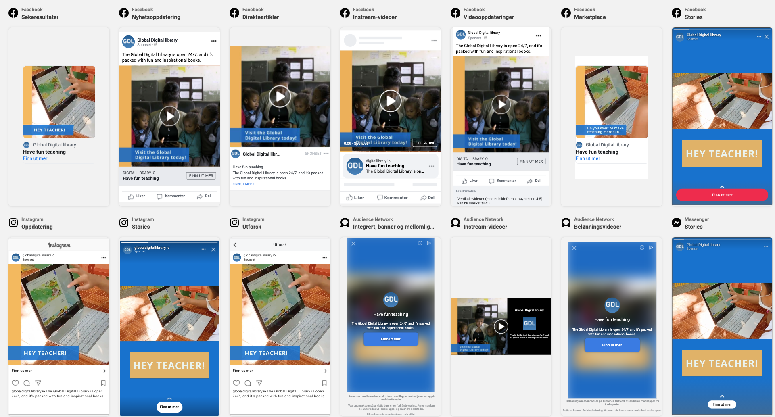
Distribution: Teacher focused campaign
Awareness
Consideration
Dynamic ads - 7 different videos served to the target group, including 3 short videos, 3 short videos and 2 slideshows

Slide 5
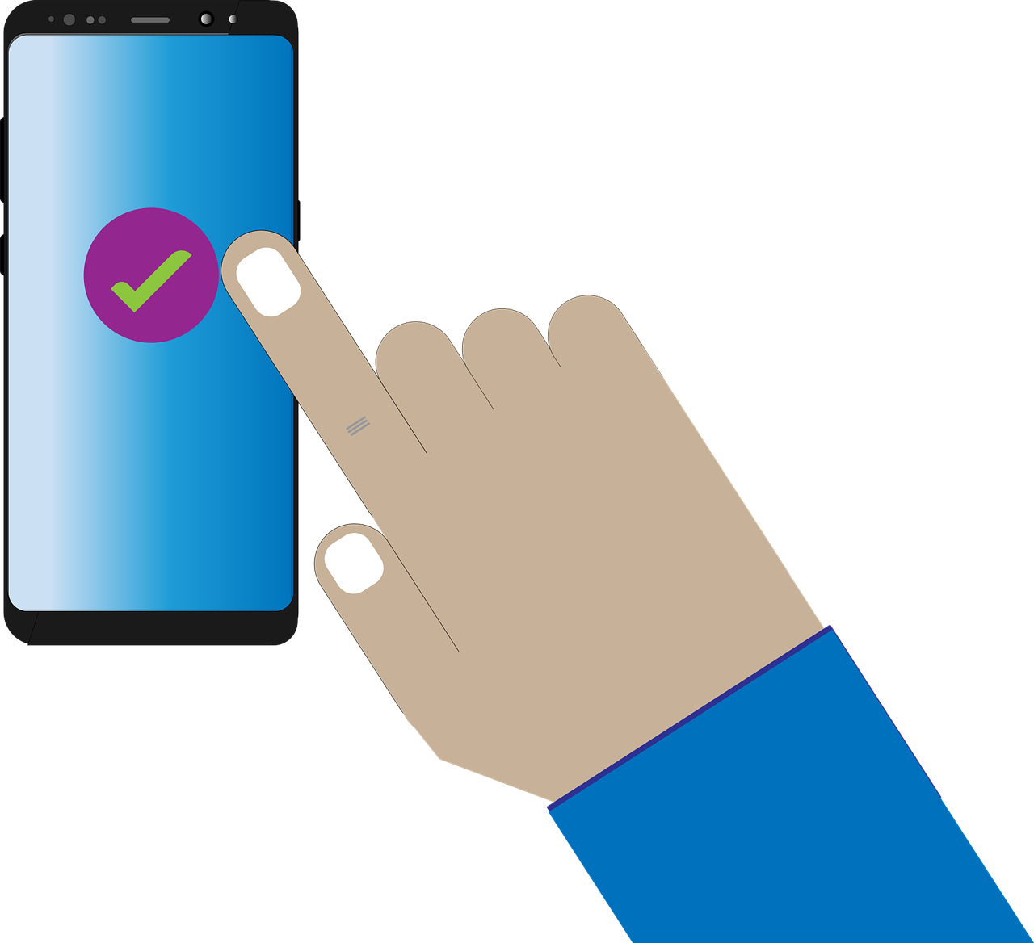
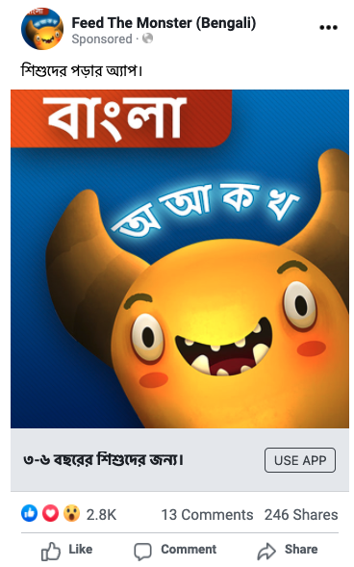
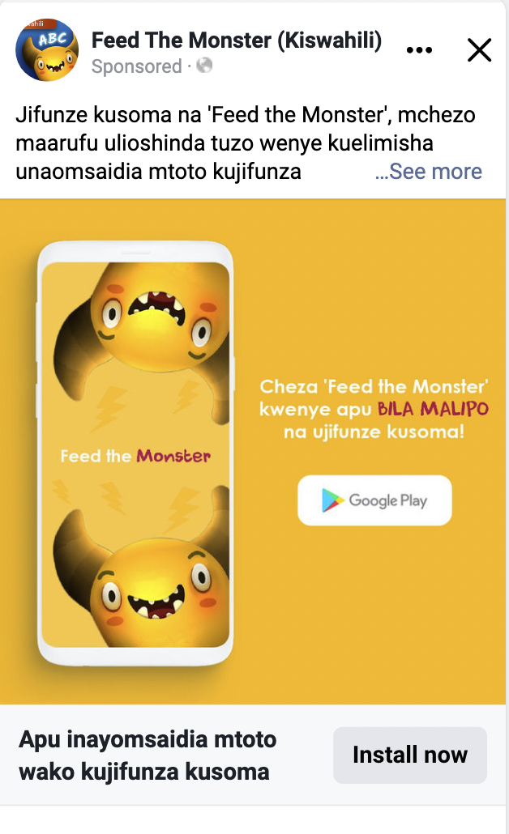
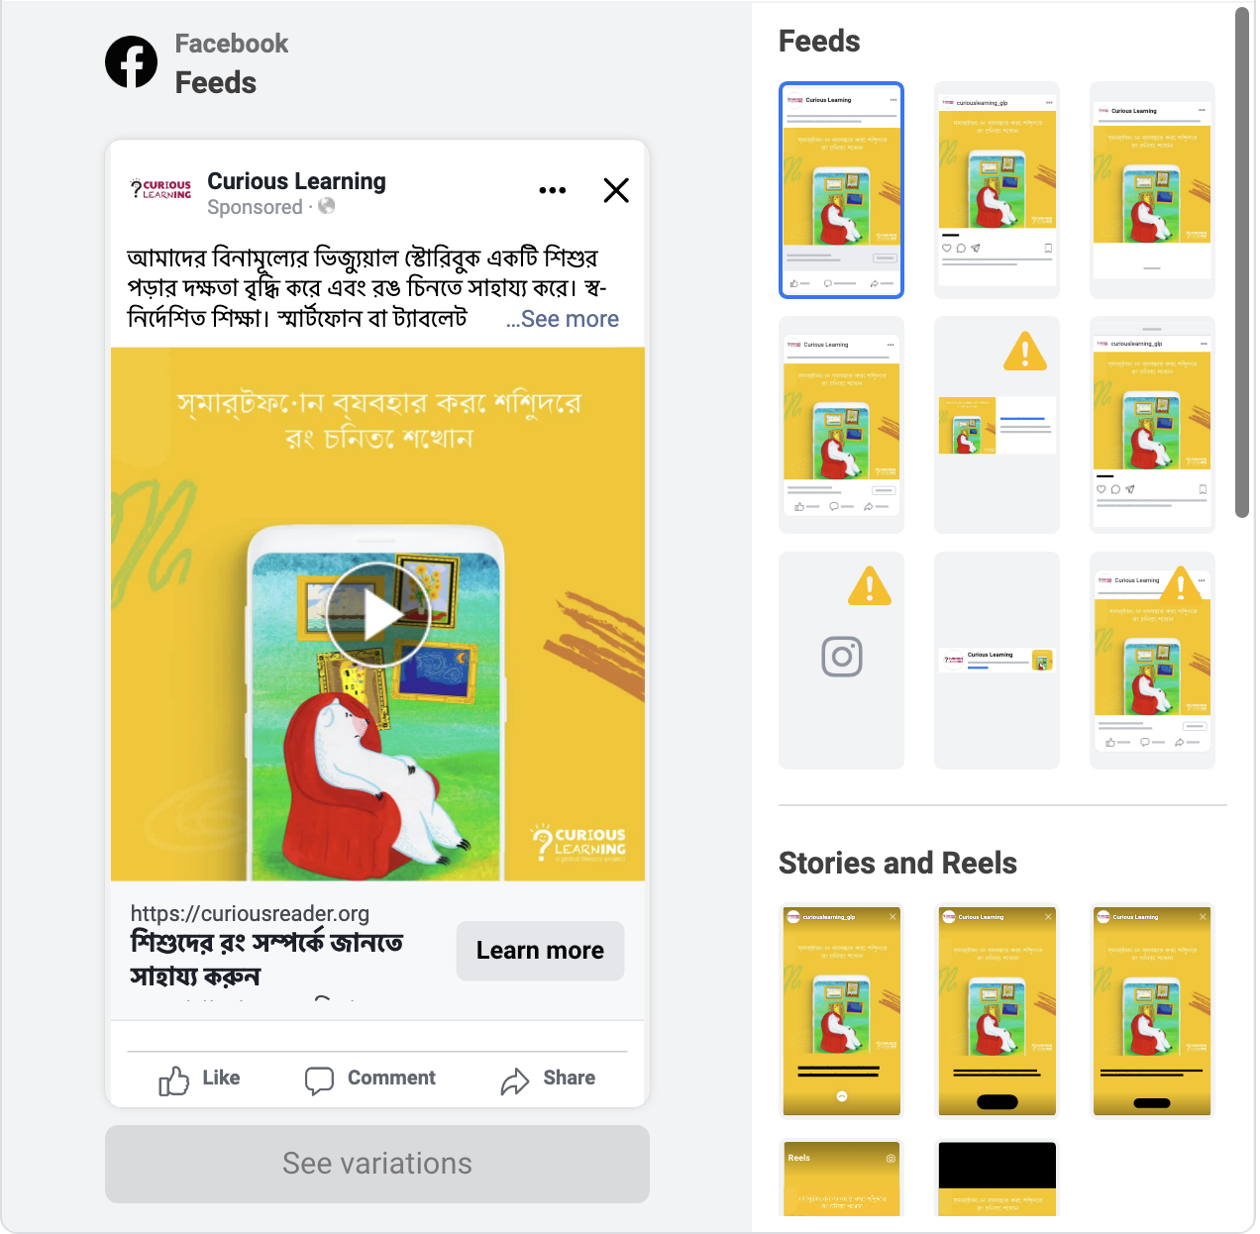
Distribution: Parent focused campaign
Awareness
Consideration
Download

Slide 6
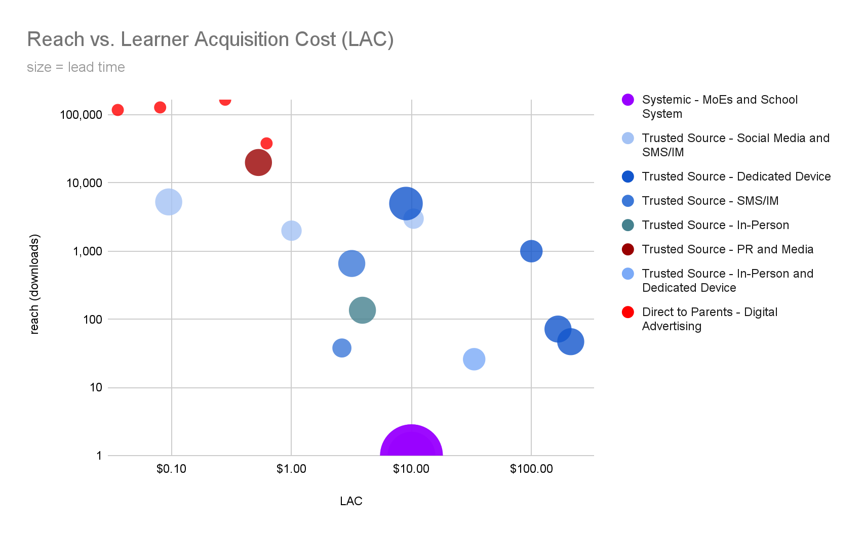
Distribution tests
The Good Space
Source Spreadsheet

Slide 7
Distribution Channels -- Pros & Cons
Systemic (MOEs & Multilaterals) | Trusted Sources (NGOs & CBOs) | Direct to Parents (CL Ads)
Pros | Pros | Pros
Large Reach Credibility | Trusted by parents Reaching vulnerable populations | Large Reach Cost effectiveness Immediately implementable
Cons | Cons | Cons
Long lead times - Bureaucratic Resistant to innovation Whole pyramid - leave no child behind - means large scale mobilization or none at all Large scale funding dependent | Lead times Limited reach (need many partners to get scale) Mostly focused on bottom of the pyramid -- not middle | Changing ad delivery platform policies and costings Starting with the middle of the pyramid - not able reach the most vulnerable immediately
Unknown | Unknown | Unknown
Cost Have yet to make it happen | Cost effectiveness for scale | Cost effectiveness and learning efficacy is unknown at country wide scale
More detail on Distribution Channels

Slide 8
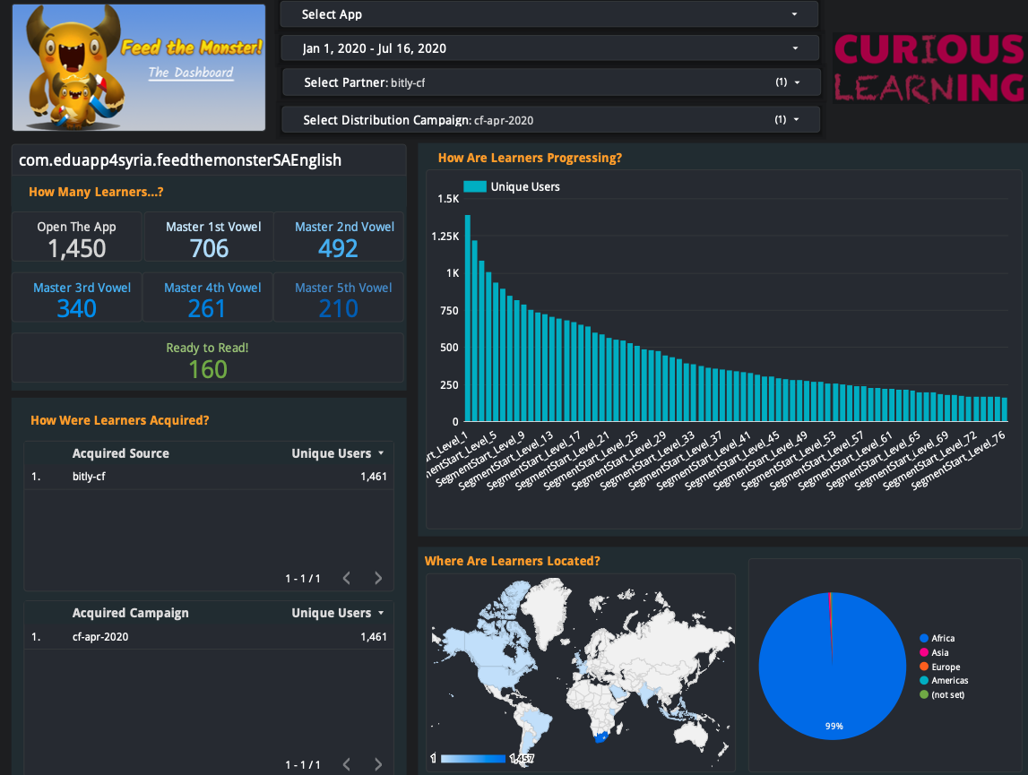
Deep data analytics - by cohort
Notes:
As long as the devices are online, google can help us track the progress of the learners and use of our apps

Slide 9
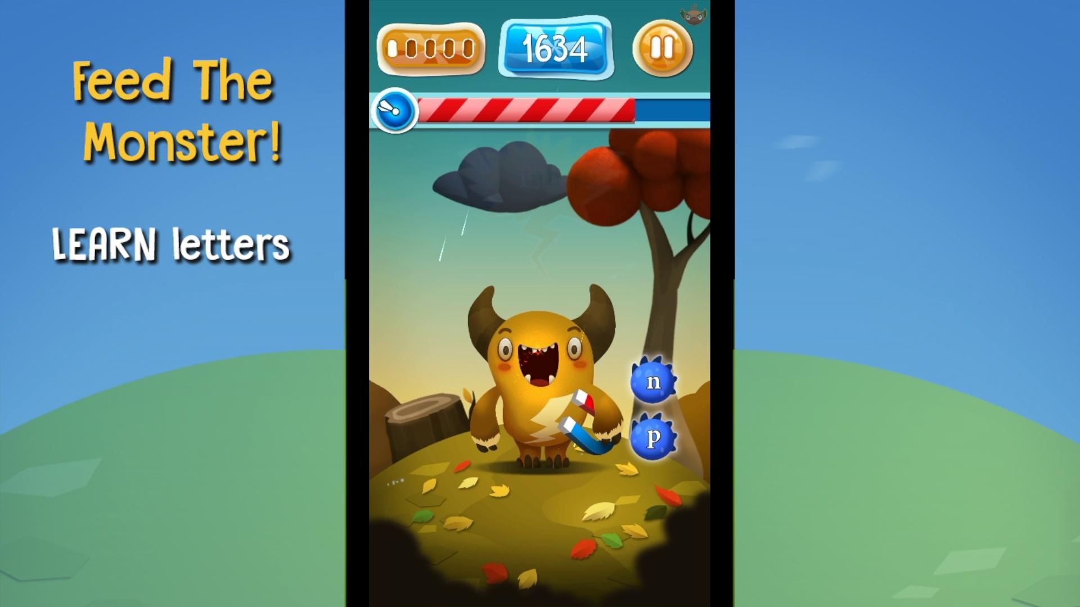
Demo: Feed the Monster

Slide 10
Thank you!
Contact: Creesen Naicker cnaicker@curiouslearning.org

