Slide 1
The Digital Economy
A Big Opportunity for the Young
Rebeca De La Vega
Corporate Affairs, Regional Manager
January 25, 2023

Slide 2

The future is uncertain
the world has changed forever
Notes:
It is clear, by any metric or measure, that the world has changed forever.
This time last year, we were facing trade wars and tariffs. We were talking about the effects of macroeconomic pressures and geopolitical challenges.
Looking back, those felt so situational. This pandemic has felt systemic.
It has changed how we work, how we live, the role of businesses, and the needs and expectations of consumers around the globe.

Slide 3

Businesses are adopting
a digital-first model
Notes:
For businesses, it’s put more focus, energy, and urgency on digital transformation and the need to deliver digital-first services.
Even those institutions that are slower or more reluctant to change have leapt into the digital world.

Slide 4

75% of companies in the US plan on accelerating their
technology transformation as a result of the pandemic
Notes:
It’s been estimated that 75% of companies have decided to accelerate their transformation plans because of this pandemic.
Source:
Fortune 500 CEO survey: How are America’s biggest companies dealing with the coronavirus pandemic?
14 May 2020
Link: https://fortune.com/2020/05/14/fortune-500-ceo-survey-coronavirus-pandemic-predictions/

Slide 5

88% of organizations worldwide encouraged their
employees to work from home because of the pandemic
Notes:
One of the most immediate impacts was the massive migration to remote work.
According to Gartner, 88% of global enterprises encouraged their office workers to work from home because of the pandemic.
Source:
Gartner HR Survey Reveals 88% of Organizations Have Encouraged or Required Employees to Work From Home Due to Coronavirus
19 March 2020
Link: https://www.gartner.com/en/newsroom/press-releases/2020-03-19-gartner-hr-survey-reveals-88--of-organizations-have-e

Slide 6

1.2 billion children moved to hybrid learning
in a matter of weeks
Notes:
And of course, as many of you have experienced firsthand, it wasn’t just work, it was school that moved to the home.
It’s been estimated that 1.2 billion children around the globe moved into virtual or hybrid education.
Source:
The COVID-19 pandemic has changed education forever. This is how.
29 April 2020
https://www.weforum.org/agenda/2020/04/coronavirus-education-global-covid19-online-digital-learning/

Slide 7
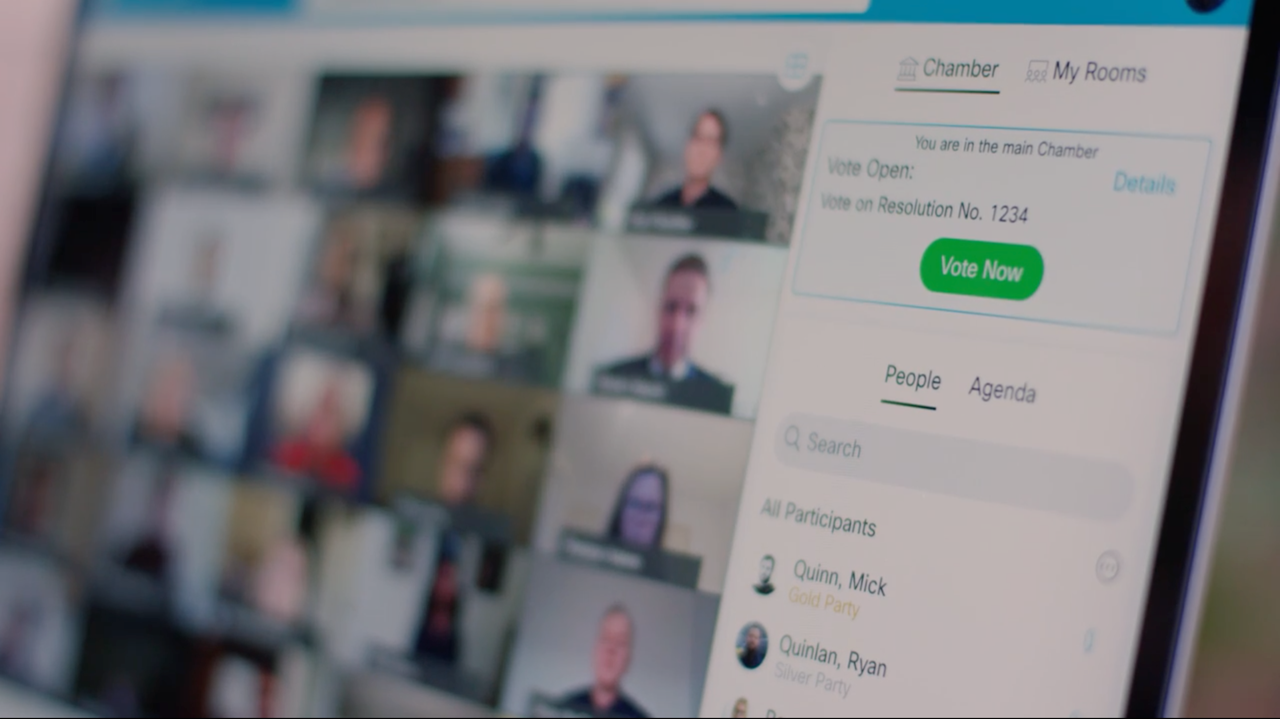
Governments around the world
met and legislated virtually
Notes:
Governments are moving virtual too, legislating, debating, doing work for the people in front of their screens rather than in the hallowed halls of their Capitols.

Slide 8
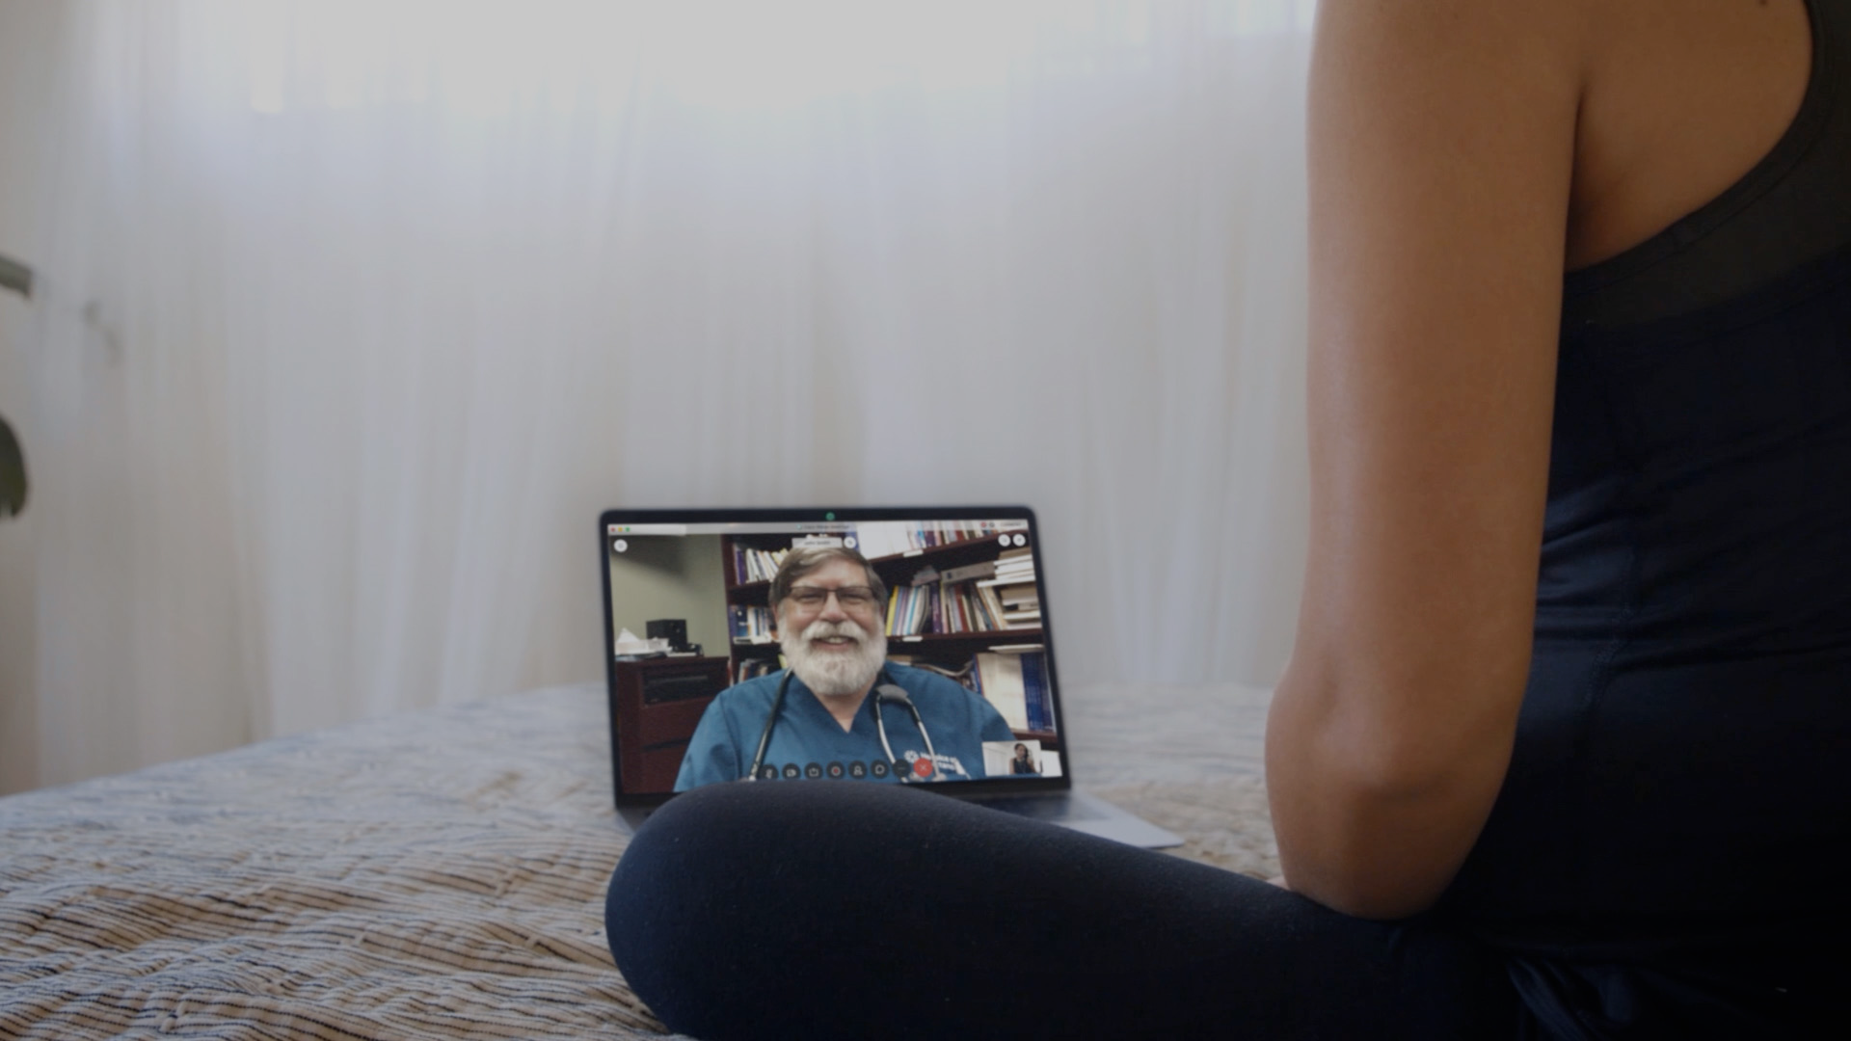
In the US alone, Telehealth adoption increased
by 50% from January to June 2020
Notes:
And medicine has been redefined as well.
In the US alone, telehealth adoption increased by 50% from January to June 2020.
Source: HHS Issues New Report Highlighting Dramatic Trends in Medicare Beneficiary Telehealth Utilization amid COVID-19
28 July 2020
Link: https://www.hhs.gov/about/news/2020/07/28/hhs-issues-new-report-highlighting-dramatic-trends-in-medicare-beneficiary-telehealth-utilization-amid-covid-19.html

Slide 9

In the next 3 years, 500 million new apps will be written,
almost all of them for the digital world
Notes:
This is why more than 500 million new applications will be developed over the next three years. It’s an amazing opportunity to reimagine how apps are designed, deployed and optimized.
Source:
IDC FutureScape Outlines the Impact "Digital Supremacy" Will Have on Enterprise Transformation and the IT Industry
29 Oct 2019
Link: https://www.idc.com/getdoc.jsp?containerId=prUS45613519

Slide 10
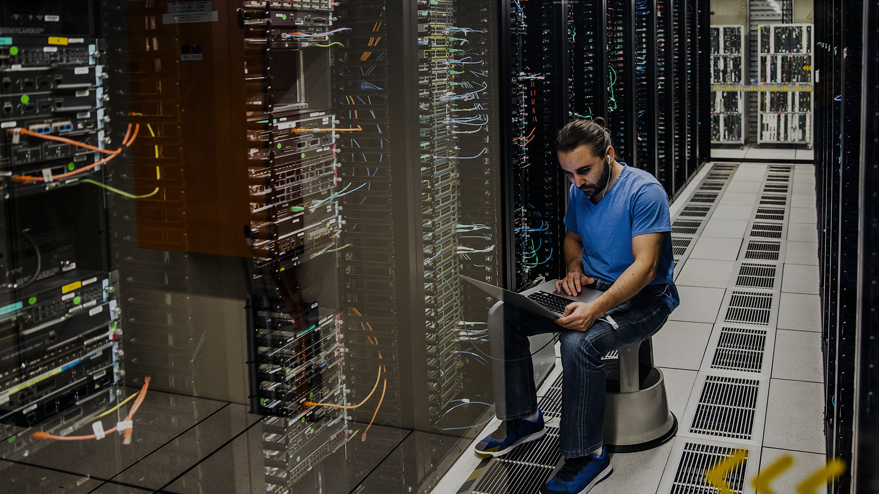
Businesses must now
transform their infrastructure
Notes:
Third, in this connected world, the network is the nervous system that allows everything to work together. And while it’s created limitless possibilities, it’s also introduced incredible complexity.

Slide 11

Business must
secure their enterprise
Notes:
Lastly, security has always been of critical importance to our customers, and it’s become even more complex.
Remote workers using their own unsecured devices from their own unsecured home networks, has expanded the attack surface exponentially.

Slide 12

The opportunity to drive value
has never been greater
Notes:
And so, while it’s clear that the opportunity to drive value in their organizations has never been greater…

Slide 13

Pandemic
Lack of Resources
Advances in Technology
Are We Ready for the Digital Economy?
Artificial Intelligence
Increasing Cyber Threats
Growing Complexity
Notes:
We’re facing some serious challenges today in the world of work…. The speed and the scale at which technologies are being developed is unprecedented.
Disruptive technologies are changing required skills and worker expectations across all industries.
Advanced technologies such as IoT, Artificial Intelligence, cloud computing and big data analytics can be very complex and considered disruptive – because they’re replacing what are now considered human tasks, contributing to job displacement and rapidly creating a serious talent shortage.
And cyber security threats are on the rise…. Every year companies lose billions of dollars to
cyber-criminal activities. Although technology is emerging to keep us safe, it can be complex to manage and there are far too few cybersecurity professionals.
Now, we also have the additional global pressure to manage through the global pandemic. It’s unprecedented and challenges everything we know about digitization timelines and the role technology plays in keeping us connected – even when we’re apart.
We will only be able to accelerate digital readiness and prepare for the digital economy if we anticipate the skills needed for the future of the workforce; and prepare students and workers to meet rapidly changing employer demands.
It makes us question, with all the challenges, whether the world will ever be fully ready for the digital economy?

Slide 14

Who can organizations count on to help them
take advantage of this massive opportunity?
Notes:
…it’s never been more important to pick the right partner to help CIOs seize this opportunity and maximize their value.
They know where they need to go and why…but they need the right partner to help them build the “what” and the “how.”

Slide 15



The need for a skilled workforce
85 million
jobs
97 million
new jobs
Displaced by a shift in labor between humans and machines by 2025¹
Created by digital transformation by 2025¹
“Future of Jobs,” World Economic Forum
Notes:
And we are up against a big challenge…. According to the World Economic Forum by 2025, 85 million jobs will be disrupted due to automation and the pandemic further aggravated this situation.
Unfortunately, there is a disproportionate impact on low-income workers, women, and young people.
However, there is hope: 97 million new jobs are being created due to technological advances by 2025. And with 40 billion connected devices on the horizon for 2025, digital skills will be critical.

Slide 16


Education and training are key

Slide 17
Digital Skills Challenges
Adaptability
50%
Advanced Cognitive
Socio-behavioral
of knowledge acquired during
the1st year of college will
be outdated by graduation**
Skills are increasingly important in labor markets***
Success in the future
will belong to those who
can ‘work’ with the machines
33%
65%
Skills development for the
changing nature of work is a
matter of lifelong learning***
of children entering K-12 will have job types that don’t yet exist**
of skills needed by 2020
didn´t exist in 2018*
*”Reskilling Revolution: A Future of Jobs for All,” World Economic Forum, accessed January 2018, https://www.weforum.org/reports/towards-a-reskilling-revolution.
**”The Future of Jobs,” World Economic Forum, accessed January 2018, http://www3.weforum.org/docs/WEF_Future_of_Jobs.pdf.
***The Changing Nature of Work, The World Bank, accessed January 2019, http://www.worldbank.org/en/publication/wdr2019

Slide 18
Human Capital
Building capacity for resilience
Skilling-Reskilling
(1st + 2nd Industrial revolutions)
Upskilling
(3rd Industrial revolution)
Human capital
(4th Industrial revolution)
Q
Q
Q
Q
Q
Q
Q
A
A
Q
A
A
A
A
A
Competence
Capable
Capacity
Perform to benchmark level
Translate competence
to new challenge
Find + frame new challenges
Draw on existing knowledge
Translate + deepen existing knowledge
Formulate new knowledge
“We have the opportunity to reach out and elevate different parts of the world, tap into talent, and provide education to places in the world that didn’t have those options before. And that’s better for all humanity.”
– Heather McGowan, Futurist and Education Speaker
Source: https://newsroom.cisco.com/feature-content?type=webcontent&articleId=2169606
Notes:
[Slide purpose: Expansion of Education to build capacity in human capital]
The way that we can address this skills shortfall and create job security is through human capital development.
Together, and in partnership, we have the opportunity to help countries to tap into their talent base and make education available to people who may not have had the ability to access quality education for whatever reason in the past.
It’s better for the individual and their families, it’s better for the community, and it’s better for the nation as education is tied to GDP growth.
So as Futurist and Education Speaker Heather McGowan says: “And that’s better for all humanity”
[PAUSE]
Sources:
https://newsroom.cisco.com/feature-content?type=webcontent&articleId=2169606

Slide 19
Skills Required for a Digital Workforce
Specialized Skills
Software Development, Analytics & IoT, Networking, Security, Data
Broad Skills
Functional (analytical thinking), business operations, product and project management, marketing, etc.
Entrepreneurial Skills
Business acumen, design thinking, critical thinking, adaptability, diversity mindset, risk taking, and more
Human Skills
Negotiation, persuasion, social perceptiveness, creativity, collaboration, coordination, service orientation

Slide 20








Cisco Digital Readiness Index
Explores country readiness for
a digitised future for planning
Links to gross domestic product per capita
Total digital readiness score
Basic needs
Business and government investment
Ease of doing business
Explore now
Human capital
Start-up environment
Technology adoption
Technology infrastructure
Notes:
[Slide purpose: to show NetAcad tie-in with digital readiness priority]
And so from a digital readiness (or digital resiliency) perspective, we developed an index that explores how ready 141 countries are for a digitised future.
We did this because research found a relationship between the digital readiness of a country and gross domestic product (GDP) per capita demonstrating the importance of economic value and digital readiness.
This is a great tool for our partners to use to help with their investment decisions to be a future-ready economy.
The index covers 7 components, with “Human Capital” rated on:
Literacy Rate
Education Index (Years of Schooling)
Labor Force Participation
Harmonized Test Scores
[TAKE A MOMENT TO EXPLORE https://www.cisco.com/c/en/us/about/csr/research-resources/digital-readiness.html]

Slide 21

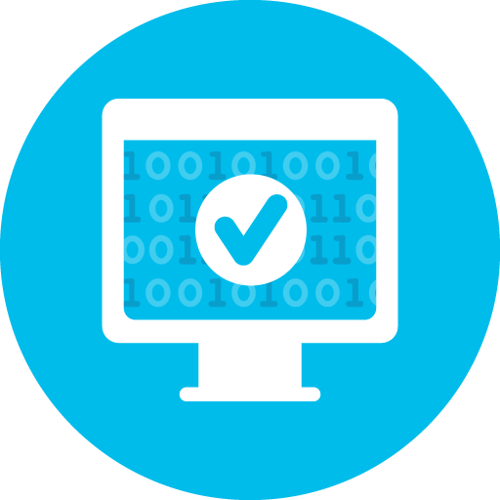
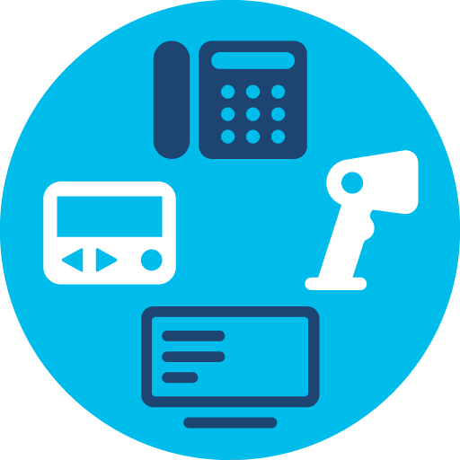


Job creation
Tech skills shortfalls continue
Software engineer
jobs growing
3+ times the average by 2026
60%
104%
65%
Cybersecurity
jobs growing
31% by 2029, 7+ times the average
Basic and advanced
programming
Connected
Technologies growing
of CIOs plan to deploy advanced network solutions
Notes:
[Slide purpose: to show NetAcad tie-in with job creation priority]
Even though 65% of CIOs are planning to deploy advanced network solutions, shortfalls in technology jobs continue.
Here are some of the other tech skills shortfalls and corresponding job opportunities.
Sources: CNBC
Bureau of Labor Statistics' Information Security Analyst's Outlook
*Skills of Mass Disruption: Pinpointing the 10 Most Disruptive Skills in Tech, Burning Glass Technologies, 2020
Cisco Global Networking Trends Survey
The IT landscape is rapidly evolving.
https://www.cisco.com/c/dam/en/us/solutions/collateral/enterprise-networks/digital-network-architecture/global-nw-trends-survey.pdf
The A.I. Paradox: How Robots Will Make Work More Human, Oxford Economics and Cisco, December 2017

Slide 22



Reducing unemployment– Top skills employers want
Networking
skills
Security
skills
Programmable Infrastructure skills
(software and data)
Non-technical skills
Network architecture and design Data center
Network management
Network security
Cybersecurity
Cloud security
Data and business
analytics App development
Software programming/development
Communication
Customer service
Critical thinking and
problem solving
Self-Management
Adaptability
*Responses are from employers engaging
with Cisco’s Talent Bridge employment program
Notes:
[Slide purpose: we further support students in finding a job with their skills through Talent Bridge]
These are the skills that are in demand from over 650 employers on Talent Bridge job-matching engine.

Slide 23

Cyber crime is changing
Threat actors are turning crime into a business model with ransoms to be paid.
In addition to targeting IT infrastructure, state-sponsored groups are also targeting the Operational Technology (OT) infrastructure, which directly impacts human lives.
Notes:
As we’ve just seen, cyber-crime isn’t limited to just the digital world. The cyber landscape is changing -- and cyber-crime is changing, too.
While IT infrastructure is a known target, there is a growing trend in state-sponsored groups targeting Operation Technology (OT) infrastructure.
Operation Technology (OT) provides direct control of physical devices using industrial control systems (ICS) across industries – which potentially has a direct harmful impact on human lives.
This new evolution of exploits is turning cyber-crime into a business model. A business model with ransoms to be paid

Slide 24
Every new location and method used by an employee to work is a new hole in your life raft.
The more flexibility offered by hybrid work, the more complexity for IT teams to manage.
The threat exposure is huge.
Source: Cisco Future of Secure Remote Work Report
Notes:
The workplace landscape is changing, too.
Before 2020, 19% of organizations surveyed in “Cisco Future of Secure Remote Work Report” had more than half of their workforce working from home. Now it’s jumped up to 62%.
The rise in flexibility for remote and hybrid work drastically increases opportunity for threat exposure.
We’re also faced with growing complexity for IT Teams to manage as they must ensure networks remains secure with every single connection.
In other words: Every new location and method used by an employee to work is a new hole in your life raft

Slide 25
Cybersecurity is crucial
40.9 billion
Total number of devices projected by 2025 worldwide, including smartphones, computers, laptops, and IoT devices¹
Billions of people around the world depend upon the Internet to be reliable, resilient, and safe.
Over 40 billion devices are expected to be connected to the Internet by 2025.
The need for security is growing - and cybersecurity threats are rising.
+125%
Reported cyber intrusions are up 125% annually across the globe²
$ 623 M
Ransomware strikes on US state and municipal governments totaled more than $623M USD in 2021³
Statista
Accenture, Triple digit increase in cyberattacks: What next?, Aug 2021
EmisoftThe State of Ransomware in the US: Report and Statistics 2021,
Notes:
Billions of people around the world depend upon the internet, with an estimated 40 BILLION devices are expected to be connected to the internet by 2025¹.
· Smartphones, laptops, and computers are expected to reach just over 10 billion units by 2025¹
· The total installed base of Internet of Things (IoT) connected devices worldwide is projected to amount to 30.9 billion units by 2025, a sharp jump from the 13.8 billion units that are expected in 2021¹
With our growing reliance on the Internet across the globe, more than ever we need it to be reliable, resilient, and safe.
The need for security is growing - and cybersecurity threats are rising.
· Reported cyber intrusions are up to 125% annually across the globe, impacting almost every industry and geography²
· Ransomware strikes totaled more than $623 million in 2021³
· Critical infrastructure like power plants and pipelines have been increasingly targeted over recent years
The Internet is an increasingly volatile place, with nation states, major crime syndicates, vigilantes, and hacktivists trying to make their mark.
As cybersecurity threats rise – with the potential to impact all of us – cybersecurity is becoming increasingly crucial.
·
Sources
1. https://www.statista.com/statistics/1101442/iot-number-of-connected-devices-worldwide/
2. https://www.accenture.com/us-en/blogs/security/triple-digit-increase-cyberattacks#:~:text=No%20slowdown%20in%20sight%20despite,almost%20every%20industry%20and%20geography
3. https://www.emsisoft.com/en/blog/40813/the-state-of-ransomware-in-the-us-report-and-statistics-2021/

Slide 26
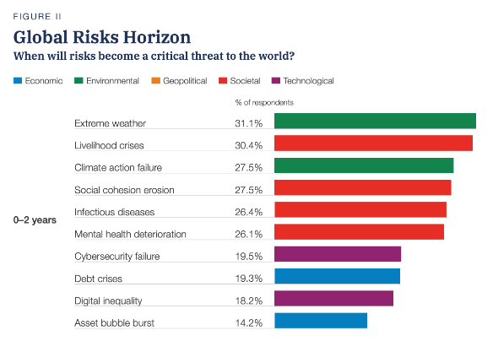
Cybersecurity is a top critical threat within the next 2 years
Cybersecurity failure risk ranks among extreme weather and infectious disease.
The risk is imminent
and global.
Global Risks Report 2022, World Economic Forum
Notes:
The World Economic Forum analyzes economic, environmental, geopolitical, societal and technological risks that will become a threat to the world within the next 2 years.
Cybersecurity as a top critical threat on Global Risks Horizon – along with threats like extreme weather and infectious disease.
Clearly the threat of cybersecurity is top of mind, imminent, and global.

Slide 27

Growing complexity and regulations
Regulations for data and privacy are critical to ensuring public trust in digital systems.
But between the expansion of remote work and growing complexity of regulations,
already-stretched IT and cybersecurity professionals are under increasing burden.
More help is needed.
Notes:
How do we mitigate these mounting risks? Regulations for data and privacy are critical to ensure public trust in digital systems.
For example, GDPR (General Data Protection Regulation) oversees regulations for the processing of personal data in the EU, and governments are working to build new policies to strengthen national security and ensure public trust. Organizations must adhere to new cybersecurity laws and regulations if they want to stay in business.
Cisco Future of Secure Remote Work reports, 97% of organizations have made changes to their policies to support remote work.
The expansion of remote work introduces increased vulnerabilities to an already stretched IT and Cybersecurity talent pool.
57% of these respondents within the United States, believe that the pandemic will result in an increase in cybersecurity investments.
But this growing complexity and regulation is increasing the burden on already-stretched IT and cybersecurity professionals. A tremendous amount of help is needed, on a global scale.

Slide 28

A network without security is irrelevant.
Notes:
Cisco Secure Freeze video (1:25) - If it’s connected, it’s protected.
In our digital economy with billions of connected devices, a network without security is irrelevant. Anything connected, must be also secured.
Let’s roll the video to see how a secure network helps organizations and governments combat cybersecurity threat actors.
[video playing]
It seems there is a hope for billions of connected devices to be secure. However, it opens the question – where is the cybersecurity workforce that will manage the secure network?

Slide 29
The skills gap
3.5 Million
undersupply of cybersecurity professionals worldwide
Continued lack of cybersecurity professionals threatens economic growth.
It is vital to have professionals who can provide cybersecurity leadership,
test and secure systems, and train people in digital hygiene.
Cybersecurity Jobs Report 2021, Cybersecurity Ventures
Notes:
Cybersecurity Ventures estimates a global demand of 3.5 million cybersecurity roles by 2025.
Cyber threats are in abundance, but cyber professionals equipped with the skillset needed to handle them are not.
The World Economic Forum estimates by 2025, 50% of all employees will need to be reskilled.
Moreover, 59% of businesses report experiencing significant difficulty responding to cybersecurity threats, as a result of the skills gap.
Continued lack of cybersecurity professionals threatens economic growth

Slide 30
Job opportunities are everywhere!
Cybersecurity jobs are not limited to tech companies only. All organizations need protection from cybersecurity threats.
There is growing demand across industries, such as:
Healthcare
Transportation
Energy
Food
Water
Smart cities
89%
65%
In 2018, 89%
of all online IT job openings were in non-tech companies
IT job growth outside the
tech sector jumped up to 65% from 2013-2018
Beyond Tech: The Rising Demand for IT Skills in Non-Tech Industries, Burning Glass, 2019
Notes:
Cybersecurity job roles are not limited to tech companies only. Every company is a digital company Job opportunities are everywhere!
In 2018, 89% of all online IT job openings were in non-tech companies
IT job growth outside of the tech sector rose by 65% from 2013-2018

Slide 31



Closing the skills gap
It starts from the top¹
Educate the next generation of skilled workforce
Network, Data & Cybersecurity awareness for all
1. How business leaders can close their cybersecurity skills gap, 2020, World Economic Forum
Notes:
Closing the cybersecurity skills gap requires a multi-pronged approach and collaboration at all levels.
It starts from the top. We’re not talking just the CISO or CIO. Everyone in the C-suite has a stake in the success of cybersecurity training and education.
According to the World Economic Forum: “Cybersecurity is now table stakes for survival… rather than bemoaning the talent deficit, the C-suite can and should do something about it.”
Including growing their own cybersecurity talent through education plus ongoing cybersecurity awareness training for all.

Slide 32





Cisco Networking Academy Model
Ecosystem Platform Curriculum
Networking Academy Partners
Enabling Academies for success with support and training.
Academies
Engaging learners via instructor-based offerings in schools, colleges/universities, government, prisons, libraries, NGOs, and more
Skills for All
Offering learners a self-paced education option to learn anytime, anywhere and on any device.
Employers
Creating access and opportunities to translate skills to jobs with Cisco’s Talent Bridge and job opportunities.
Meeting Learners Wherever They Are in Their Learning Journeys
Notes:
The Cisco Networking Academy is the longest standing IT skills-to-jobs program in the world.
Our partner ecosystem and learning product offerings are world-class
Here’s how the program works.
Cisco provides top notch IT courses and a platform that operates at web scale and we have have established a vast ecosystem of public private partnerships to delivery impactful outcomes
We have an over 800 NetAcad partners that provide training and support to our instructors at academies
Our academies are high schools, vocational colleges, universities, non-profits, prisons, and other organizations that deliver our courses.
We developed a direct to consumer offering through skills for all to expand our reach
And because we are focused on ensuring learner success, we have the Talent Bridge program and matching engine that includes over 1K Cisco Channel Partners to connect students to job opportunities.
All of this is done to meet our learners wherever they are at and empower them with skills and job opportunities

Slide 33
Cisco Networking Academy can help
For Leaders
Develop your cybersecurity workforce with free skilling and re-skilling
Defend your organization
with cybersecurity
awareness training for all
For Employers
Hire job-ready, diverse talent
For Learners
Free self-paced courses, career resources, and
job matching
For Educators
Free, quality curriculum, teaching resources, and professional development
For Individuals, NGOs,
and Governments
Free online courses to build cybersecurity awareness
for all
Notes:
Workforce development and cybersecurity skills training are of deep importance to Cisco. We have built out a comprehensive cybersecurity education portfolio, including:
· awareness training for all
· learning pathways that lead to industry certifications and the skills required for real job roles
· high-quality curriculum licensed free to educators
· and opportunities to hire job-ready, diverse talent through our job matching services
We are dedicated to doing our part in moving the needle to foster a diverse, inclusive cyber workforce.
Workforce development and cybersecurity skills training are of deep importance to Cisco. We have built out a comprehensive cybersecurity education portfolio, including:
· awareness training for all
· learning pathways that lead to industry certifications and the skills required for real job roles
· high-quality curriculum licensed free to educators
· and opportunities to hire job-ready, diverse talent through our job matching services

Slide 34
High Quality
Why Cisco Networking Academy
Cisco Networking Academy is a comprehensive skills-to-jobs program offering Cisco-funded curriculum to build cybersecurity awareness and provide pathways to real cybersecurity jobs.
Skills-to-Jobs
Learning Experience
Practice-oriented curriculum built upon learning science with Cisco industry expertise and kept up-to-date as
industry needs evolve.
Courses developed with the end in mind: transferable, vendor-neutral, job-ready skills for roles like Cybersecurity Technician and SOC Analyst.
Engaging, interactive, mobile-first learning, with ample practice labs to build real skills.
Flexible Offerings
Global Reach
Strong Partnerships
Easy entry points from awareness-building to careers, with choices to take courses self-paced or with an instructor.
Available in 190 countries with courses in up to 27 languages, in support of our mission to empower all people with career possibilities through inclusive workforce development.
Our vast network of 11,800 educational institutions, 29,300 educators, plus partners, governments, non-profits, and employers, underscores the value and impact of our efforts.
As of October 2022
Notes:
About Cisco Networking Academy
Cisco Networking Academy is an IT and cybersecurity skills-to-jobs program offering digital skills training through strong public-private partnerships, high-quality curriculum, and inclusive workforce development programs. We are one of the longest-running, purpose-driven digital skills program in the world and have trained over 17.5 million people since 1997.

Slide 35
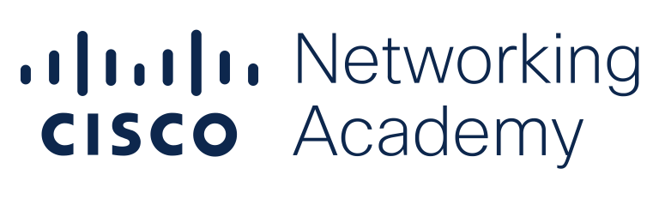
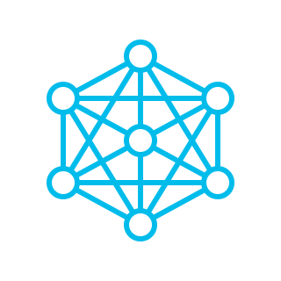



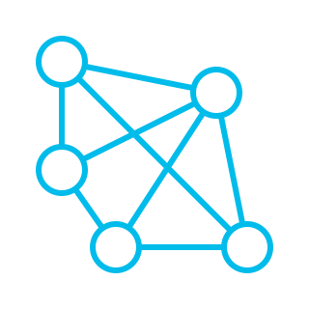

Skills-to-Jobs Curriculum
A comprehensive portfolio
Networking
Programmable Infrastructure
Cybersecurity
Gain hands-on, relevant
networking skills
Learn programming, infrastructure automation, and Internet of Things
Learn to secure
and defend networks
Operating Systems and IT
Programming
Practice
Essential skills for the
digital world
Learn to code in languages like Python, C, or C++
Interactive tools and experiences build real skills, not just knowledge
Notes:
We provide a differentiated learning experience that includes high quality courses aligned to in demand skills, personalized assessments, and practice to help learners master skills tied to job opportunities.
We have 34 courses that span from introductory courses to courses aligned to industry certifications such as CCNA, DevNet, CyperOps and CompTIA A+. Learners acquire skills to obtain entry level jobs such as
associate network engineers, junior software programmers, Security Operactions Center specialists, and technical support specialists.

Slide 36

Let´s work together to
equip young people with knowledge and skills to understand data, harness digital disruption, and prepare them for a digital future that is happening now.
Agnes I Kenya
Cisco Networking Academy student
Notes:
We are proud of our reach and especially proud of our impact.

Slide 37

To power an
inclusive future for all
Our Purpose
Notes:
Finally, everything we’ve been talking about comes together with our purpose.
We have a unique opportunity to make a difference in the world. To build a better, more equitable and inclusive future for everyone.
This mission drives our actions, our conversations, our priorities.
It’s how we’ve positively impacted 527 million people through our social impact grants and our signature programs like Network Academy, moving us closer to our goal of positively impacting 1 billion people by 2025.
It’s why we are focused on inclusive recovery from this pandemic, and ensuring that everyone benefits as we move into the next phase.
[PAUSE]
As we’ve said before, it’s clear, by any metric or measure, that the pandemic has changed the world forever.
And yet, we’ve also seen that there are some things that will never change, that there are things the pandemic cannot touch.
The spirit and determination of our people is one. The role that our technology can play in being a force for good is another.
Powering an inclusive future for all is not just a call to action. It’s recognizing that it’s going to take all of us.
If we approach this as individuals or lone companies, we won’t get very far. But if we can come together as a community – Cisco, our customers, our partners, other like-minded companies, even those that might be seen as competitors – we CAN make a difference. We CAN leave the world a bit better than we found it.
And that’s what we’re going to do. So, join us, and let’s get there together.
Thank you.
Source: Cisco Key Facts & Figures
Link (Internal):
https://cisco.sharepoint.com/:b:/r/sites/GCSHub/SiteAssets/Facts%20%26%20Figures%20Page%20Assets/Supporting%20Content%20%26%20Messaging/Facts%20%26%20Figures%20for%20Spokespeople.pdf?csf=1&web=1&e=JIReoQ

Slide 38


The bridge to possible

Slide 39
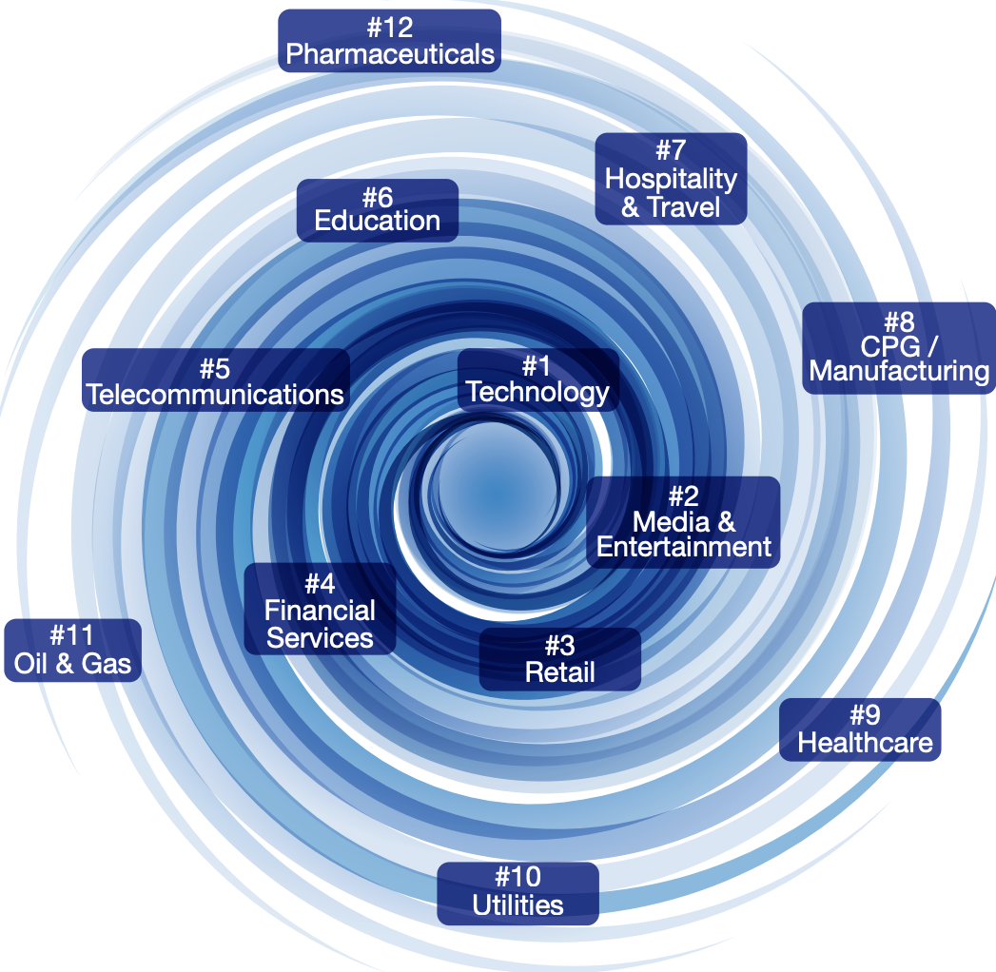
The Digital Vortex
Source: The Globe Center for Digital Business Transformation, 2015

