Slide 1
Bloom’s Growth Over Time
Paul Frank,PhD
SIL Bloom Program Director
Reflecting on Mainstreaming and Scaling Principles in Education
February 2, 2023

Slide 2
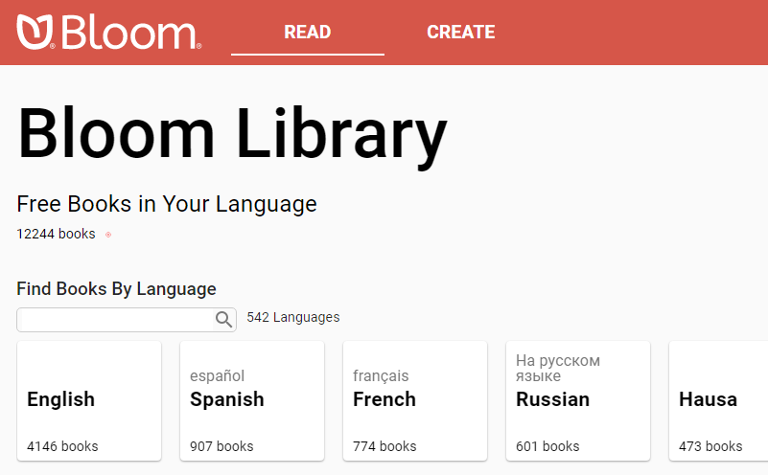
Bloom Library, Editor, and Reading App
A library of 12,000+ books in more than 540 languages
Openly licensed, available for:
Reading online
Downloading as PDF or ePUB
Reading in free Bloom Reader Android app
Translating to new languages with free Bloom Desktop Editor (Windows)

Slide 3
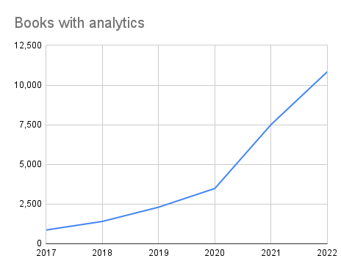
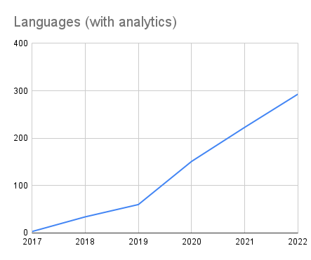
Growth in number of books and number of languages
10,985 books
303 languages
864
3

Slide 4
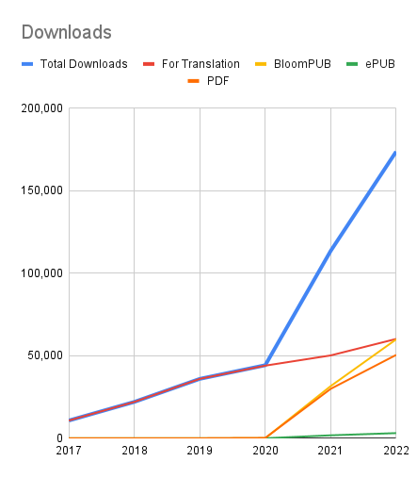
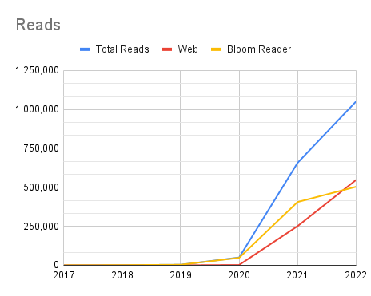
Growth in number of reads and downloads
1.1M reads
178,457 downloads
10
10,747

Slide 5
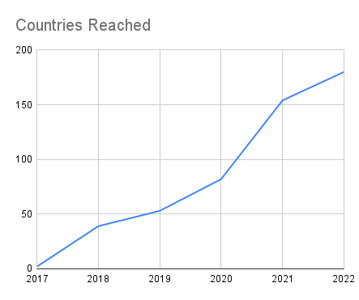
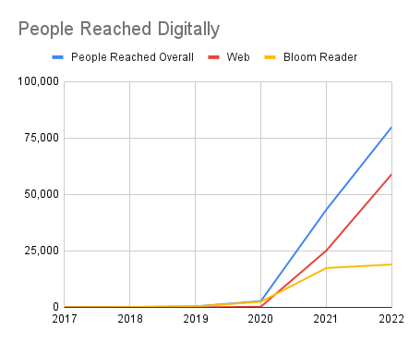
Growth in number of countries and people reached
179 countries
82,980 people
2
4

Slide 6
