Slide 1
Coordinating National Scaling Efforts for Food Systems Transformation The Role of Private Seed Companies: Challenges and Prospects in Ghana’s Seed industry By Amos Rutherford Azinu, PhD LCIC, Founder & CEO

Slide 2
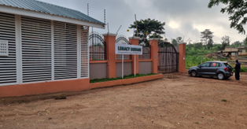
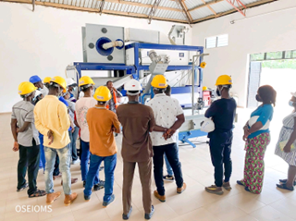
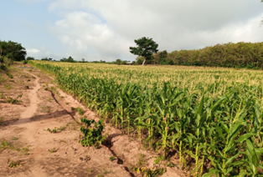
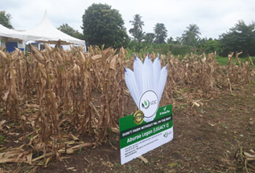
Contents
Ghana’s Seed Sector in Glance
LCIC Snapshot
Challenges
Opportunities
Q & A
Notes:
Sources
https://www.wfp.org/countries/ghana
https://agra.org/news/ghanas-seed-experts-draft-new-seed-sector-strategy-and-investment-plan/

Slide 3
Snapshot of Hybrid Seed Production in Ghana(1958 -2017)
1958
1961
1990s
1996
1997 -2006
2007 - 2017
*Obaatanpa
Sasakawa Global 2000 (SG 2000) provided substantial supports to privatization of seed industry.
An Example of PPP?
*New varities released
*Plants and Fertilizer Act passed
*new private seed companies
*NASTAG – 58 members
Hybrid Maize Production Unit. The first time commercial seed business was established
“Mamaba” First locally bred hybrid maize was released
No activity
Seed Multiplication Unit (OPVs production)

Slide 4
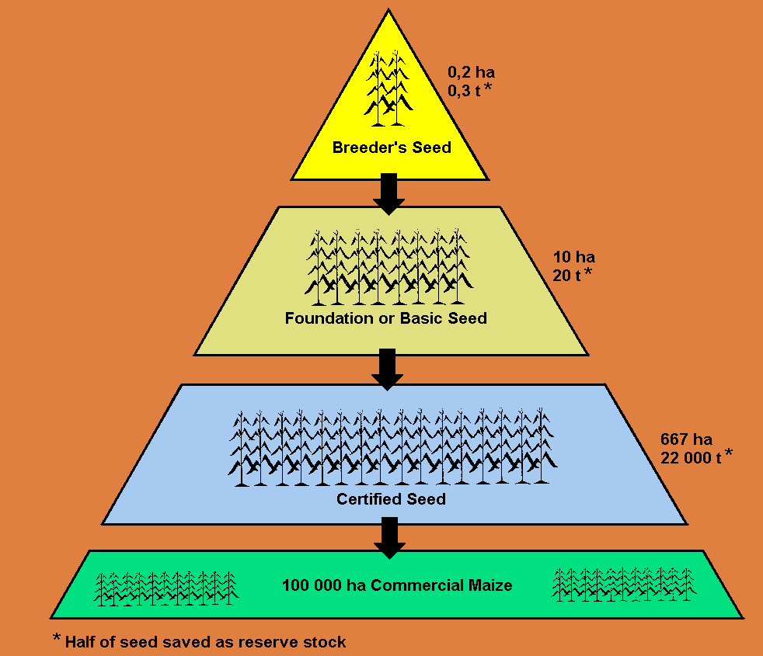
Radical? But true…
“The key challenge for any vibrant seed
system success will be seed production
and dissemination, and the key linkage
needed to accomplish this is the
linkage between breeders and
farmers”
The most important,
missing,
part of the solution is ……YOU
a Vibrant Private Sector Participation

Slide 5
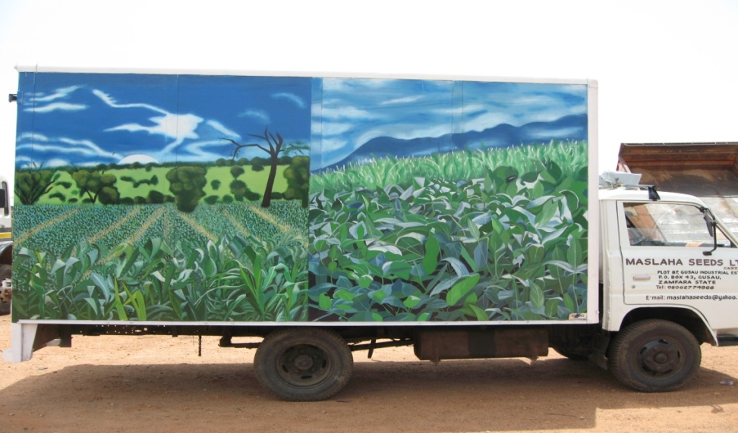
Private seed companies- what do you think they are after?

Slide 6
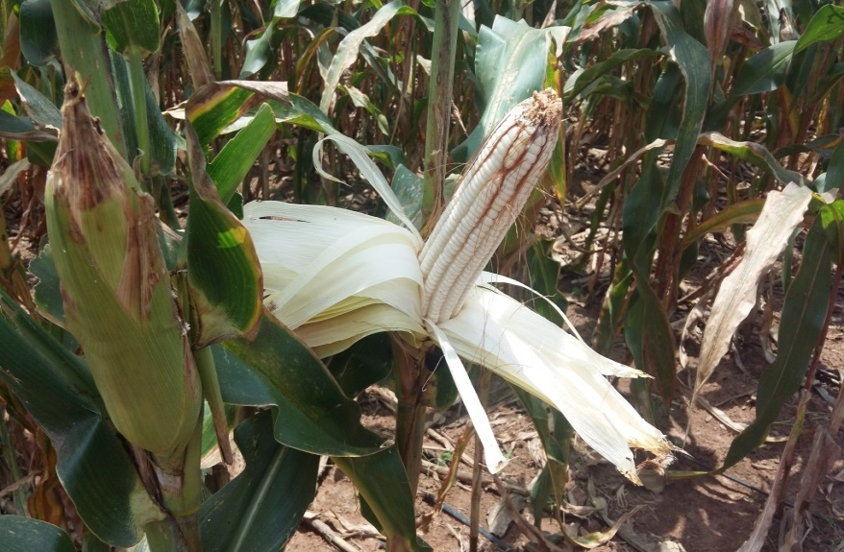
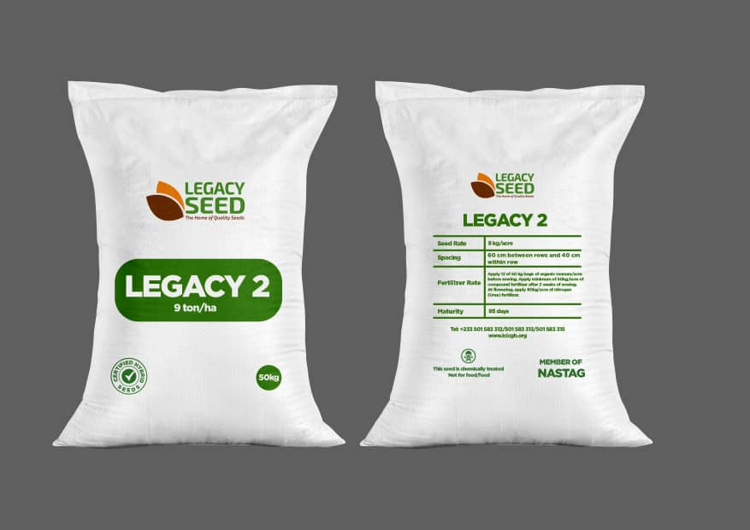
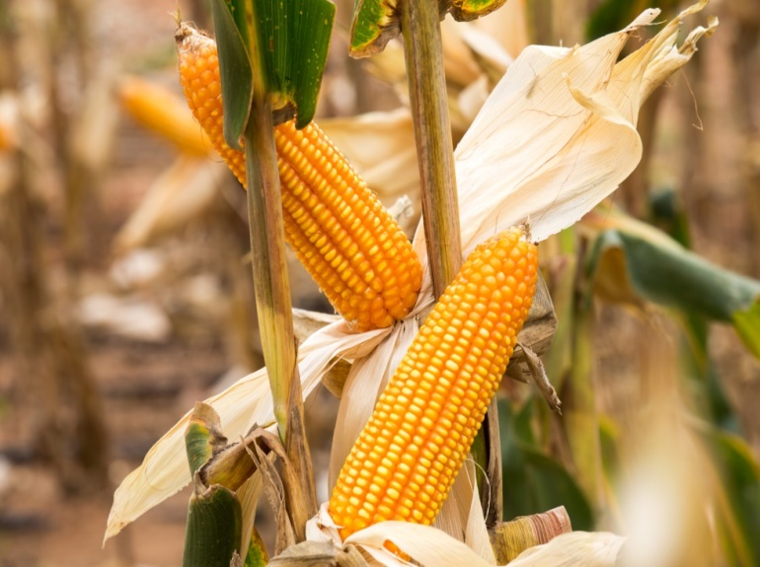
Indicators of Successful Seed Company
+ PCI
Technology
Availability:
Accessibility
Affordability
Quality

Slide 7
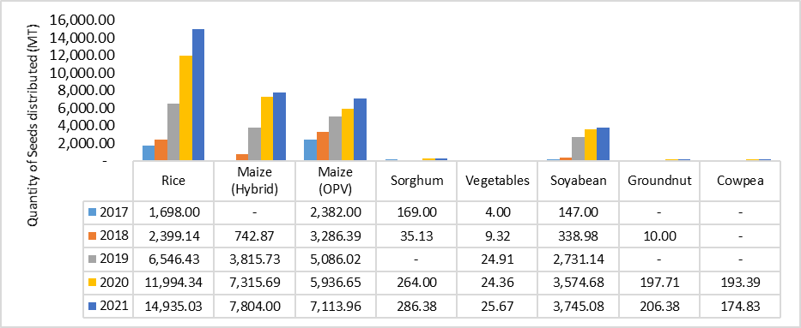
Seeds Produced and Distributed by Private Seed Companies from 2017 - 2021

Slide 8
Problem
Solution
The demand for high quality commercial seeds far outstrips its supply and is further exacerbated by:
Private sector being nascent in its ability to meet this demand due to previous lack of resources in finance, infrastructure, logistics, and local skills.
The seed sector has to rely on expensive imported seeds to meet market demand.
Previous inadequate attempts to
commercialise improved varieties released and registered locally.
Legacy Crop Improvement Centre (LCIC) specializes in the production and marketing of basic and commercial seeds for hybrid corn seed, soybean and cowpea.
LCIC is establishing an irrigation facility on 150 acres of land to produce climate smart hybrid maize seed all year round. It is partnering with other stakeholders to produce soybean and cowpea seeds on 300 acres of land within a year.
It has state of the art seed processing devices, drying equipment, and storage facilities, the first of its kind in West Africa.
LCIC sells seed and agricultural inputs to small and large holder farmers, aggregators, distributors and food processors.
Availability and Accessibility of high quality improved smart climate seeds guarantees an increase in food production, household incomes, and a reduction in malnutrition and hunger in rural households.
Notes:
Sources
https://www.wfp.org/countries/ghana
https://agra.org/news/ghanas-seed-experts-draft-new-seed-sector-strategy-and-investment-plan/

Slide 9
Our mission
Develop and Promote high quality technologies (hybrid seeds) suitable to tropical environments through research, seed production, training and extension services.

Slide 10
Why Early Generation Seed
EGS - a lifeline to any vibrant Seed Industry!

Slide 11
Milestones
2015
LCIC established
2017
9.6 tonnes of basic seeds delivered
2021
Smart Seed Business Centre Established
2023 onwards
Expand Business operations to Togo Burkina Faso & Mali
2023 - 2027
achieve 2500 tonnes of produced & delivered seeds
Year
Year
Year
year
Year
Year
Year
Year
Year
2016
15 Acres Drip Irrigation Installed
2018 - 2019
Legacy Seed Established & Seeds delivered 1000 kg to delivered
2022
First 1000 kgs of basic seeds delivered to Togo
2023
Complete new Irrigation Plant

Slide 12
Our Markets
Market Size (Ghana)
Ghana - produce and market basic and commercial seeds for maize, cowpea and soybean, inputs (crop nutrition, crop protection etc), seed processing, grain/seed drying and storage service.
(under development)
Togo - market basic and commercial seeds for hybrid maize and cowpea.
Burkina Faso - market commercial seed for hybrid maize.
Mali - market basic and commercial seeds for hybrid maize.
$72.2 M
TAM
$ 14.5M
SAM
$1.2 M
SOM
2023 revenue projections
Market covers maize, soybean and cowpea seeds in Ghana representing 1.2 M ha, 166 000 ha and 169 000 ha respectively
Source (TASAI, 2022)
Notes:
Define the Market Sizes for Total Available Market (TAM), Serviceable Available Market (SAM), Serviceable Obtainable Market (SOM).

Slide 13
Pests & Diseases
Climate change
Irrigation
Age
Agricultural inputs eg fertiliser
Credit facilities
Challenges
Processing facilities
Skill labour
Poor financial Architecture and Managerial Skills

Slide 14
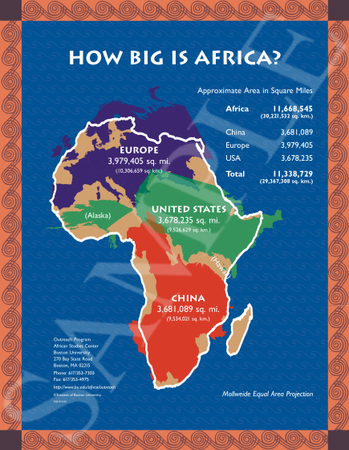
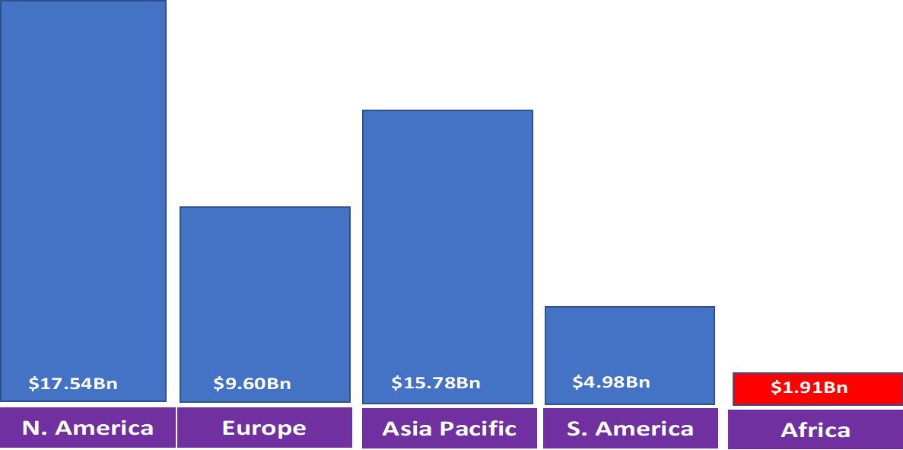
Is Africa a significant player in Global Seed Industry?
Opportunities

Slide 15
Ghana’s Food System Transformation Agenda
Modernization of the agricultural sector
- Ensure immediate and adequate availability of selected crops
Improved productivity and intensification of food crops
Extended support to private sector service providers
Job opportunities (youth)
Raw materials for agro-industry
Structural transformation of national economy through
food security, food sufficiency and commodity export
employment opportunities
- reduced poverty

Slide 16
Our
Partners
Notes:
Add any additional partner logos here. The current logos all have active link to the respective websites inserted.

Slide 17
Contact Detail
Address
LEGACY SQUARE
Akuapem North Municipality
Eastern Region, Ghana.
Phone
+233 (0) 245 9291 94
+233 (0) 257 431 809
+233 (0) 595 263 585
Email
info@legacycrop.com sales@legacycrop.com
Get In Touch
The Legacy Crop Improvement Centre,
Legacy Square – Otareso,
GPS: E2-2152-2182
along koforidua- Adawso Road,
Koforidua, Eastern Region, Ghana.

Slide 18
THANK YOU!

